Slide 1
CS 2160
Introduction to Assembly Programming and
Computer Organization
Lecture 08: Boolean Logic
Fall 2026
Instructor: Himon Thakur
TA: Hassan Shakil
University of Colorado Colorado Springs (UCCS)
Himon Thakur (hthakur@uccs.edu); CC BY-NC-SA 4.0;
Special Thanks to Dr. Keith Paarpong and Dr. Xi Tan.

Slide 2
Today’s Agenda.
Boolean Logic

Slide 3
Boolean
Pioneered by George Boole. Recognized by pioneers including John Atanasoff and Claude Shannon
Logical thought can be represented through mathematical equations
Late 1800s: fear and loathing
Mid 1900s: revolutionary concept - computers implement Boole’s Laws of Thought

Slide 4
Boolean
Variables may have one of two values
  True (1, “on”, “high”)
  False (0, “off”, “low”)
Operations define relations between values
Expressions compose operations
Binary:
  0 -> OFF -> false -> 0 Volts
  1 -> ON -> True -> 5 Volts

Slide 5
Boolean
Variables may have one of two values
  True (1, “on”, “high”)
  False (0, “off”, “low”)
Operations define relations between values
Expressions compose operations
Binary:
  0 → OFF → false → 0 Volts
  1 → ON → True → 5 Volts
Notes:
Boolean algebra is the basis for all computer logic. Originally formulated by George Boole, an English mathematician (1815-1864), Boolean algebra describes propositions whose outcomes are either true or false. In computer work, the true and false statements are represented by the output state of an electronic circuit, whose state can be either 1 (true) or 0 (false). We perceive these logic changes as voltage levels. That is, when the logic level is supposed to represent a 1, the output voltage will typically measure five volts. Conversely, a logic 0 is represented by — what else? Zero volts. This is important. Logic 1 is five volts and logic 0 is no volts.

Slide 6
Logic Gates
Boolean functions are implemented by digital computer circuits using gates.
A gate is an electronic device that produces a result based on one or more input values.
Logic Gate
Input(s)
Output

Slide 7
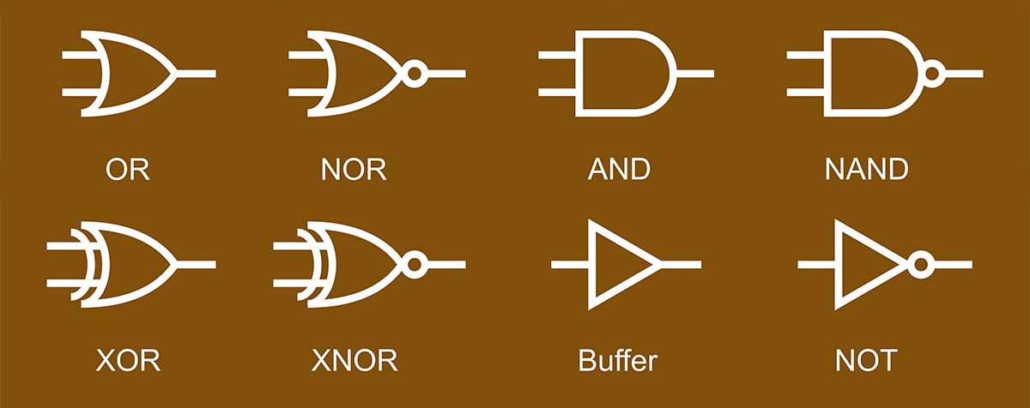
Logic Gate Symbols
Boolean functions are implemented by digital computer circuits using gates.
A gate is an electronic device that produces a result based on one or more input values.
https://www.nutsvolts.com/magazine/article/small-logic-gates-spawn-big-dreams-part-1

Slide 8

Boolean Algebra
A Boolean operator can be completely described using a truth table.
Simple examples:
X
In | Out
0 | 0
1 | 1
A
Y
buffer
NOT X
In | Out
0 | 1
1 | 0
A
Y
inverter

Slide 9
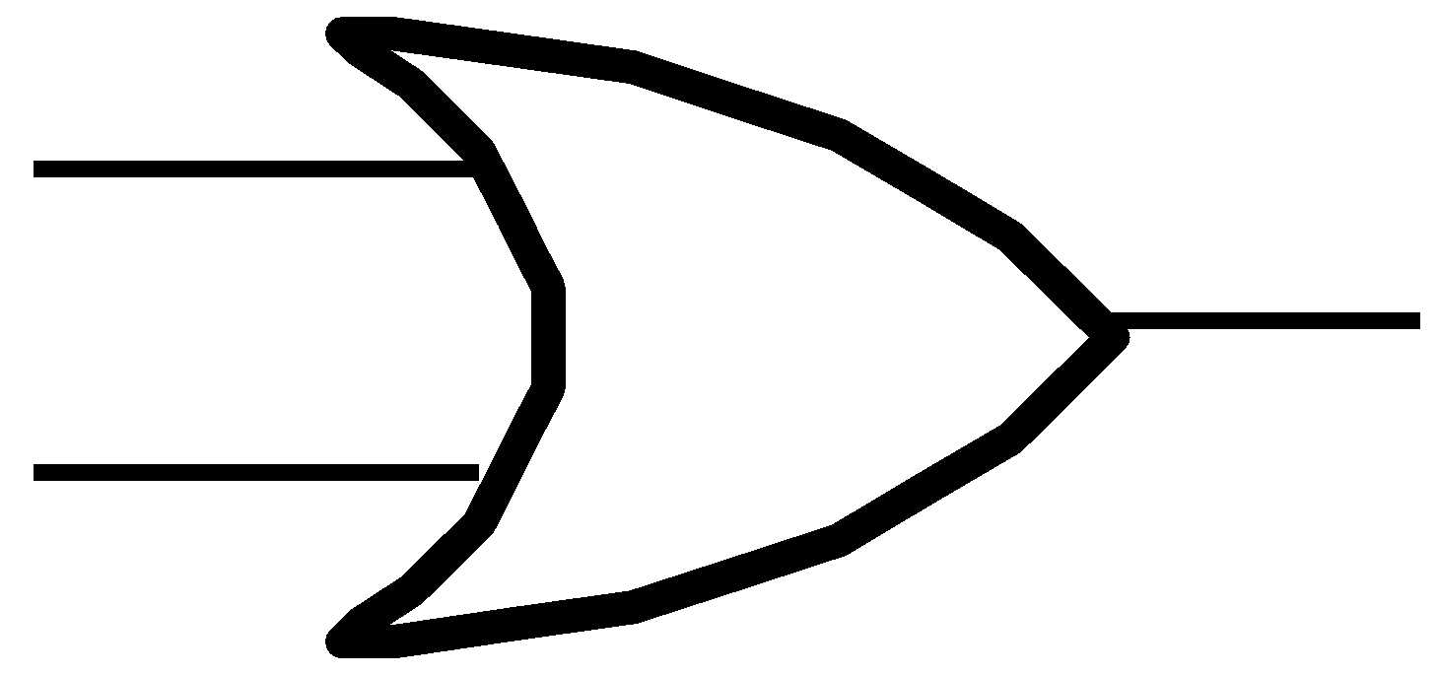
Boolean Algebra
A Boolean operator can be completely described using a truth table.
The truth table for the Boolean operators OR and AND are shown at the following.
X OR Y
X | Y | X+Y
0 | 0 | 0
0 | 1 | 1
1 | 0 | 1
1 | 1 | 1
X AND Y
X | Y | XY
0 | 0 | 0
0 | 1 | 0
1 | 0 | 0
1 | 1 | 1
X Y
X Y
OR
X+Y
XY
AND

Slide 10
Boolean Algebra
0 + 0 = 0
0 + 1 = 1
1 + 0 = 1
1 + 1 = 1
0 * 0 = 0
0 * 1 = 0
1 * 0 = 0
1 * 1 = 1
X OR Y
X | Y | X+Y
0 | 0 | 0
0 | 1 | 1
1 | 0 | 1
1 | 1 | 1
X AND Y
X | Y | XY
0 | 0 | 0
0 | 1 | 0
1 | 0 | 0
1 | 1 | 1
The OR operator is the Boolean sum.
Operators: +, |
The AND operator is also known as a Boolean product.
Operators: *, ­&, ·

Slide 11
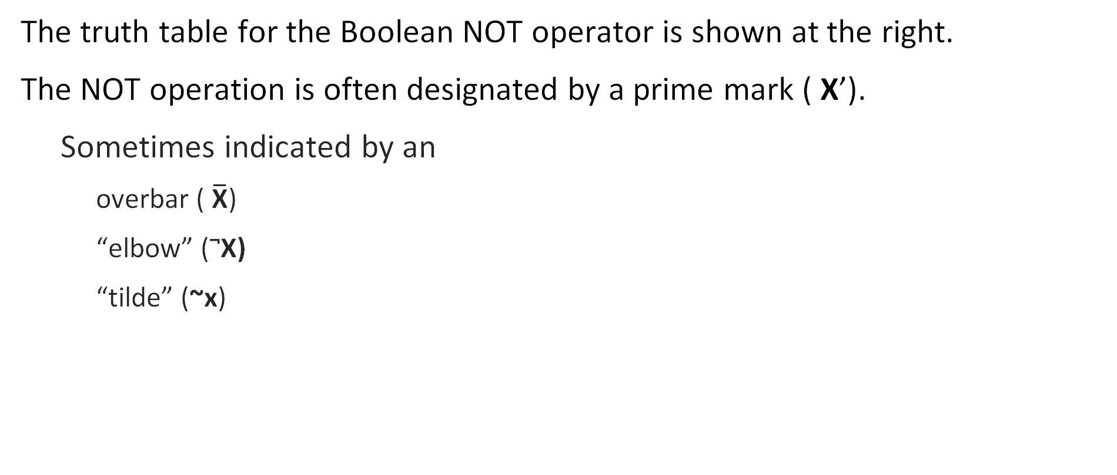
Boolean Algebra
The truth table for the Boolean NOT operator is shown at the right.
The NOT operation is often designated by a prime mark ( X’).
  Sometimes indicated by an
    overbar ( $\overline{\text{X}}$)
    “elbow” (¬X)
    “tilde” (~x)
NOT X
X | X’
0 | 1
1 | 0

Slide 12
Boolean Algebra
A Boolean function has:
  At least one Boolean variable,
  At least one Boolean operator.
Given input from the set {0,1}, it produces an output that is also a member of the set {0,1}.
Do you see why the binary numbering system is so handy in digital systems?

Slide 13
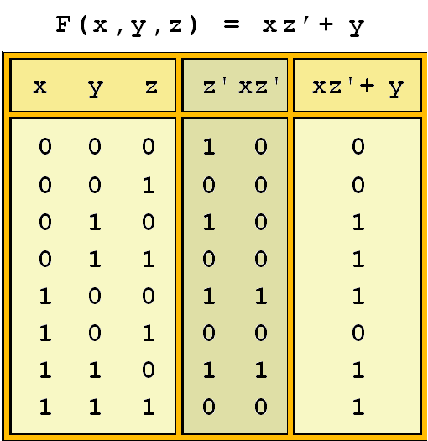

Boolean Algebra
The truth table for the Boolean function:
Extra (shaded) columns hold evaluations of subexpressions
Notes:
AND → *
OR → addition

Slide 14
Boolean Algebra
Boolean operations have rules of precedence.
The NOT operator has highest priority, followed by AND and then OR.
Determines the (shaded) function subparts in our table.

Slide 15
Boolean Algebra
Digital computers contain circuits that implement Boolean functions.
The simpler the Boolean function, the smaller the circuit: cheaper to build, consume less power, and run faster than complex circuits.
Reduce Boolean functions!

Slide 16
Boolean Algebra
Most Boolean identities have an AND (product) form as well as an OR (sum) form. We give our identities using both forms. Our first group is rather intuitive:
Identity Name | AND Form | OR Form
Identity Law | 1x = x | 0 + x = x
Null Law | 0x = 0 | 1 + x = 1
Idempotent Law | xx = x | x + x = x
Inverse Law | xx’ = 0 | x + x’ = 1

Slide 17
Boolean Algebra
This second group of Boolean identities should be familiar from high school algebra:
Identity Name | AND Form | OR Form
Commutative Law | xy = yx | x+y = y+x
Associative Law | (xy)z = x(yz) | (x+y)+z = x+(y+z)
Distributive Law | x+yz = (x+y)(x+z) | x(y+z) = xy+xz
Notes:
(5+2)+3 = 10,
(5 * 2) * 3 = 30

Slide 18
Boolean Algebra
The last group of Boolean identities are perhaps the most useful.
These laws appear in set theory and formal logic.
Identity Name | AND Form | OR Form
Absorption Law | x(x+y) = x | x+xy = x
De Morgan’s Law | (xy) = x’+y’ | (x+y)’ = x’y’
Double Complement Law | (x)’’=x
Notes:
double complement law = double negation law

Slide 19
De Morgan’s Law
The complement of the product of two variables equals the sum of their complements
(xy) = x’+y’
The complement of the sum of two variables equals the product of their complements
(x+y)’ = x’y’
Notes:
double complement law = double negation law

Slide 20
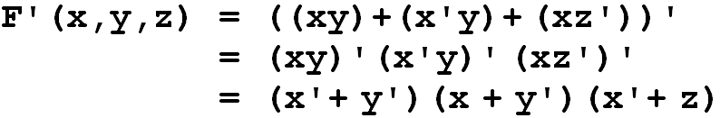
De Morgan’s Law
De Morgan’s law can be extended to any number of variables.
Replace each variable by its complement and change all ANDs to ORs and all ORs to ANDs.
Thus, we find the complement of:
is:

Slide 21
Boolean Algebra
Identity Name | AND Form | OR Form
Identity Law | 1x = x | 0 + x = x
Null Law | 0x = 0 | 1 + x = 1
Idempotent Law | xx = x | x + x = x
Inverse Law | xx’ = 0 | x + x’ = 1
Commutative Law | xy = yx | x+y = y+x
Associative Law | (xy)z = x(yz) | (x+y)+z = x+(y+z)
Distributive Law | x+yz = (x+y)(x+z) | x(y+z) = xy+xz
Absorption Law | x(x+y) = x | x+xy = x
De Morgan’s Law | (xy) = x’+y’ | (x+y)’ = x’y’
Double Complement Law | (x)’’=x
Notes:
double complement law = double negation law

Slide 22
Boolean Algebra
We can use Boolean identities to simplify:
x + (xy)’

Slide 23
Boolean Algebra
We can use Boolean identities to simplify:
x + (xy)’
= x + (x’ + y’) | DeMorgan's Law
= (x + x’) + y’ | Associative Law
= 1 + y’ | Inverse Law
= 1 | Null Law

Slide 24
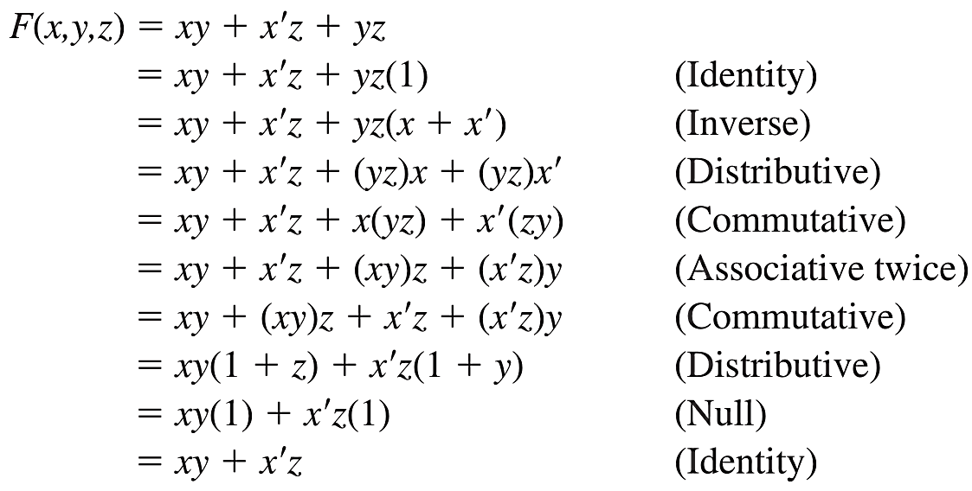
Boolean Algebra
We can use Boolean identities to simplify:
F(x,y,z) = xy + x′z + yz

Slide 25
Boolean Algebra
We can use Boolean identities to simplify:
F(x,y,z) = xy + x′z + yz

Slide 26
Boolean Algebra
We can use Boolean identities to simplify:
(xy)’(x’ + y)(y’ + y)

Slide 27
Boolean Algebra
We can use Boolean identities to simplify:
(xy)’(x’ + y)(y’ + y)
= (xy)’(x’ + y)1 | Inverse law
= (xy)’(x’ + y) | Identity law
= (x’ + y’)(x’ + y) | DeMorgan's Law
= x’x’+ x’y + y’x’ + y’y | Distributive law
= x’ + x’y + y’x’ + y’y | Idempotent law
= x’ + y’y | Absorption law
= x' + 0 | Inverse law
= x’ | Identity law

Slide 28
Boolean Algebra
Sometimes it is more economical to build a circuit using the complement of a function (and complementing its result) than it is to implement the function directly.
DeMorgan’s law provides an easy way of finding the complement of a Boolean function.
Recall DeMorgan’s law states:
(xy)’ = x’+ y’ and (x + y)’= x’y’

Slide 29
Boolean Algebra
Two canonical forms for Boolean expressions: sum-of-products and product-of-sums.
SOP (Sum-of-Products): A logical OR of ANDed terms (minterms). It is often used when a function is true for a few combinations of inputs.
POS (Product-of-Sums): A logical AND of ORed terms (maxterms). It is useful when a function is false for only a few combinations of inputs.
Notes:
Although there can be many logically equivalent ways to write a Boolean expression, we often prefer to use specific, standardized forms for clarity and simplicity. These standard forms are called canonical forms, and the two most common ones are:
Sum-of-Products (SOP)
Product-of-Sums (POS)
Both forms represent the same logical function but use different arrangements of ANDs and ORs

Slide 30
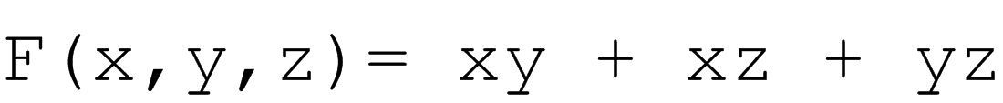
Boolean Algebra
Two canonical forms for Boolean expressions: sum-of-products and product-of-sums.
  Boolean product is AND; Boolean sum is OR.
In the sum-of-products form, ANDed variables are ORed together.
  For example:
In the product-of-sums form, ORed variables are ANDed together:
  For example:
Notes:
Although there can be many logically equivalent ways to write a Boolean expression, we often prefer to use specific, standardized forms for clarity and simplicity. These standard forms are called canonical forms, and the two most common ones are:
Sum-of-Products (SOP)
Product-of-Sums (POS)
Both forms represent the same logical function but use different arrangements of ANDs and ORs

Slide 31
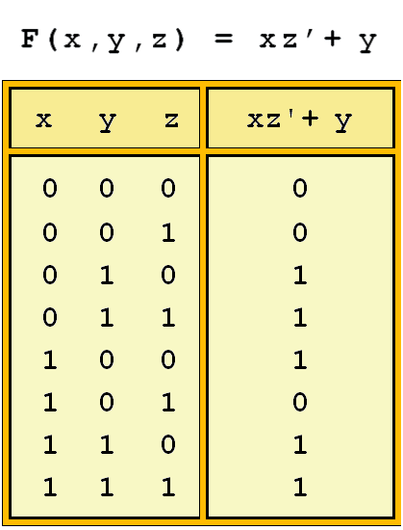
Boolean Algebra
It is easy to convert a function to sum-of-products form using its truth table.
We are interested in the values of the variables that make the function true (=1).
Using the truth table, we list the values of the variables that result in a true function value.
Each group of variables is then ORed together.

Slide 32
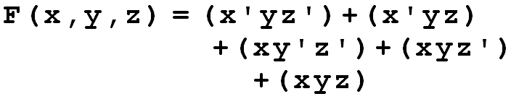
Sum of Products
The sum-of-products form for our function is:
Note: this function is not in simplest terms. Our aim is only to rewrite our function in canonical sum-of-products form.

Slide 33
Product of Sums
product-of-sums form takes the OR of complemented variables that make the value ‘false’ (0) then ANDs them together
Rules:
  If the variable is 0 in that row, use the uncomplemented form of the variable (because that literal will be 0).
  If the variable is 1 in that row, use the complemented form of the variable (because that literal will be 0)
F(x,y,z)= (x+y+z)(x+y+z’)(x’+y+z’)
Notes:
Rules:
If the variable is 0 in that row, use the uncomplemented form of the variable (because that literal will be 0).
If the variable is 1 in that row, use the complemented form of the variable (because that literal will be 0).

