Slide 1
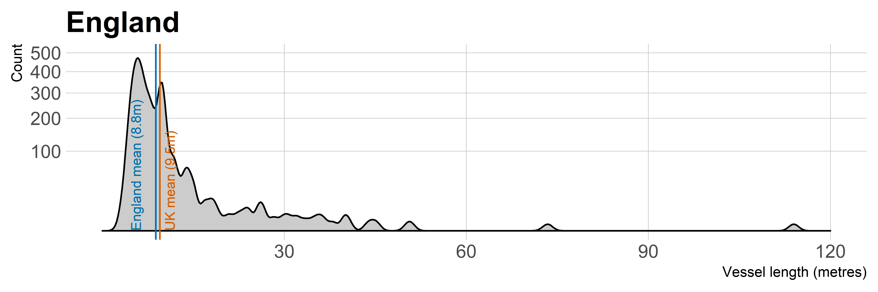
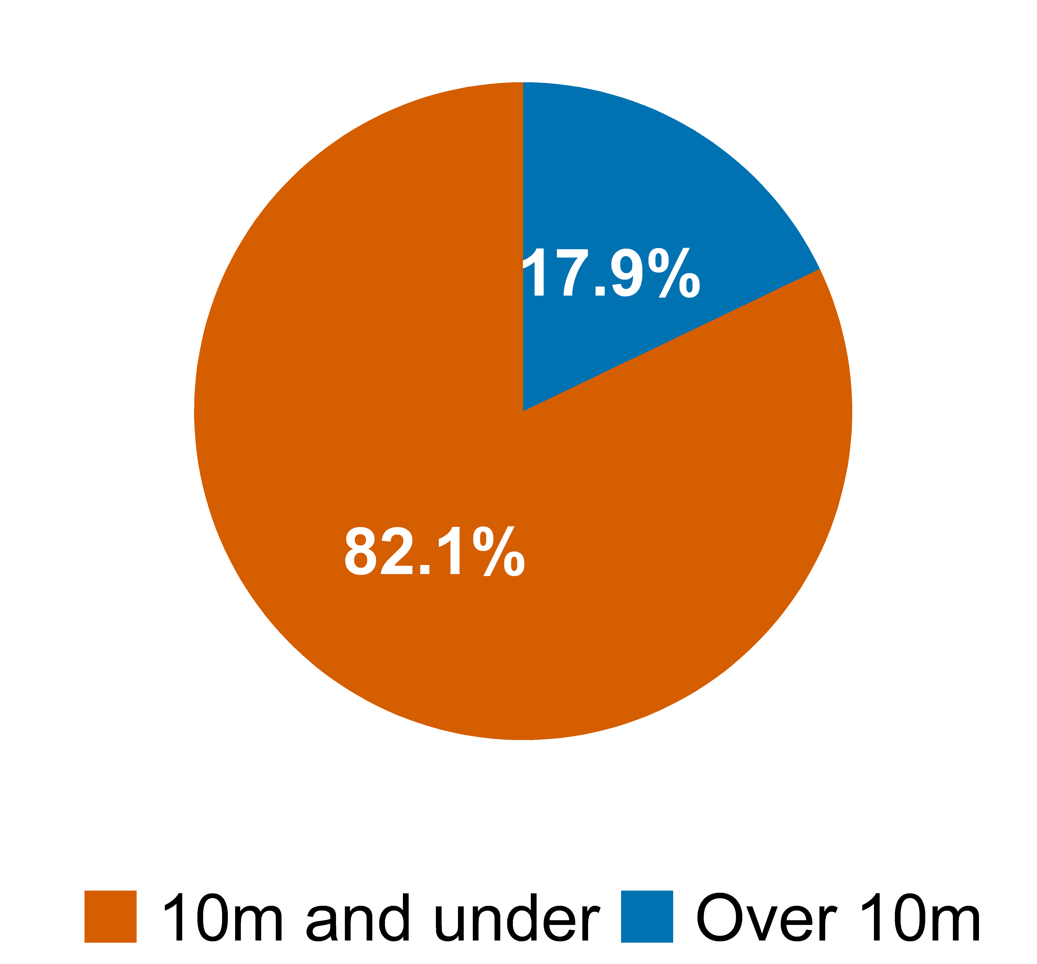
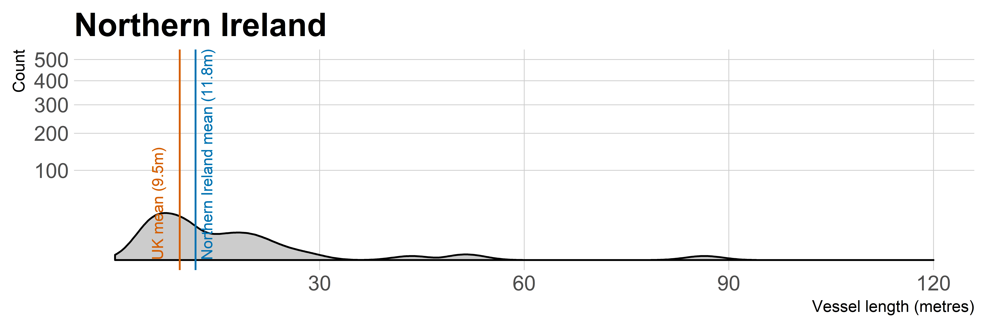
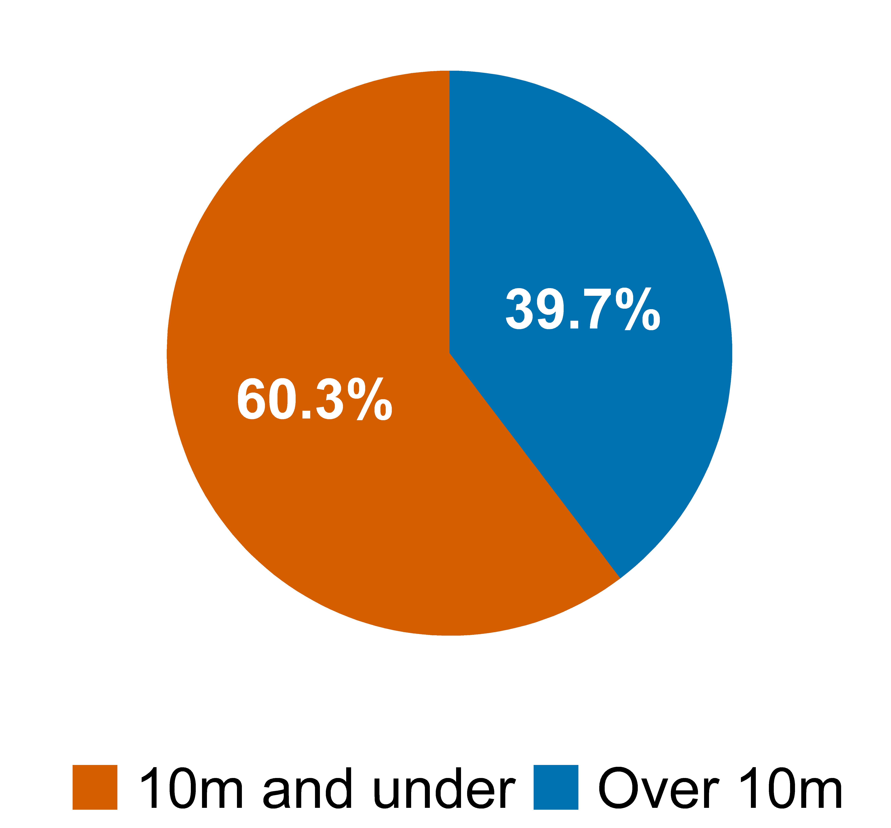
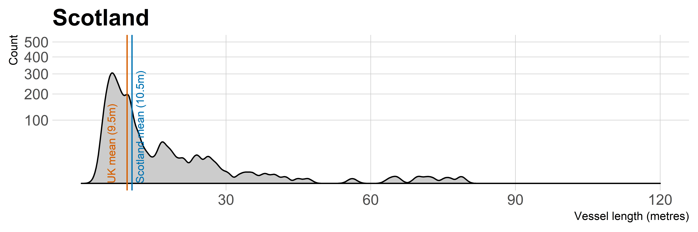
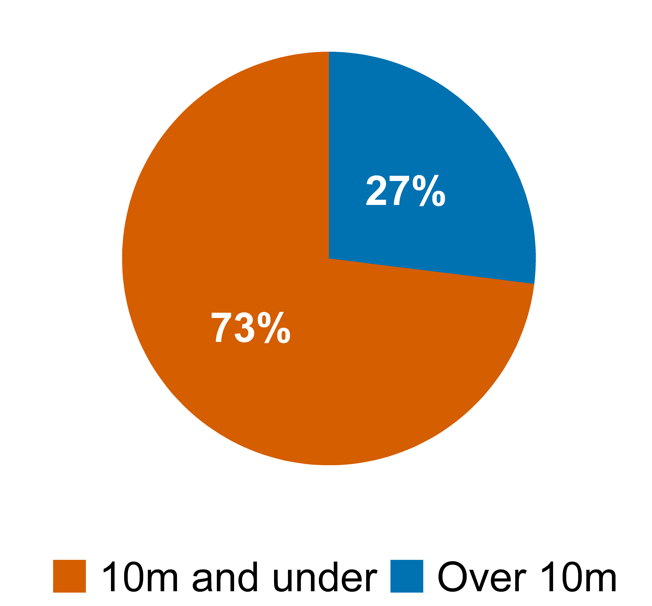
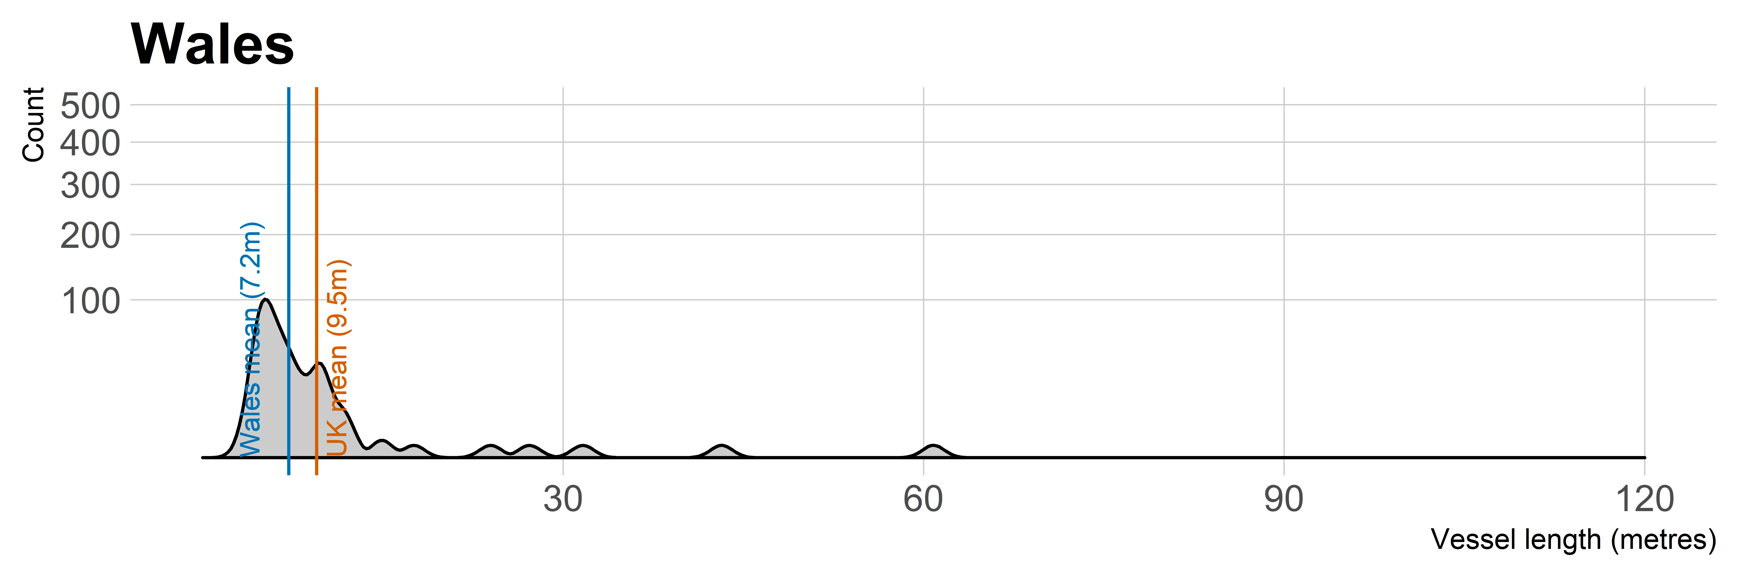
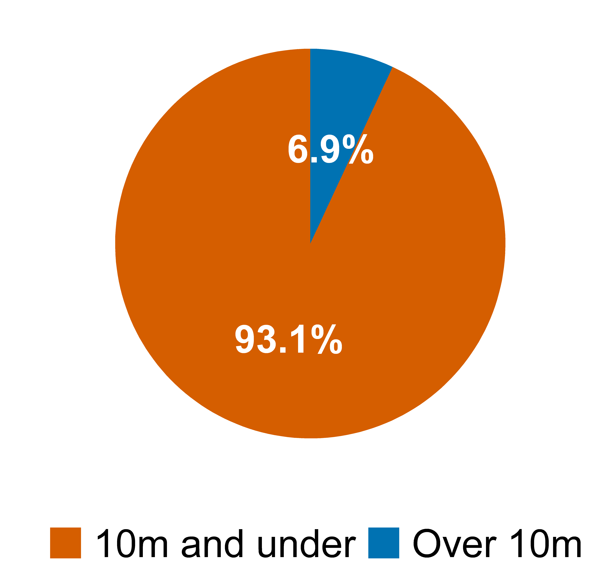



Post-Brexit fisheries policy and devolution
Differences in fishing fleet composition across the UK
Dr Christopher Huggins
Total vessels: 2,713
Total capacity: 52,089 tonnes
Total vessels: 310
Total capacity: 15,814 tonnes
Total vessels: 1,966
Total capacity: 92,259 tonnes
Total vessels: 404
Total capacity: 4,687 tonnes
As at 1 July 2018. Data: Marine Management Organisation (https://www.gov.uk/government/collections/uk-vessel-lists)
@chris_huggins

