Slide 1


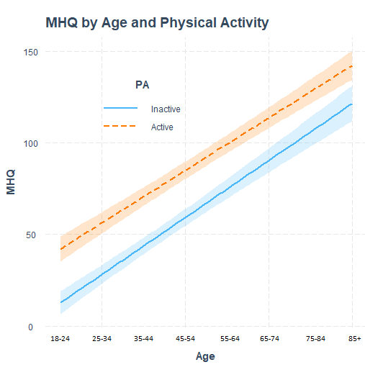
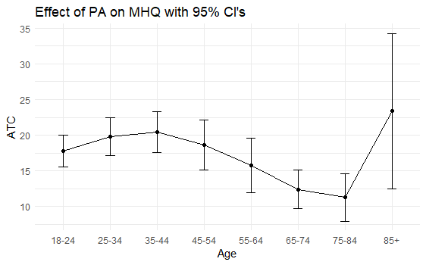
Estimating treatment effects of physical exercise
on mental health: A propensity score analysis
Background
Various lines of evidence has shown a decline in mental health, especially in younger cohorts
Physical activity is increasingly adopted as a first-line or adjunct treatment for psychological problems
The purpose of the present study was to investigate how mental health differs across age groups and estimate the treatment effect of regular physical activity (PA) engagement on overall mental health
v
Physical activity is associated with greater overall mental health across all adult age groups
Methods
The 47-item MHQ is designed to assess a comprehensive range of psychiatric symptoms in a single questionnaire to estimate overall mental wellbeing and functioning in the population
Distributions of covariates were balanced between the inactive and active groups using propensity score weights estimated with generalized boosted modeling
The propensity score is the probability of assignment to a treatment given a vector of observed covariates, and were used to compute an ATC
ATC: The hypothetical average treatment effect (i.e. PA) on those who did not receive the treatment
v
Results
Age is associated with greater wellbeing across active and inactive groups
Physical activity was associated with significant (p < 0.01) treatment effects on MHQ (ATC = 17.86; 95% CI: 15.07-20.64), which coincided with a standardized mean difference = 0.25
This effect was relatively stable across age groups
v
Christopher Huong & Denver Brown, 2023

