Slide 1
Validation of The Social Anxiety and Depression Life Interference Inventory – 24 (SADLI-24)
April Yancey
Stefany Pleitez
Christopher Huong

Slide 2
Anxiety disorders and depression tend to co-occur in clinical populations (Osman 2011)
No existing measures assess both Social Anxiety Disorder and MDD symptoms
Current tools do not emphasize the extent to which Social Anxiety Disorder might “interfere with the daily or normal routine of an individual” (Osman 2011)
The SADLI-24 was developed to address these limitations

Slide 3
SADLI-24
24 items assessing the impact of social anxiety and depressive symptoms on daily functioning , as well as general symptom severity
Items are rated on how much each statement contributed to interference with daily life/activities on a scale of 1 to 5
1 = Never, 2 = Rarely, 3 = Sometimes, 4 = Nearly Everyday, 5 = Everyday
Subscales:
Social anxiety life interference - 12
Depression life interference - 12

Slide 4
Social Anxiety Life Interference - 12
3. fear or concerns about what other people think of you in social situations
4. fear or concerns about being criticized in social situations (i.e., in front of unfamiliar people)
7. fear or concerns about your heart beating too hard or fast when you are in most new or social situations
10. fear or concerns about feeling self-conscious in front of other/unfamiliar people
11. fear or concerns about looking nervous or tense in front of unfamiliar people
12. fear or concerns about being embarrassed or humilatied in front of other people
14. fear of being called on to do or say sometjing in front of unfamiliar people
15. feelings of anxiety (i.e., intense dread or panic) about meeting or interacting with unfamiliar people
20. feelings of being quite uncomfortable when you are around other people
21. fear of other people staring or looking at you in public places (e.g., restaurants)
23. fear or concerns about making a fool of yourself in front of unfamiliar people
24. fear of concerns about talking to other people in authority

Slide 5
Depression Life Interference - 12
1. feelings of being depressed, down, or sad
2. feelings of guilt, shame, or worthlessness,
5. feelings of being tired (or fatigued, low, down) more easily than usual
6. problems with falling or staying asleep at night when you wanted to
8. repeated lack of interest in or desire for things that you used to enjoy
9. difficulties with making decisions or concentrating as well as usual
13. feelings of not being excited or motivated to have as much fun as you used to with the people in your life
16. thoughts of suicide (ideation, wish, or attempt) or death that pop into your head
17. feelings of being unhappy or discontent about most situations in your life
18. feelings of being irritable or in a bad mood more easily than usual
19. difficulties getting started, not having as much energy as you used to
22. problems with sudden changes (loss or gain) in your typical or usual appetite

Slide 6
Concurrent Instruments (to test validity)
Suicidal Behaviors Questionnaire – Revised
Positive and Negative Affect Scale
Positive affect
Negative affect
Social Phobia and Anxiety Inventory – 23
Social phobia
Agoraphobia

Slide 7
Analysis

Slide 8
Demographic Summary Statistics
N = 683 (Female 51%)
Age = 18-53 (21.05 sd = 4.71)
34.7% White/European, 37.2% Hispanic/Latino American

Slide 9
SADLI – 24 Descriptive Statistics
sbqr_demo <- read_sav("BGRD683.sav")
panas <- read_sav("PANAS683.sav")
sadli <- read_sav("SADLI683.sav")
spai <- read_sav("SPAI683.sav")
all(sbqr_demo$gender == panas$gender,
sbqr_demo$gender == sadli$gender,
sbqr_demo$gender == spai$gender,
sbqr_demo$age == sadli$age,
sbqr_demo$age == spai$age)
[1] TRUE

Slide 10
Check for Missingness
> sum(is.na(sbqr_demo))
[1] 0
> sum(is.na(sadli))
[1] 0
> sum(is.na(panas))
[1] 0
> sum(is.na(spai))
[1] 0

Slide 11
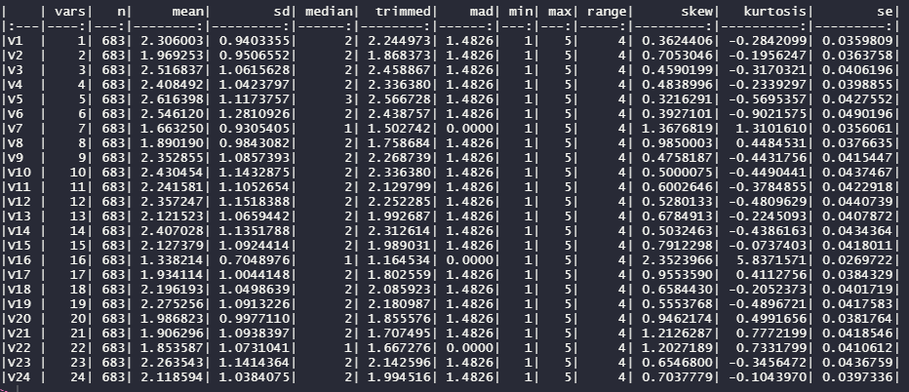
SADLI – 24 Item-level Descriptive Statistics

Slide 12
Reliability Analysis

Slide 13
Computing Subscale Scores
### COMPUTE SUM SCORES FOR SOCIAL ANXIETY LIFE INTERFERENCE - 12
sadli <- mutate(sadli,
sadli_sa = V3 + V4 + V7 + V10 + V11 + V12 +
V14 + V15 + V20 + V21 + V23 + V24)
### COMPUTE SUM SCORES FOR DEPRESSION LIFE INTERFERENCE - 12
sadli <- mutate(sadli,
sadli_depr = V1 + V2 + V5 + V6 + V8 + V9 +
V13 + V16 + V17 + V18 + V19 + V22)

Slide 14
### SOCIAL PHOBIA AND ANXIETY INVENTORY - 23
### SPAI-23
###
### COMPUTE SUM SCORES FOR SOCIAL PHOBIA SCALE
spai <- mutate(spai,
spai_sp = V1 + V2 + V3 + V4 + V5 + V6 + V7 +
V8 + V9 + V10 + V11 + V12 + V13 + V14 + V15 + V16)
### COMPUTE SUM SCORES FOR AGORAPHOBIA SCALE
spai <- mutate(spai,
spai_agora = V17 + V18 + V19 + V20 + V21 + V22 + V23)

Slide 15
### POSTIVE AND NEGATIVE AFFECT SCALE
### POSITIVE AFFECT
panas <- mutate(panas,
pos = V1 + V3 + V5 + V9 + V10 + V12 + V14 + V16 + V17 + V19)
### NEGATIVE AFFECT
panas <- mutate(panas,
neg = V2 + V4 + V6 + V7 + V8 + V11 + V13 + V15 + V18 + V20)

Slide 16
Merge subscale columns to SBQ-R + Demographics data frame
sbqr_demo <- sbqr_demo %>%
add_column( sadli_sa = sadli$sadli_sa,
sadli_depr = sadli$sadli_depr,
spai_sp = spai$spai_sp,
spai_agora = spai$spai_agora,
panas_p = panas$pos,
panas_n = panas$neg

Slide 17
Confirmatory Factory Analysis
library(lavaan)
cfa_model <- 'sa =~ V3 + V4 + V7 + V10 + V11 + V12 + V14 + V15 + V20 + V21 + V23 + V24
depr =~ V1 + V2 + V5 + V6 + V8 + V9 + V13 + V16 + V17 + V18 + V19 + V22'
cfafit <- cfa(cfa_model, data = sadli, std.lv = TRUE)
summary(cfafit, fit.measures = T)

Slide 18
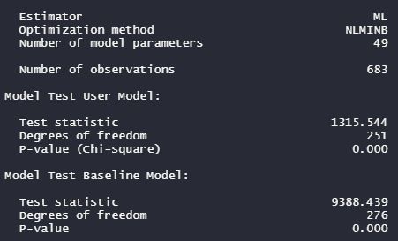
Model Fit Statistics

Slide 19

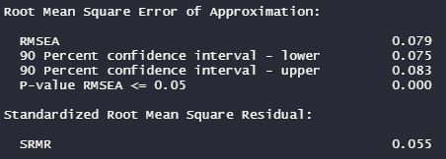
Model Fit Statistics
CFI > 0.90 = adequate
TLI > 0.95 = adequate
RMSEA < 0.08 = adequate
SRMR < 0.08 = excellent

Slide 20
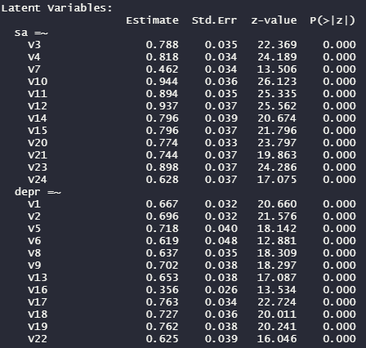
Factor Loadings
V7: fear or concerns about your heart beating too hard or fast when you are in most new or social situations
V10: fear or concerns about feeling self conscious in front of other/unfamiliar people
V16: thoughts of suicide (ideation, wish, or attempt) or death that pop into your head
V19: difficulties getting started, not having as much energy as you used to have

Slide 21
Validity Analysis (Correlation Matrix)
library(corrplot)
correlation.pvalues <- cor.mtest(cor_matrix)
corrplot(cor_matrix, method = "number", type = "full",
tl.col = "black", order = "original",
p.mat = correlation.pvalues[["p"]], sig.level = .05)

Slide 22
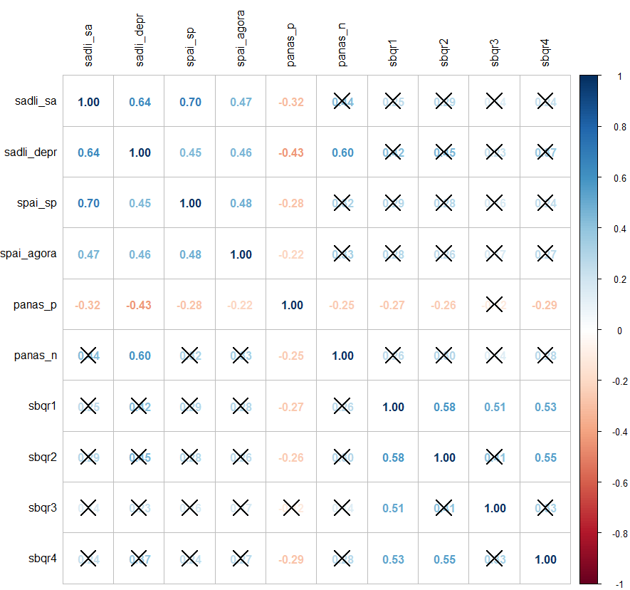

Slide 23
Conclusion
Limitations: Not all model fit indices were adequate

