Slide 1
My markdown demo
Christopher Wilson

Slide 2
Introduction
This is text.

Slide 3
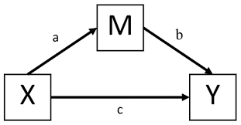
Method
This is an image.

Slide 4
Design
The design of this study is.
The variables were…
Participants
Item 1
Item 2

Slide 5
Results
route | meanHours | SDHours
FullTime | 3.66 | 2.361338
PartTime | 4.40 | 2.610810

Slide 6
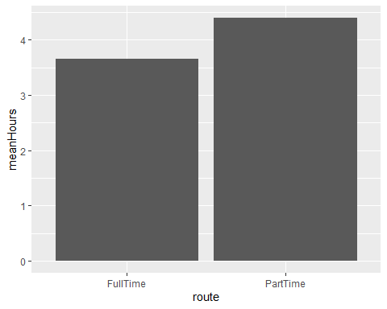
Results 2

Slide 7
Discussion
This is a blockquote

