Slide 1
Robot Design Scoring
Four base robots, six criteria, one afternoon
Look at the robots together, score them together, then fill in the spreadsheet.
Look it's a Giraffe! · 21 September 2026
Notes:
Goal today: everyone looks at the same pictures and scores the four designs independently, then we compare. Disagreements are the useful part.

Slide 2
The six things we are scoring
Score each robot 1 (poor) to 5 (excellent). If we have not tested it, leave it blank rather than guessing.
1
Archetype match
2
Attachment swap speed
Does it look like robots that win? Compact box shape, wheels near the middle, hub low and flat.
How fast can we change a tool at base? Time ten swaps with a stopwatch.
3
Squaring
4
Stability under load
Flat back and sides, and they must be the WIDEST part. Push a ruler against each face.
Fit the heaviest attachment, drive fast, stop hard. Does anything lift?
5
Maneuverability
6
Drive repeatability
Drive it through the tightest gap on the mat.
Drive 1 m ten times. Do ten 90-degree turns. Measure the spread.
Notes:
Criterion 3, squaring, is the one people get wrong. Flat faces only help if nothing sticks out past them - a wheel touching the wall first means the robot pivots instead of squaring.

Slide 3
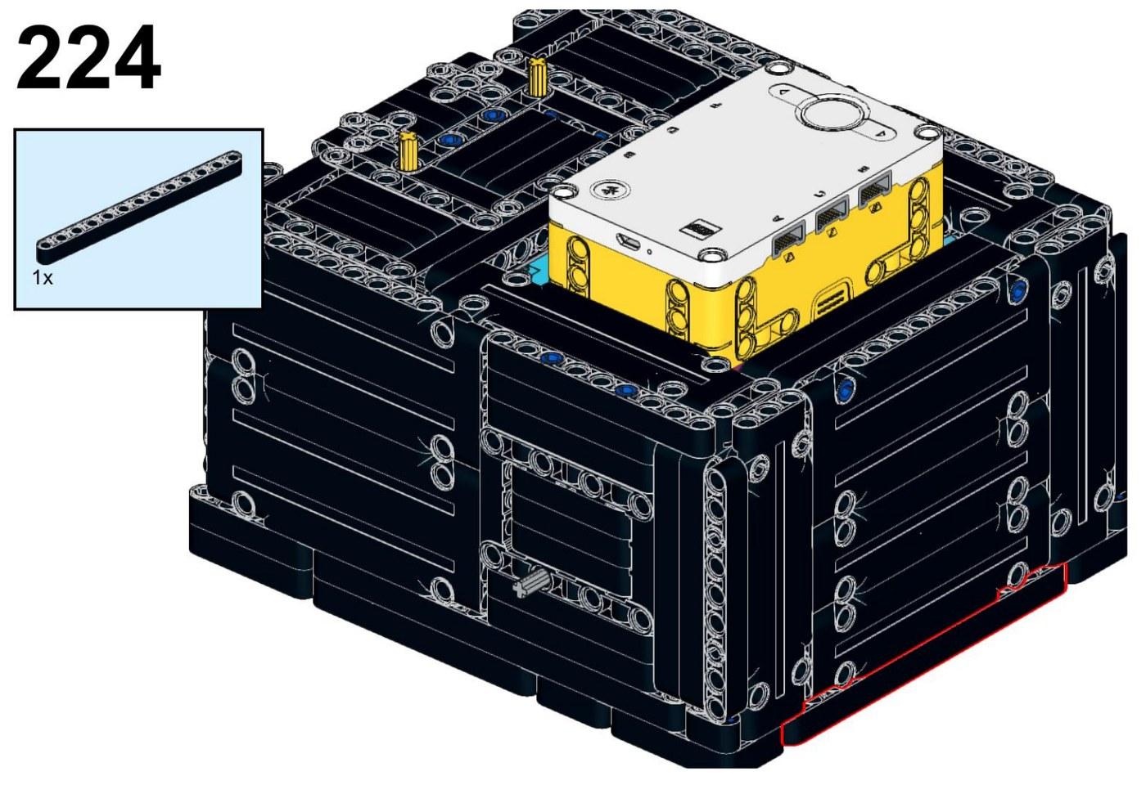
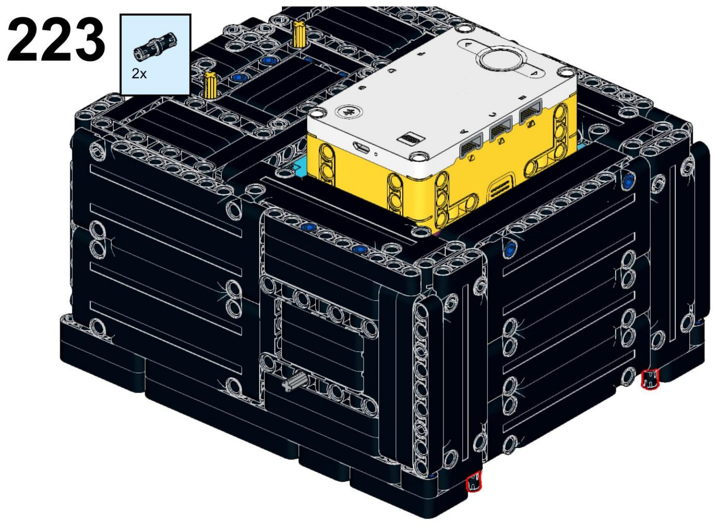
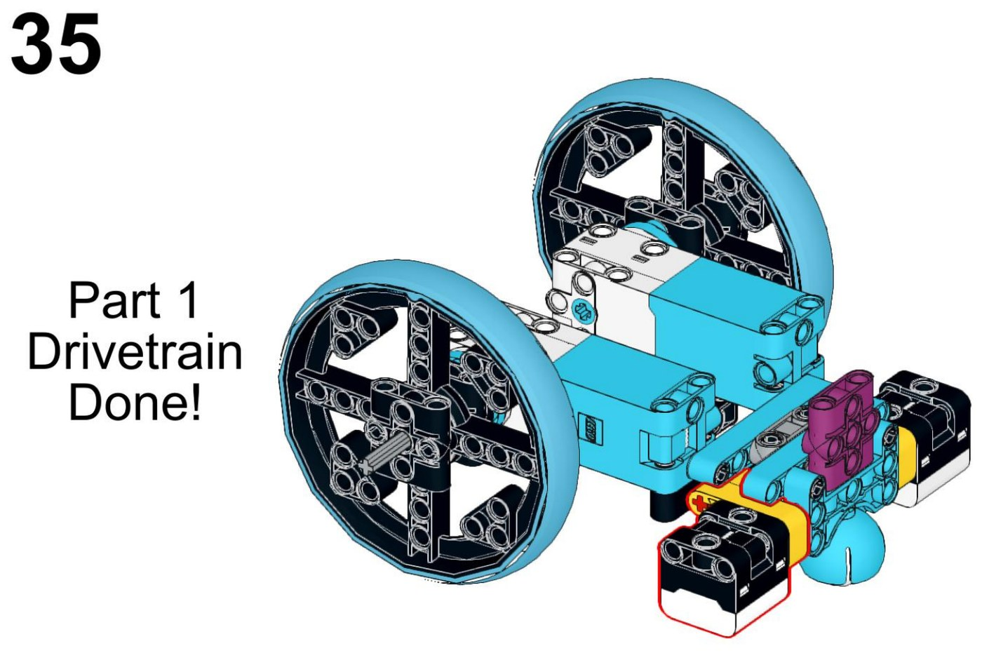
Comp Bot
Zain Khan · free PDF · 225 build steps, 158 of them framing
Same robot, other side
Drivetrain, before the frame goes on
Drive wheels sit completely inside the frame
Two attachment motors with dog-gear couplings
SPIKE hub recessed into the top deck
Biggest and heaviest of the four
WHAT TO LOOK AT
The outside is flat on every side - nothing sticks out past it
Compare the bare drivetrain to the finished shell: the frame is most of the robot
Think about the size: can it fit between close mission models?
Finished robot - a fully enclosed shell, wheels entirely inside
Notes:
225 steps is several meetings. It also needs four motors, which is probably more than one core set - check our inventory before anyone falls in love with it.

Slide 4
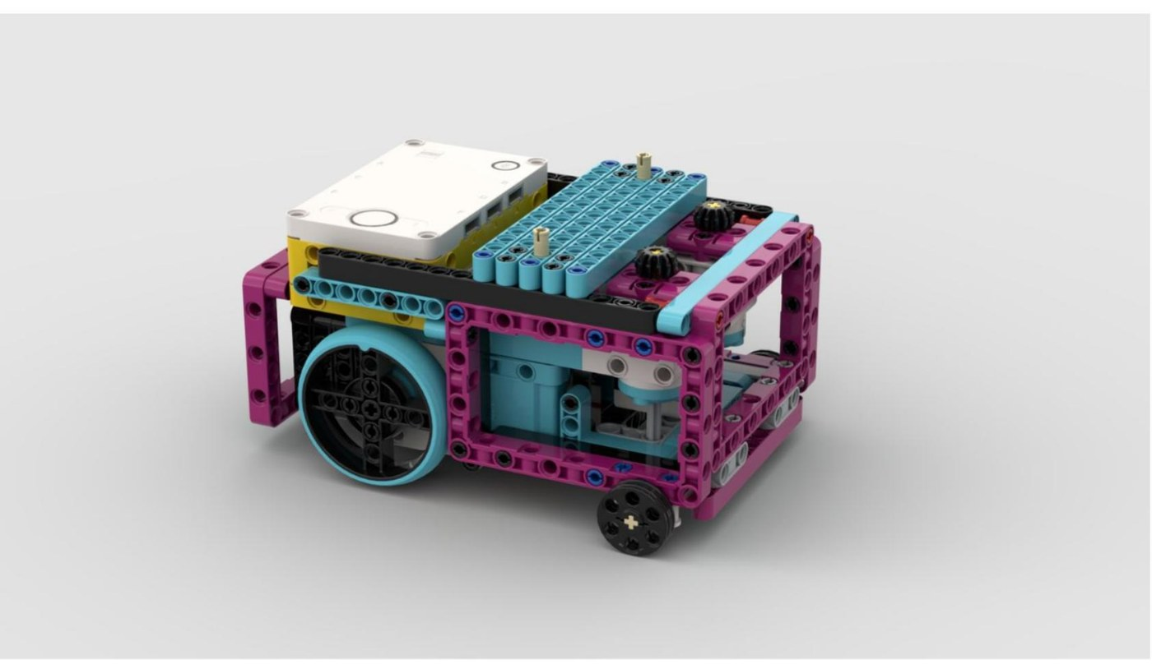
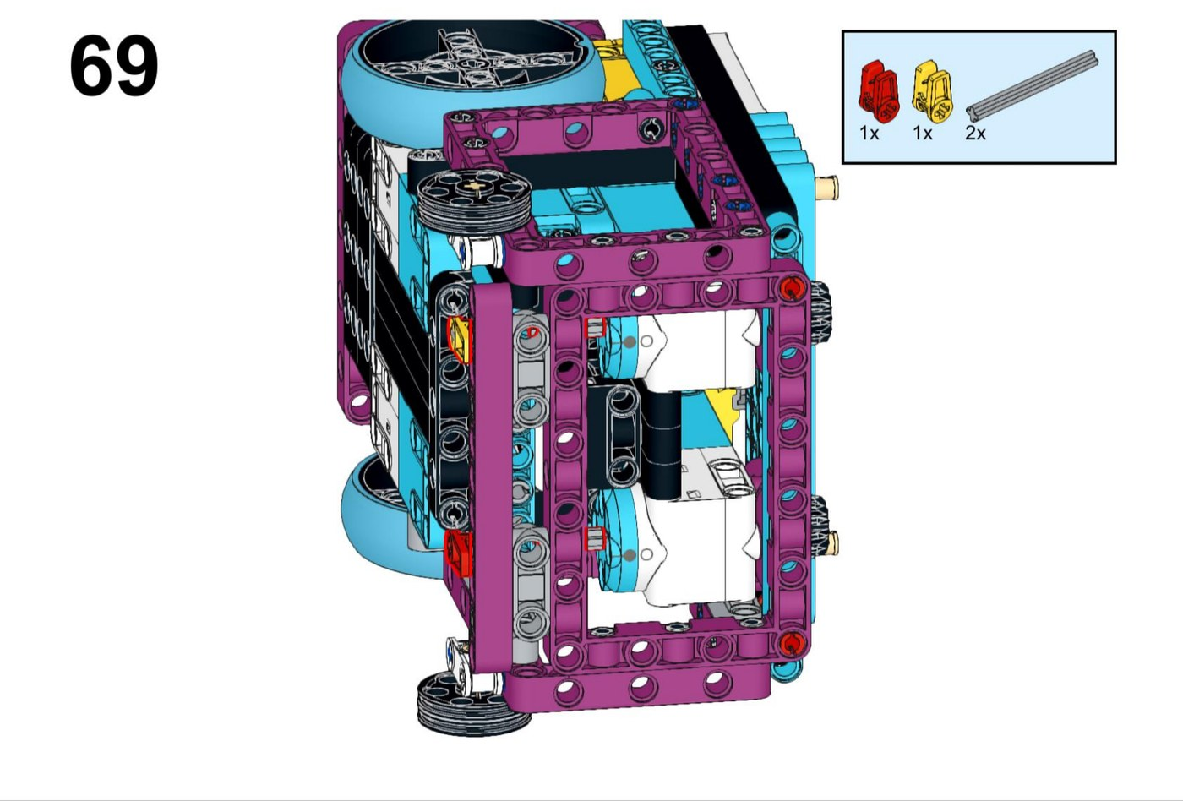
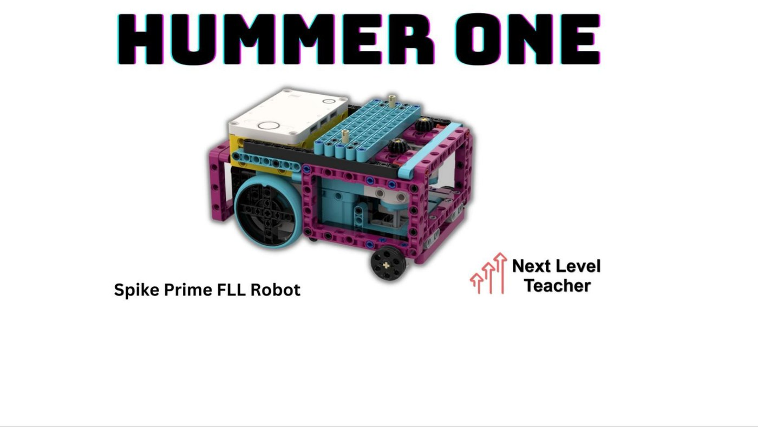
HummerOne
Next Level Teacher · free with course signup · 73 build steps
Underside - the frame cage around the wheels
Title page from the build instructions
Full-width bar on top for gliding attachments on and off
Two rear drive wheels plus a front support wheel
Reinforced frame - very little flex
Large footprint
WHAT TO LOOK AT
The magenta frame panels down the sides and across the back
Does the front-left drive wheel stick out past that frame?
The attachment bar across the top - how quick would a swap be?
Finished robot - perimeter frame with flat side and rear panels
Notes:
Second best squaring. Its frame gives real flat faces, but check whether the front wheel is proud of them - that is the one thing that would spoil it.

Slide 5
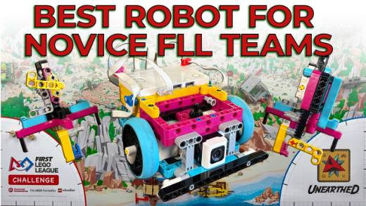
StarterBot
Robotics Rules · instructions cost $30 · 18 x 19 studs, one core set
WATCH THIS BEFORE SCORING
StarterBot - The AWESOME robot system for novice and rookie FLL teams (12 min)
youtube.com/watch?v=oZh5O4pW1y4
We only have one picture of this robot, so it is fair to leave its scores blank until we have watched the video.
Attachments couple through gears, not pins
A colour sensor tells the robot which attachment is fitted, so all our code lives in one program
Centre of gravity deliberately set toward the front
The sides are NOT flat, so it does not square against a wall well
Promotional still from the creator's video - we have no build instructions for this design
CAREFUL WITH THIS ONE
The creator advertises easy wall alignment. Our own check says the sides are not flat - so treat that claim as marketing, not a measurement.
Notes:
This is the one design we cannot see properly. Watching the 12 minute video together is worth it - the attachment identification idea is good enough to borrow whichever robot we build.

Slide 6
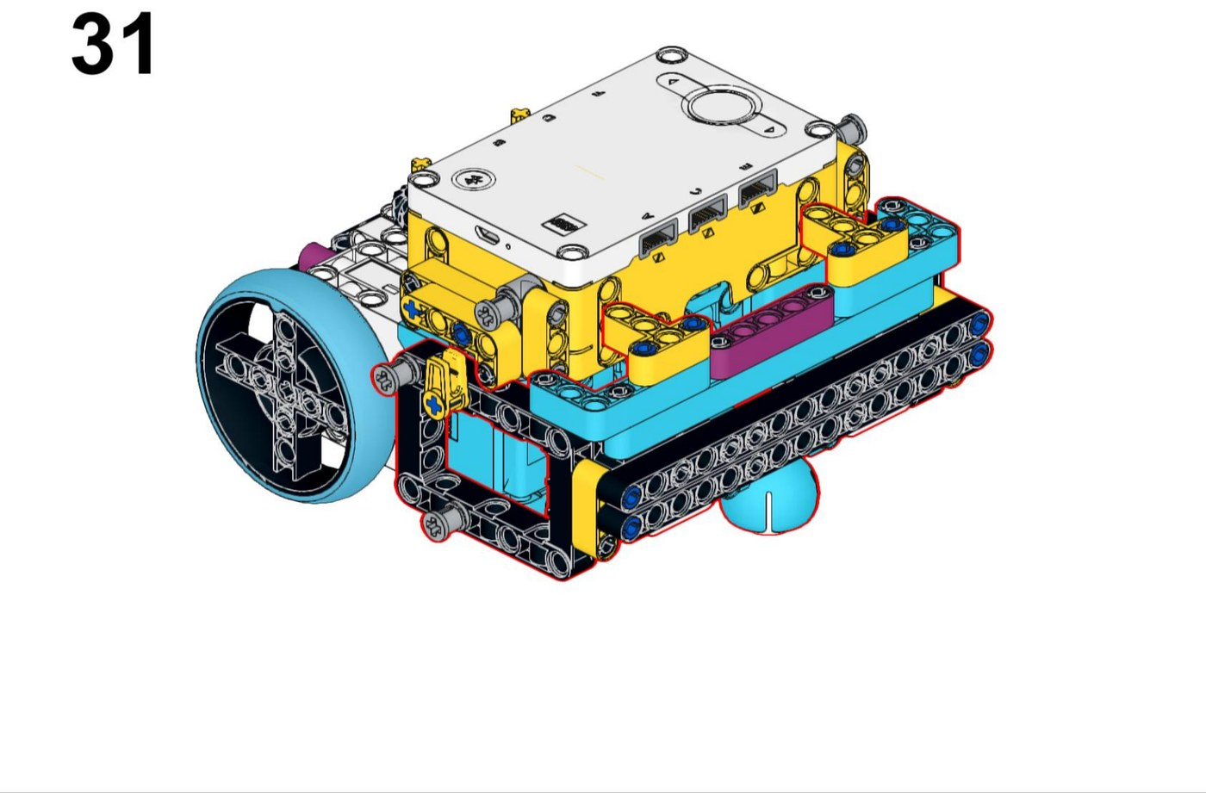
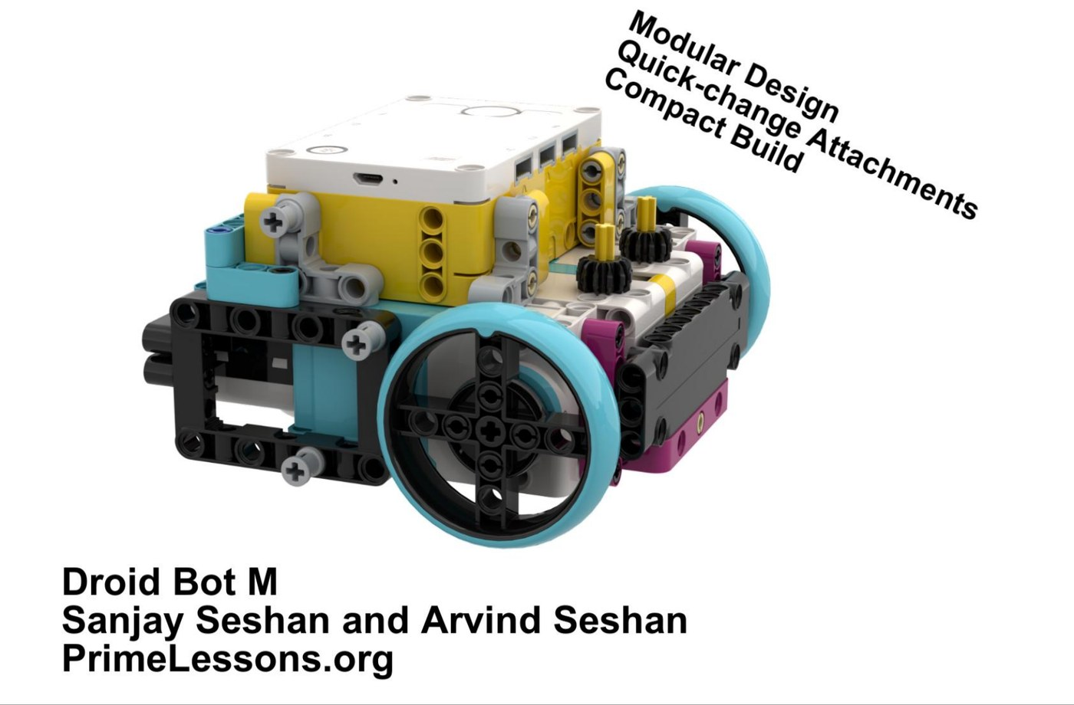
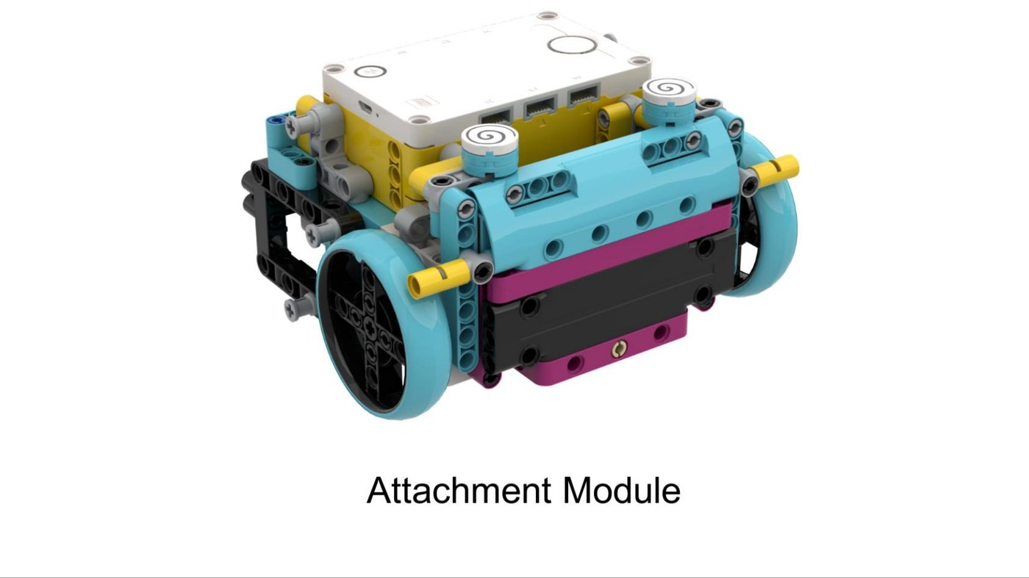
GummyBears / Droid Bot M
GummyBears Robotics and the Seshan Brothers · both free · about 31-39 steps
Droid Bot M - near-identical robot
Droid Bot M attachment module
Two published builds, so close we score them as one robot
Smallest and lightest here - best in tight spaces
Much the fastest to build
Droid Bot M also needs expansion-set parts
WHAT TO LOOK AT
Look at where the big wheels sit - do they stick out past the body?
That is the squaring problem: nothing flat may be able to reach a wall
Compare how quickly we could build this against Comp Bot's 225 steps
GummyBears build - compact chassis, wheels outboard
Notes:
The Gummy Bears won the World Festival Robot Design Award, so the pedigree is real - but pedigree is about the builders, not this robot. Score what we can see.

Slide 7
All four, side by side
Same scale problem every team has: the sturdiest robot is the biggest, and the nimblest is the least stable.
Comp Bot
HummerOne
StarterBot
GummyBears / Droid Bot M
Enclosed frame. Squares from any side. 225 steps.
Glide-on attachment bar. Sturdy. 73 steps.
Clever attachments. Sides not flat. $30.
Small, quick to build, weakest squaring.
Score each robot on its own merits first. Only compare them once everyone has their own numbers down.
Notes:
Go round the table one criterion at a time rather than one robot at a time - it keeps the scale consistent.

Slide 8
Now fill in the spreadsheet
robot-design-scoring.xlsx - the Scoring tab
Yellow cells only. Everything else works itself out.
Blank beats a guess. If we have not tested it, go and test it.
Score every robot on one criterion before moving to the next.
Write down why, not just the number. Judges ask about the why.
Look it's a Giraffe!
Notes:
After scoring, the Reference Scores tab has the review's numbers. Compare, argue, and record where we disagreed - that is genuinely good Robot Design judging material.

