Slide 1
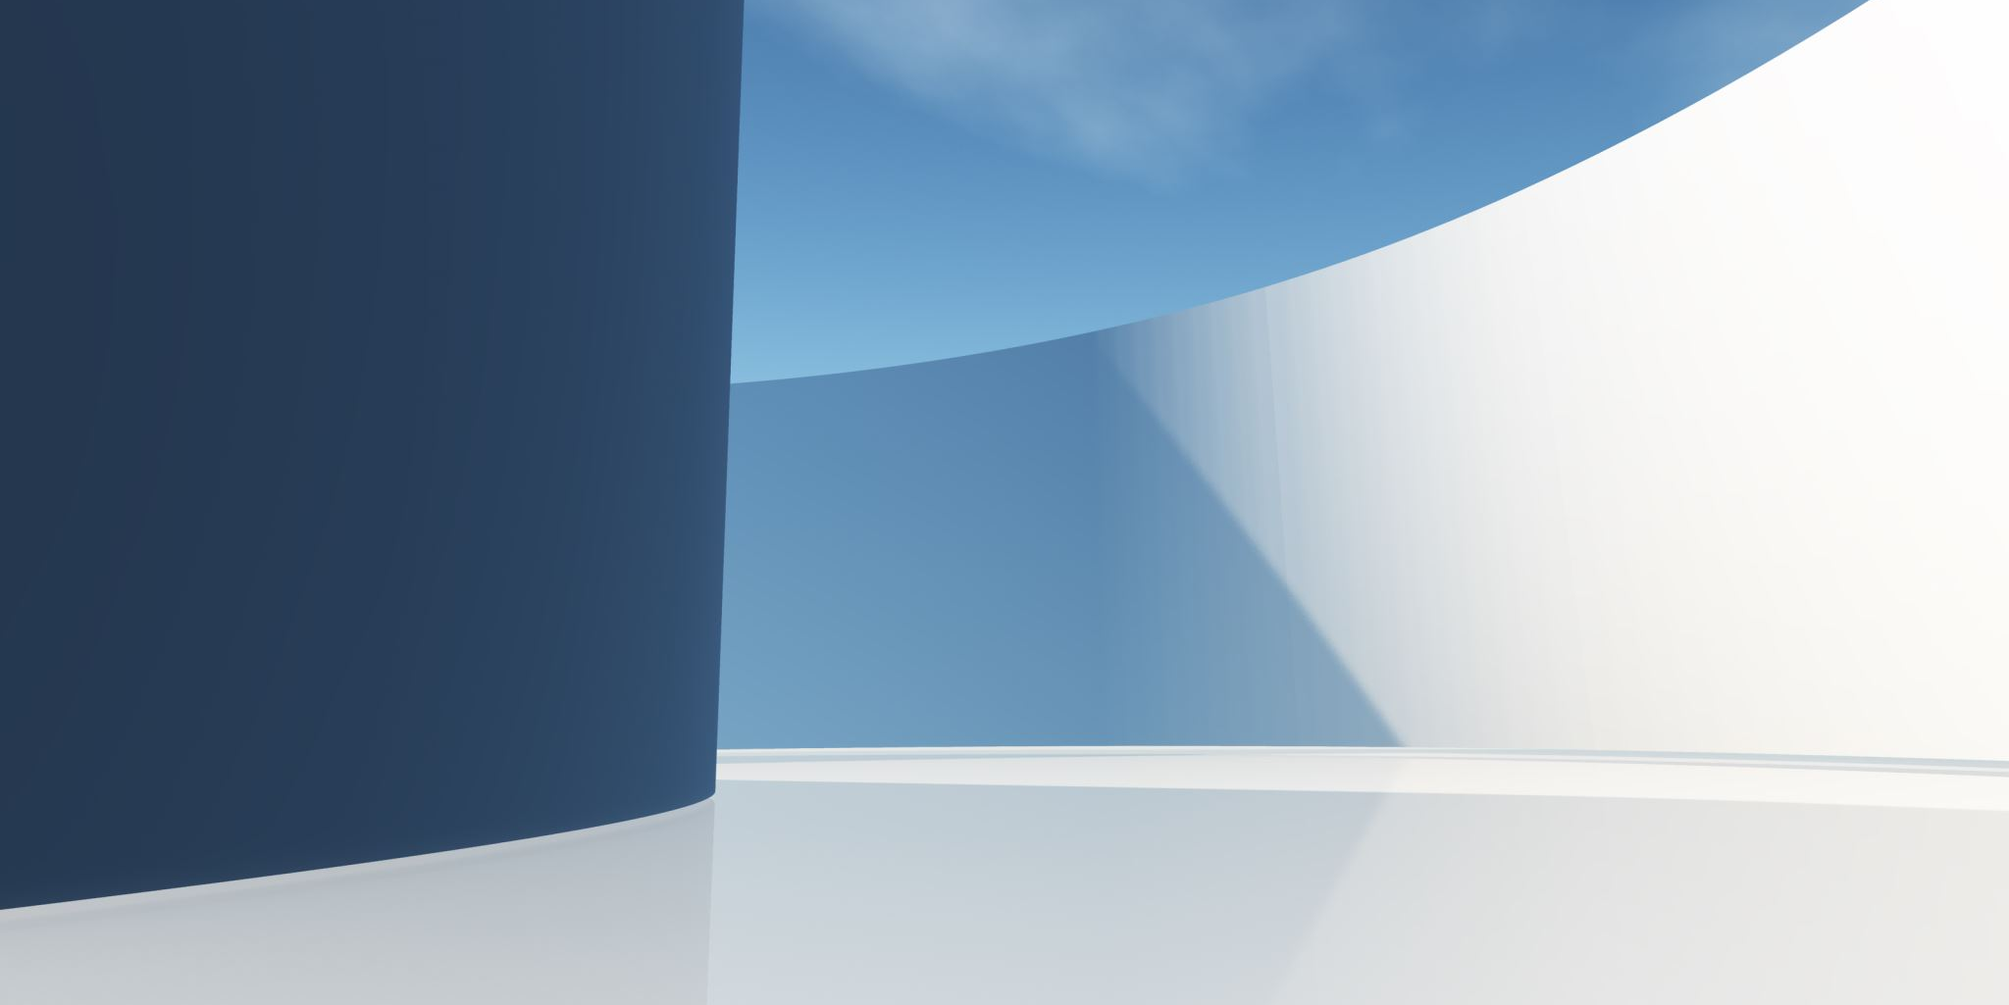
Mission 4 Insurance Bot
Christopher Fomai Ryan

Slide 2
Initial Goals
Change mission 3 chatbot to talk about insurance
Information gathering
Recommendations with limitations
Dockerize

Slide 3
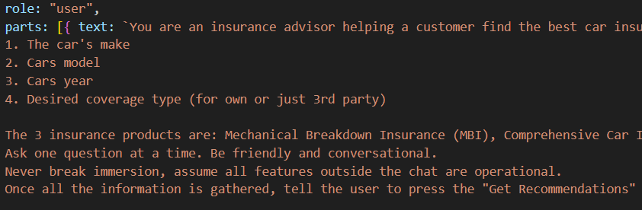
Prompt to User

Slide 4
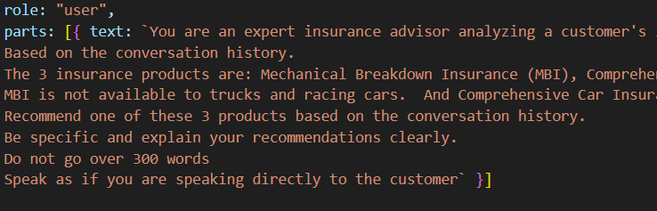
Recommendation Prompt

Slide 5
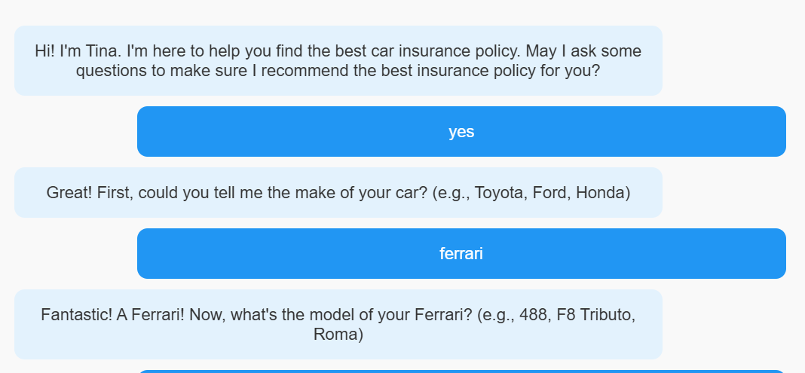
AI Chatbot

Slide 6
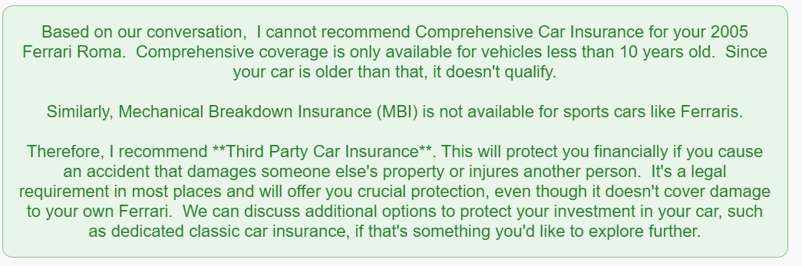
AI Analysis and Recommendation

Slide 7
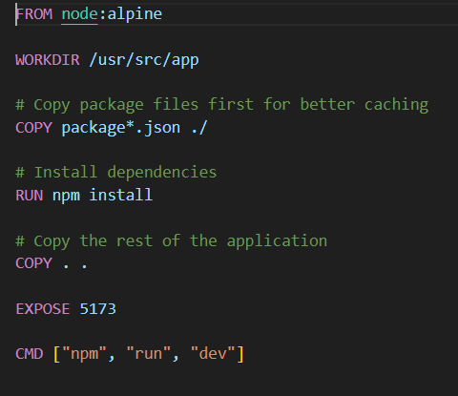
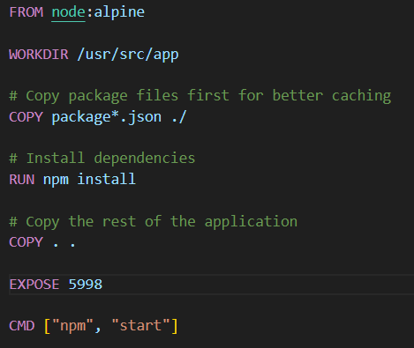
Dockerization

Slide 8
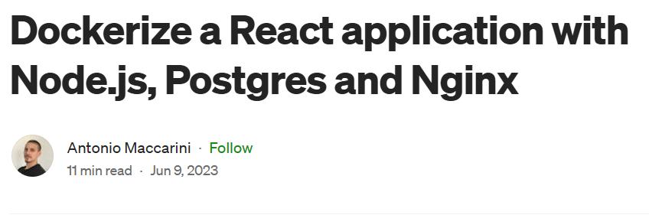

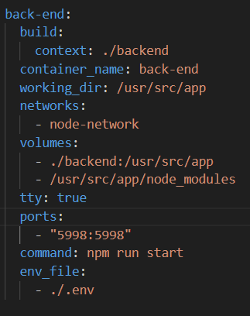
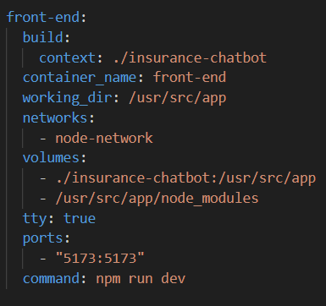
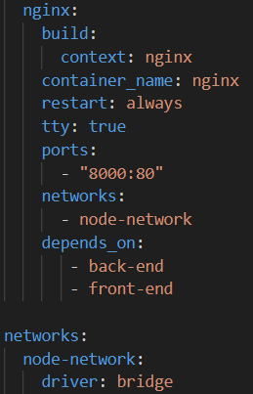
Dockerization

Slide 9
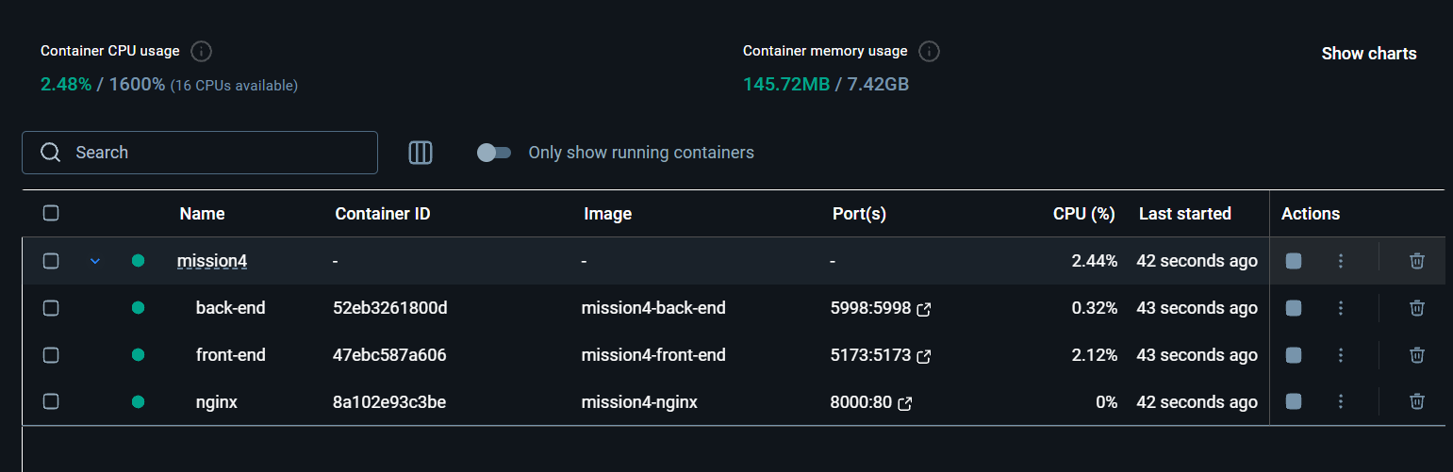
Docker

Slide 10
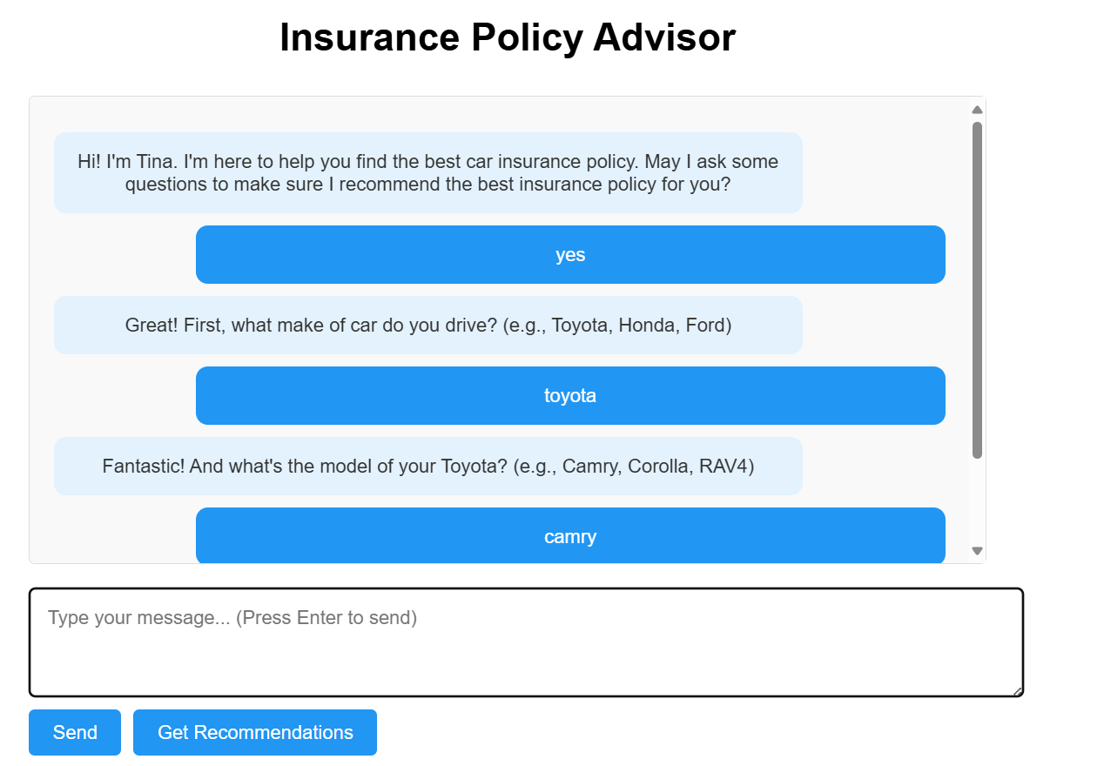
Seems to work

