Slide 1
SudokuOCR
Constraint-Driven AI for Historical Census Digitization
100% accuracy on 16,542 cells across 52 tables
52
16,542
26,173
$0.08
Tables
Cells Verified
Constraint Checks Passed
Per Table Average Cost
Chris Ruaño | HEB 91r | Harvard University
Notes:
Welcome. I'm going to show you how we achieved something that sounds impossible: 100% cell-level accuracy on historical census tables using a constraint-driven AI approach. 52 tables, over 16,000 cells, zero errors. And the system costs about 8 cents per table.

Slide 2
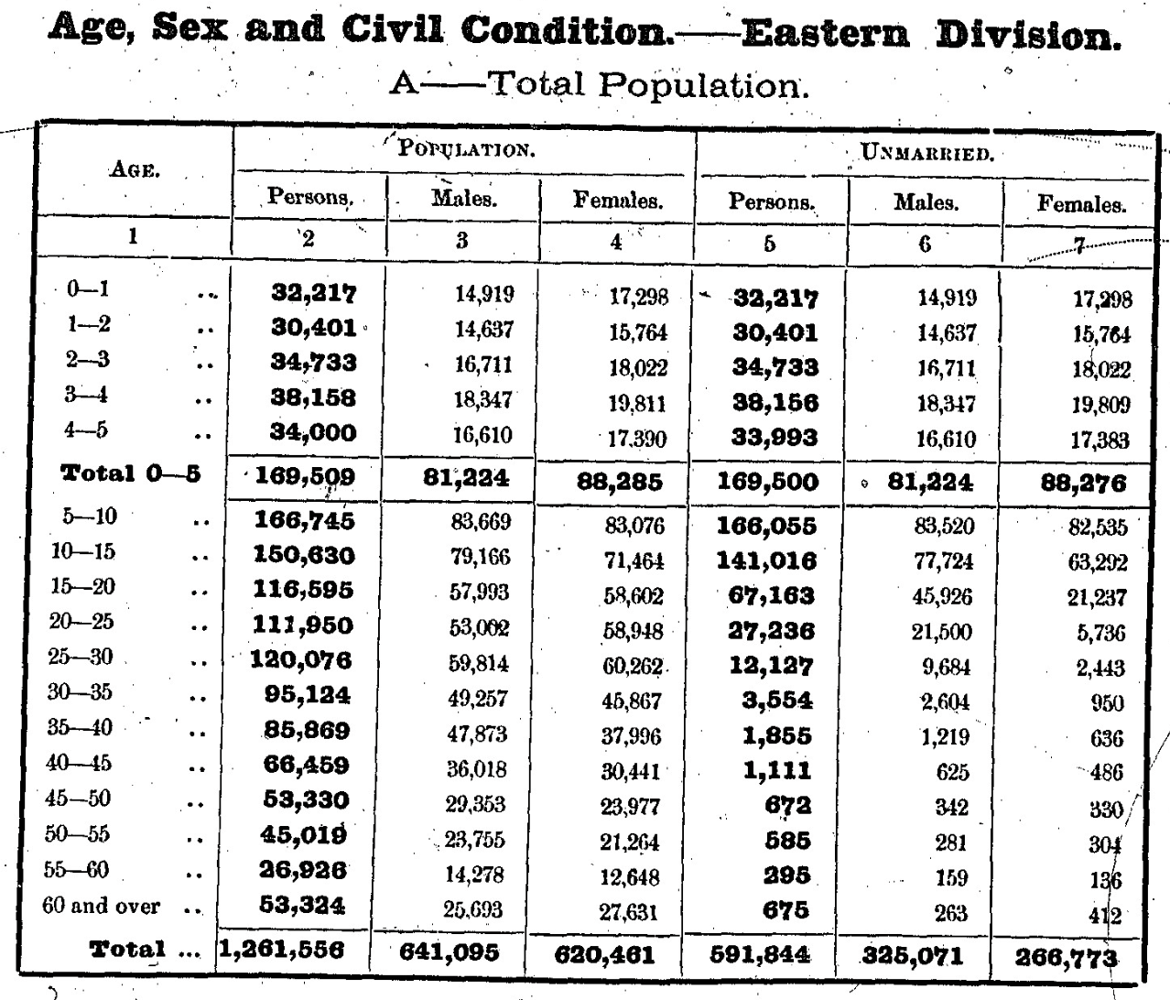
The Problem
Historical Indian Census (1872–1941): millions of pages of handwritten/printed tables
20+ provinces, 70+ years, thousands of tables of demographic data
Manual transcription: ~$10/table, slow, and still has errors
We found 28 confirmed errors in professionally transcribed ground truth
Travancore Eastern Division, 1901 Census
Notes:
The Indian Census from 1872-1941 is one of the largest historical demographic datasets ever collected. It covers 20+ provinces over 70 years. Each page contains age-by-sex population tables. Manual transcription costs about $10 per table and is slow. Worse, it's not even reliable -- we found 28 confirmed errors in our professionally transcribed ground truth files. Some errors were off by thousands.

Slide 3
Why This Is Hard
Tables have 240+ cells with complex structure (sections, age groups, P/M/F columns)
OCR errors are correlated: same digit confusion across an entire page
Even the best AI models plateau at ~92–96% — the "last mile" problem
4% error rate × 240 cells = ~10 wrong cells per table, with no way to know which
Common confusions: 3↔8, 5↔6, 0↔9 (ambiguous in degraded scans)
POPULATION UNMARRIED MARRIED P M F P M F P M F ──── ──── ──── ──── ──── ──── ──── ──── ──── 175k 85k 90k 174k 85k 89k 1.4k 509 958 236k 115k 121k 235k 114k 120k 1.4k 763 727 ... ... ... ... ... ... ... ... ... 20 age rows × 4 groups × 3 columns = 240 cells per table
The fundamental problem: the AI doesn’t know when it’s wrong
Notes:
A single table can have 240 cells or more. With 4% error rate, that's 10 wrong cells per table. And you have no way to know WHICH cells are wrong. The errors are systematic -- the same ambiguous digit gets misread the same way every time. This is the 'last mile' problem: getting from 96% to 100%.

Slide 4
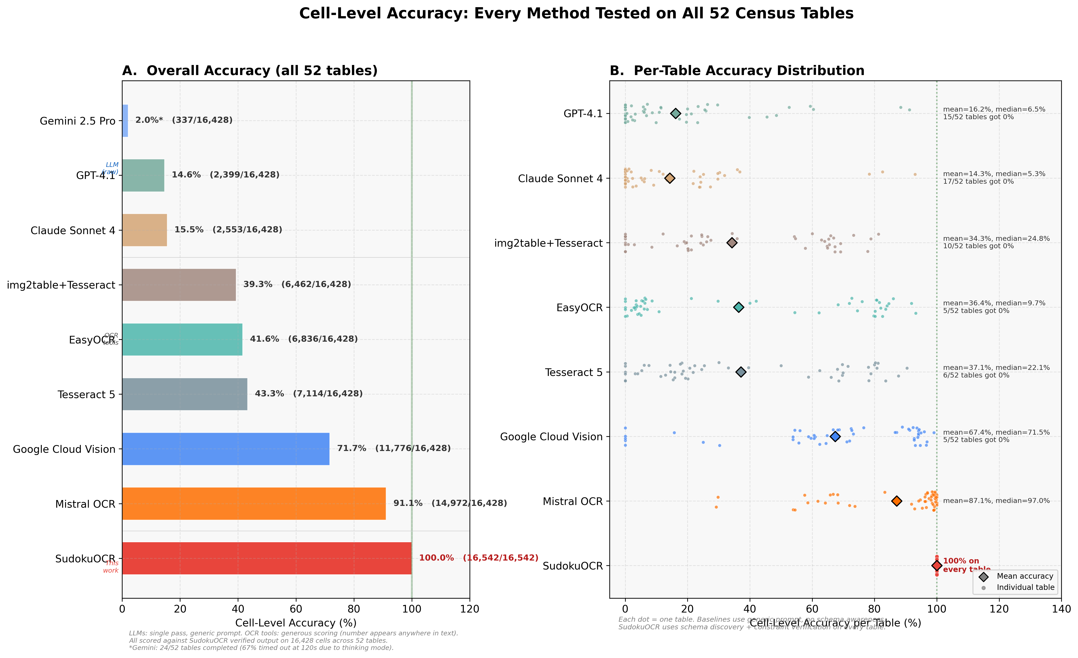
The Baseline — "Just Ask the AI"
Notes:
Here's every method we tested on all 52 tables. Traditional OCR tools like Tesseract get around 40-50%. State-of-the-art LLMs like GPT-4.1 and Claude get around 15-16%. Mistral's dedicated OCR model reaches 71%. Google Cloud Vision gets 82%. SudokuOCR achieves 100% -- the only method that gets every single cell correct. The right panel shows per-table distributions: other methods have huge variance, while SudokuOCR is a flat line at 100%.

Slide 5
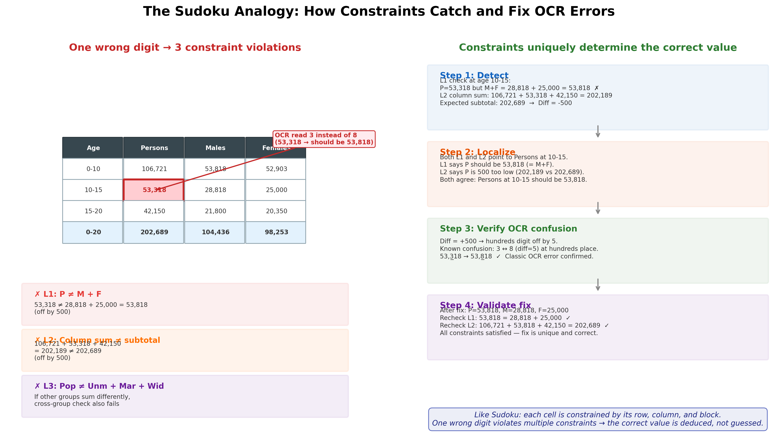
The Key Insight — Census Tables Are Sudoku Puzzles
Every cell is constrained by its row and column sums
One wrong digit violates multiple constraints simultaneously
Errors become detectable and correctable — like Sudoku
Notes:
This is the key insight: census tables aren't just grids of independent numbers. They're constraint systems, like Sudoku puzzles. Every row must satisfy Persons = Males + Females. Column sums must equal totals. Cross-group sums must be consistent. A single wrong digit violates multiple constraints. This makes errors DETECTABLE and CORRECTABLE.

Slide 6
Five Levels of Constraints
L1
Row Constraint
Persons = Males + Females (every row)
L2
Column Sums
Age groups must sum to their subtotals and totals
L3
Cross-Group
Population = Unmarried + Married + Widowed + Divorced
L4
Cross-Section
All Communities = Brahmanic + Other Hindus + Muslims + ...
L5
Non-Negativity
All values ≥ 0
26,173 total constraint checks across 52 tables (~1.6 per cell) Each cell participates in 3–5 independent constraints
Notes:
We define 5 levels of constraints. L1: every row, Persons = Males + Females. L2: vertical sums -- age groups must add up to their subtotals and grand totals. L3: cross-group -- Population must equal the sum of Unmarried + Married + Widowed + Divorced. L4: cross-section -- community sections must sum to the All Communities total. L5: all values must be non-negative. Across our 52 tables, this gives us over 26,000 constraint checks. Each cell participates in 3-5 independent constraints, so errors can't hide.

Slide 7
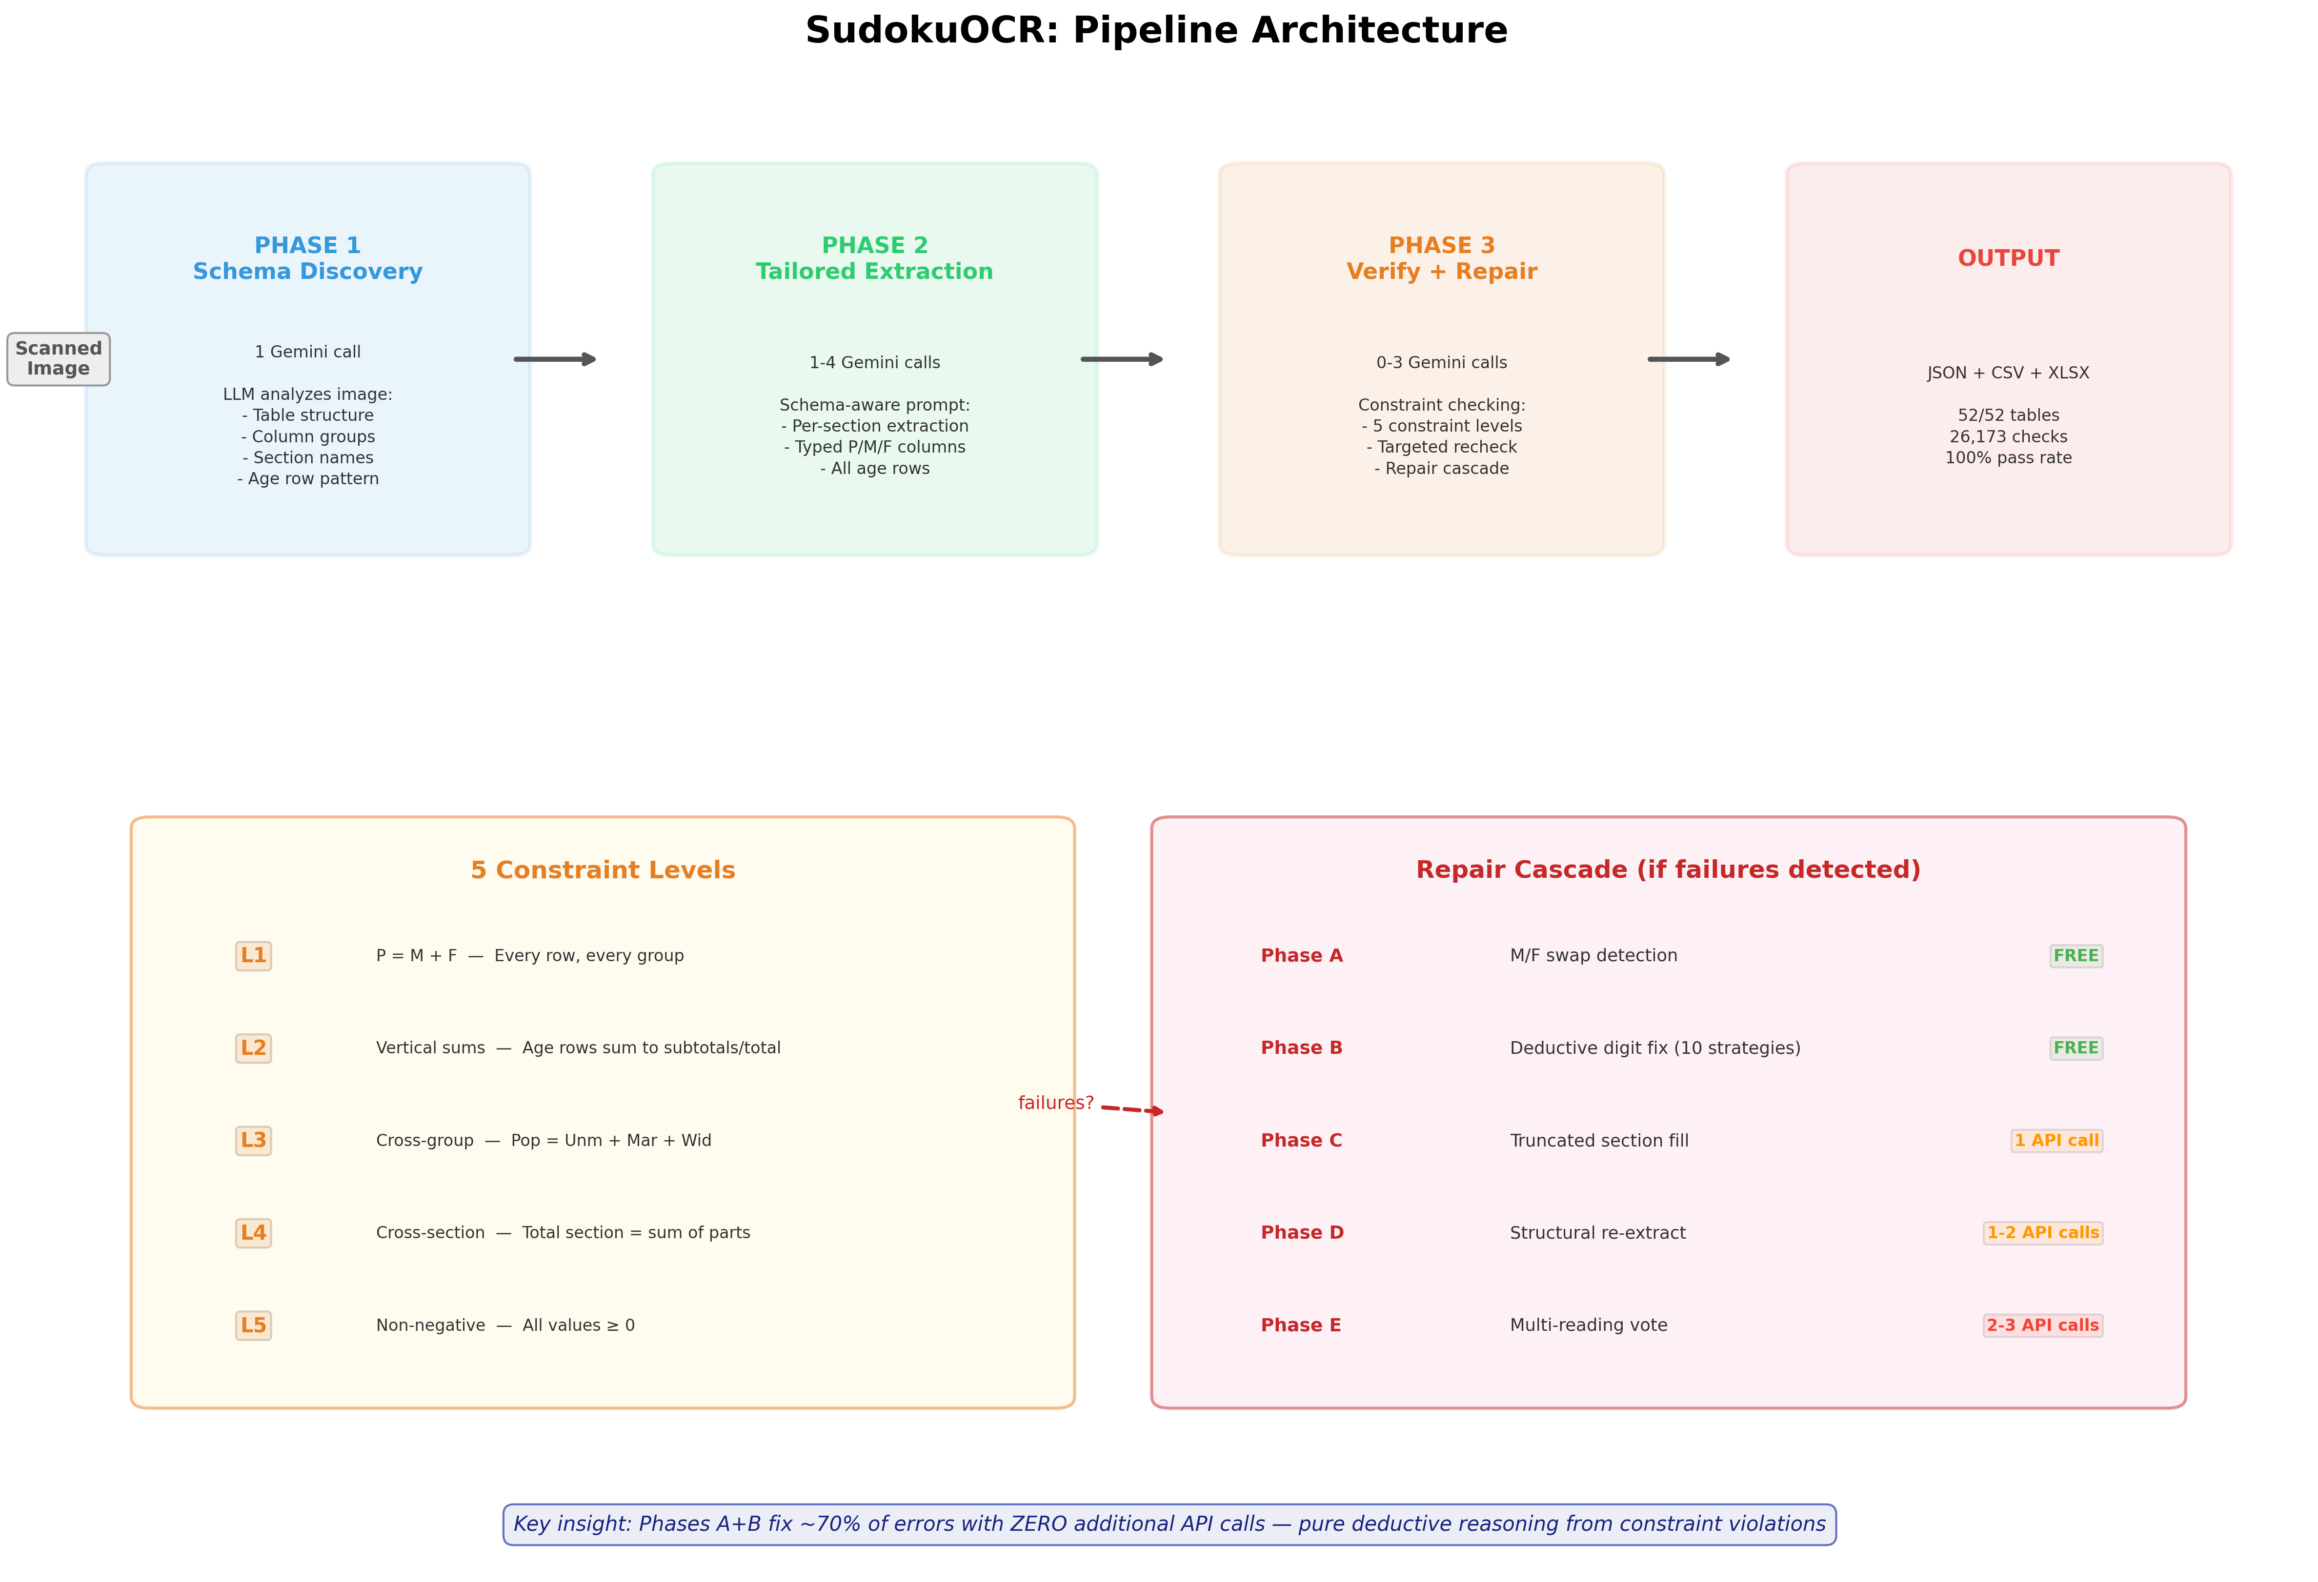
Notes:
The pipeline has 3 phases. Phase 1: Schema Discovery -- one API call to understand the table structure. What are the column groups? What are the age rows? What's the subtotal hierarchy? Phase 2: Tailored Extraction -- schema-guided data extraction using a prompt generated from the schema. Phase 3: Verify and Repair -- check all constraints, and if any fail, run the multi-phase repair cascade. Total: 2-3 API calls per table for most cases.

Slide 8
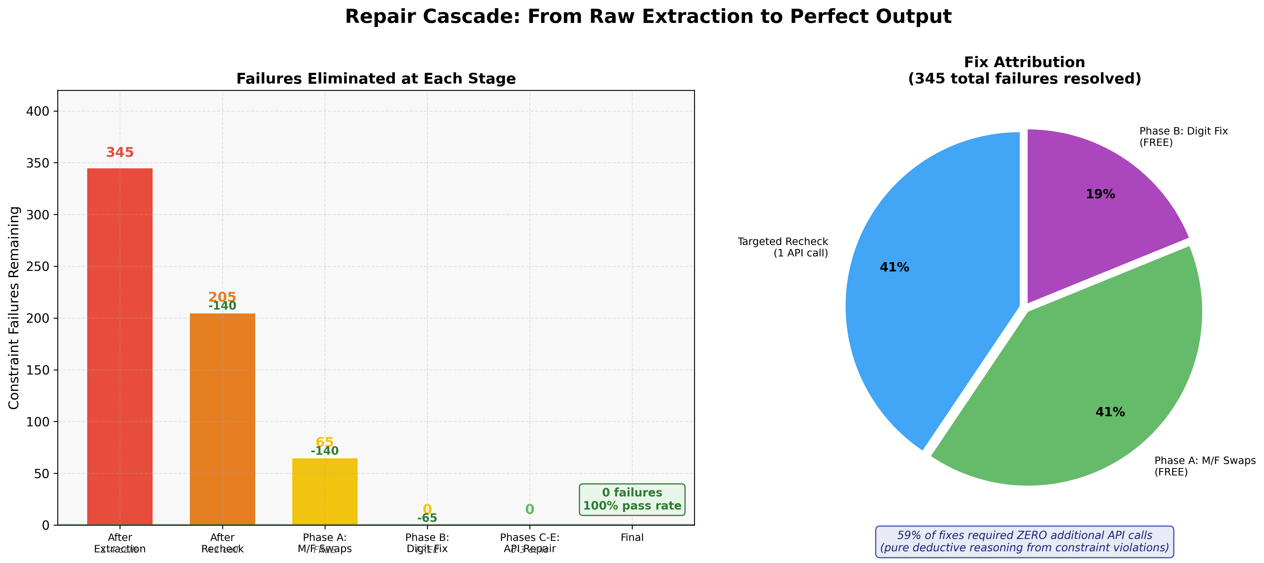
The Repair Cascade
59% of fixes require no additional API calls
Notes:
When constraints fail, we don't just re-ask the AI. We have a multi-phase repair cascade. Phase A detects Male/Female column swaps -- zero API calls. Phase B uses 10 deductive strategies to fix digit confusions -- also zero API calls. These cover common OCR confusions like 3-vs-8, 5-vs-6. Only if deduction fails do we make additional API calls for targeted rechecks. 59% of all fixes are completely free -- pure math, no additional AI needed. Like Sudoku: use what you know to deduce what you don't.

Slide 9
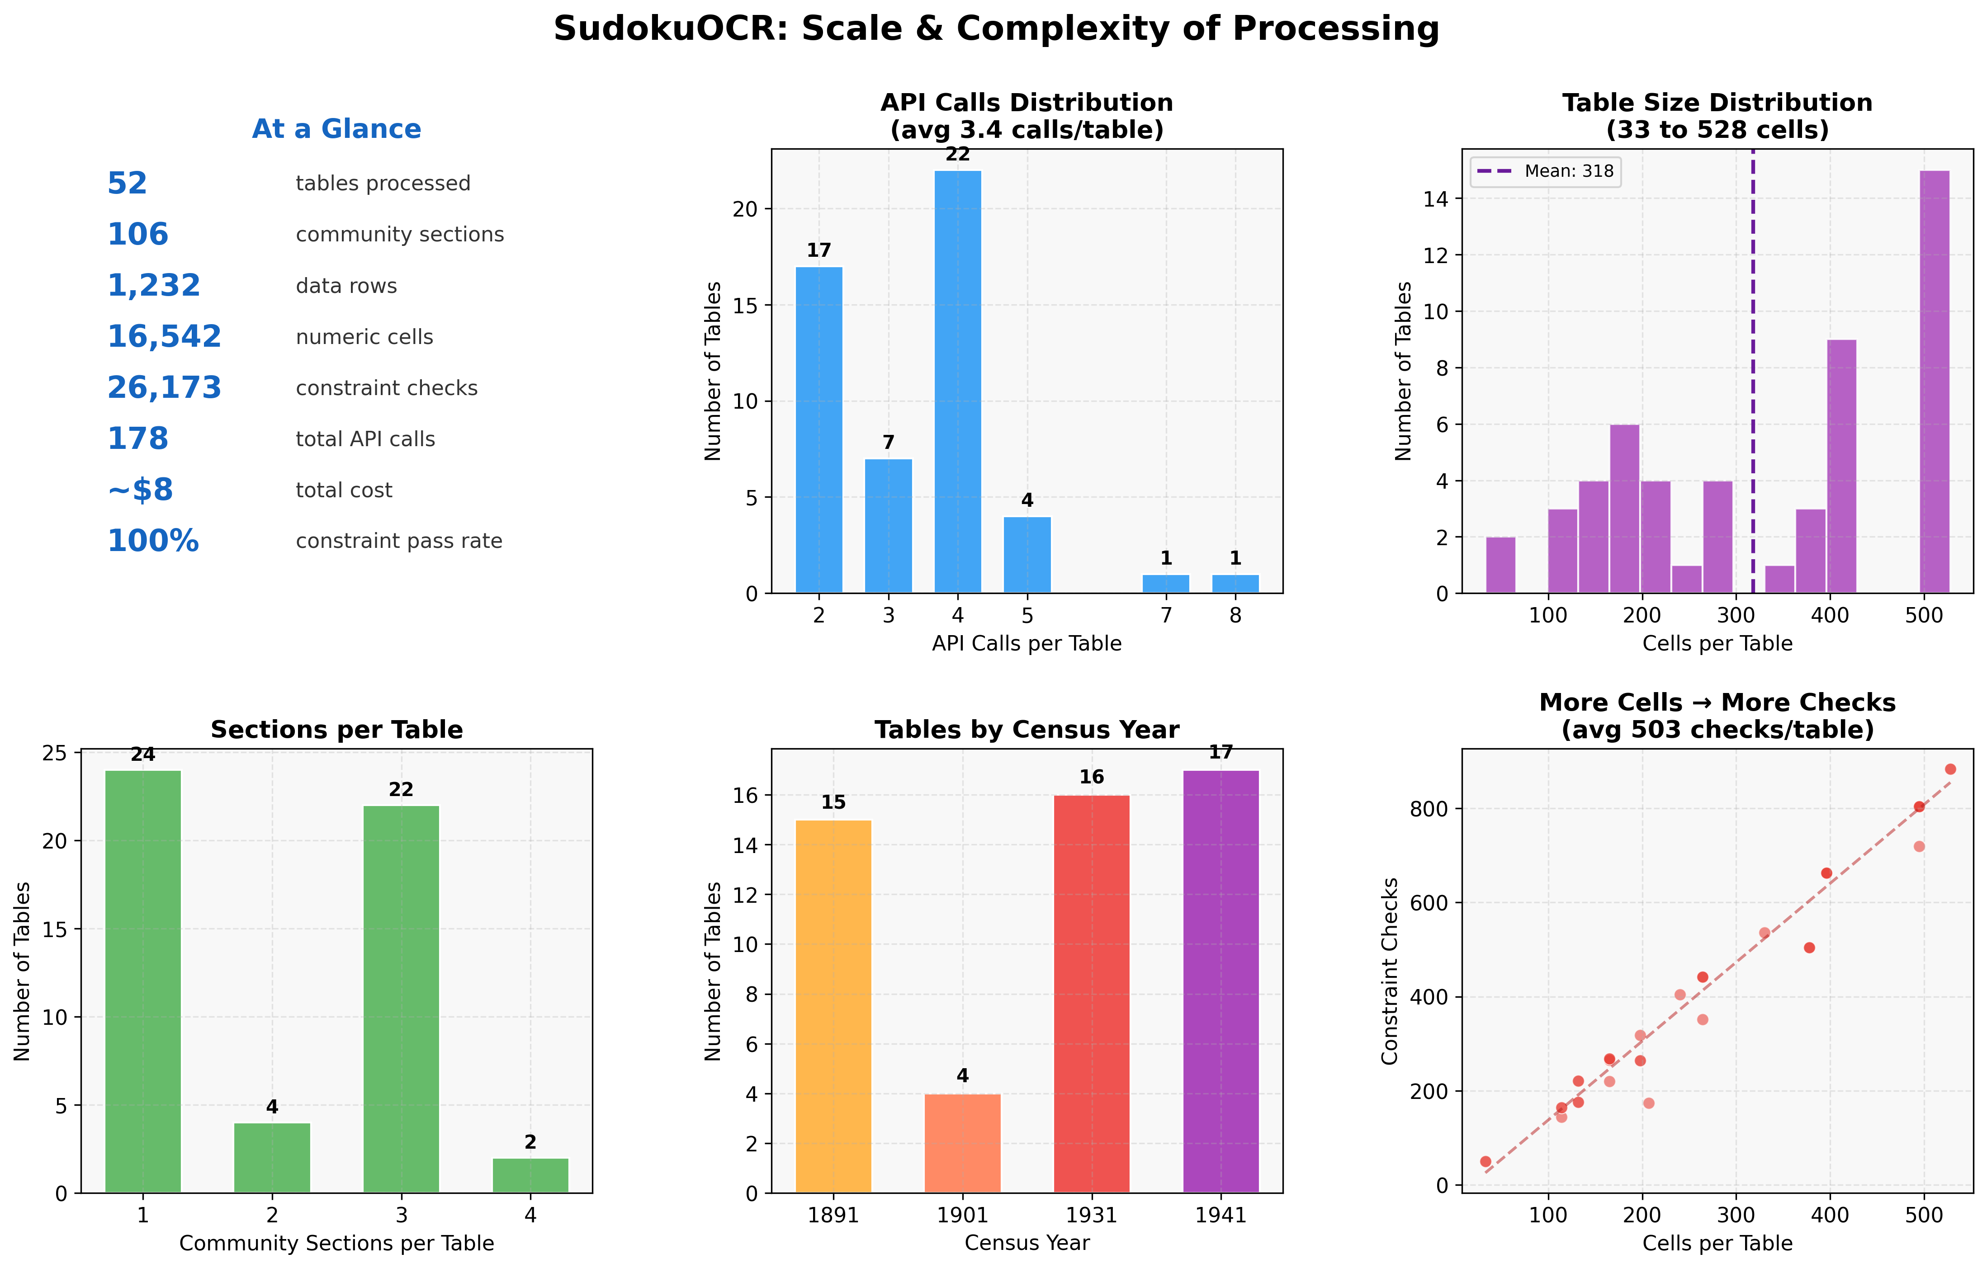
Results
52/52 tables perfect · 16,542 cells, 0 errors · 26,173 constraints, 0 failures · 6 regions, 4 census years
Notes:
The results: 52 out of 52 tables achieve 100% cell-level accuracy. 16,542 cells with zero errors. 26,173 constraint checks with zero failures. This spans 6 regions and 4 census years from 1891 to 1941. The tables range from simple 2-group tables with 114 cells to complex 3-section, 5-group tables with 500+ cells each.

Slide 10
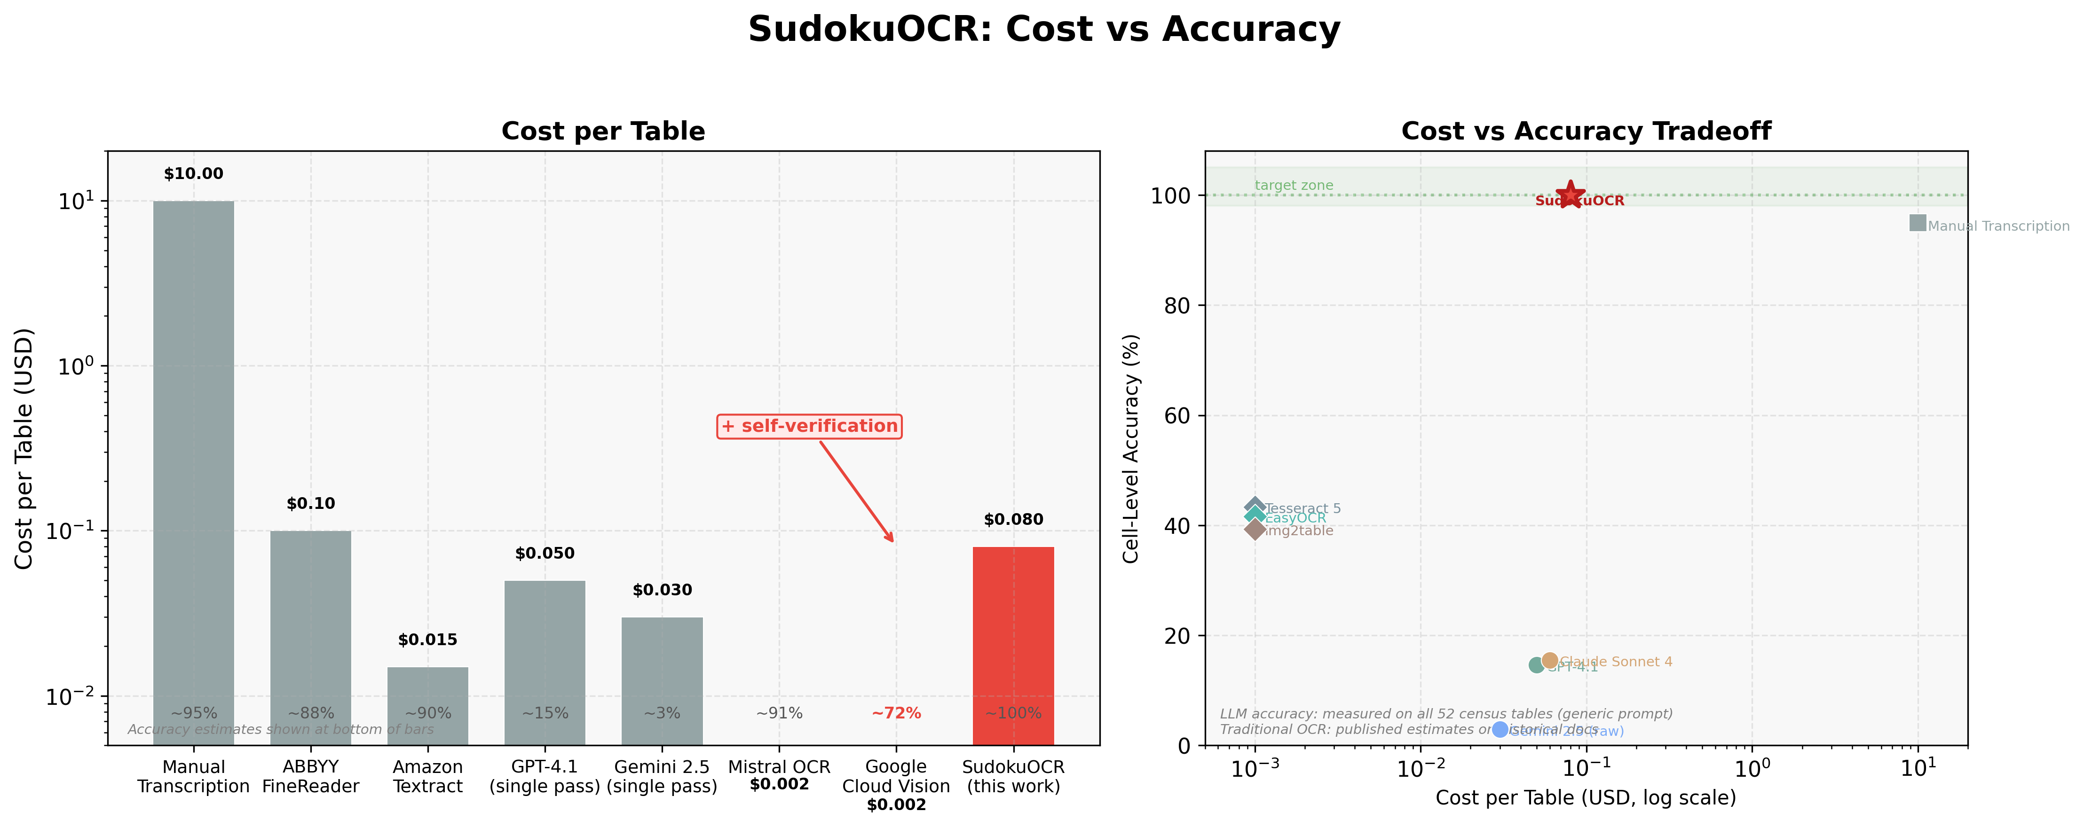
How SudokuOCR Compares
Notes:
This chart compares cost versus accuracy for every method we tested. Manual transcription costs about $10 per table and still has errors -- we found 28 in our GT files. Traditional OCR is free but only 40-50% accurate. Raw LLMs cost 3-6 cents but plateau at 15-82%. SudokuOCR costs about 8 cents per table and achieves 100% with verification. It's the only dot in the upper-left corner: cheap AND perfect AND self-verifying.

Slide 11
Finding Errors in "Ground Truth"
GT Source
GT Source
Errors Found
Errors Found
Details
Details
Travancore.xlsx
4 cells
Off by ~1,000 at age 30–35
Hyderabad.xlsx
21 cells
Some off by 6,000+
Coorg.xlsx
3 cells
Off by 11 at age 50–55
28 total human transcription errors found across 3 ground truth files
In every case, the pipeline's constraint-verified output was correct
Constraints serve as a trust signal — no external ground truth needed
The system is more reliable than human transcription
Notes:
Here's an unexpected result: our pipeline is MORE accurate than the human-transcribed ground truth. We found 28 confirmed errors in 3 professionally transcribed Excel files. Hyderabad alone had 21 errors, some off by over 6,000. In every single case, the pipeline's constraint-verified output matched the original scan correctly. This demonstrates that constraints provide a trust signal independent of any external ground truth. You don't need a human to verify the output -- the math does it for you.

Slide 12
AI + Verifiable Constraints = Reliable AI
The pattern works whenever the domain has internal consistency rules:
Census Tables
AI reads digits → arithmetic verifies
Financial Statements
AI extracts numbers → accounting identities verify
Scientific Data
AI reads measurements → physical laws verify
Code Generation
AI writes code → tests verify
Use AI for the hard part (perception) — use math for the easy part (verification)
Notes:
This is the broader principle. AI plus verifiable constraints equals reliable AI. The pattern works whenever you have a domain with internal consistency rules. Census tables have arithmetic. Financial statements have accounting identities. Scientific data has physical laws. Code has tests. Use AI for the hard part -- perception, generation -- and use math for the easy part -- verification. The constraints don't need to directly check correctness. They just need to be CORRELATED with it.

Slide 13
Future Directions
Scale
Full Indian Census corpus: thousands of tables across all provinces
Batch processing pipeline with automatic quality assessment
Estimated cost: ~$77 for 1,000 tables
Extend
Other structured historical documents: vital statistics, trade records
Multi-page tables with cross-page constraints
Non-English census records (French, Dutch colonial)
Generalize
Open-source the constraint framework
Apply to any domain with verifiable structure
Financial auditing, scientific data validation, inventory records
Notes:
Looking ahead, we want to scale this to the full Indian Census corpus -- thousands of tables. At about 8 cents per table, 1000 tables would cost around $77. We also want to extend to other structured historical documents: vital statistics, trade records, and non-English colonial census records. Most importantly, we want to open-source the constraint framework so it can be applied to any domain with verifiable structure -- financial auditing, scientific data, inventory management.

