Slide 1
DNA sequence comparison
Recurrent neural network

Slide 2
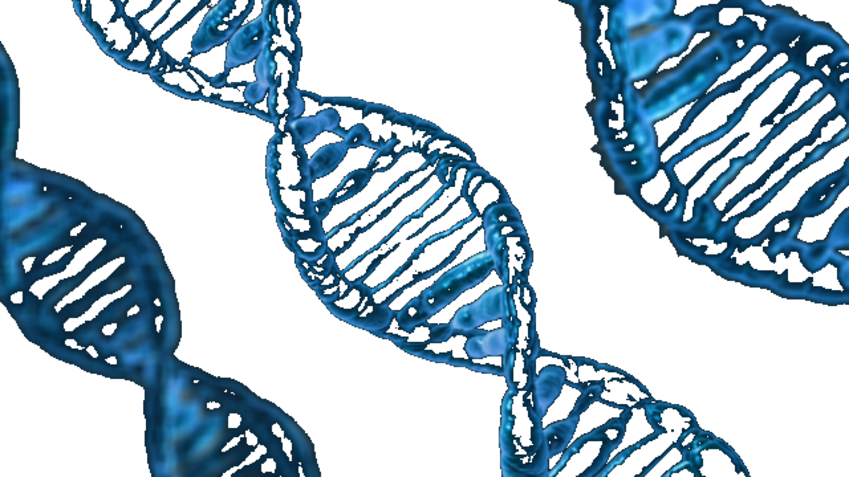
Today we will cover
Goals
DNA and DNA sequencing
Genetic algorithms
Recurrent neural networks
And DNA sequence comparison

Slide 3
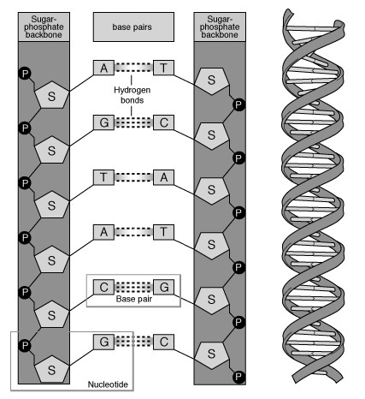
Deoxyribonucleic acid
Dna
Double helix structure
Chain of nucleotides known as base pairs
Adenine, guanine, cytosine, and thymine
DNA sequencing

Slide 4
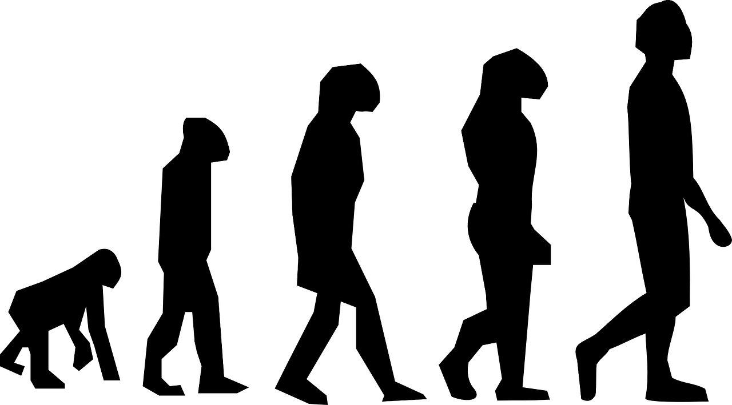
Genetic algorithms
Ga
Survival of the fittest
Individuals and population
Grading
Crossover, mutation and breeding
Evolution
Type to enter a caption.

Slide 5
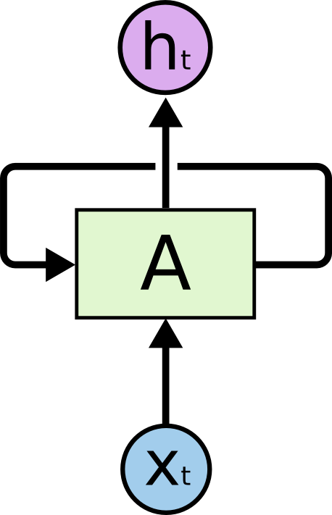
Recurrent neural networks

Slide 6
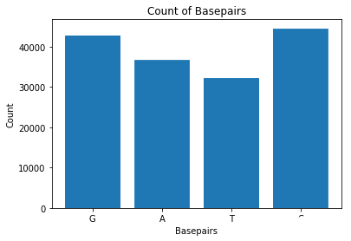
Locus NT 187300

Slide 7
Vectorize sequences
A = 1000
T = 0100
G = 0010
C = 0001

Slide 8
Creating the population
Rnn layers
30 networks
3 layers
8 input nodes
1 LSTM layer with 88 nodes
1 dense layer as the output with 1 node
Tanh function

Slide 9

Grading the population
Fitness and grading
Define fitness score
Sort the networks with art sort
Separate the fittest from the weakest

Slide 10
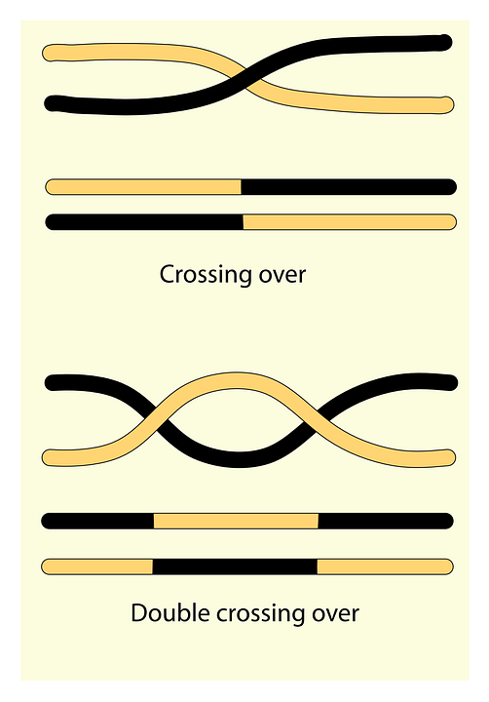
Crossover and mutation
Breeding
Crossover
Mutation
Breeding

Slide 11
Evolving the population
Evolution
Load the DNA sequences for comparison
Split into train and test set
Load the initial network population
Grade and breed the population
Validate the top individual of each epoch to preserve top individuals
Visualize the results to determine fit

Slide 12
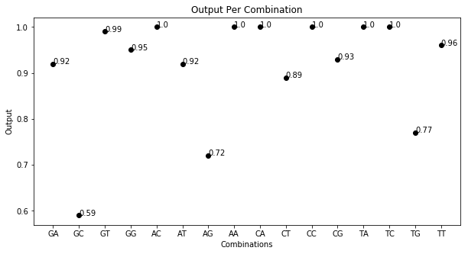

Slide 13
Recurrent neural network using backpropagation
Backpropagation
Same layers as before
Loss function
Optimizer
Metrics

Slide 14
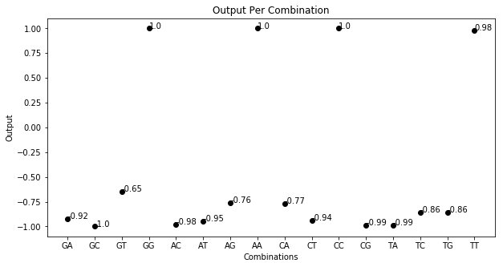

Slide 15
Create sequences for testing
Sequence creation
0% similar
33% similar
66% similar
100% similar

Slide 16
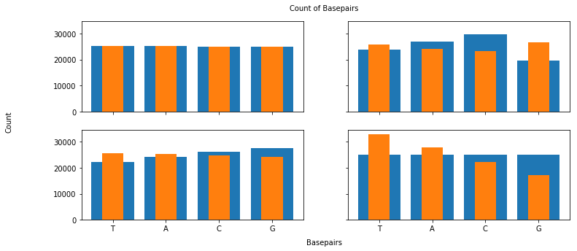
Created sequence’s distribution

Slide 17
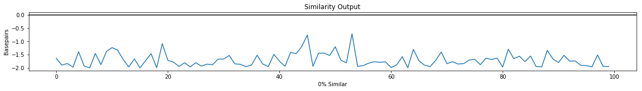
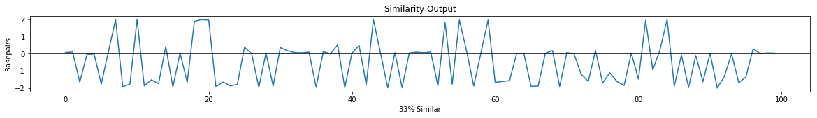
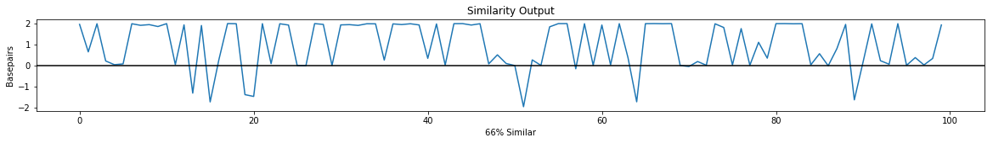
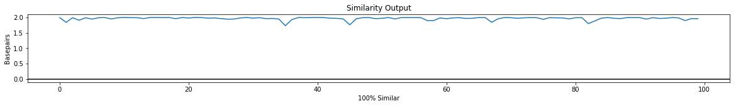
Testing the top individual

Slide 18
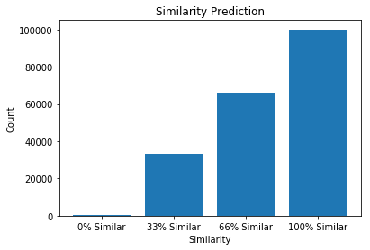
Accuracy

Slide 19
Discussion and conclusion
Discuss and conclude
Processing the sequences
Creating the population
Grading the population
Crossover, mutation and breeding
Evolution
Back propagation

