Slide 1

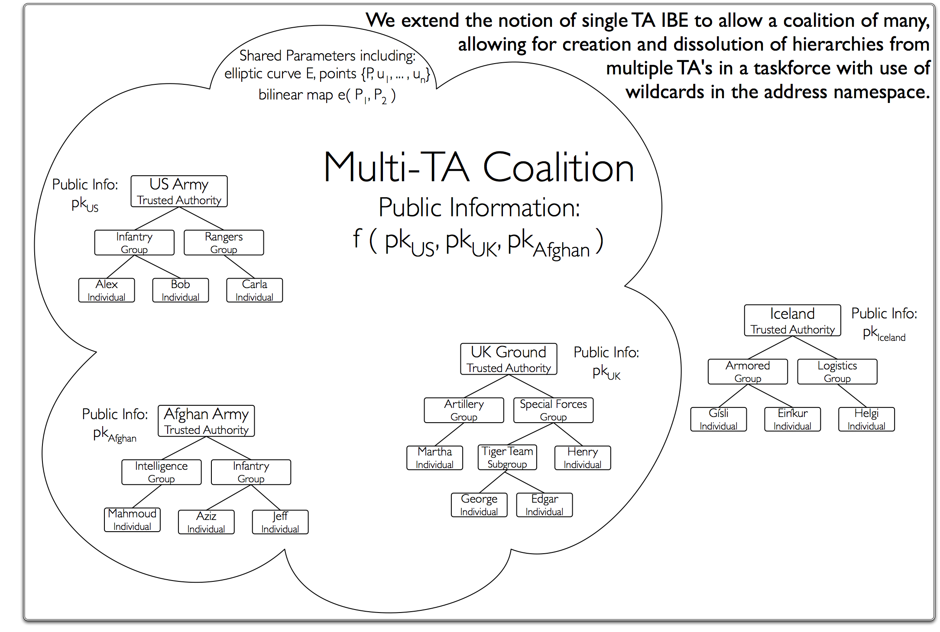
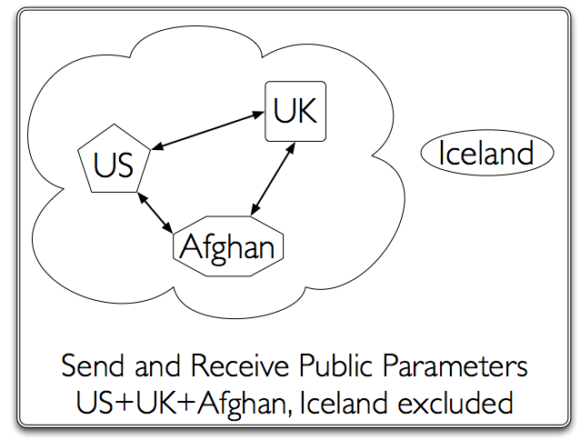

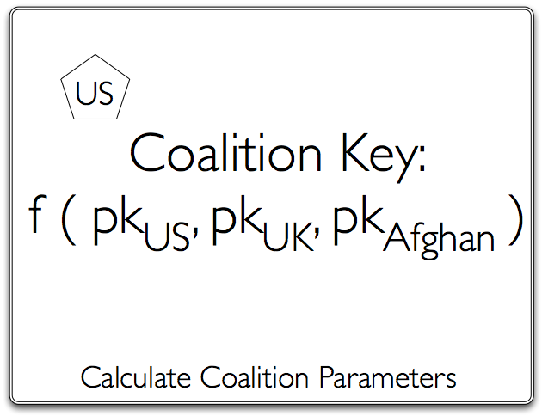
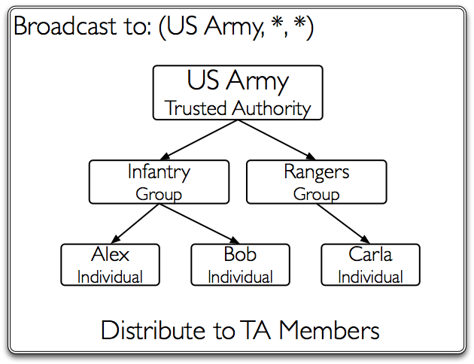
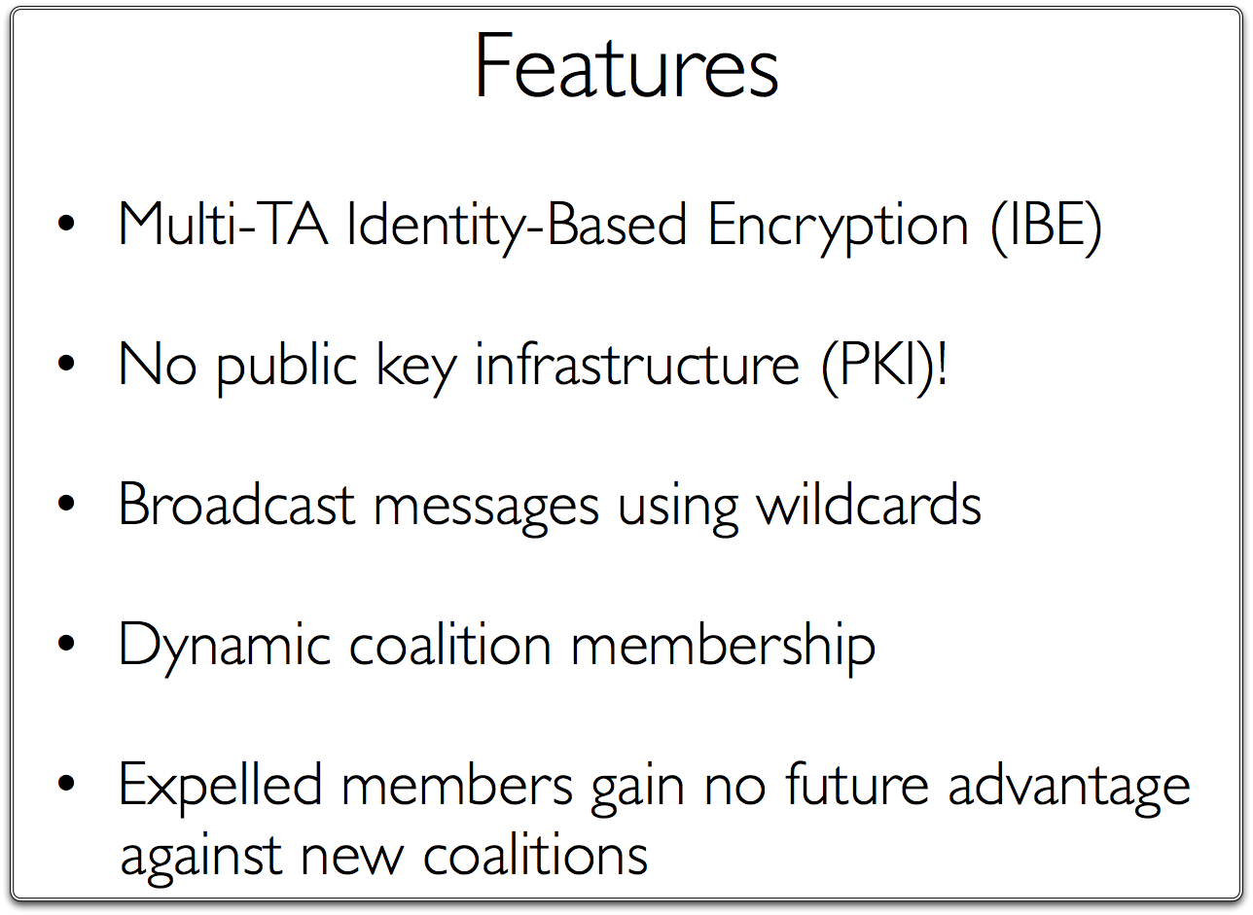
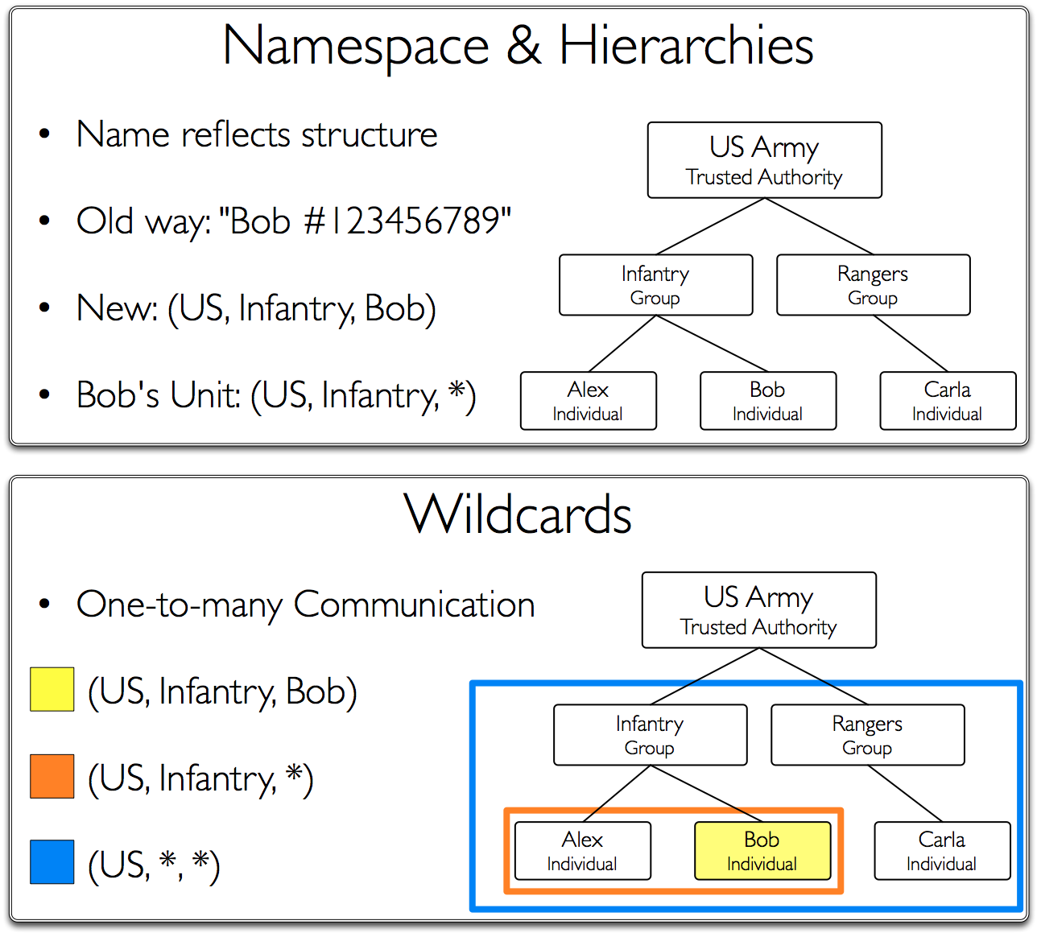
Annual Conference of ITA
ACITA 2009
Broadcast Encryption with Multiple Trust Centers and Dynamic Coalitions
Christopher A. Seaman
Graduate Center
City University of New York
Kent D. Boklan
Queens College
City University of New York
Alex W. Dent
Royal Holloway
University of London

