Slide 1
Unit-3
Identifying use cases
Object Analysis
Classification
Identifying Object relationships
Attributes and Methods.

Slide 2
Agenda
Identifying Use Cases
Object Analysis: Classification
Identifying object relationships, Attributes and Methods.

Slide 3
1.Object oriented analysis Process: Identifying Use cases

Slide 4

Identifying the use cases: Goals
The use-case approach to object-oriented analysis and the object-oriented analysis process.
Identifying actors.
Identifying use cases.
Documentation.

Slide 5
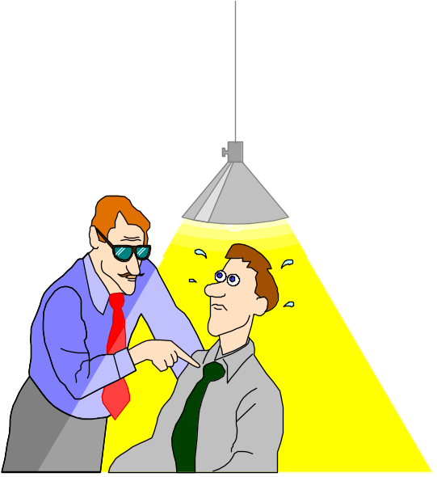
What Is Analysis?
Analysis is the process of transforming a problem definition from a fuzzy set of facts and myths into a coherent statement of a system’s requirements.

Slide 6
Analysis
The main objective of the analysis is to capture:
  a complete, unambiguous, and consistent picture of the requirements of the system and
  what the system must do to satisfy the users' requirements and needs.

Slide 7
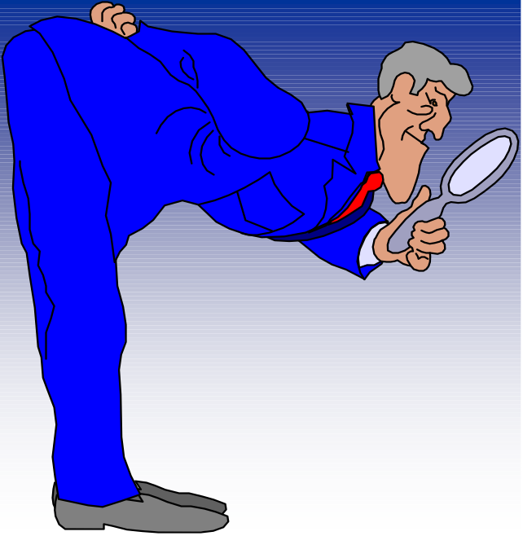
Where Should We Start?
1. Examination of existing system documentation.
2. Interviews.
3. Questionnaire.
4. Observation.

Slide 8

Requirements Difficulties
Three most common sources of requirements difficulties are:
1. Incomplete requirements.
2. Fuzzy descriptions (such as fast response).
3. Unneeded features.

Slide 9

The Object-Oriented Analysis (OOA) Process
The process consists of the following steps:
1. Identify the actors:
  Who is using the system?
  Or, in the case of a new system, who will be using system?

Slide 10
The OOA Process (Con’t)
2. Develop a simple business process model using UML activity diagram.

Slide 11
The OOA Process (Con’t)
3. Develop the use case:
  What the users are doing with the system?
  Or, in the case of a new system, what users will be doing with the system?
Use cases provide us with comprehensive
documentation of the system under study.

Slide 12
The OOA Process (Con’t)
4. Prepare interaction diagrams:
  Determine the sequence.
  Develop collaboration diagrams.

Slide 13
The OOA Process (Con’t)
5. Classification—develop a static UML class diagram:
  Identify classes.
  Identify relationships.
  Identify attributes.
  Identify methods.

Slide 14
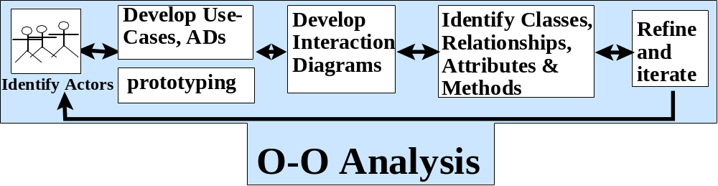
The OOA Process (Con’t)
6. Iterate and refine: If needed, repeat the preceding steps.

Slide 15
Developing Business Processes
Developing an activity diagram of the business processes can provide us with an overall view of the system.
Notes:
Business process modeling can be very time consuming, so the main idea should be to get a basic model without spending too much time on the process. The advantage of developing a business process model is that it makes you more familiar the system and therefore the user requirements and also aids in developing use cases.

Slide 16
Use Case Model
Use cases are scenarios for understanding system requirements.
The use-case model describes the uses of the system and shows the courses of events that can be performed.
Some Definitions
  User – Human Users + Other Systems
  Use Case – A piece of functionality
  Use-Case Model – All the use cases
  Use-Case Driven – Development process follows a flow

Slide 17
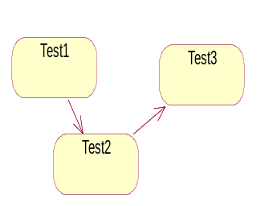
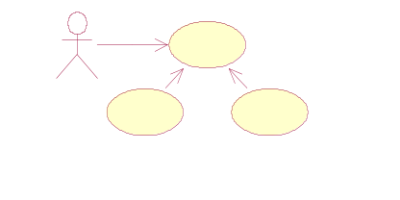
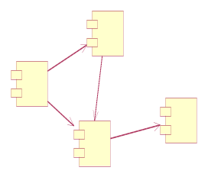
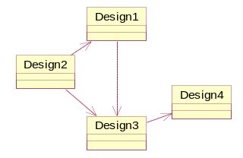
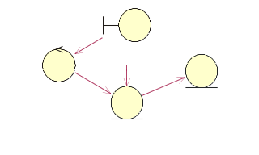
Use case Driven
Product development is Use case driven:
Capture the user’s needs (requirements - in users context)
- Helps in Project Scheduling
Analyse to specify the needs
Design to realize the needs
Implement to implement the needs
Test to verify the needs
Verified by
Implemented by
Realized by
Use cases
Test
Specified by
Implementation
Design
Analysis

Slide 18
Use Case Model (Con’t)
Use case defines what happens in the system when a use case is performed.
The use-case model tries to systematically identify uses of the system and therefore the system's responsibilities.

Slide 19
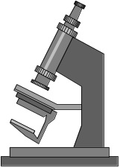

Use Cases Under the Microscope
"A Use Case is a sequence of transactions in a system whose task is to yield results of measurable value to an individual actor of the system."
What is a
Use Case
again?

Slide 20
Use Case Key Concepts
Use case. Use case is a special flow of events through the system.
Actors. An actor is a user playing a role with respect to the system.
In a system. This simply means that the actors communicate with the system's use case.
Notes:
Remember, when dealing with actors, it is important to think about roles rather than just people and their job titles.

Slide 21
Use Case Key Concepts (Con’t)
A measurable value. A use case must help the actor to perform a task that has some identifiable value.
Transaction. A transaction is an atomic set of activities that are performed either fully or not at all.

Slide 22
Use Associations
The use association occurs when you are describing your use cases and notice that some of them have common subflows.
The use association allows you to extract the common subflow and make it a use case of its own.
Notes:
A use-case description can be difficult to understand if it contains too many alternatives or exceptional flows of events that are performed only if certain conditions are met as the use-case instance is carried out. A way to simplify the description is to take advantage of extends and uses associations. The extends and uses associations often are sources of confusion, so let us take look at these relationships.

Slide 23
Extends Associations
The extends association is used when you have one use case that is similar to another use case but does a bit more or
Is more specialized; in essence, it is like a subclass.

Slide 24
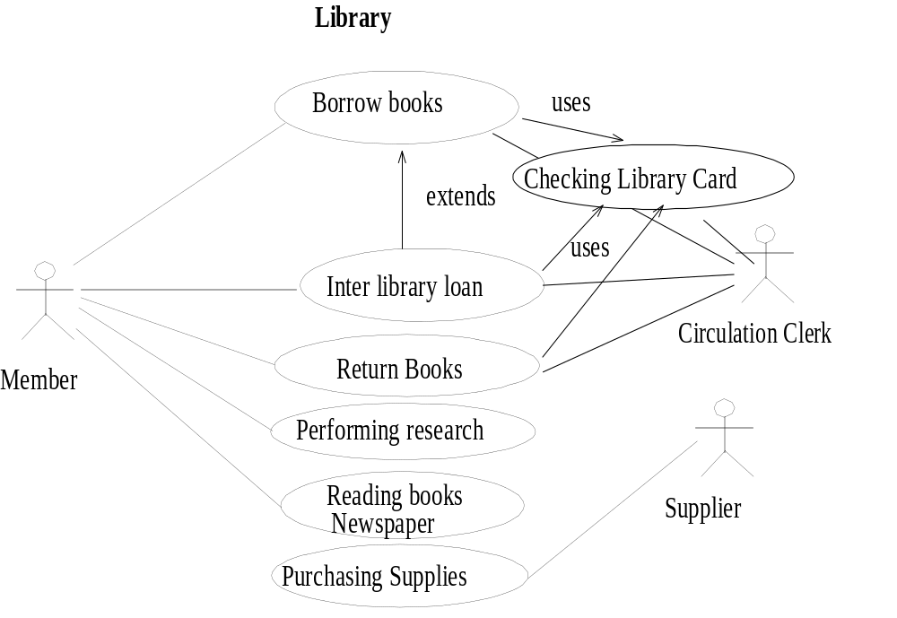
Notes:
The similarity between extends and uses associations is that both can be viewed as a kind of inheritance. When you want to share common sequences in several use cases utilize the uses association by extracting common sequences into a new, shared use case. The extends association is found when you add a bit more specialized, new use case that extends some of use cases that you have.

Slide 25
Fully Developed
Use Case Description
Use Case Name: | Checkout Movies
Scenario: | Checkout movies at counter
Triggering Event: | Customer brings movies to checkout counter
Brief Description: | When customer brings movies to counter, clerk checks membership ID, clerk scans in each movie identifier, takes payment, and notifies customer of return due date and time.
Actors: | Video clerk
Related Use Cases: | Add new member
Stakeholders: | Clerk, Store manager
Preconditions: | Movie titles must exist Movie copy must exist Customer must exist (or Add new member must be invoked)
Postconditions: | Video Rental and rental line items must be created Payment transaction must be created Status of movie copy must be updated Video Rental must be connected to customer family member

Slide 26
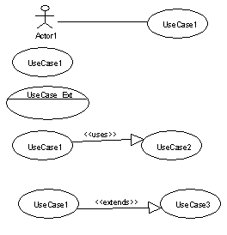
Use Case Diagram Notation
Actor
Association
Use Case
Use case with Extension points
<<Uses>>
<<Extends>>

Slide 27
Types of Use Cases
Use cases could be viewed as concrete or abstract.
An abstract use case is not complete and has no initiation actors but is used by a concrete use case, which does interact with actors.

Slide 28

Identifying the Actors
The term actor represents the role a user plays with respect to the system.
When dealing with actors, it is important to think about roles rather than people or job titles.
Notes:
A user may play more than one role. For instance, a member of a public library also may play the role of volunteer at the help desk in the library.

Slide 29
Identifying the Actors (Con’t)
Candidates for actors can be found through the answers to the following questions:
  Who is using the system? Or,
  Who is affected by the system? Or,
  Which groups need help from the system to perform a task?

Slide 30
Identifying the Actors (Con’t)
  Who affects the system? Or,
  Which user groups are needed by the system to perform its functions? These functions can be both main functions and secondary functions, such as administration.
  Which external hardware or other systems (if any) use the system to perform tasks?

Slide 31
Identifying the Actors (Con’t)
  What problems does this application solve (that is, for whom)?
  And, finally, how do users use the system (use case)? What are they doing with the system?

Slide 32
Guidelines for Finding Use Cases
For each actor, find the tasks and functions that the actor should be able to perform or that the system needs the actor to perform.
Name the use cases.
Describe the use cases briefly by applying terms with which the user is familiar.

Slide 33
Separate Actors From Users
Each use case should have only one main actor.
Isolate users from actors.
Isolate actors from other actors (separate the responsibilities of each actor).
Isolate use cases that have different initiating actors and slightly different behavior.

Slide 34

Documentation
An effective document can serve as a communication vehicle among the project's team members, or it can serve as initial understanding of the requirements.

Slide 35
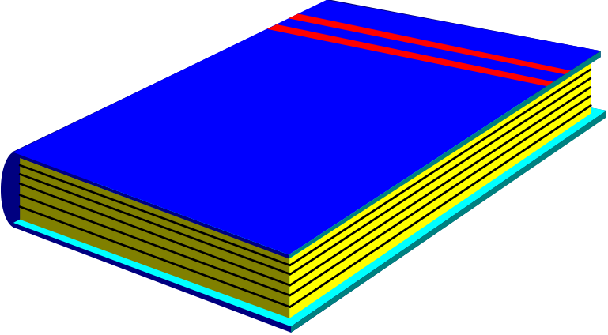
Effective Documentation: Common Cover
All documents should share a common cover sheet that identifies the document, the current version, and the individual responsible for the content.

Slide 36
80–20 Rule
80 percent of the work can be done with 20 percent of the documentation.
The trick is to make sure that the 20 percent is easily accessible and the rest (80 percent) is available to those (few) who need to know.
80%-20%

Slide 37

Familiar Vocabulary
Use a vocabulary that your readers understand and are comfortable with.
The main objective here is to communicate with readers and not impress them with buzz words.

Slide 38

Make the Document as Short as Possible
Eliminate all repetition;
Present summaries, reviews, organization chapters in less than three pages;
Make chapter headings task oriented so that the table of contents also could serve as an index.

Slide 39
Organize the Document
Use the rules of good organization (such as the organization's standards, college handbooks, Strunk and White's Elements of Style, or the University of Chicago Manual of Style) within each section.

Slide 40

Summary
The main objective of the analysis is to capture a complete, unambiguous, and consistent picture of the requirements of the system.
Construct several models and views of the system to describe what the system does rather than how.

Slide 41
Summary (Con’t)
Capturing use cases is one of the first things to do in coming up with requirements.
Every use case is a potential requirement.

Slide 42
Summary (Con’t)
The key in developing effective documentation is to eliminate all repetition; present summaries, reviews, organization chapters in less than three pages.
Use the 80–20 rule: 80 percent of the work can be done with 20 percent of the documentation.

Slide 43
Object Analysis: Classification

Slide 44
Introduction
OOA is a process by which we can identify classes that play a role in achieving system goals and requirements
Various Approaches for identifying the classes
Classification: is the process of checking to see if an object belongs to a category or a class, is regarded as a basic attribute of human nature.
Example: Classifying the car

Slide 45
What is an Object
  An object Is an unique, identifiable, self-contained entity that possesses operations and contains attributes
  • Possesses all the know-how and information it needs to perform the services for which it was designed
  Is a "black box" which receives and sends messages

Slide 46
What is a Class ?
A Class is a software template that defines the methods and variables to be included in a particular kind of Object.
Is a blue print used to create objects. As it is a blue print, at runtime it will not occupy any memory.
Examples :
    Animal, Human being, Automobiles

Slide 47
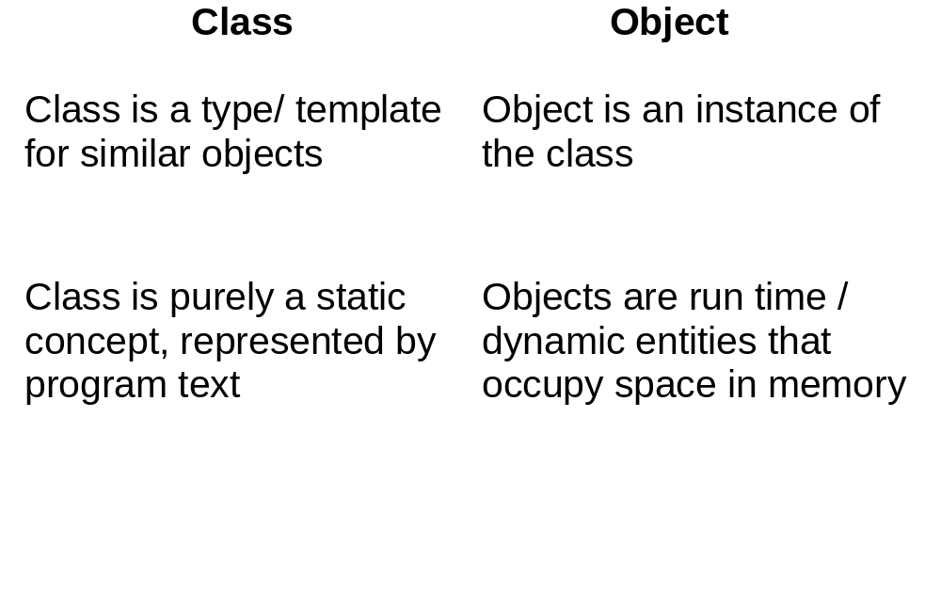
Classes VS. Objects

Slide 48
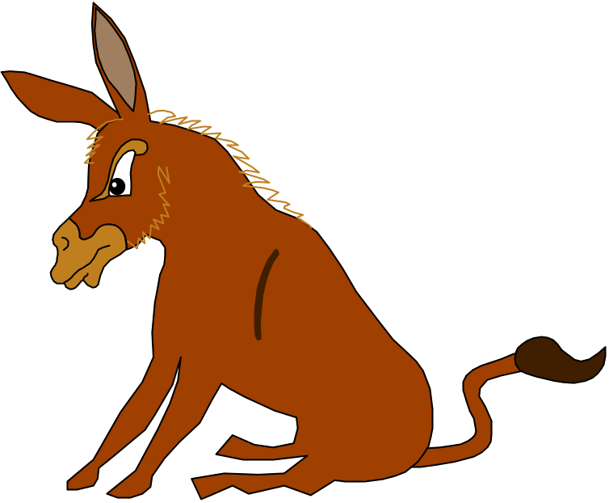
... Intelligent classification is intellectually hard work, and it best comes about through an incremental and iterative process
Booch

Slide 49

..There is no such thing as the perfect class structure, nor the right set of objects. As in any engineering discipline, our design choice is compromisingly shaped by many competing factors.
Booch

Slide 50

Point To Remember
Two Issues
A class is a specification of structure, behavior, and the description of an object.
Classification is more
concerned with identifying
classes than identifying the
individual objects ina system.

Slide 51
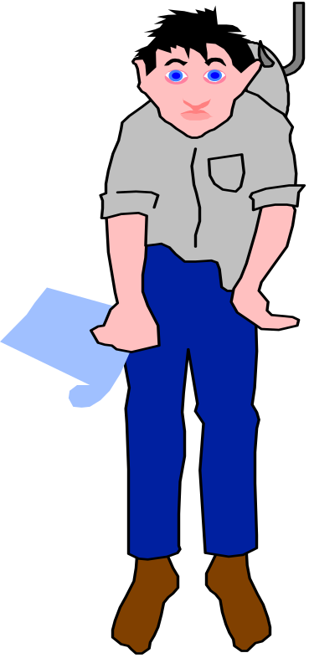
The Challenge of Classification
Intelligent classification is intellectually hard work and may seem rather arbitrary.
Martin and Odell have observed in object-oriented analysis and design, that
  “In fact, an object can be categorized in more than one way.”

Slide 52
Employer
Employee
Pet Owner
Good Credit Risk
Notes:
The same object, Betty, can be classified in many ways.

Slide 53
Approaches for Identifying Classes
The noun phrase approach.
The common class patterns approach.
The use-case driven approach.
The class responsibilities collaboration (CRC) approach.

Slide 54

Noun Phrase Approach
Using this method, you have to read through the Use cases, interviews, and requirements specification carefully, looking for noun phrases.

Slide 55
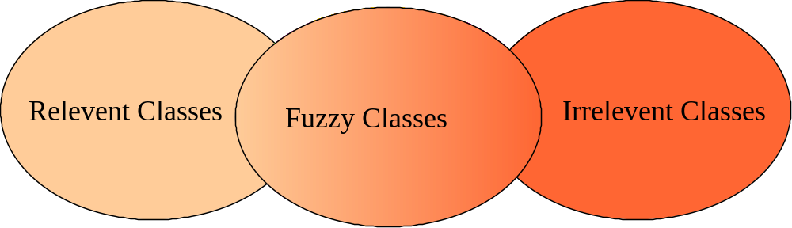
Noun Phrase Strategy (Con’t)
Change all plurals to singular and make a list, which can then be divided into three categories.

Slide 56
Noun Phrase Strategy (Con’t)
It is safe to scrap the Irrelevant Classes.
You must be able to formulate a statement of purpose for each candidate class; if not, simply eliminate it.
You must then select candidate classes from the other two categories.

Slide 57
Guidelines For Identifying Classes
The followings are guidelines for selecting classes in your application:
Look for nouns and noun phrases in the problem statement.
Some classes are implicit or taken from general knowledge.

Slide 58
Guidelines For Identifying Classes (Con’t)
All classes must make sense in the application domain.
Avoid computer implementation classes, defer it to the design stage.
Carefully choose and define class names.

Slide 59

Guidelines For Refining Classes
Redundant Classes:
Do not keep two classes that express the same information.
If more than one word is being
used to describe the same idea,
select the one that is the most meaningful in the context of the
system.

Slide 60

Guidelines For Refining Classes (Con’t)
Adjective Classes:
Does the object represented by the noun behave differently when the adjective is applied to it?

Slide 61
Guidelines For Refining Classes (Con’t)
If the use of the adjective signals that the behavior of the object is different, then make a new class.
For example, If Adult Membership and Youth Membership behave differently, than they should be classified as different classes.

Slide 62
Guidelines For Refining Classes (Con’t)
Attribute Classes:
Tentative objects which are used only as values should be defined or restated as attributes and not as a class.
For example the demographics of Membership are not classes but attributes of the Membership class.

Slide 63

Guidelines For Refining Classes (Con’t)
Irrelevant Classes:
Each class must have a purpose and every class should be clearly defined and necessary.
If you cannot come up with a statement of purpose, simply eliminate the candidate class.

Slide 64
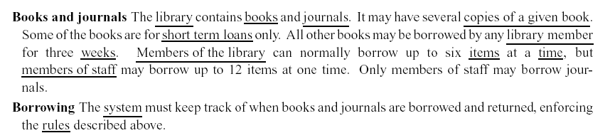
Identifying a list of candidate classes
Take a coherent, concise statement of the requirement of the system
Underline its noun and noun phrases, that is, identify the words and phases the denote things
This gives a list of candidate classes, which we can then whittle down and modify to get an initial class list for the system

Slide 65
In this particular case we discard
Library, because it is outside the scope of our system
Short term loan, because a loan is really an event, which so far as we know is not a useful object in this system
Member of the library, which is redundant
Week, because it is a measure, not a thing
Item, because it is vague (we need to clarify it)
Time, because it is outside the scope of the system
System, because it is part of the meta-language of requirements description, not a part of domain
Rule, for the same reason

Slide 66
This leaves:
Book
Journal
Copy (of book)
Library member
Member of staff

Slide 67
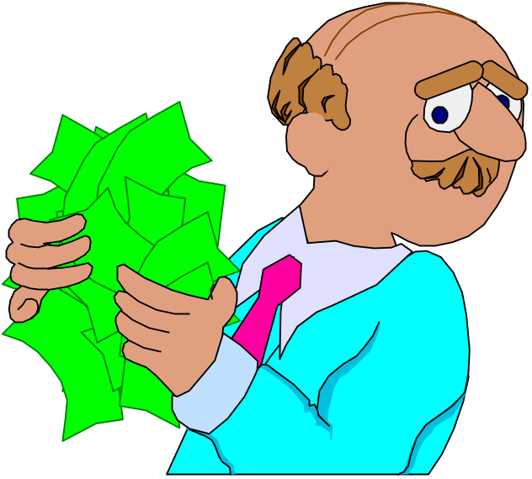
Common Class Patterns Approach
This approach is based on the knowledge-base of the common classes that have been proposed by various researchers.

Slide 68

Candidate Classes - Events
These are points in time that must be recorded and remembered.
Things happen, usually to something else, at a given date and time, or as a step in an ordered sequence.
For example order which is an event that must be remembered.

Slide 69

Candidate Classes - Organization
The organizational units that people belong to.
For example, accounting department might be considered as a potential class.

Slide 70

Candidate Classes - People and Person (Roles and Roles Played)
The different roles users play in interacting with the application.

Slide 71

Candidate Classes - People (Con’t)
It can be divided into two types (Coad & Yourdon):
Those representing users of the system, such as an operator, or a clerk;

Slide 72
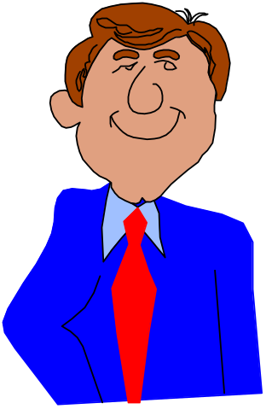
Candidate Classes - People (Con’t)
Those people who do not use the system but about whom information is kept.
  Some examples are Client, Employee, Teacher, Manager.

Slide 73

Candidate Classes - Places
These are physical locations, such as buildings, stores, sites or offices that the system must keep information about.

Slide 74
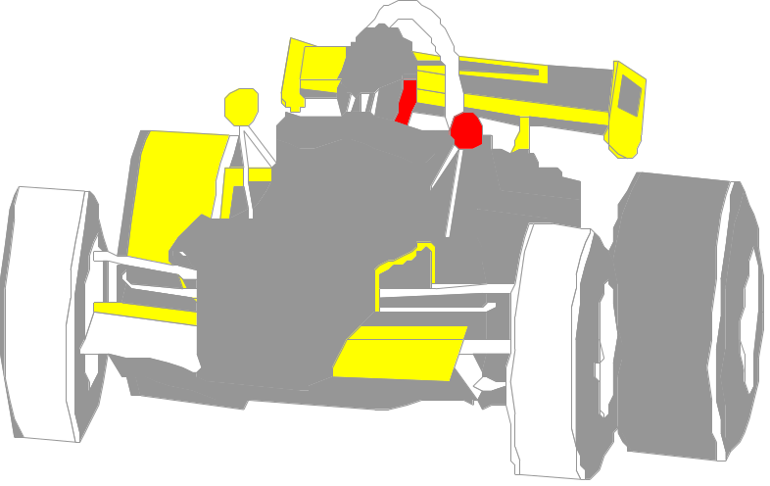
Candidate Classes - Tangible Things and Devices
Physical objects, or group of objects, that are tangible, and devices with which the application interacts.
For example, cars, pressure sensors.

Slide 75

Candidate Classes - Concepts
Concepts are principles or
ideas not tangible but used to
organize or keep track of
business activities and/or communications.

Slide 76
Use-case Driven Approach
Once the system has been described in terms of its scenarios, we can examine the textual description or steps of each scenario to determine what objects are needed for the scenario to occur.
Notes:
The third method to identify classes in a system is use-case driven approach .

Slide 77
Use-case Driven Approach
To identify objects of a system and their behaviors, the lowest level of executable use cases is further analyzed with a sequence and collaboration diagram pair.
By walking through the steps, you can determine what objects are necessary for the steps to take place.

Slide 78
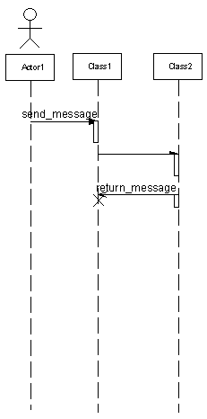
Sequence Diagram Notation
Actor
Class
Synchronous message
Asynchronous message
Focus of Control
Return message
Termination
lifeline

Slide 79
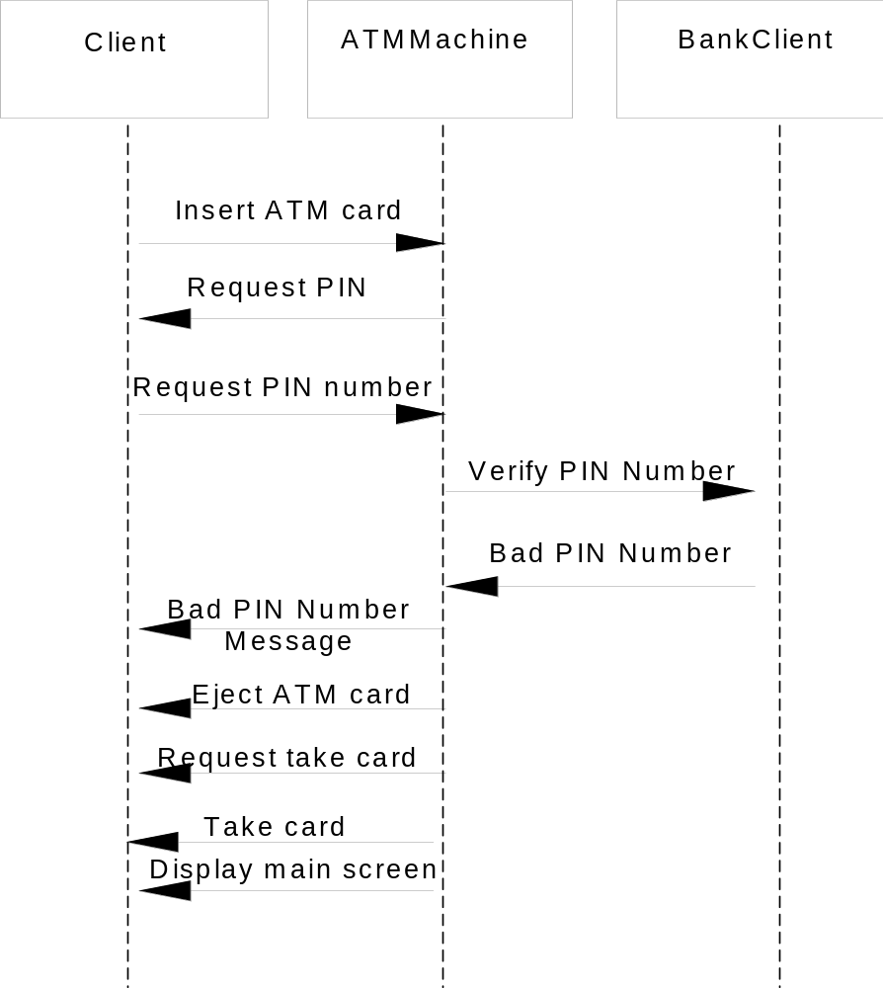
Notes:
The sequence diagram for the Invalid PIN use case.

Slide 80
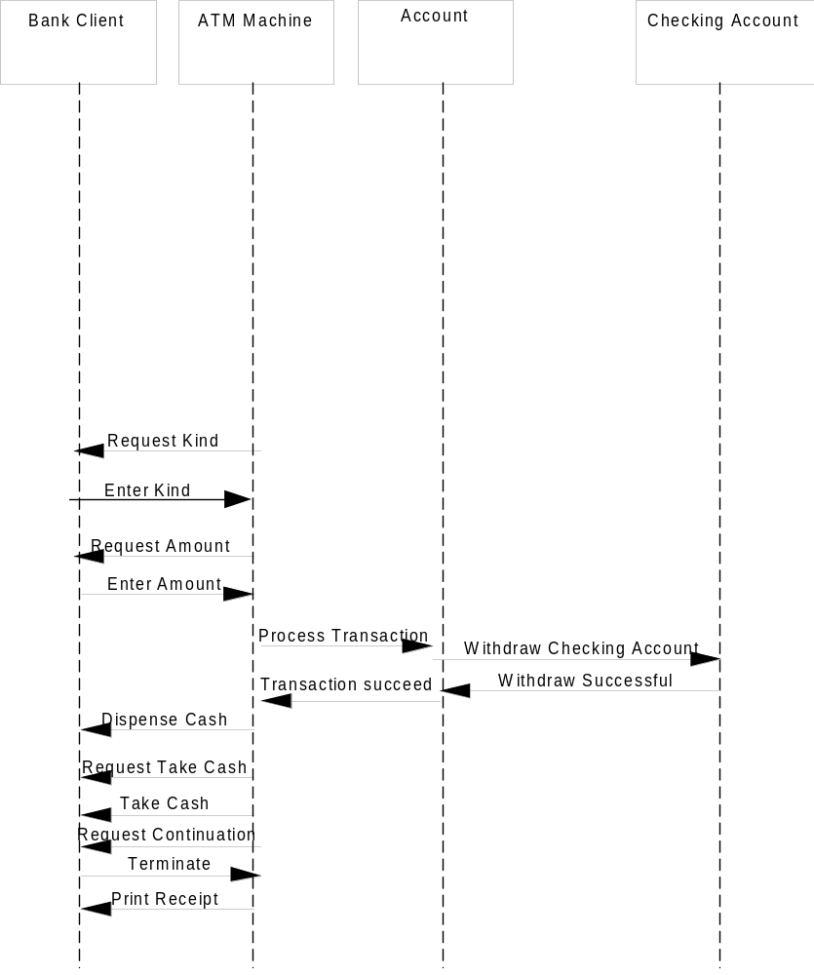
Notes:
Sequence diagram for the withdraw Checking use case.

Slide 81
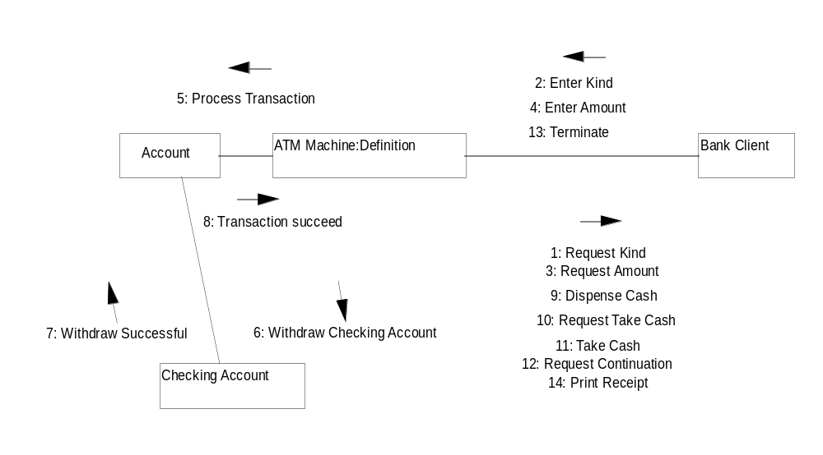
Notes:
The collaboration diagram for the withdraw checking use-case.

Slide 82
COLLABORATION DIAGRAM
A Collaboration is a name given to the interaction among two or more classes\objects.
Collaboration Diagram show
  objects and their links to each other, as well as
  how messages are sent between the linked objects.

Slide 83
COLLABORATION DIAGRAM CONT.,
Collaboration shows
  the implementation of an operation or
  the realization of a use case.
The focus here is on Message.(Hence numbered)
5o focus on message means that they focus on object roles instead of time, and therefore explicitly shown in the diagram.

Slide 84
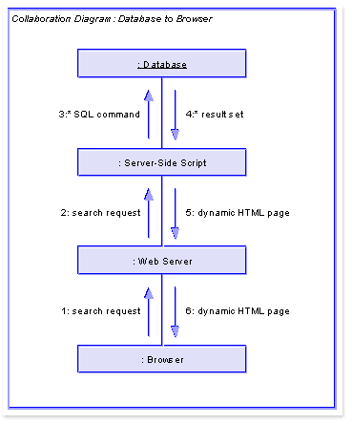
COLLABORATION DIAGRAM

Slide 85
COLLABORATION DIAGRAM - PURPOSE
Collaboration Diagrams are useful when we want to refer to a particular interaction.
To illustrate the coordination of object structure and flow of control.

Slide 86
COLLABORATION DIAGRAM VS SEQUENCE DIAGRAM
Both show the interaction between the objects\classes.
If time is the most important aspect to emphasize, choose sequence diagrams.
If the role is the most important aspect to emphasize, choose collaboration diagram

Slide 87

CRC Cards
CRC stands for Class, Responsibilities and Collaborators developed by Cunningham, Wilkerson and Beck.
CRC can be used for identifying classes and their responsibilities.

Slide 88
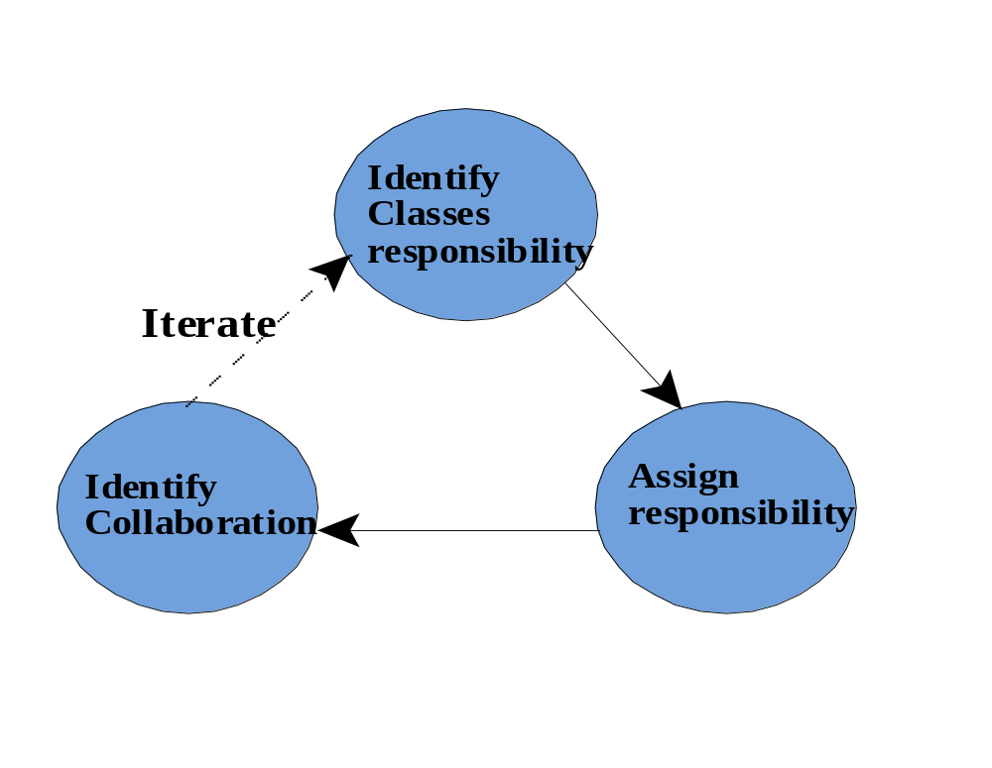
Process of the CRC Technique

Slide 89

Collaborations
An object can accomplish either a certain responsibility itself, or it may require the assistance of other objects.
If it requires an assistance of other objects, it must collaborate with those objects to fulfill its responsibility.

Slide 90
CRC Cards (Con’t)
CRC cards are 4" x 6" index cards. All the information for an object is written on a card.
...
ClassName
Collaborators
...
Responsibilities

Slide 91
CRC Cards (Con’t)
CRC starts with only one or two obvious cards.
If the situation calls for a responsibility not already covered by one of the objects:
  Add, or
  Create a new object to address that responsibility.

Slide 92
Guidelines for Naming Classes
The class should describe a single object, so it should be the singular form of noun.
Use names that the users are comfortable with.
The name of a class should reflect its intrinsic nature.

Slide 93
Guidelines for Naming Classes (Con’t)
By the convention, the class name must begin with an upper case letter.
For compound words, capitalize the first letter of each word - for example, LoanWindow.

Slide 94
Summary
Finding classes is not easy.
The more practice you have, the better you get at identifying classes.
There is no such thing as the “right set of classes.”
Finding classes is an incremental
and iterative process.

Slide 95
Summary (Con’t)
Unless you are starting with a lot of domain knowledge, you are probably missing more classes than you will eliminate.
Naming a class is also an important activity.
The class should describe a single object, so it should be a singular noun or an adjective and a noun.

Slide 96
Identifying Object Relationships, Attributes, and Methods

Slide 97
Goals
Analyzing relationships among classes.
Identifying association.
Association patterns.
Identifying super- and subclass hierarchies.

Slide 98
Introduction
Identifying aggregation or a-part-of compositions.
Class responsibilities.
Identifying attributes and methods by analyzing use cases and other UML diagrams.

Slide 99

Objects contribute to the behavior of the system by collaborating with one another.
—Grady Booch

Slide 100
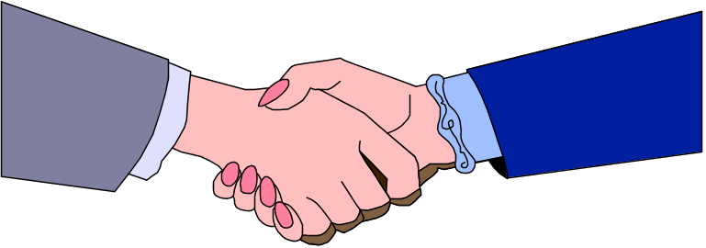
In OO environment, an application is the interactions and relationships among its domain objects.
All objects stand in relationship to others, on whom they rely for services and controls.

Slide 101

Objects Relationships
Three types of relationships among objects are:
  Association.
  Super-sub structure (also known as generalization hierarchy).
  Aggregation and a-part-of structure.

Slide 102

Associations
A reference from one class to another is an association.
Basically a dependency between two or more classes is an association.
For example, Jackie works for John.

Slide 103

Associations (Con’t)
Some associations are implicit or taken from general knowledge.

Slide 104
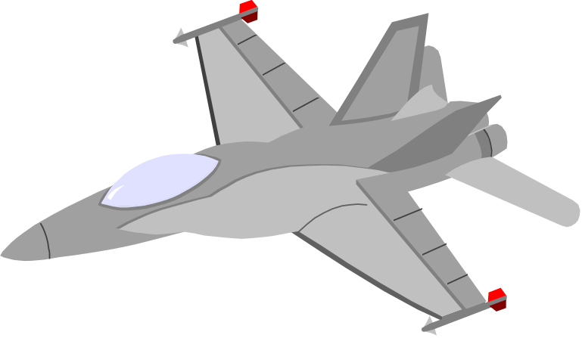
Guidelines For Identifying Associations
Association often appears as a verb in a problem statement and represents relationships between classes.
For example a pilot can fly planes.

Slide 105

Guidelines For Identifying Associations (Con’t)
Association often corresponds to verb or prepositional phrases such as part of, next to, works for, contained in, etc.

Slide 106
Common Association Patterns
Common association patterns include:
Location Association: next To, part of, contained in, ingredient of etc. :
For example cheddar cheese is an ingredient of the French soup.
Notes:
The common association patterns are based on some of the common associations defined by researchers and practitioners: Rumbaugh et al., Coad and Yourdon, and others.

Slide 107

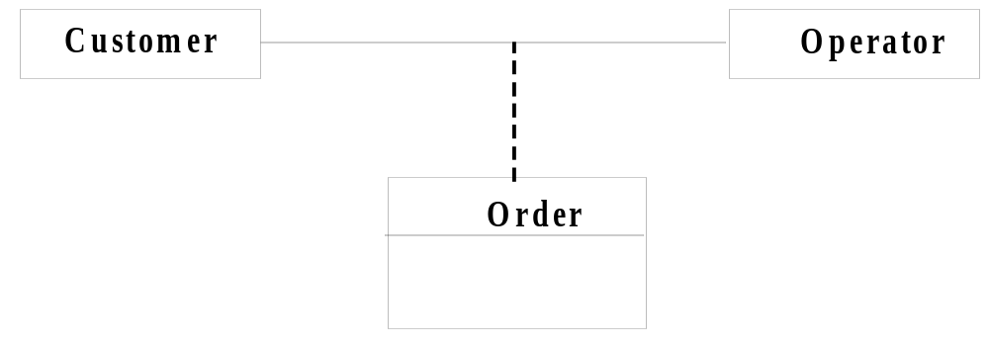
Common Association Patterns (Con’t)
Communication association—talk to, order to.
For example, a customer places an order with an operator person.

Slide 108
Eliminate Unnecessary Associations
Implementation association. Defer implementation-specific associations to the design phase.
Ternary associations. Ternary or n-ary association is an association among more than two classes

Slide 109
Eliminate Unnecessary Associations (Con’t)
Directed actions (derived) associations can be defined in terms of other associations.
Since they are redundant you should avoid these types of association.

Slide 110
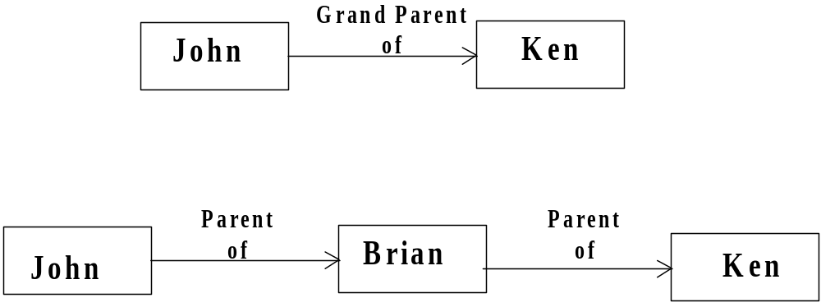
Eliminate Unnecessary Associations (Con’t)
Grandparent of Ken can be defined in terms of the parent association.

Slide 111

Superclass-Subclass Relationships
Recall that at the top of the class hierarchy is the most general class, and from it descend all other, more specialized classes.
Sub-classes are more specialized versions of their super-classes.

Slide 112
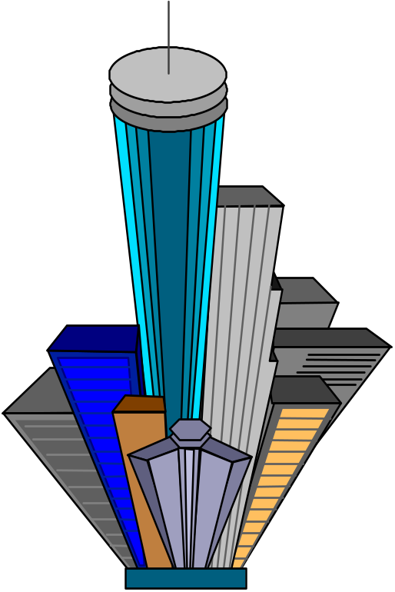
Guidelines For Identifying Super-sub Relationships: Top-down
Look for noun phrases composed of various adjectives on class name.
Example, Military Aircraft and Civilian Aircraft.
Only specialize when the sub
classes have significant behavior.

Slide 113

Guidelines For Identifying Super-sub Relationships: Bottom-up
Look for classes with similar attributes or methods.
Group them by moving the common attributes and methods to super class.
Do not force classes to fit a preconceived generalization structure.

Slide 114
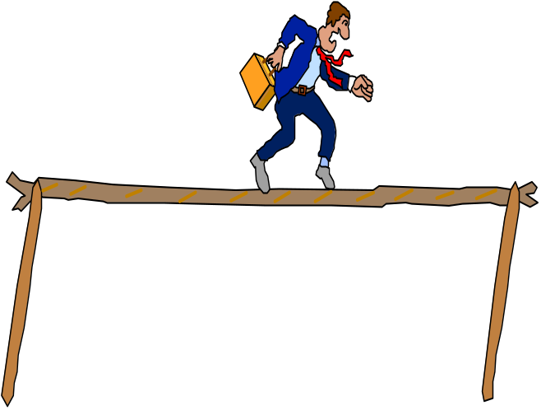
Guidelines For Identifying Super-sub Relationships: Reusability
Move attributes and methods as high as possible in the hierarchy.
At the same time do not create very specialized classes at the top of hierarchy.
This balancing act can be achieved through several iterations.

Slide 115

Guidelines For Identifying Super-sub Relationships:
Multiple inheritance
Avoid excessive use of multiple inheritance.
It is also more difficult to understand programs written in multiple inheritance system.

Slide 116
Multiple inheritance (Con’t)
One way to achieve the benefits of multiple inheritance is to inherit from the most appropriate class and add an object of other class as an attribute.
In essence, a multiple inheritance can be represented as an aggregation of a single inheritance and aggregation. This meta model reflects this situation.
Multiple Inheritance
Single Inheritance
Aggregation

Slide 117
A-Part-of Relationship - Aggregation
A-part-of relationship, also called aggregation, represents the situation where a class consists of several component classes.

Slide 118
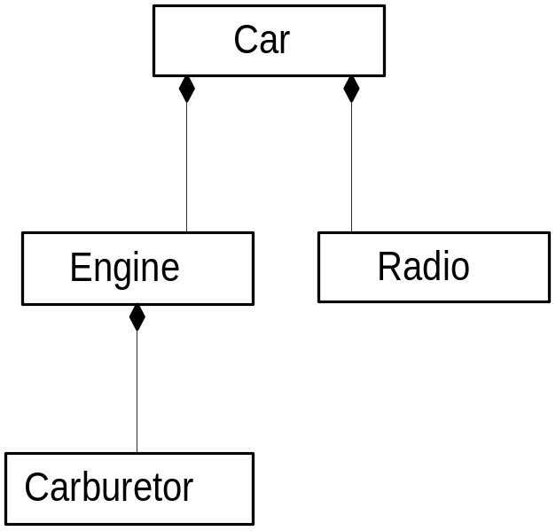
A-Part-of Relationship - Aggregation (Con’t)
This does not mean that the class behaves like its parts.
For example, a car consists of many other classes, one of them is a radio, but a car does not
behave like a radio.
Notes:
In Chapter 5, we saw that the UML uses hollow or filled diamonds to represent aggregations. A filled diamond signifies the strong form of aggregation, which is composition. For example, one might represent aggregation such as container and collection as hollow diamonds and use solid diamond to represent composition, which is a strong form of aggregation as in this example.

Slide 119
A-Part-of Relationship - Aggregation (Con’t)
Two major properties of a-part-of relationship are:
  transitivity
  antisymmetry

Slide 120
Transitivity
If A is part of B and B is part of C, then A is part of C.
For example, a carburetor is part of an engine and an engine is part of a car; therefore, a carburetor is part of a car.

Slide 121
Antisymmetry
If A is part of B, then B is not part of A.
For example, an engine is part of a car, but a car is not part of an engine.

Slide 122

Where responsibilities for certain behavior must reside?
Does the part class belong to problem domain?
Is the part class within the system's responsibilities?

Slide 123
where responsibilities ...(Con’t)
Does the part class capture more than a single value?
If it captures only a single value, then simply include it as an attribute with the whole class.
Does it provide a useful abstraction in dealing with the problem domain?

Slide 124

A-Part-of Relationship Patterns
Assembly
An assembly-Part situation physically exists.
For example, a French soup consists of onion, butter, flour, wine, French bread, cheddar cheese, etc.

Slide 125

A-Part-of Relationship Patterns
Container
A case such as course-teacher situation, where a course is considered as a container. Teachers are assigned to specific courses.

Slide 126
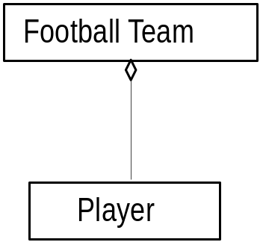

A-Part-of Relationship Patterns
Collection-Member
A soccer team is a collection of players.

Slide 127
Class Responsibility: Identifying Attributes and Methods
Identifying attributes and methods, like finding classes, is a difficult activity.
The use cases and other UML diagrams will be our guide for identifying attributes, methods, and relationships among classes.

Slide 128
Identifying Class Responsibility by Analyzing Use Cases and Other UML Diagrams
Attributes can be identified by analyzing the use cases, sequence/collaboration, activity, and state diagrams.

Slide 129
Responsibility
How am I going to be used?
How am I going to collaborate with other classes?
How am I described in the context of this system's responsibility?
What do I need to know?
What state information do I need to remember over time?
What states can I be in?
Notes:
Ask students to imagine themselves as objects in an object-oriented environment, what kind of questions would they like to ask?

Slide 130

Assign Each Responsibility To A Class
Assign each responsibility to the class that it logically belongs to.
This also aids us in determining the purpose and the role that each class plays in the application.

Slide 131

Object Responsibility: Attributes
Information that the system needs to remember.

Slide 132

Guidelines For Identifying Attributes Of Classes
Attributes usually correspond to nouns followed by possessive phrases such as cost of the soup.

Slide 133
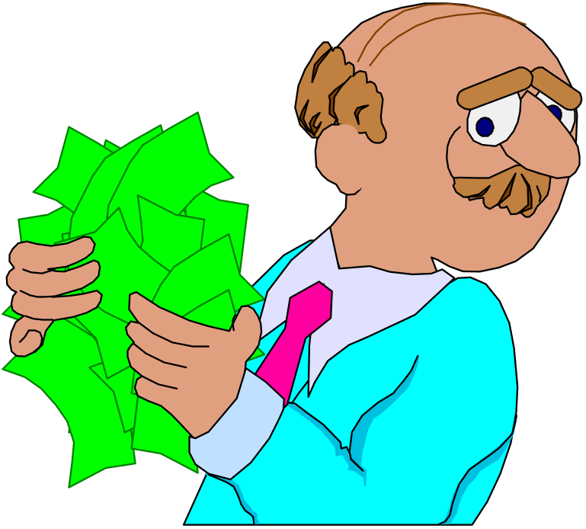
Guidelines For Identifying Attributes Of Classes (Con’t)
Keep the class simple; only state enough attributes to define the object state.

Slide 134
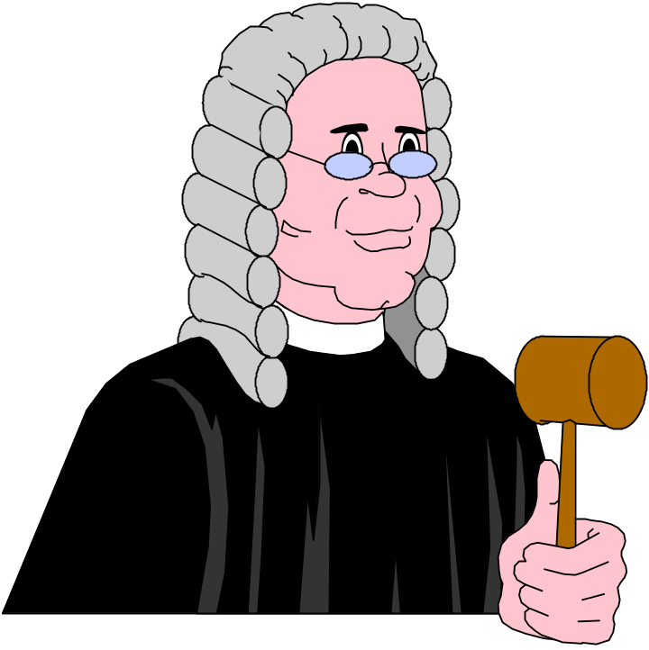
Guidelines For Identifying Attributes Of Classes (Con’t)
Attributes are less likely to be fully described in the problem statement.
You must draw on your
knowledge of the application
domain and the real
world to find them.

Slide 135
Guidelines For Identifying Attributes Of Classes (Con’t)
Omit derived attributes.
For example, don't use age as an attribute since it can be derived from date of birth.
Drive attributes should be expressed as a method.

Slide 136

Guidelines For Identifying Attributes Of Classes (Con’t)
Do not carry discovery of attributes to excess.
You can always add more attributes in the subsequent iterations.

Slide 137

Object Responsibility: Methods & Messages
Methods and messages are the work horses of object-oriented systems.
In O-O environment, every
piece of data, or object,
is surrounded by a rich set
of routines called methods.

Slide 138
Identifying Methods by Analyzing UML Diagrams and Use Cases
Sequence diagrams can assist us in defining the services the objects must provide.

Slide 139
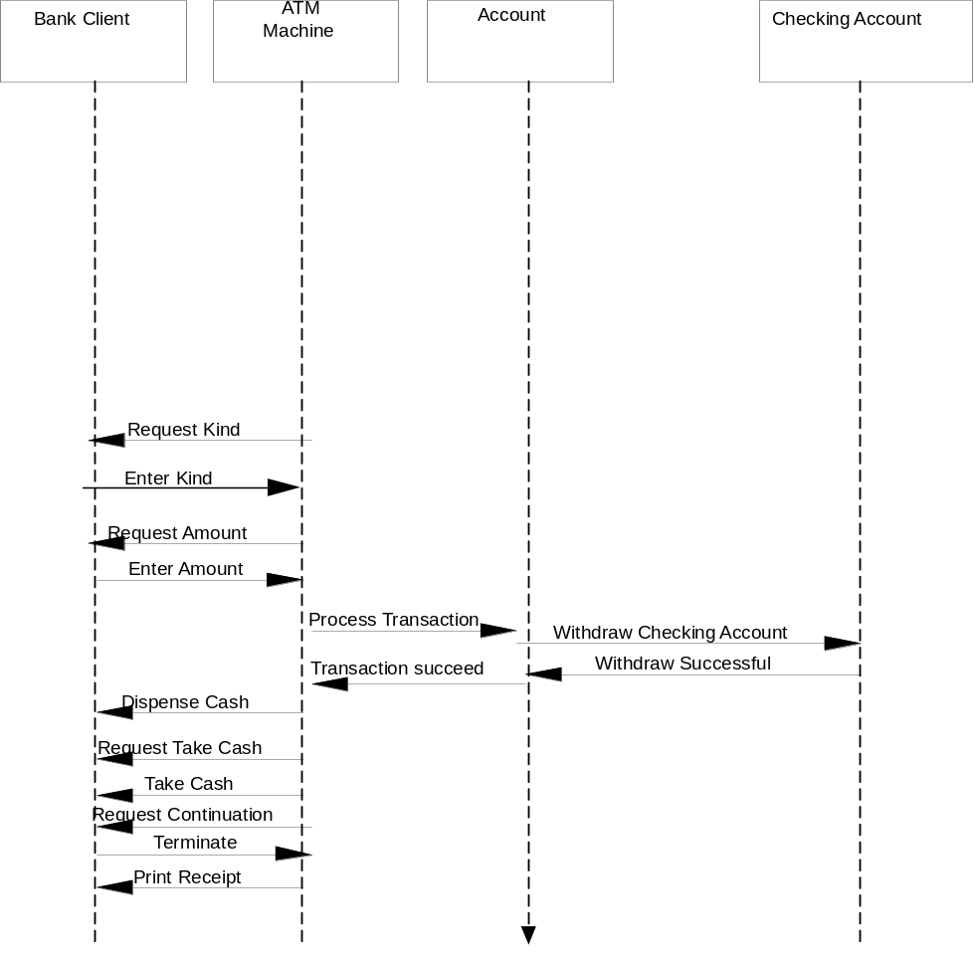
Identifying Methods (Con’t)
Notes:
For example, by studying the sequence diagram for Withdraw Checking, it is clear that the Account class (which is the superclass of CheckingAccount and SavingsAccount) must provide a service such as withdrawal.

Slide 140
Identifying Methods (Con’t)
Methods usually correspond to queries about attributes (and sometimes association) of the objects.
Methods are responsible for managing the value of attributes such as query, updating, reading and writing.

Slide 141

Identifying Methods (Con’t)
For example, we need to ask the following questions about soup class:
What services must a soup class provide? And
What information (from domain knowledge) is soup class responsible for storing?

Slide 142
Identifying Methods (Con’t)
Let's first take a look at its attributes which are:
name
preparation,
price,
preparation time and
oven temperature.

Slide 143
Identifying Methods (Con’t)
Now we need to add methods that can maintain these attributes.
For example, we need a method to change a price of a soup and another operation to query about the price.

Slide 144
Identifying Methods (Con’t)
setName
getName
setPreparation
get Preparation
setCost
getCost
setOvenTemperature
getOvenTemperature
setPreparationTime
getPreparationTime

Slide 145
Summary
We learned how to identify three types of object relationships:
Association
Super-sub Structure (Generalization Hierarchy)
A-part-of Structure

Slide 146
Summary (Con’t)
The hierarchical relation allows the sharing of properties or inheritance.
A reference from one class to another is an association.
The A-Part-of Structure is a special form of association.

Slide 147
Summary (Con’t)
Every class is responsible for storing certain information from domain knowledge .
Every class is responsible for performing operations necessary upon that information.

