Slide 1
Title: Flood Monitoring System
Song Wang Ye (71680)
Ho Wan Yu (69860)
Christopher Sii How Chiong (69385)

Slide 2
Description to this title
Flood is a well-known significant natural disaster that causes significant damage to the environment and to living things.
In these circumstances, it is of extreme significance to get emergency notifications regarding the water level situation at riverbeds.
The purpose of this project is to measure the water levels in riverbeds and determine whether or not they are normal.
If they exceed the threshold, LED indicators and an online application are used to notify the users.
Here, an ultrasonic sensor is used to detect river levels, and a NodeMCU ESP8266 is used to analyse the data.
The data will be transferred to the Arduino IoT cloud, allowing graphic monitoring of river levels from anywhere in the world.

Slide 3
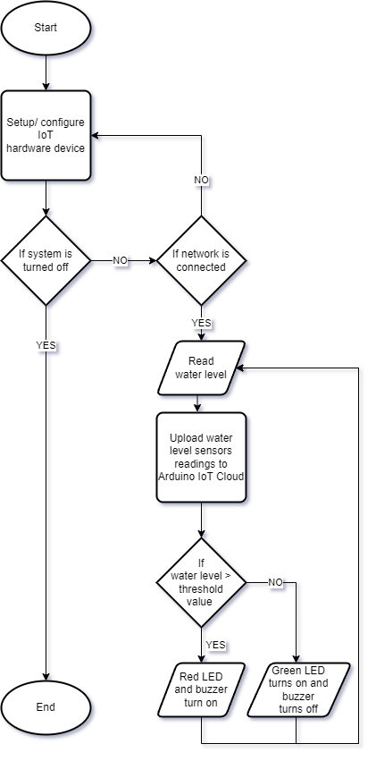
Flowchart

Slide 4
Hardware | Description
ESP8266 NodeMCU | Used to connect sensors and let sensor’s data transfer using the Wi-Fi protocol.
Ultrasonic Sensor (HC-SR04) | Used to measure the water level then transmits the data to the NodeMCU.
LEDs (Red & Green) | Act as indicator. Red LED is used to signal critical flood conditions, while a green LED indicates normal condition.
Breadboard | Used for creating electrical connections between sensor components and ESP8266 NodeMCU microcontroller
Jumpers | Used to pass power and data utilising GPIO ports by connecting devices on the breadboard.
Buzzer | Play the sound as alert when there is a critical flood condition.

Slide 5
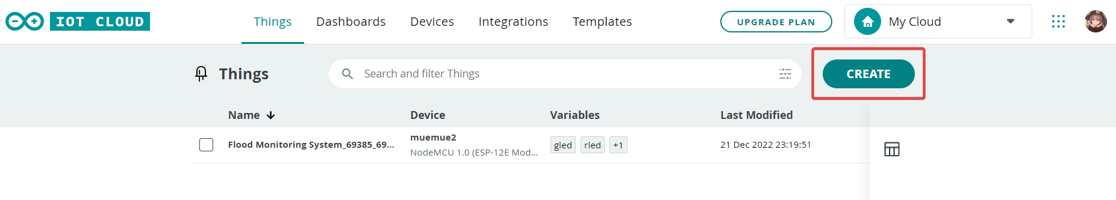
Steps to create the sketch:
Step 1) Click on the create button in IOT Cloud.

Slide 6
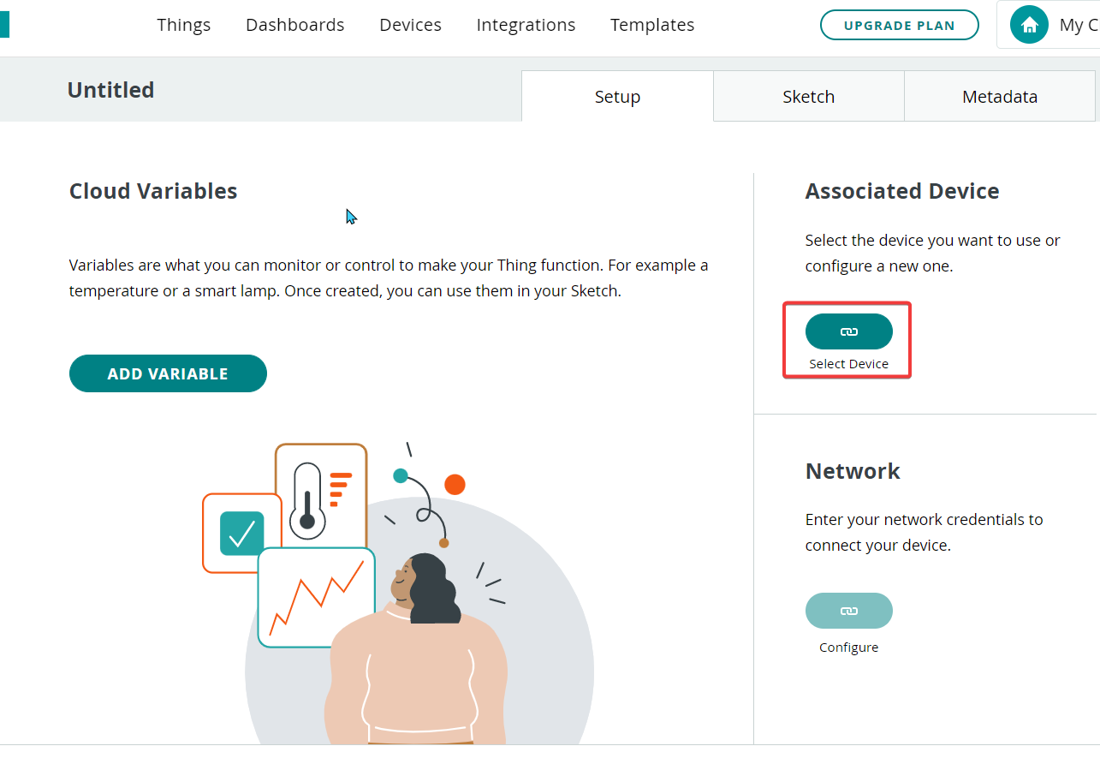
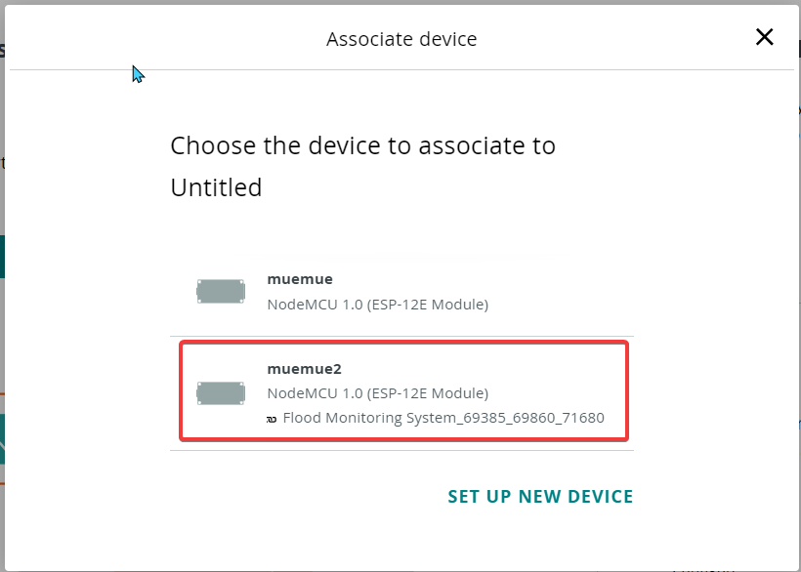
Step 2) Select device, need to create new device if no device available.

Slide 7
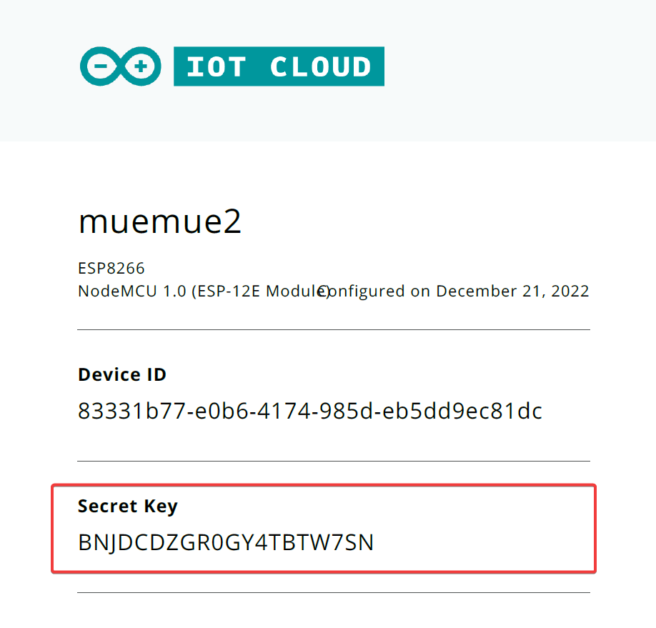
Step 3) Copy the device’s Secret Key.

Slide 8
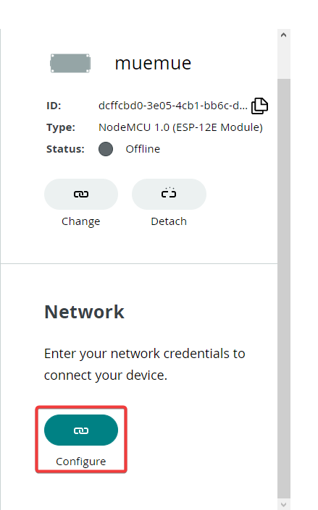
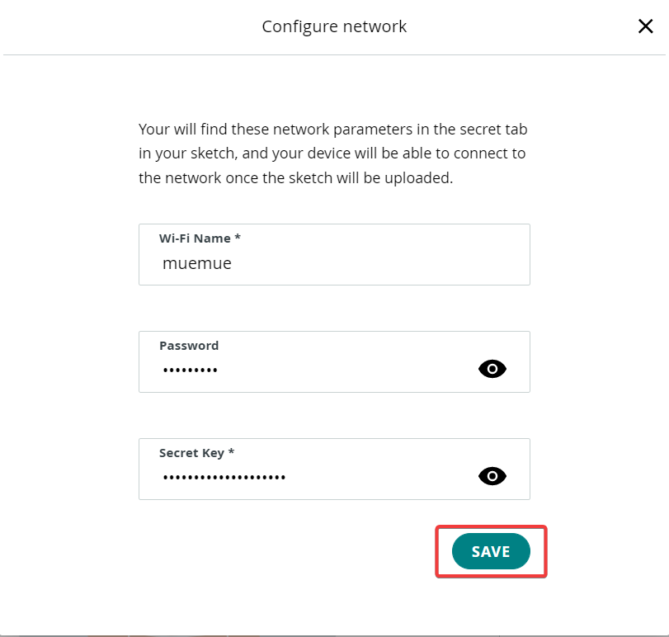
Step 4) Configure network, write wifi’s name and password, paste the device’s secret key.

Slide 9
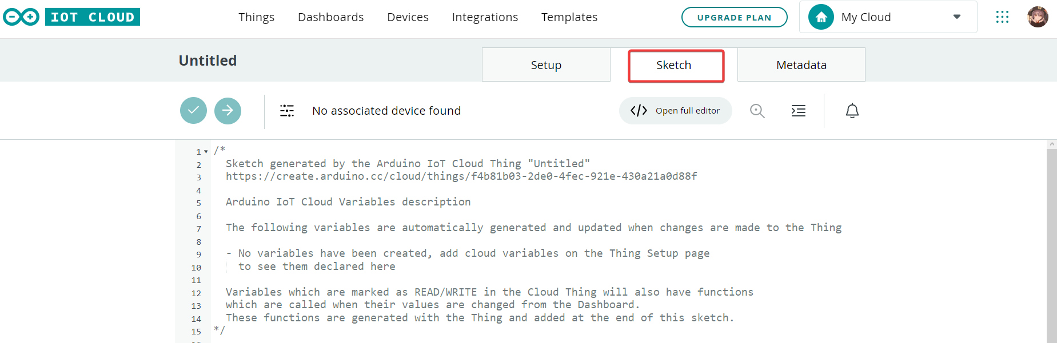
Step 5) Switch to the sketch tab, write the code.

Slide 10
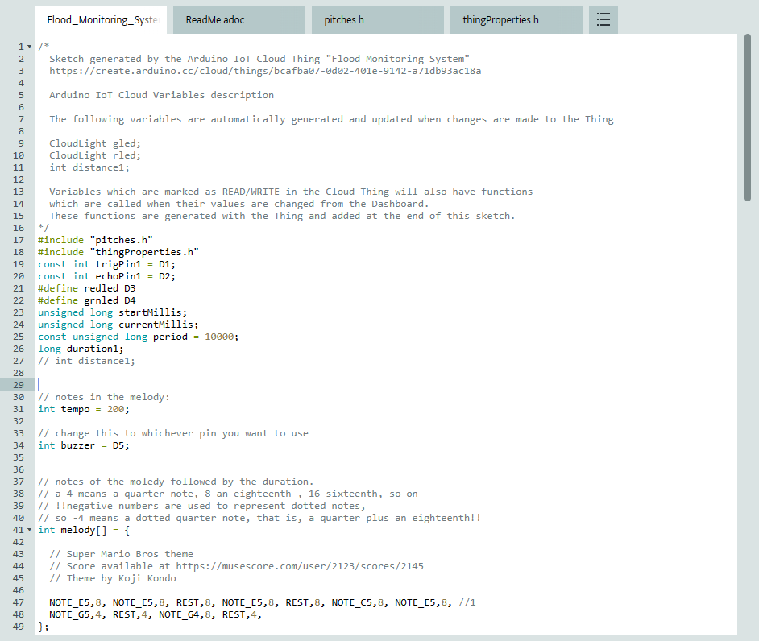
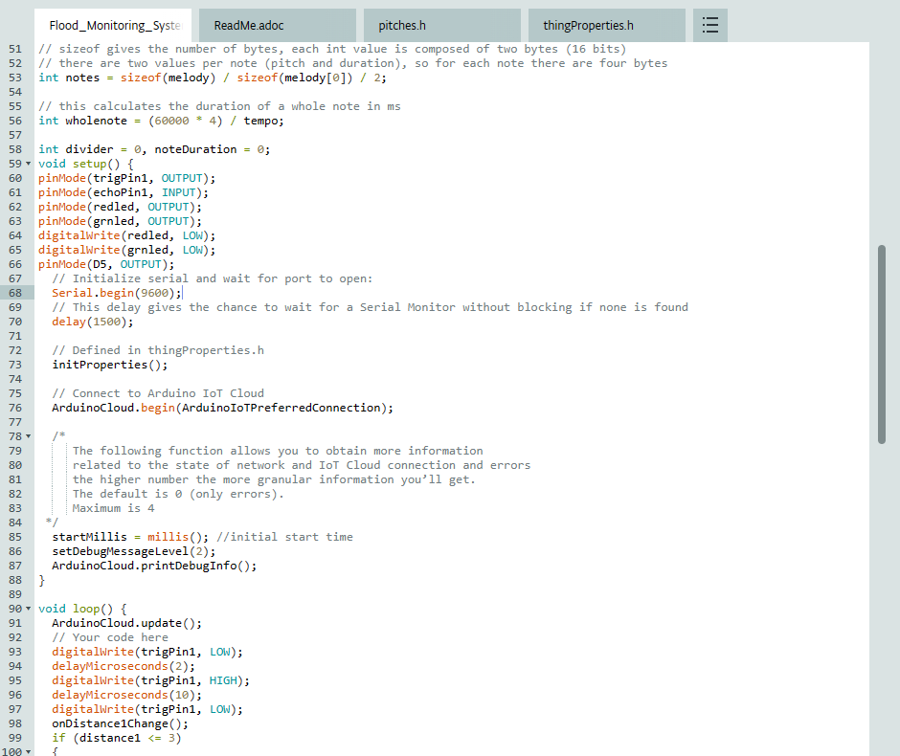
Coding- Flood_Monitoring.ino

Slide 11
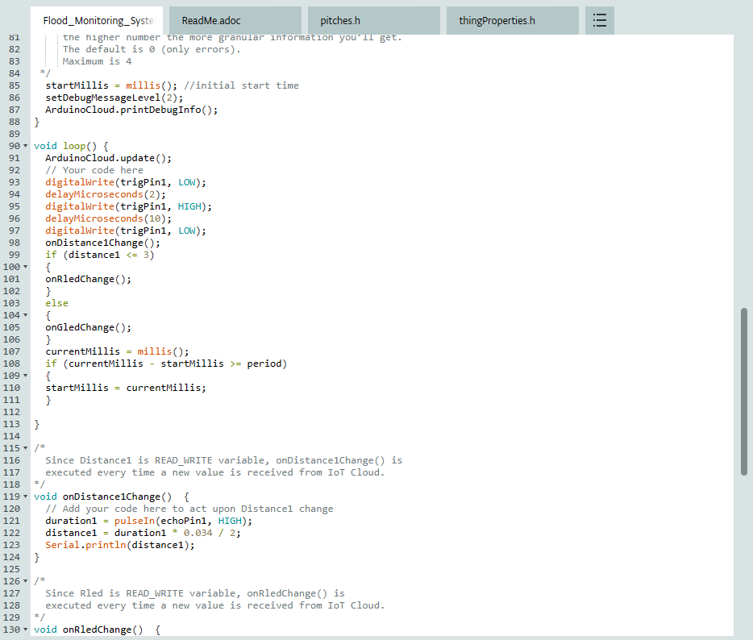
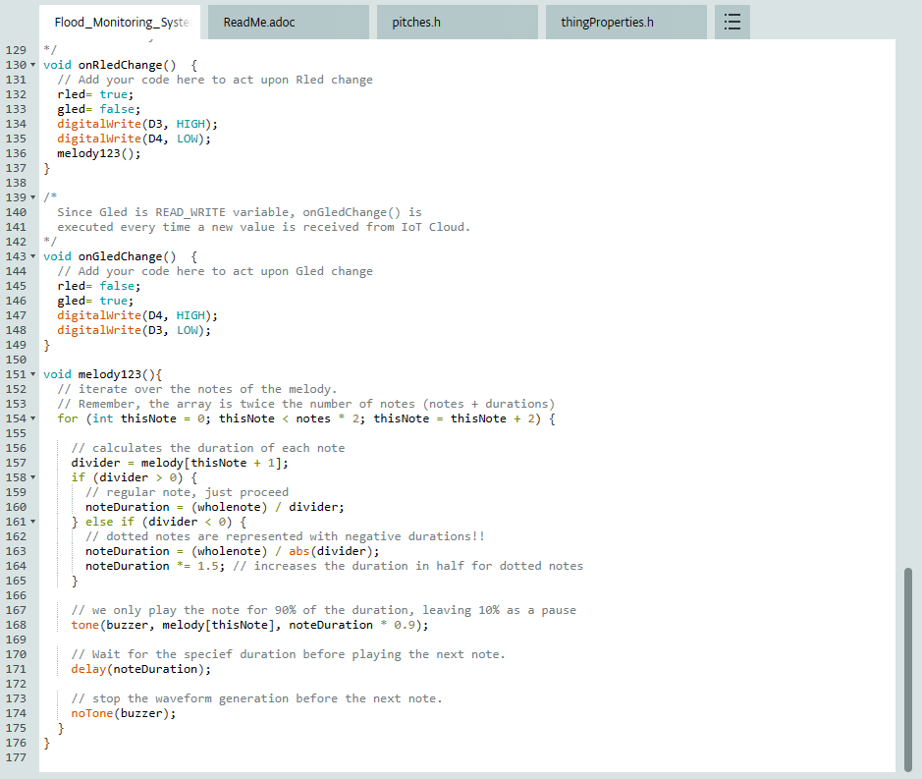
Coding- Flood_Monitoring.ino part2

Slide 12
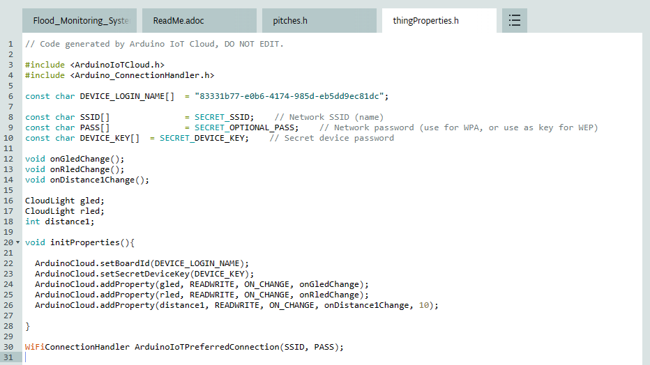
Coding- thingProperties.h

Slide 13
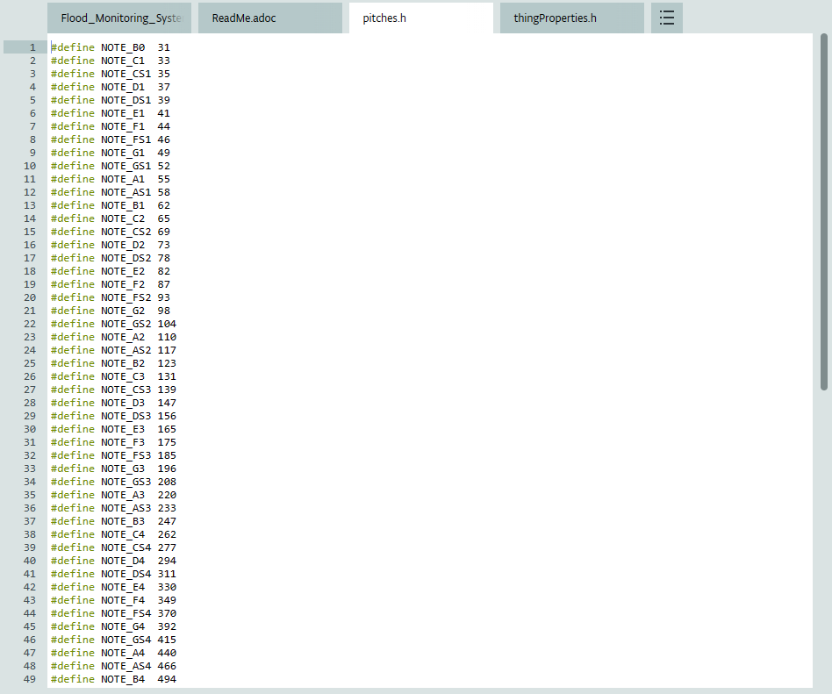
Coding- pitches.h

Slide 14
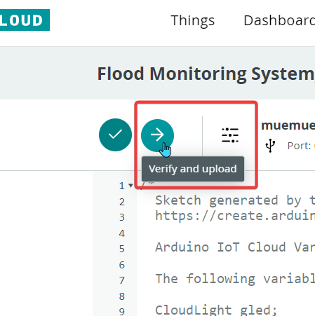
Step 6) Save and upload the sketch and connect to the device.

Slide 15
What has been modified and added
The subsequent lists contain additional and revised functionality:
Add a melody function for the buzzer to alert when there is a critical flood condition.
Add libraries and functions for connection to mobile Arduino IoT Cloud.
Change threshold distance value.

Slide 16
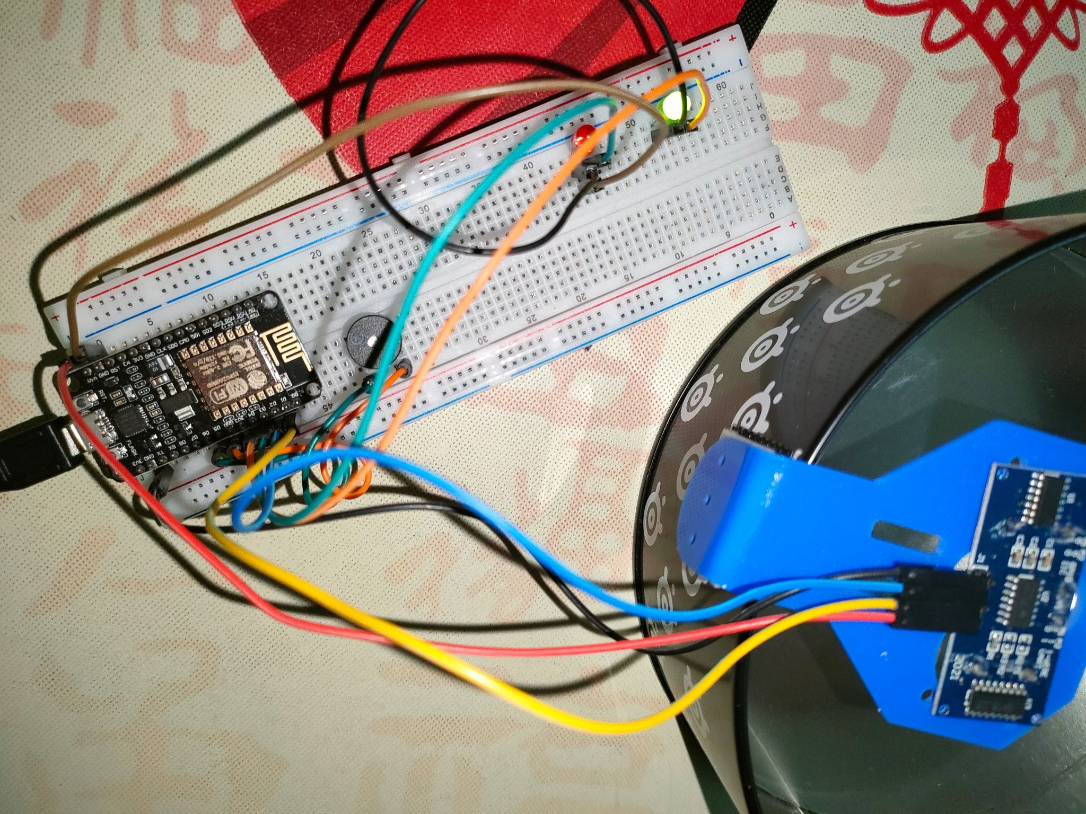

Slide 17
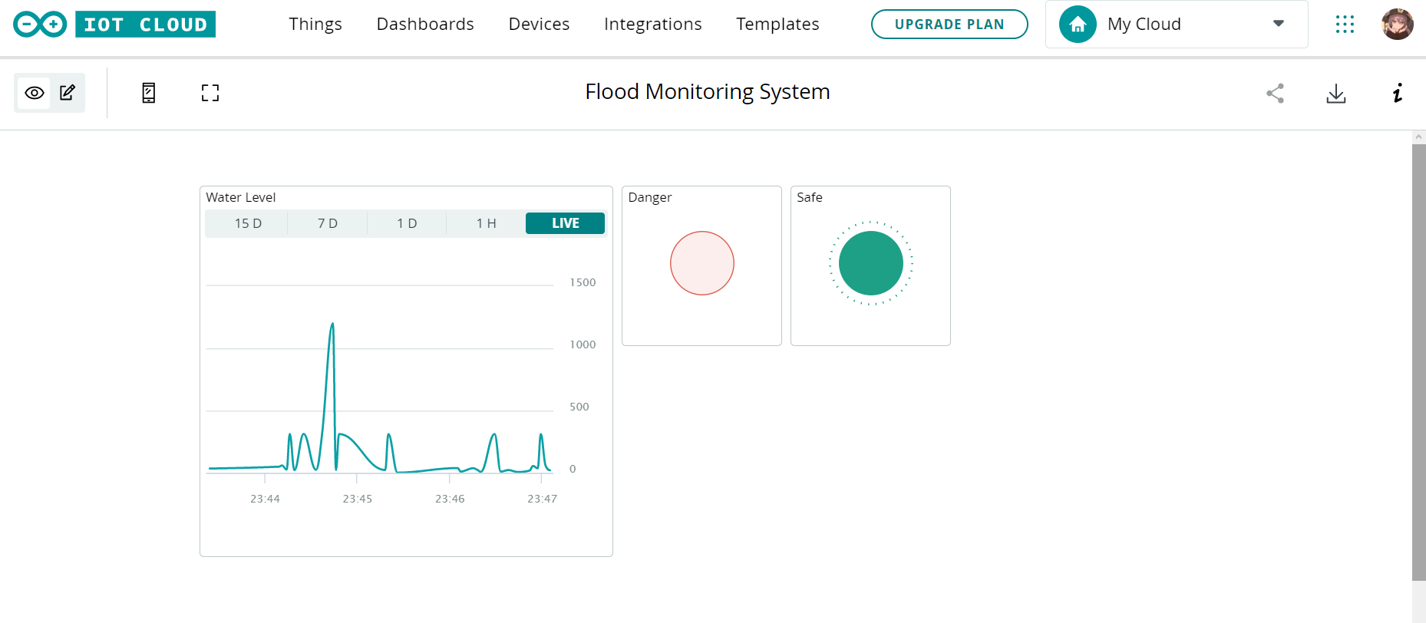
Web Arduino IOT Cloud

Slide 18
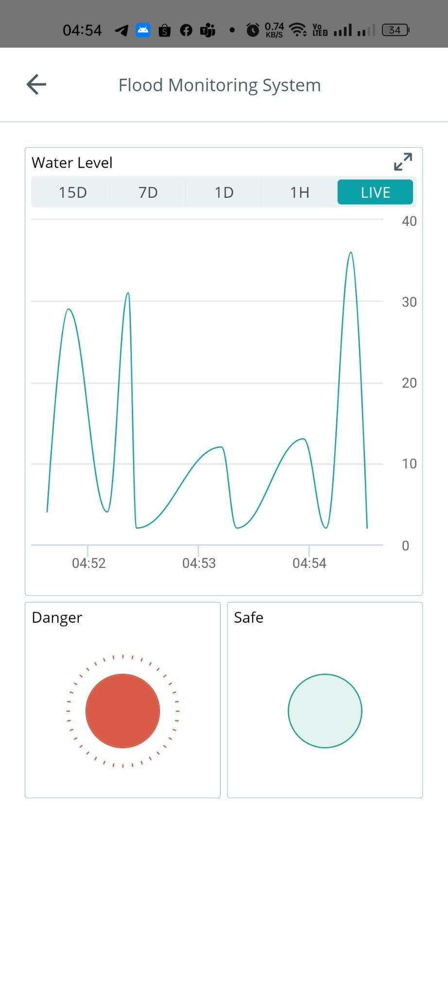
Mobile Arduino IOT Cloud

Slide 19

Thank You

