Slide 1
Data Science Workshop Week 1

Slide 2
Timeline
TB1 | Python Fundamentals
TB2 | Data Science Workshop

Slide 3
What you learned so far
Variables, Data types
Arithmetic, Comparisons
Loops, Conditionals
Lists, Dictionaries
Functions, Exceptions, File I/O

Slide 4
Teaching Structure
Every session is 2 hours on Wednesdays
4 Topics per session, 25 mins each
10 min break between topics 2 and 3
Each topic = approx 10 min guide + 15 min practice

Slide 5
Topic 1
Topic 3
Introduction to Pandas
Data Manipulating
Topic 2
Topic 4
Data Querying
Working with multiple tables

Slide 6
What is Pandas and why should we learn it?
Pandas is a module
Lets us represent data in terms of series and dataframes, which are similar to excel tables
Provides functions to query and manipulate these structures
Compatible to modern ML frameworks in Python (scikit-learn, tensorflow, etc)

Slide 7
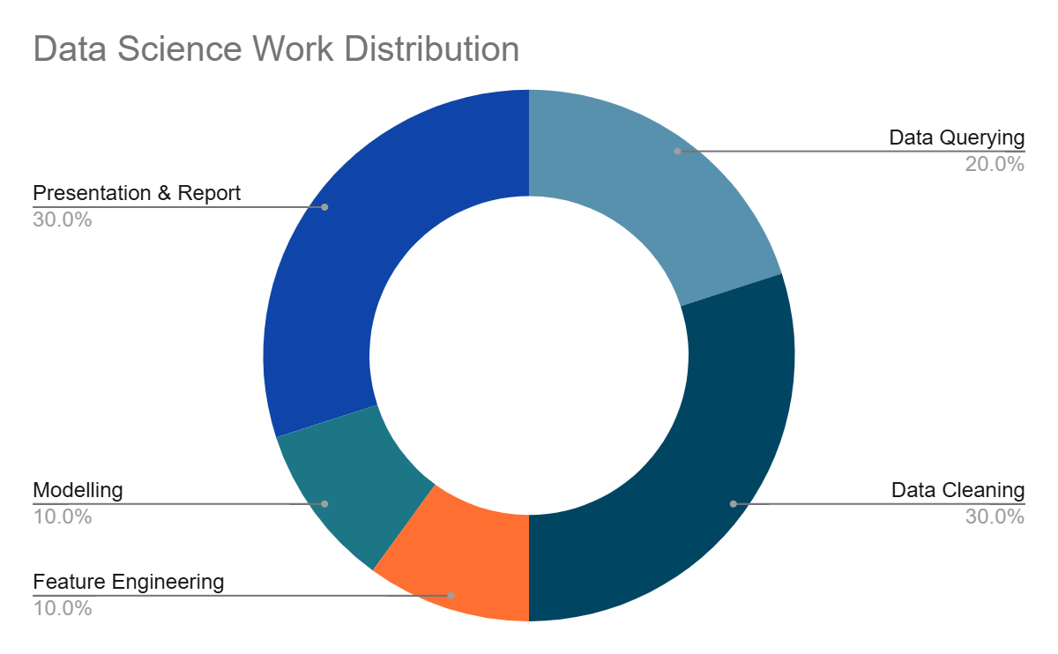
What is Pandas and why should we learn it?
Data Querying: understanding the data & select features / rows that are relevant (usually in SQL)
Data Cleaning: dealing with errors, inconsistencies and missing values (Pandas)
Feature Engineering: transforming the structure of the data for compatibility and performance (Pandas)
Knowing Pandas alone gets you 40% of the workflow!

Slide 8
Let’s get practical
Github Link: https://github.com/christophersoo/bdss-ws2526

