Slide 1
Introduction to Emacs
J. Caldwell, N. McCaw, D. Powell
Advanced Computational Methods II
6th March

Slide 2
Introduction to Emacs
Virtual Machine:
  http://www.southampton.ac.uk/~ngcmbits/virtualmachines/Emacs_Intro.ova
Tutorial Documents:
  https://github.com/JimC12/Intro_to_emacs_tasks
Notes:
- Can use help commands to find out what your options are or what the command does
Rebinding of keys
Change comment manipulation
Create new commands – written in Lisp

Slide 3

Introduction to Emacs
Aim: Introduction to the basic usage and familiar terms/concepts used in Emacs.
  Kill and yank = cut and paste
Contents
  What and why
  The View
  The Control
  Major and Minor Modes
  Configuration
  Using EMACS Hands-On:
    General navigation and use
    Programming
Notes:
- Can use help commands to find out what your options are or what the command does
Rebinding of keys
Change comment manipulation
Create new commands – written in Lisp

Slide 4

Back in the day
The first state-of-the-art input to a computer was a teletype
  Line editor
The invention of model terminals, users still wanted line editors:
  Emacs – 1976
  Vi – 1976
Focused on using the keyboard as a feature:
  Open/close/save files
  Switch buffers
  Orientate screen layout (split screens)
  Move letters/words
  Formatting
  Spell checking
Notes:
- Can use help commands to find out what your options are or what the command does
Rebinding of keys
Change comment manipulation
Create new commands – written in Lisp

Slide 5
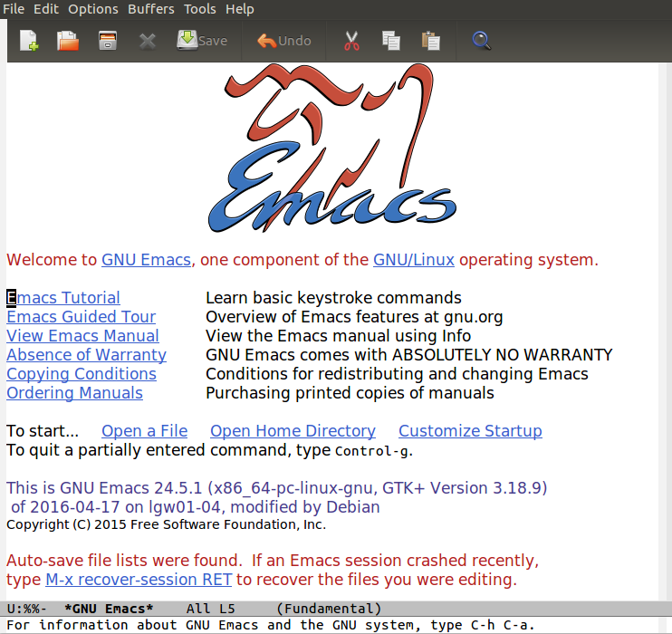
What is Emacs?
Controlled by MACROS to perform large edits
Editor MACroS -> Emacs
Under the hood is an interpreter for Lisp
More than just an Editor
  Coding/Debugging
  Email
  Calendar
  Control sub processes
  Indent programs automatically
  Handle multiple files at once
Free under GNU license
Notes:
- Can use help commands to find out what your options are or what the command does
Rebinding of keys
Change comment manipulation
Create new commands – written in Lisp

Slide 6
What is EMACS
Highly Customisable
  Change Emacs to suit your needs and style
  Content aware editing modes
Self-Documenting
  Built-in documentation for help
Extensible
  Download packages
  Write you own Lisp functions
    Load them when required
    Input it initialization file so that it is always loaded up
  Make your own key-bindings
Notes:
- Can use help commands to find out what your options are or what the command does
Rebinding of keys
Change comment manipulation
Create new commands – written in Lisp

Slide 7
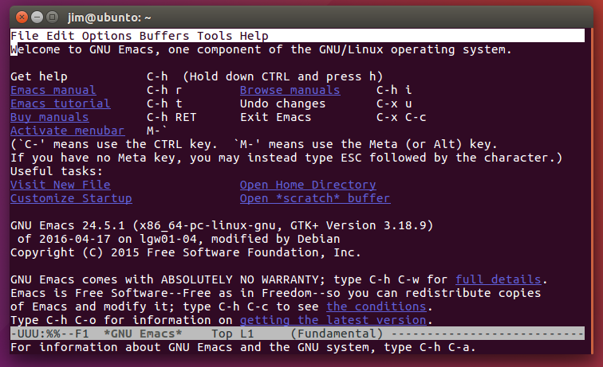
Why EMACS?
Hardware independent – not locked to any specific format
Used on graphical systems (X Window) or terminal
  Allows remote editing (ssh) without graphical connection
Lightweight editor
Keyboard controlled
  ’pointy-click’ too slow!
Integrated platform for general purposes
Community
  Share the power
Notes:
- Can use help commands to find out what your options are or what the command does
Rebinding of keys
Change comment manipulation
Create new commands – written in Lisp

Slide 8
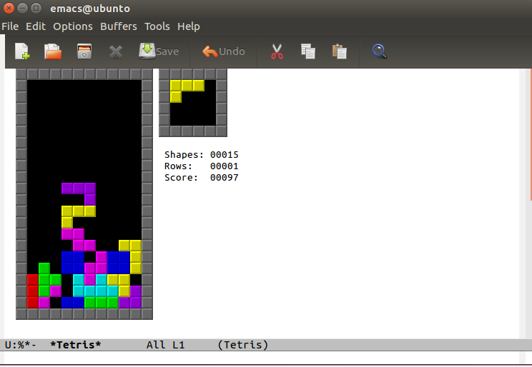
Why EMACS?
You can play Tetris
Really is more than just a text editor
Notes:
- Can use help commands to find out what your options are or what the command does
Rebinding of keys
Change comment manipulation
Create new commands – written in Lisp

Slide 9
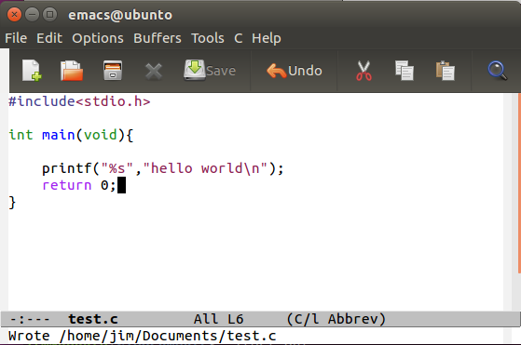
Fundamentals – The View
FRAME: where you view everything
WINDOW: Displays buffer content
MODE-LINE: Contains important information
Buffer State
  Modified (**)
  Unmodified (--)
Filename
Amount of file visible (All)
The major mode
MINI-BUFFER (ECHO Area):
Displays messages and prompts for commands
Notes:
- Can use help commands to find out what your options are or what the command does
Rebinding of keys
Change comment manipulation
Create new commands – written in Lisp

Slide 10
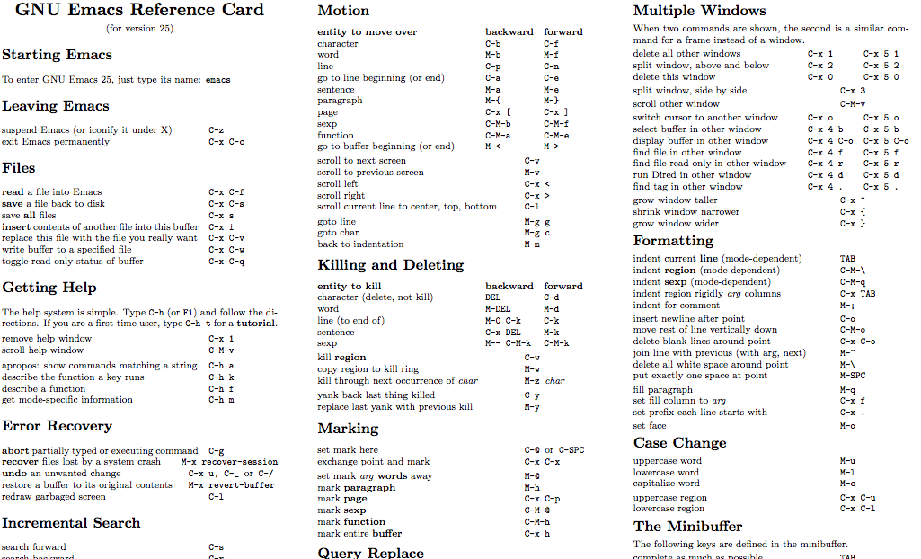
Fundamentals – The Control
Buffer: The text being edited
  Can be bound to various contents: file, external process
Every keystroke is a command
  Keys (C-n) are mapped to commands (next-line)
  Each command is a special type of Lisp function
Has over 2000 commands
Modifier Keys:
  The Control(Ctrl) key –> c-x (ctrl and x together)
  The Meta(Alt) key -> m-x (alt and x together)
Notes:
- Can use help commands to find out what your options are or what the command does
Rebinding of keys
Change comment manipulation
Create new commands – written in Lisp

Slide 11
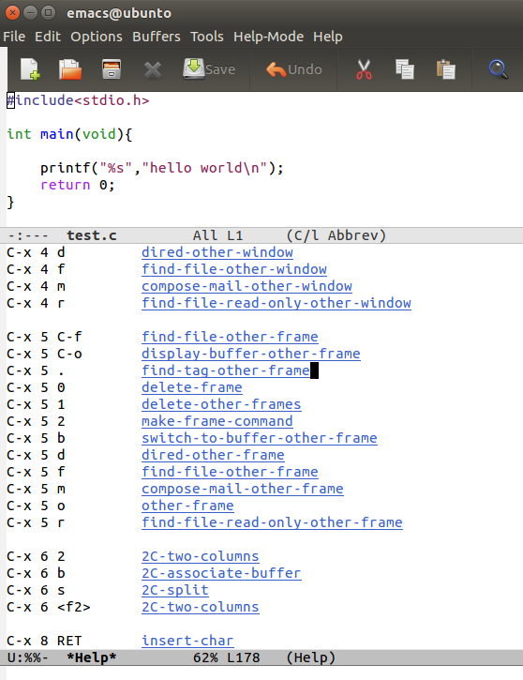
Fundamentals – The Control
Uses sequence of commands: C-f C-x C-f
  Sequence displayed in the mini-buffer if you are slow
  Space between characters means release keys
  Tab auto-complete
Prefix Key – Combines with the input which follows the key: c-x
  c-h of F1 after prefix key lists commands that are used with the prefix key
Multiple buffers in same window
Notes:
- Can use help commands to find out what your options are or what the command does
Rebinding of keys
Change comment manipulation
Create new commands – written in Lisp

Slide 12
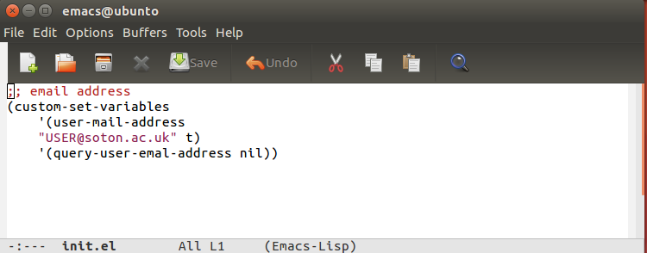
Configuration
On start-up, Emacs looks at the initialization File
  ~/.emacs.d/init.el
Personal Emacs Lisp code that you want to execute when you start Emacs.
  automatic formatting
  auto complete
  Build additional menus

Slide 13
Major Modes
Major: Specialised facilities for working on a particular file type (c, shell).
  Mutually excluse – only one mode
To enable mode M-x mode-name
Least specialised is ‘fundamental mode’
  Generally the default mode
Examples: Shell-mode, org-mode, c-mode, compile-mode
Org-Mode (organising mode)
  Note taking
  Information/task/time organisation

Slide 14
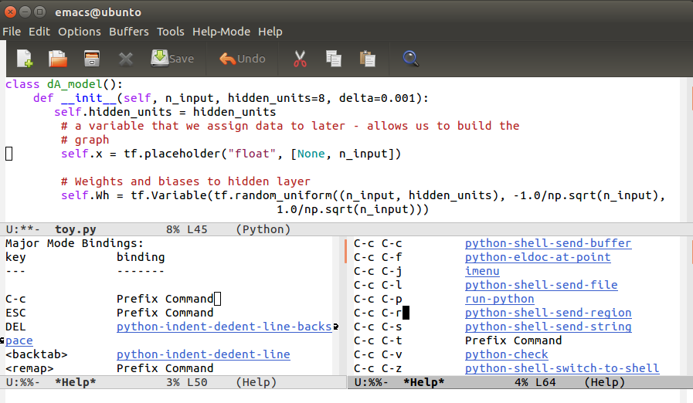
Major Modes
  Python

Slide 15
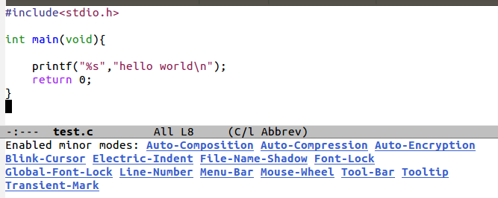
Minor Modes
Minor: Optional features which can be turned on and off
  Auto-fill
  Show line number
  Scrollbar
  Status information
Buffer can have multiple minor modes active
  Independent of other modes

Slide 16
Starting Emacs
Start: Easiest from terminal - $ emacs
  Opens in GUI mode
Start: In terminal model - $ emacs -nw
Open file: $ emacs <file_name>
To exit: C-x C-c (save-buffers-kill-terminal)

Slide 17
Hands On
Basic Navigation and Use

Slide 18
Basic Navigation
To start Emacs open the terminal (ctrl-alt-t)
Type Emacs, press enter
Open file named ‘emacs_tutorial’
  C-x C-f and find the file

Slide 19
Changing Colours
Call Load Theme
View Options with tab
Select Theme

Slide 20
Use of Calendar
M-x calendar: to open calendar mode
Adding event to date
  i d to add day event
  i w to add weekly event
  i m to add monthly event
  i y to add yearly event
M-x diary to view todays events while editing a buffer.

Slide 21
Tasks
Create new file
Import the ‘sample.txt’ file
Navigate through it
Add something at the end
Save
Add event to todays date
Go back to the file
Check what events are on today
Close the event buffer

Slide 22
Hands On
Programming in C

Slide 23
Task 1
Open file01.c
Edit the file in Emacs to correct it so that the desired output is displayed.
  (Depending on your keyboard, one symbol may be a little tricky…)
Compile and run using the terminal
  The file should compile with all the usual flags (pedantic, ansi and Wall) without any errors or warnings.
Output should be the same →
Number 0.
Number 1.
Number 2.
Number 3.
Number 4.
Number 5.
Number 6.
Number 7.
Number 8.
Number 9.

Slide 24
Task 2a
Save the corrected file01.c as file02.c
Change the for loop so that the final printed value is 99.
Compile again and pipe the output of the program to “text02.txt”.
Open the newly created file in Emacs in a second window.
  One buffer showing the code in file02.c
  Another buffer (within the same window) showing the text02.txt contents

Slide 25
Task 2b – illustrating the buffer
Change the for loop back to its previous value
Recompile the code and pipe the answer to the same file (text02.txt
Notice how although the file has changed, Emacs still displays the old contents as you are currently working within a buffer.
Finally, open the new output in anther buffer to confirm this.

Slide 26
Summary
Emacs is a very versatile and powerful text editor
Introduced to basic and fundamental concepts
All content is available for use on bitbucket
  http://computationalmodelling.bitbucket.org/tools/
Helpful Links
https://www.emacswiki.org/emacs/InitFile
https://www.gnu.org/software/emacs/manual/html_node/emacs/index.html#SEC_Contents

