Slide 1
HDF5
James Harrison & Rory Brown
jch1g10@soton.ac.uk & rob1g10@soton.ac.uk
NGCM

Slide 2
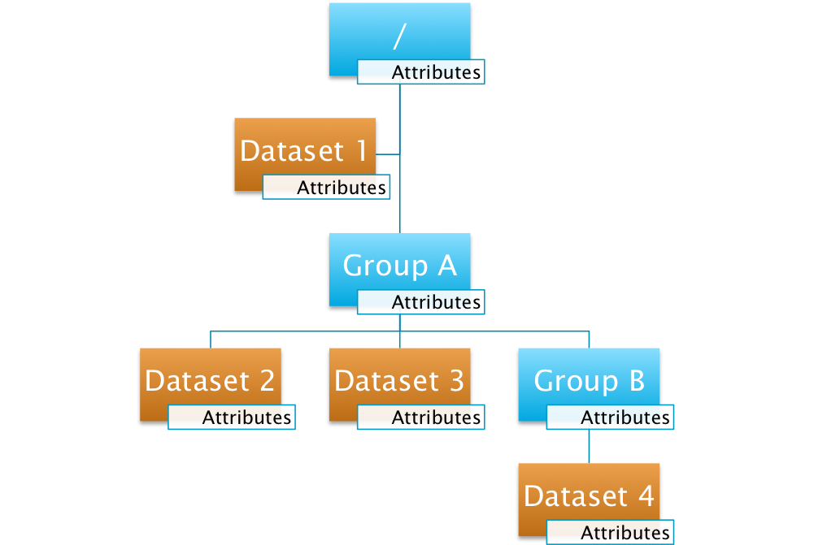
What is HDF5?
A hierarchical file
Structure:
  Groups
  Datasets
  Attributes

Slide 3
Why use it?
Store multiple datasets together
Structural versatility
Include metadata in attributes (self-describing)
Can be read/written in parallel
Interfaces in C, C++, Fortran, Java and Python

Slide 4
h5ls
Similar to ls in terminal
h5ls file.h5/path
Flag | Description
-r | Recursive
-v | Verbose
-d | Display data (unstructured)

Slide 5
h5dump
Display contents of an HDF5 file
Flag | Description
-n | List objects in file
-n 1 | List objects and attributes
-H | Display only header information (no data)
-A 0 | Suppress display of attributes

Slide 6
h5dump
Display contents of an HDF5 file
Flag | Description
-g /path/to/G | Display group G
-d /path/to/D | Display dataset D
-a /path/to/A | Display attribute A
-N path | Display any object matching path

Slide 7
h5copy
Copy objects from one HDF5 file to another, or within a file
Flag | Description
-i | Input file
-o | Output file
-s | Source object
-d | Destination object
-v | Verbose
-p | Create parent groups

Slide 8
Exercise 1
Copy datasets from exercise1.h5 to solution.h5
Clues are found in the attributes
Start from the attribute in the root group
Run “python codebreaker.py” to check solutions

Slide 9
h5py
In the second half of the presentation, the h5py module will be introduced
Documentation: http://docs.h5py.org/en/latest/
The following knowledge is assumed:
  Basic Python (incl. dictionaries)
  Numpy

Slide 10
h5py
Python module for manipulating HDF5 files
  Create HDF5 files
  Change file structure
  Read and write data
Use “import h5py” to access module commands

Slide 11
Files and groups
f = h5py.File(‘filename’, ‘a’)
f.close() when finished
Groups work like dictionaries (keys and values)
grp = f.create_group(‘name’)
del group[‘subgroup’]

Slide 12
Datasets
Multi-dimensional datasets
dset = group.create_dataset(‘name’, size, dtype)
  size: tuple
  dtype (optional): e.g. ‘f’, ‘i8’
dset = grp.create_dataset(‘name’, data=x)
  x: numpy array

Slide 13
Reading and Writing Data
data = dset[…] or dset[…] = data
Numpy slicing syntax
  e.g. dset[3:5, :, 2]
shape / len / dtype / size (same as numpy)
dset.parent: group containing dset

Slide 14
Attributes
Can be attached to any group or dataset
object.attrs[‘name’] = data
data can be a scalar, string or numpy object

Slide 15
Exercise 2
This exercise will be about creating your own HDF5 file
Work through the exercises in exercise2.ipynb

