Slide 1


Computing with units
Advanced Computational Methods II workshop
Emanuele Zappia e.zappia@soton.ac.uk
national Centre for Advanced Tribology at Southampton (nCATS)| Bioengineering Science Research Group
Hossam Ragheb
har1g15@soton.ac.uk
Engineering and Environment
Fluid Structure Interaction (FSI)|Research Group
29 – 02 -2016

Slide 2
OVERVIEW
Introduction: physical quantities in computational environment (Python)
Basic commands with Pint
Advanced feature: Bukingham 𝛑 theorem
Summary
Exercises

Slide 3


INTRODUCTION – physical quantities
A physical quantity is essentially a set composed by:
Number (or magnitude)
Unit(s)
Such a quantity posses also:
Dimensionality (expressed in fundamental dimensions)
Notes:
Different units, same qunatity and same dimensionality

Slide 4
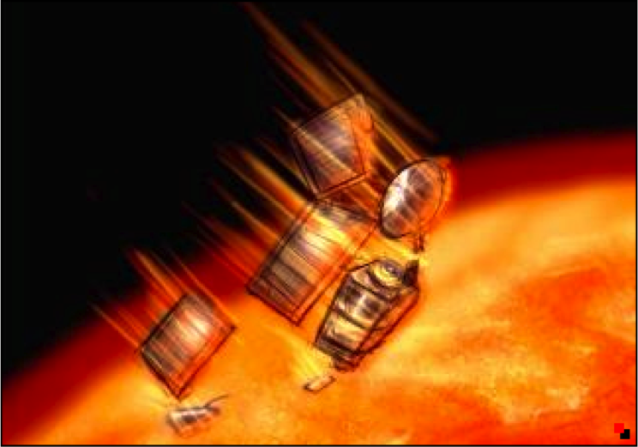
INTRODUCTION – physical quantities
Is computing with units really important?
Mars Climate Orbiter disaster
In 1999 NASA lost the mars climate orbiter because part of the project staff used imperial units and the other metric units
The money loss was estimated to be greater than 125 millions of dollars
https://en.wikipedia.org/wiki/Mars_Climate_Orbiter
We need to compute with units!

Slide 5
INTRODUCTION – physical quantities
The idea on how to implement units in a computational environment
How is basically defined a unit library in Python?
Container model approach (employed by Pint and other libraries):
class Quantity(object):
def __init__(self, magnitude, unit):
...
Other approaches:
subclass of numpy
approach with random numbers (numerical units)
Notes:
Example on how define a unit in Pint

Slide 6

INTRODUCTION – physical quantities
The idea on how to implement units in a computational environment
Then a physical quantity is an object defined by 2 main arguments: magnitude and unit.
F = 24 * ureg.newton
Computational
Environment
or
F = Q(24, ‘newton’)
F is now an object, a quantity that belongs to Quantity class and has:
magnitude attribute (24)
units attribute (newton)
Other attributes and methods
Notes:
Example on how define a unit in Pint with different syntaxes. Q stands for quantity.

Slide 7
INTRODUCTION – units libraries
These are the criteria you should look in a units library:
Simple syntax
Numpy compatibility
Overhead/Speed
Considering only the Python language, there are a lot of different packages to choose from, for example:
units
physics
quantities
pint
numerical units
For more details on different units libraries look at https://github.com/tbekolay/quantities-comparison
Notes:
I want to stress the importance of numpy compatibility and rember that quantities are objects

Slide 8

INTRODUCTION – why Pint?
Pint
Pros
Simple syntax
Versatile syntax
Presents some smart advanced features
Cons
Speed
Not excellent (but
fairly good) numpy
compatibility
For Pint documentation look at https://pint.readthedocs.org/en/0.6/

Slide 9
INTRODUCTION – How to install Pint?
If you have pip, open the terminal and write:
$ pip install pint
Otherwise:
$ easy_install pint
For Pint documentation look at https://pint.readthedocs.org/en/0.6/

Slide 10
Basic commands with Pint
Pint initialisation:
from pint import UnitRegistry
ureg = UnitRegistry()
UnitRegistry ( ) CALLS default file “default_en.txt”
Can define our own units “myunits.txt” and calls it as follows:
ureg = UnitRegistry(myunits.txt)
For Pint documentation look at https://pint.readthedocs.org/en/0.6/

Slide 11
Basic commands with Pint
ASSIGNING UNITS:
[Variable Name] = [Magnitude] * [Unit]
Distance = 10.0 * ureg.meter
OR
Distance = 10.0 * ureg(‘meter’)
The 2nd method is useful when dealing with Units from txt files
For Pint documentation look at https://pint.readthedocs.org/en/0.6/

Slide 12
Basic commands with Pint
ASSIGNING UNITS:
[Variable Name] = [Magnitude] * [Unit]
Distance = 10.0 * ureg.meter
OR
Distance = 10.0 * ureg(‘meter’)
OR
Q_ = ureg.Quantity
Distance = Q_(10.0, ‘meter’)
The 2nd method is useful when dealing with Units from txt files
For Pint documentation look at https://pint.readthedocs.org/en/0.6/

Slide 13
Basic commands with Pint
Pint stores Physical Quantities which has a Magnitude, Unit and Dimension
print(Distance.magnitude)
10.0
print(Distance.units)
meter
print(Distance.dimensionality)
[length]
For Pint documentation look at https://pint.readthedocs.org/en/0.6/

Slide 14
Basic commands with Pint
UNITS CONVERSION
print(Distance.to(ureg.inch))
393.70078740157476 inch
print(Distance)
10.0 meter
On the fly conversion
Distance.ito(ureg.inch)
print(Distance)
393.70078740157476 inch
Permenant conversion
For Pint documentation look at https://pint.readthedocs.org/en/0.6/

Slide 15
Basic commands with Pint
QUANTITIES LIST WITH NUMPY
distances = numpy.array([2,3,4,5]) * ureg.meter
print(distances[3])
4 meter
NUMPY COMPATIBILITY
total_distances = numpy.sum(distances)
print(total_distances)
14 meter
For Pint documentation look at https://pint.readthedocs.org/en/0.6/

Slide 16
Basic commands with Pint
FORMATTING
Latex:
print('the latex formatting is {:L}'.format(Distance))
Appreviated:
print('appreviated formating is {:~}'.format(Distance))
HTML:
print('the HTML formatting is {:H}'.format(Distance))
Can also set the defualt formatting:
ureg.default_format='P’
print('the defualt formatting is {}'.format(Distance))
For Pint documentation look at https://pint.readthedocs.org/en/0.6/

Slide 17
Basic commands with Pint
DEFINING UNITS
Units can be defined in terms of other units (for example in a .txt file) :
Hour = 60 * minute = h = hr
[Canonical name] = [Definition] = [Aliases]
And we can define reference units as follows:
Second = [time] = s = sec
[Canonical name] = [Dimensionality] = [Aliases]
For Pint documentation look at https://pint.readthedocs.org/en/0.6/

Slide 18
Basic commands with Pint
DEFINING UNITS
These definitions can be implemented in two ways:
Using Text file
Ureg = UnitRegistry(‘mydef.txt’)
Programmatically
from pint import UnitRegistry
ureg = UnitRegistry()
ureg.define(‘hour=60*minute=hr=h’)
For Pint documentation look at https://pint.readthedocs.org/en/0.6/

Slide 19
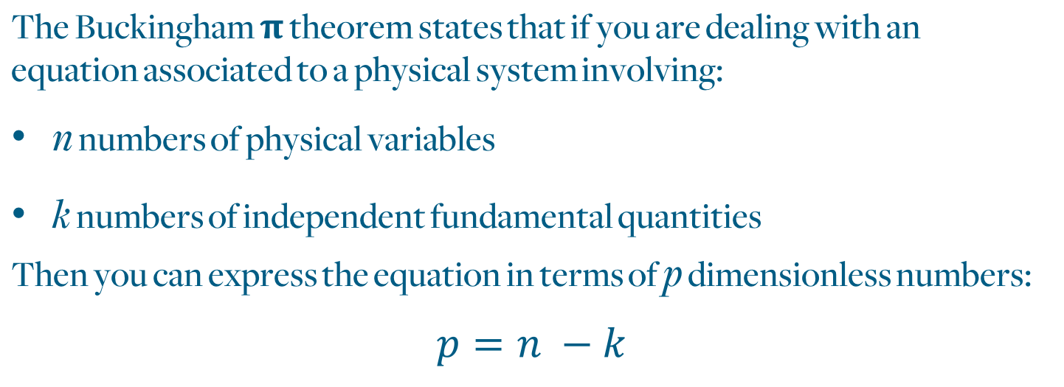
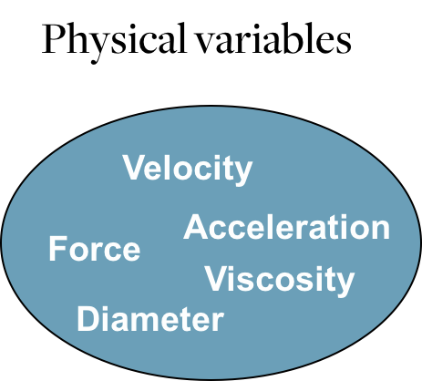
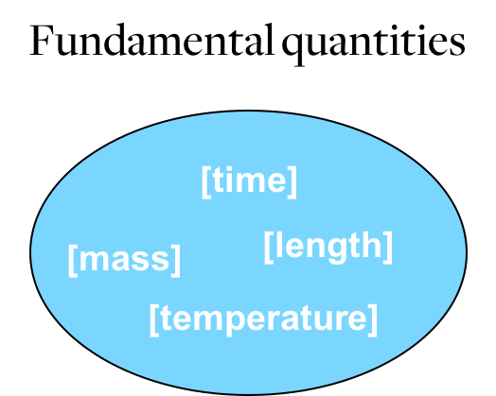
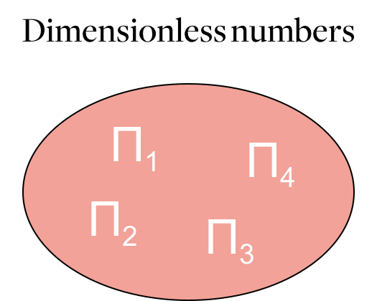
BUKINGHAM 𝛑 THEOREM

Slide 20
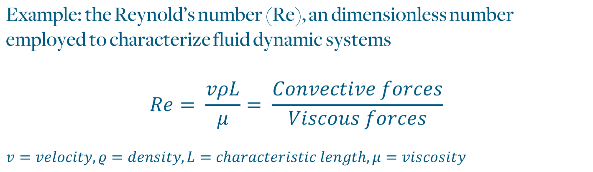
BUKINGHAM 𝛑 THEOREM
Used to state if a fluid dynamic system is "dynamically" similar to another one.
Employed to predict the flow regime of a given system (for example for a flow in a Pipe there is laminar flow for Re < 2000 , transitory flow for Re = 2100-4000 and fully developed turbolent flow for Re > 4000.
It can also be exploited to calculate characteristic quantities of the system.

Slide 21
BUKINGHAM 𝛑 THEOREM
In Pint is possible to exploit the ureg.pi_theorem command to get some possible adimensional numbers of your system.
First import the pi_theorem from Pint:
from pint import pi_theorem
Then give to the ureg.pi_theorem all the physical variables and fundamental quantities as arguments:
ureg.pi_theorem({ 'L': '[length]’,
'D': '[length]’,
'ro': '[mass]/[volume]', 'mi': '[viscosity]’,
'v': '[speed]'})

Slide 22
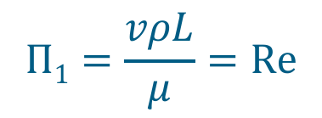
BUKINGHAM 𝛑 THEOREM
The output for the ureg.pi_theorem command will be a list of possible dimensionless numbers printed in this fashion:
{'L': 1.0, 'mi': -1.0, 'ro': 1.0, 'v': 1.0}
Physical variable
Power
Where the dimensionless number is displayed as a fraction of the physical variables of the system to some powers.
We have found the Reynold’s number.

Slide 23
BUKINGHAM 𝛑 THEOREM
The pi_theorem feature of Pint can be used to:
Determine dimensionless numbers of a given systems and, if they have a physical meaning, employ them.
Derive useful relations between physical variables.
However, be careful as will not display always all the possible dimensionless numbers.

Slide 24
SUMMARY
Try to compute with units as often as possible.
Remember that, in general, quantities are objects.
Be aware of numpy and general commands compatibilities.
For high speed purposes only, try to work with magnitudes or consider numerical units library.
Useful links:
https://conference.scipy.org/scipy2013/presentation_detail.php?id=174 , a nice talk about units libraries.
https://github.com/tbekolay/quantities-comparison , units libraries comparison repository.
https://pint.readthedocs.org/en/0.6/ , Pint documentation webpage.

Slide 25
Thank you for your attention
and
be ready for the exercises!
Emanuele Zappia e.zappia@soton.ac.uk
national Centre for Advanced Tribology at Southampton (nCATS)| Bioengineering Science Research Group
Hossam Ragheb
har1g15@soton.ac.uk
Engineering and Environment
Fluid Structure Interaction (FSI)|Research Group

