Slide 1
HDF5
James Harrison & Rory Brown
jch1g10@soton.ac.uk & rob1g10@soton.ac.uk
NGCM

Slide 2
Assumed knowledge
For the second half of the presentation, the following knowledge is assumed:
  Basic Python (incl. dictionaries)
  Numpy

Slide 3
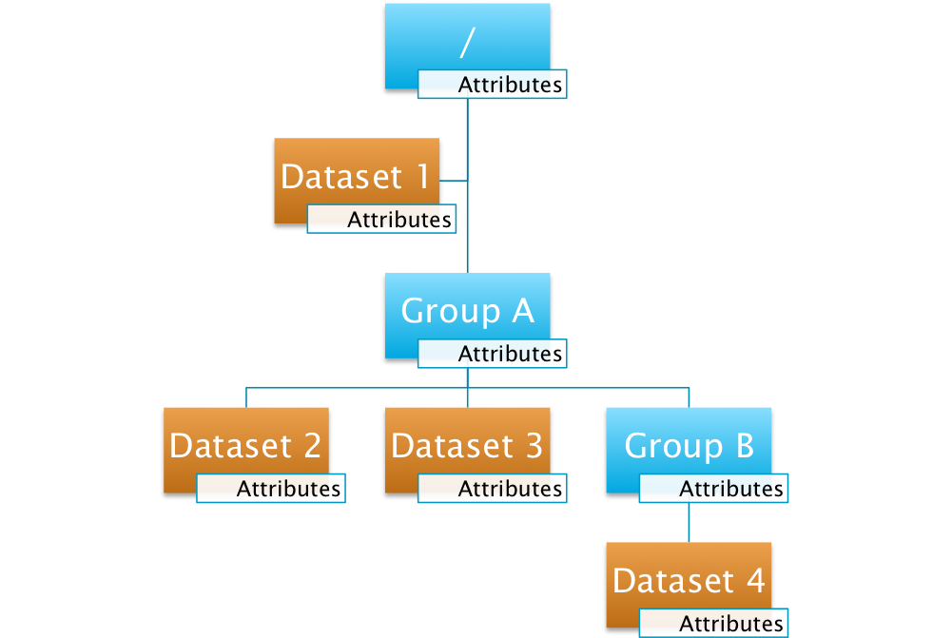
What is HDF5?
A hierarchical file
Structure:
  Groups
  Datasets
  Attributes

Slide 4
Why use it?
Store multiple datasets together
Structural versatility
Include metadata in attributes (self-describing)
Can be read/written in parallel
Interfaces in C, C++, Fortran, Java and Python

Slide 5
Datatypes
Array
String
Object reference (code?)
Region reference (code?)

Slide 6
h5ls
Similar to ls in terminal
h5ls file.h5/path
Flag | Description
-r | Recursive
-v | Verbose
-d | Display data (unstructured)

Slide 7
h5dump
Display contents of an HDF5 file
Flag | Description
-n | List objects in file
-n 1 | List objects and attributes
-H | Display only header information (no data)
-A 0 | Suppress display of attributes

Slide 8
h5dump
Display contents of an HDF5 file
Flag | Description
-g /path/to/G | Display group G
-d /path/to/D | Display dataset D
-a /path/to/A | Display attribute A
-N path | Display any object matching path

Slide 9
h5copy
Copy objects from one HDF5 file to another, or within a file
Flag | Description
-i | Input file
-o | Output file
-s | Source object
-d | Destination object
-v | Verbose
-p | Create parent groups

Slide 10
Exercise

Slide 11
h5py
Python module for manipulating HDF5 files
  Create HDF5 files
  Change file structure
  Read and write data
Use “import h5py” to access module commands

Slide 12
Files and groups
Create command
Create groups, datasets, attributes
maxshape
Initialise with numpy array?
resizable files?
Compression? (gzip and maybe lzf)

Slide 13
Files and groups
f = h5py.File(‘filename’, ‘a’)
f.close() when finished
Groups work like dictionaries (keys and values)
grp = f.create_group(‘name’)
del group[‘subgroup’]

Slide 14
Datasets
Multi-dimensional datasets
dset = group.create_dataset(‘name’, size, dtype)
  size: tuple
  dtype (optional): e.g. ‘f’, ‘i8’
dset = grp.create_dataset(‘name’, data=x)
  x: numpy array

Slide 15
Reading and Writing Data
data = dset[…] or dset[…] = data
Numpy slicing syntax
  e.g. dset[3:5, :, 2]
shape / len / dtype / size (same as numpy)
dset.parent: group containing dset

Slide 16
Attributes
Can be attached to any group or dataset
object.attrs[‘name’] = data
data can be a scalar, string or numpy object

Slide 17

Exercise 2

