Slide 1
Comparison of Parallel Sorting Algorithms
Group 14 Rohit Barichello, Kelton Chesshire, Christopher Tran, Vicente Trevino

Slide 2
Project Outline
Details
4 sorting algorithms implemented in MPI
Odd-Even Transposition Sort
Enumeration Sort
Parallel Merge Sort
Hyper Quick Sort
Process sizes: 8, 16, 32, 64
Input sizes: 2,560; 25,600; 256,000; 2,560,000
Input types: random, sorted, reversed sorted
Input generated and stored in a binary file and read in parallel by each process depending on rank and # of processes
Configuration
4 processes per node
16 nodes requested
8GB per node

Slide 3
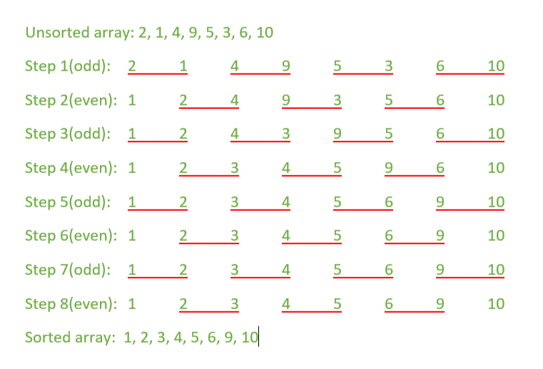
Odd-Even Sort
Algorithm
Parallel sorting algorithm based on Bubble Sort Technique
Separated into odd and even phase
Odd phase, compare every odd indexed element with the next even indexed element
Even phase, compare every even indexed element with next odd indexed element
Input sizes were chosen because the input size had to be divisible by # of processes
MPI Implementation
Read input from previously generated binary file
Given # of procs, divide input # of procs, each proc handles sorting within itself with quick sort.
During odd and even phases, each process communicates and determine if a swap of data elements is necessary
std::merge is used to merge two sorted data sets of each process
Depending on rank, each process will receive back either the lower or the upper half of the newly merged and sorted input, thus completing a phase.

Slide 4
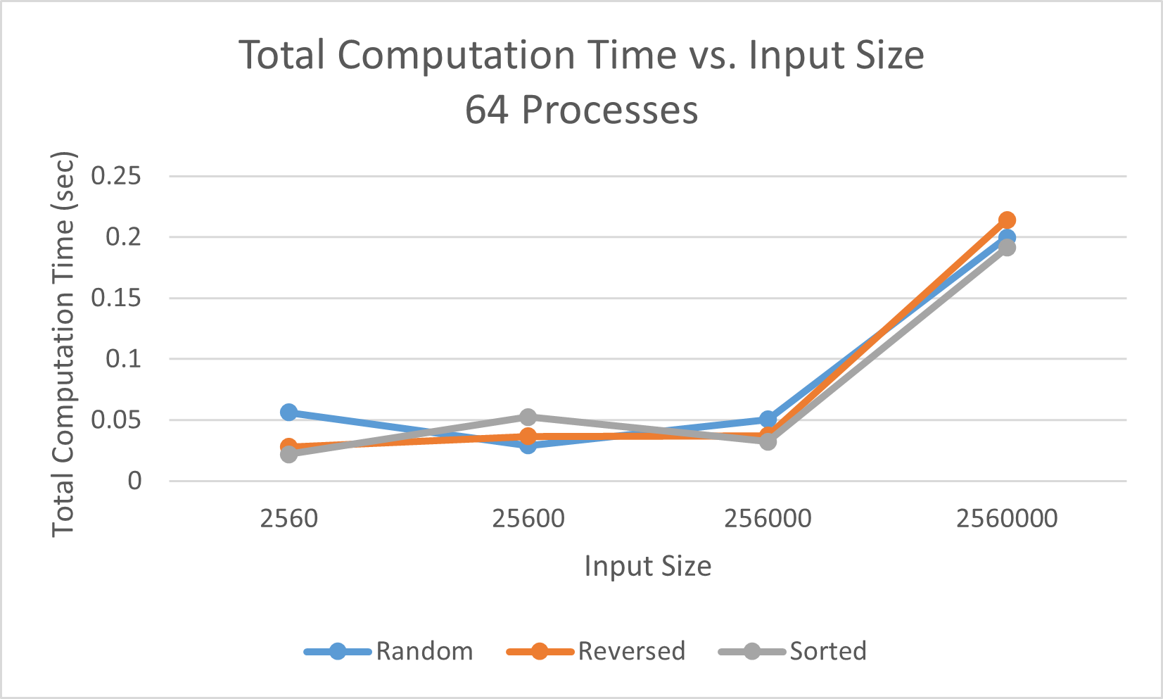
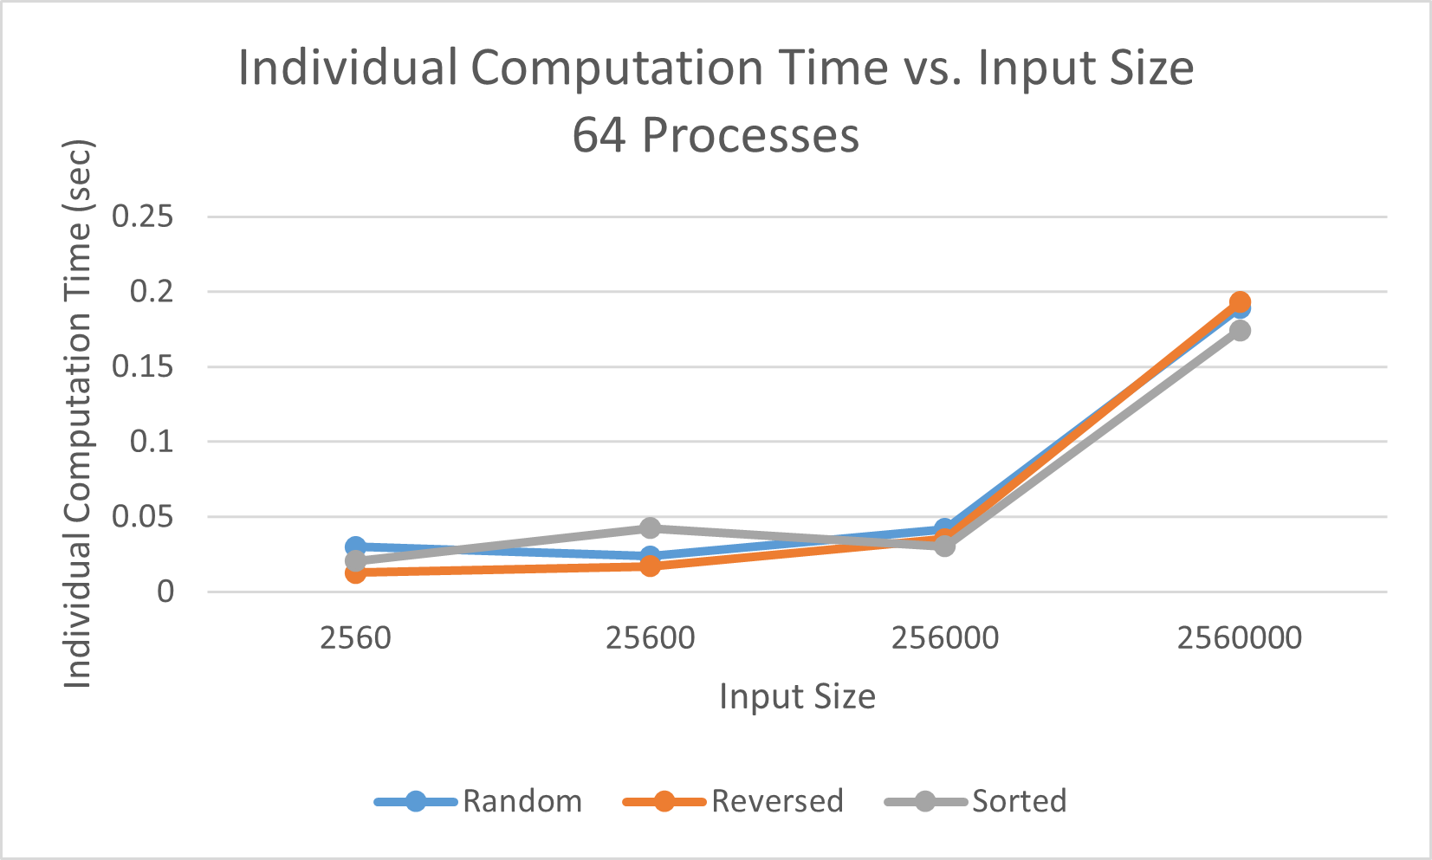
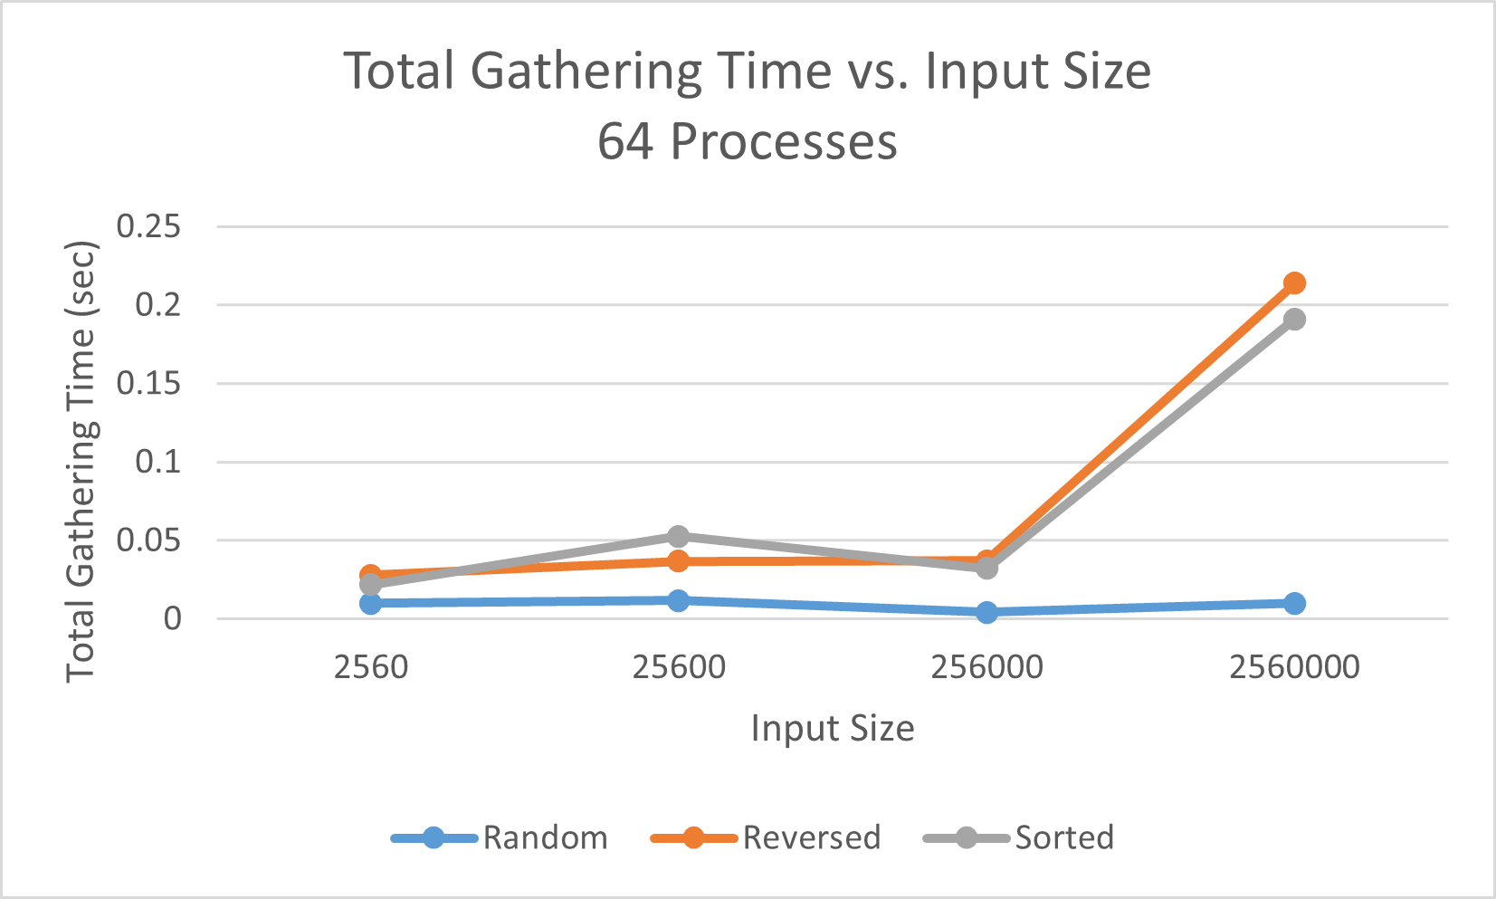

Slide 5
Enumeration Sort
Algorithm
Compares every element in a set to every other element
Ranks elements based on comparison
Final element index in sorted array is equal to comparison rank
Naive algorithm unless parallelized
Num rocesses must equal input size
No strong scaling
Implementation
Read input data from a binary file
Generate unique process for every item in element
Create a final destination array of size num_procs

Slide 6
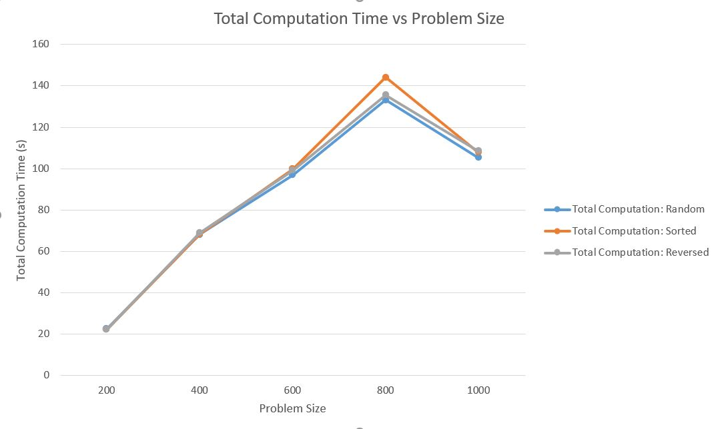
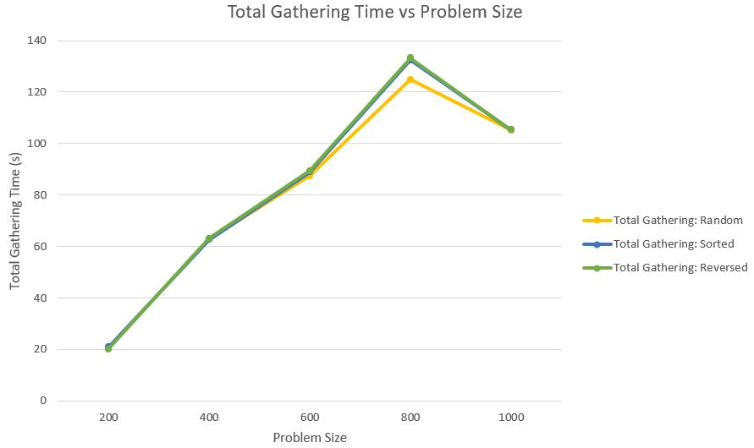
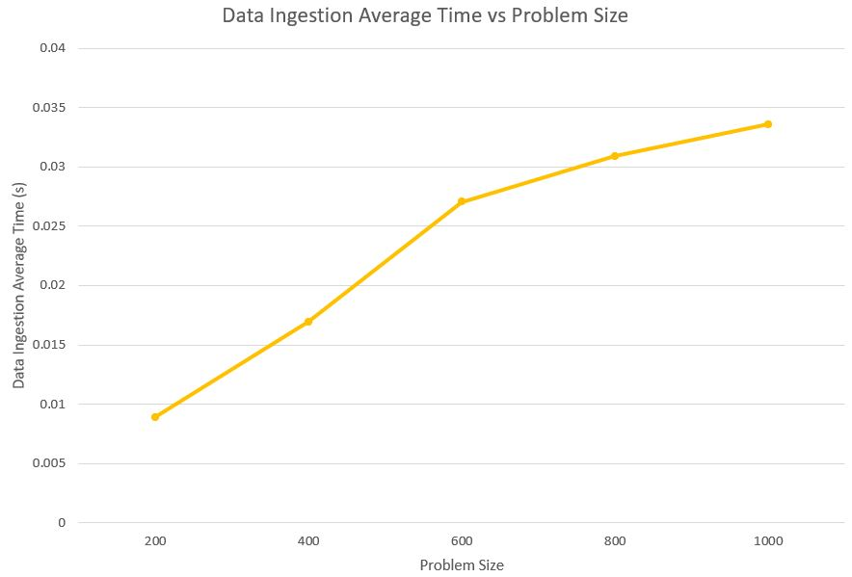
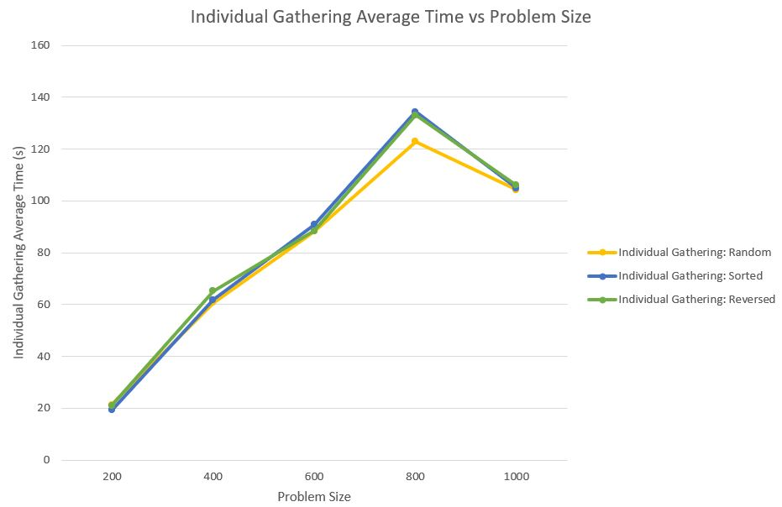
Notes:
Because the algorithm compares all elements against each other, the original order of the data doesn’t impact runtime
A sorted list and reversed sorted list take same amount of time because there’s no conditional logic in the algorithm
Predictable results
Data ingestion time increases with problem size because the size of our binary file increases
We see a decrease in runtimes after 800 processes, potentially because of caching that only makes a difference at high problem sizes
Note that gathering time is only slightly under total computation time, meaning that the comparisons took relatively short time in comparison to message passing between processses

Slide 7
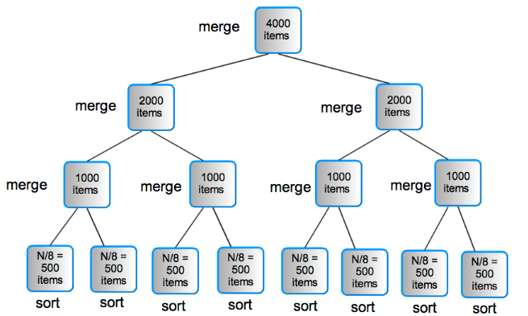
Parallel Merge Sort
Algorithm:
Randomized numbers read into program, divided evenly among processes
Divides the array and sorts each division, before joining back into array
Process arrays combined back on process 0
Final merge sort performed for completed array
MPI Implementation:
Binary file is read in chunks; each process reads and creates array of numbers from file
Each process sorts their chunk using the Merge Sort algorithm
Each process pushes their data to process 0 via the MPI_Gather function
Process 0 does one final merge and sort into the sorted array

Slide 8
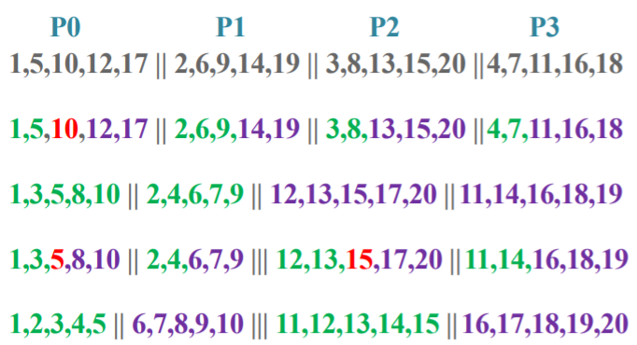
Hyper Quick Sort
Algorithm
Take unsorted list and divide among each process .
Each processor sorts its list locally
Find the pivot and broadcast it every processor
Each processor splits their list locally, into lower and upper halves
Each processor in upper half of processor list will send low list to a partner processor in lower half of processor list and obtains high list in return
Now upper half of the processors only have values greater than the pivot and lower half of the processors have values smaller than pivot
Recurse between the upper half and lower half processors
Implementation
Read input from binary file
Divide everything into equal parts and spread among all processes
Find the pivot and each process divides into its two parts according to pivot
Based on the rank of the processor it will either receive lower or higher values of the pivot
Results are gathered and written by main process
Red - pivot point
Green - lower values
Blue - higher values

Slide 9
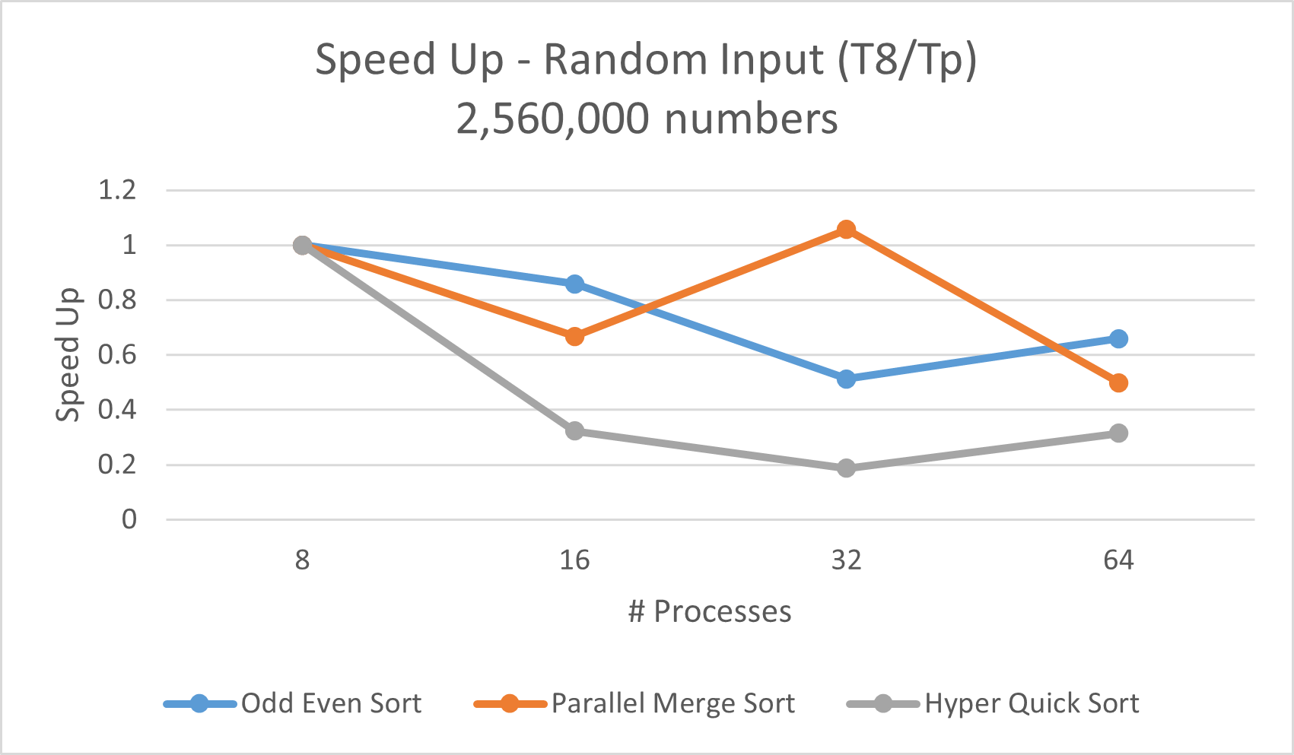
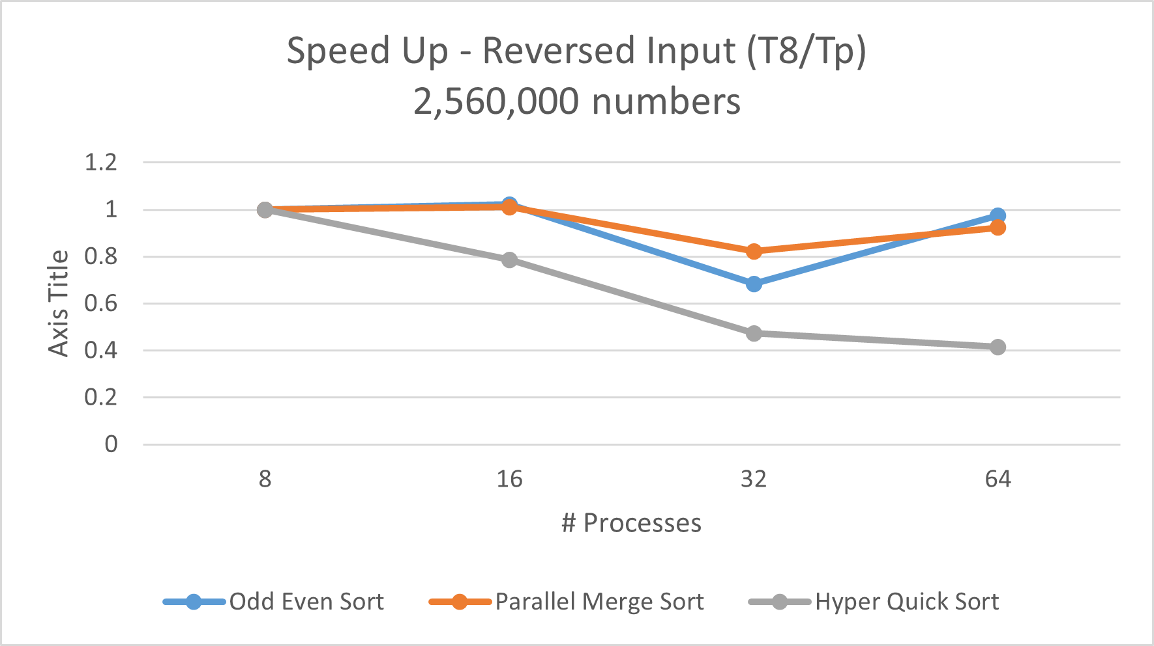
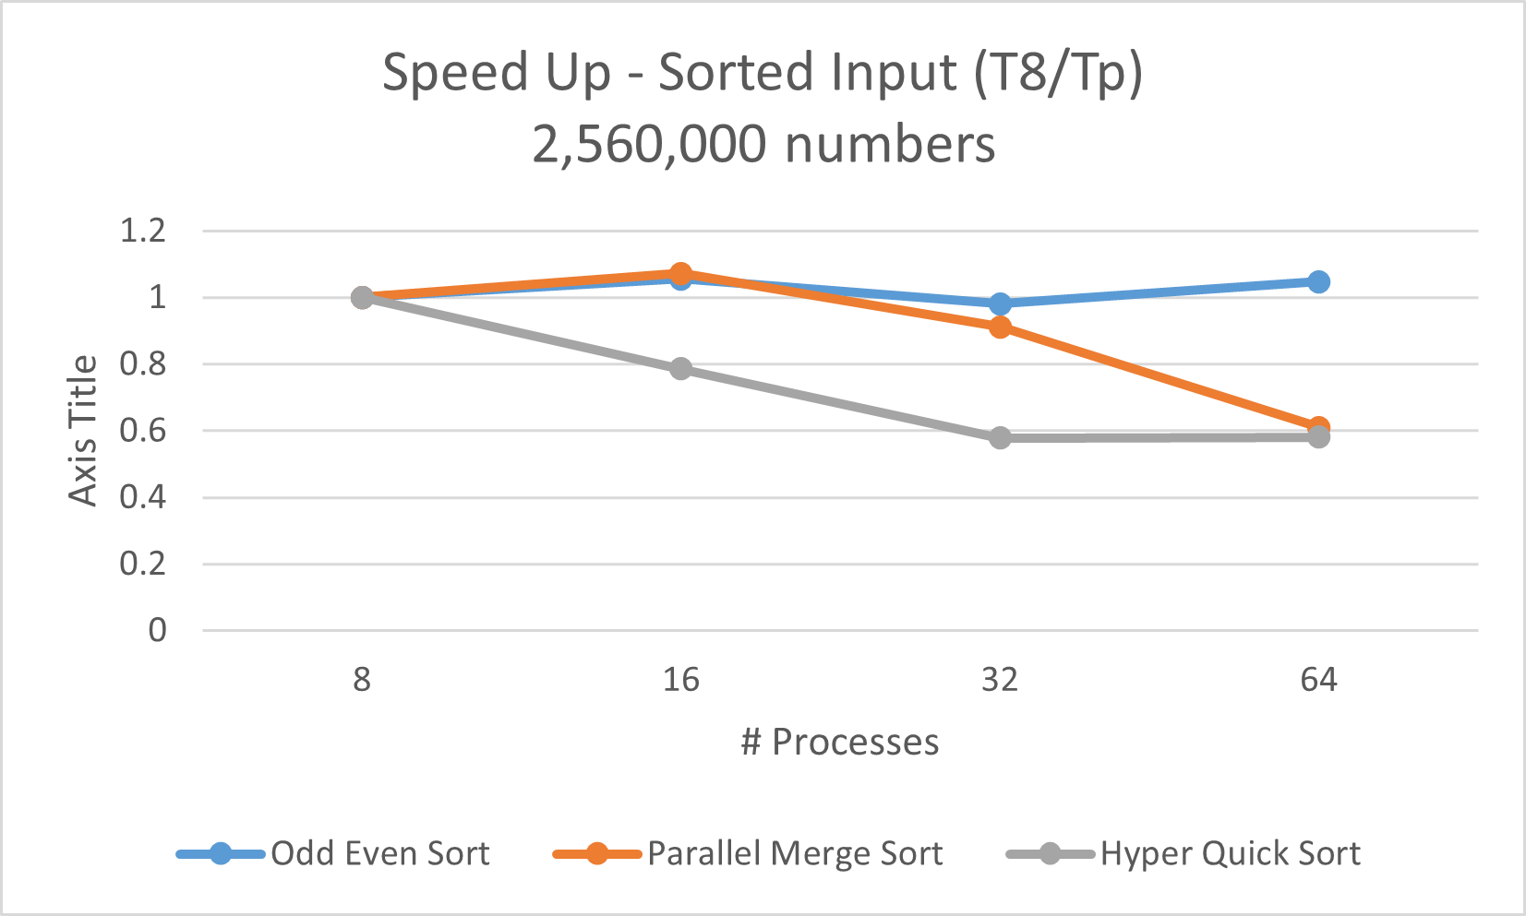
Comparison:
Strong scaling
Speedup was calculated by taking dividing the total computation time with 8 processes by the total computation time with N processes.
None of the implemented sorting algorithms seem to exhibit strong scaling.

Slide 10
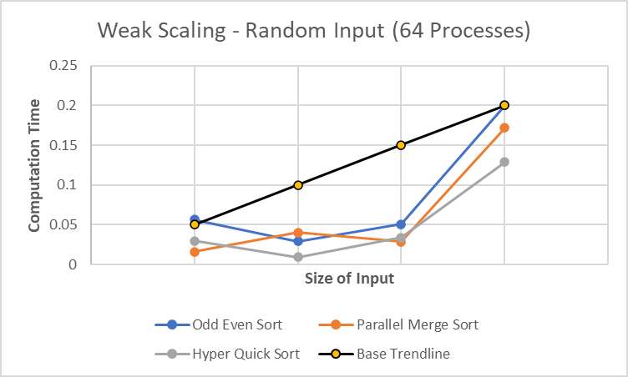
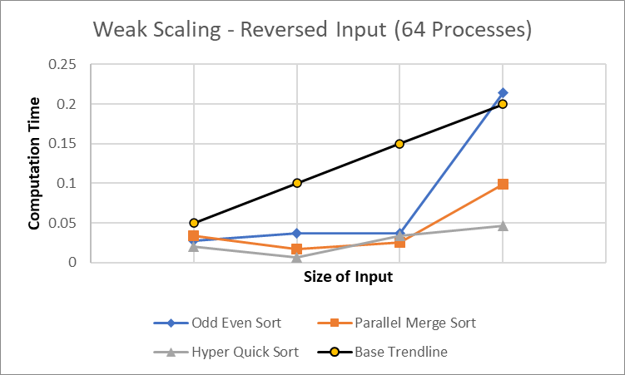
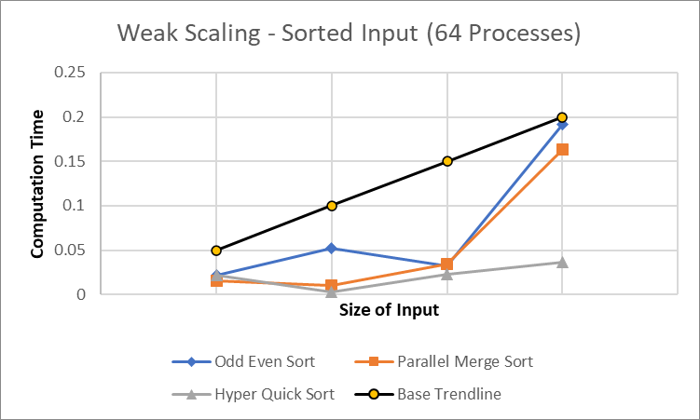
Comparison:
Weak scaling
Weak scaling was calculated by keeping the process size constant and comparing computation time to the size of the input.
Input Sizes Used: 2560, 25600, 256000, 2560000

Slide 11
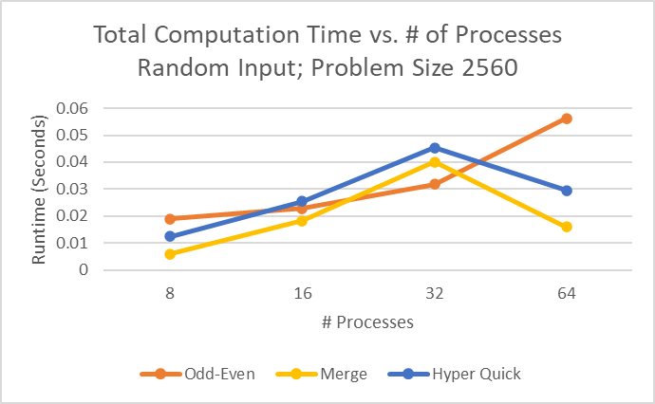
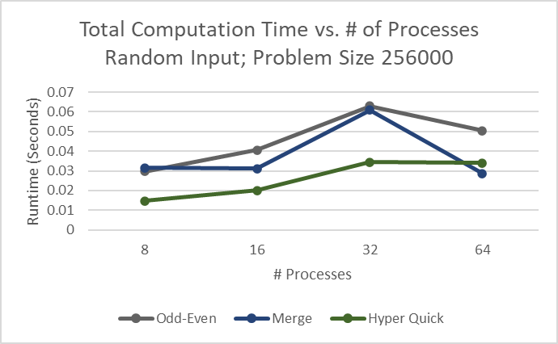
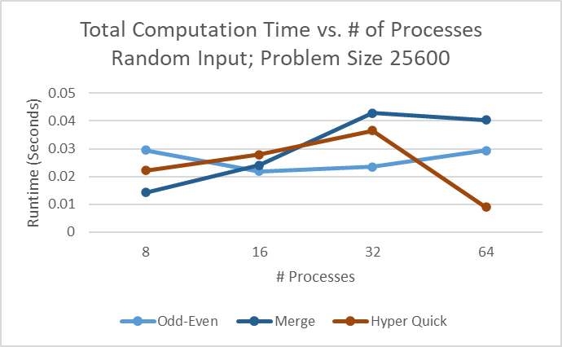
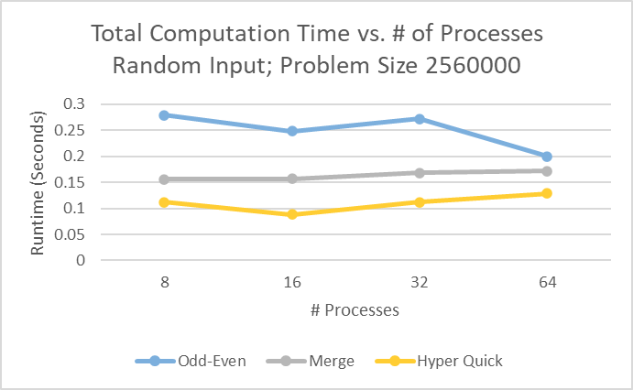
Comparison:
Computation Time
Merge sort and hyper quick peak at 32 procs, overtaking Odd-Even for input sizes 2560 and 25600
For larger problem sizes , Odd-Even takes significantly longer, likely because of increased message passing overhead due to odd-even comparisons
We see computation times become more consistent with increased input size
Merge and Hyper Quick see a decrease in runtime at higher proc counts, benefitting from being able to make more comparisons at a time
Odd even sort is hurt by an increase in procs past 32, likely because of the doubly random nature of odd/even random values. Having more procs doesn’t necessarily help

Slide 12
Questions?

