Slide 1

USE case
Restaurant data set loaded into Power BI
Team members: Naomi Thiru (captain) Mikael Dominguez Christophe Schellinck

Slide 2
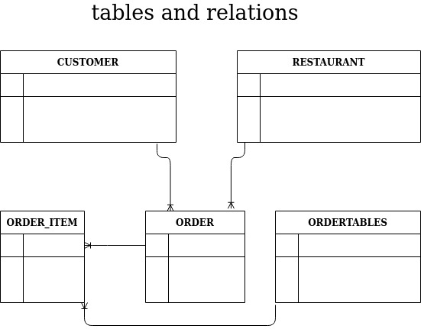

Slide 3
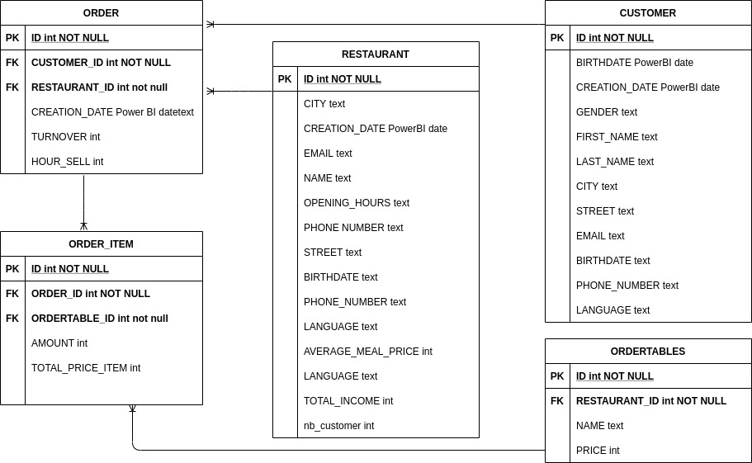
Data Structure
Notes:
3

