Slide 1
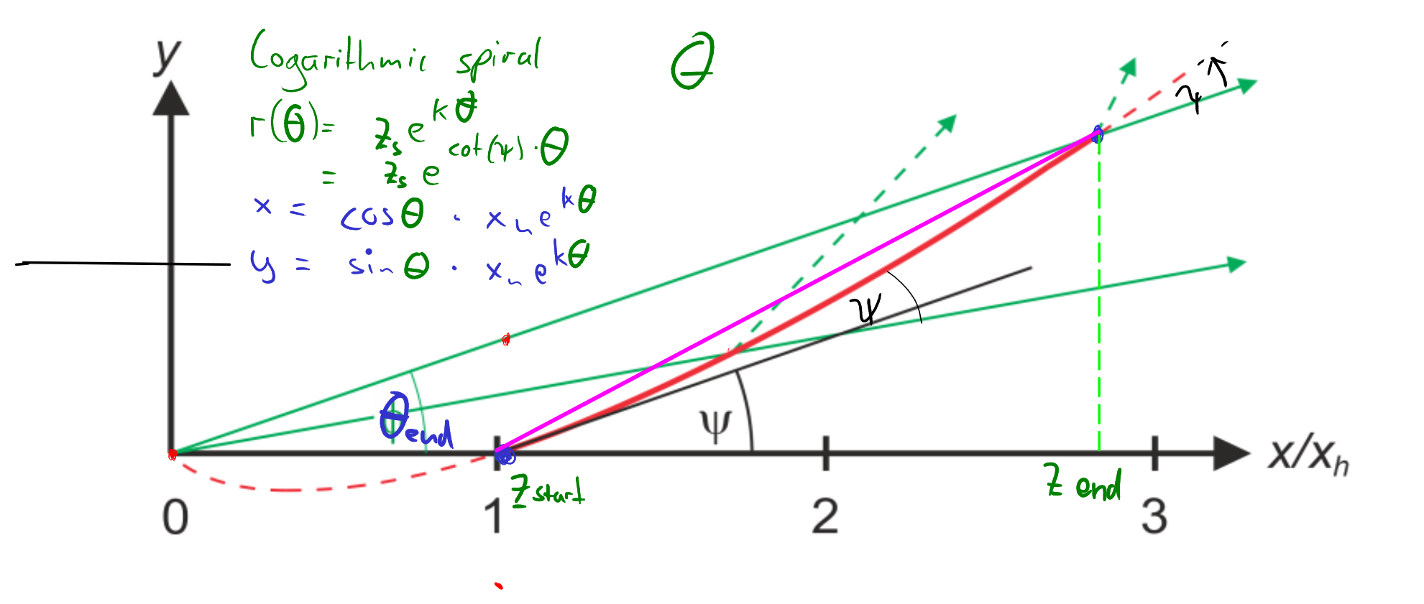
Polarizer

Slide 2
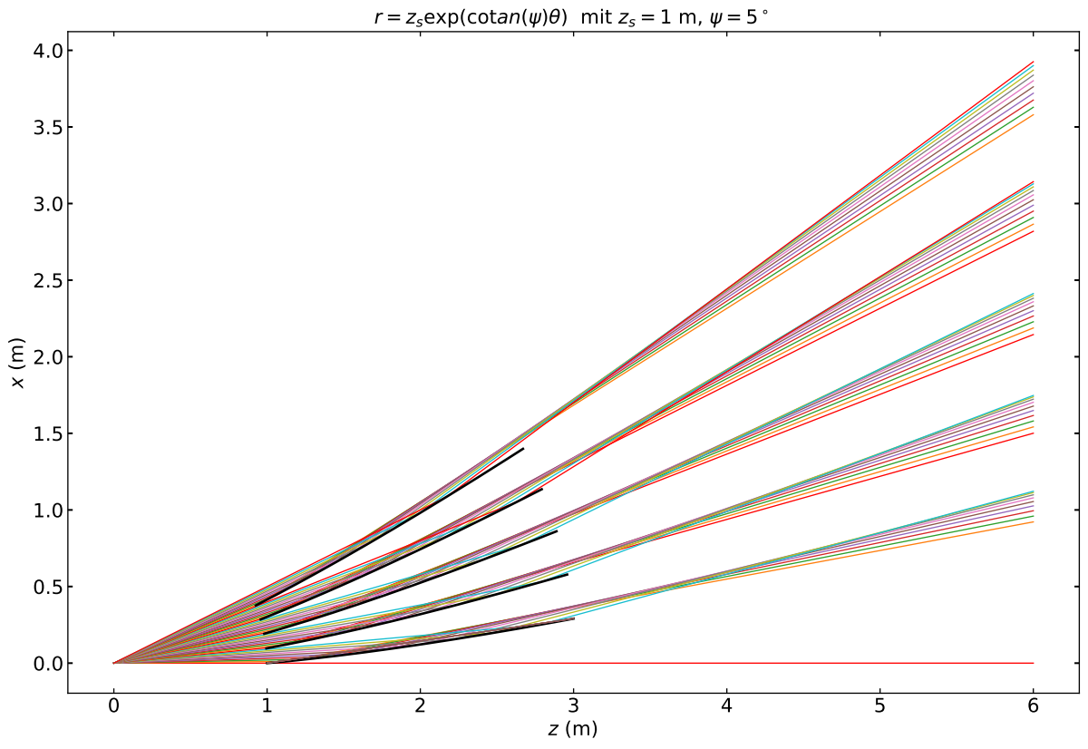
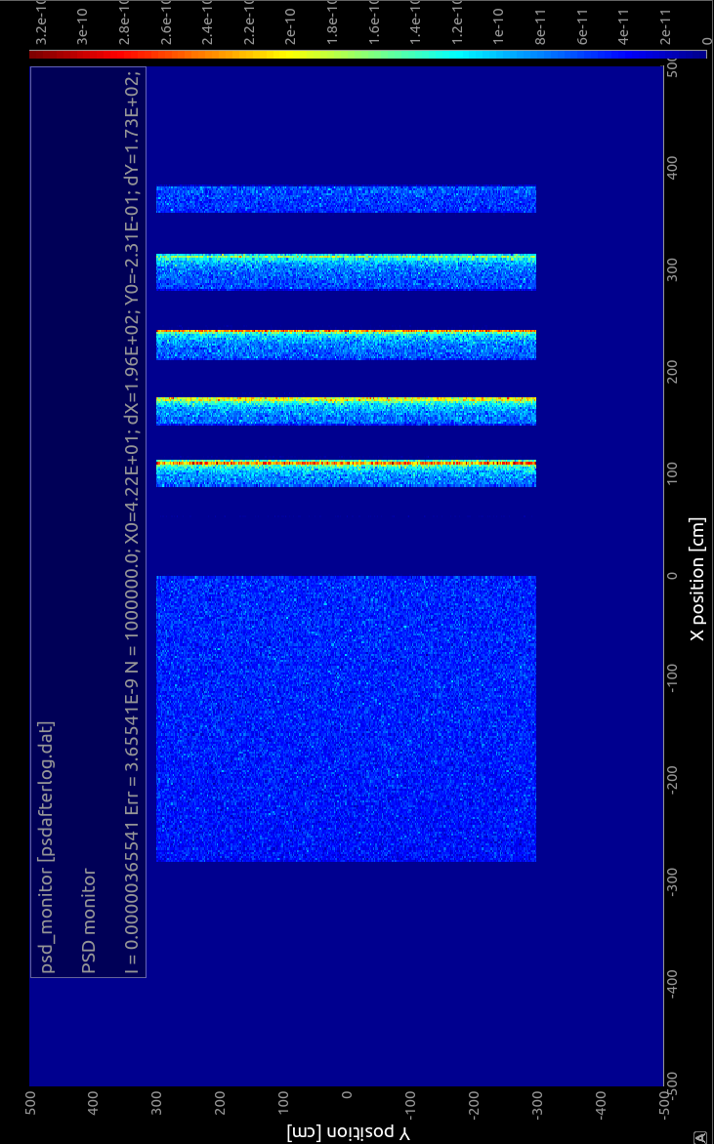
From Focus

Slide 3
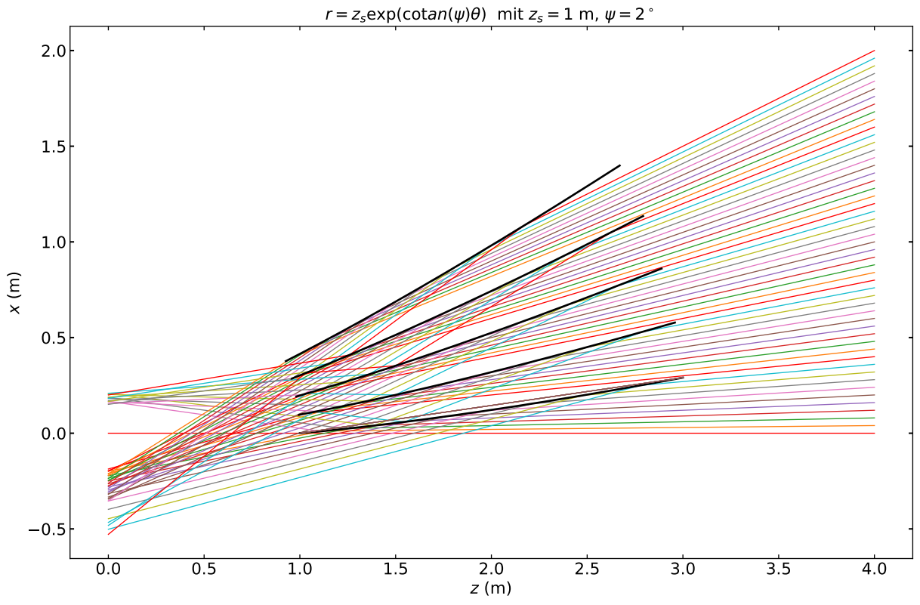
Into Focus
Problem:
double reflect

Slide 4
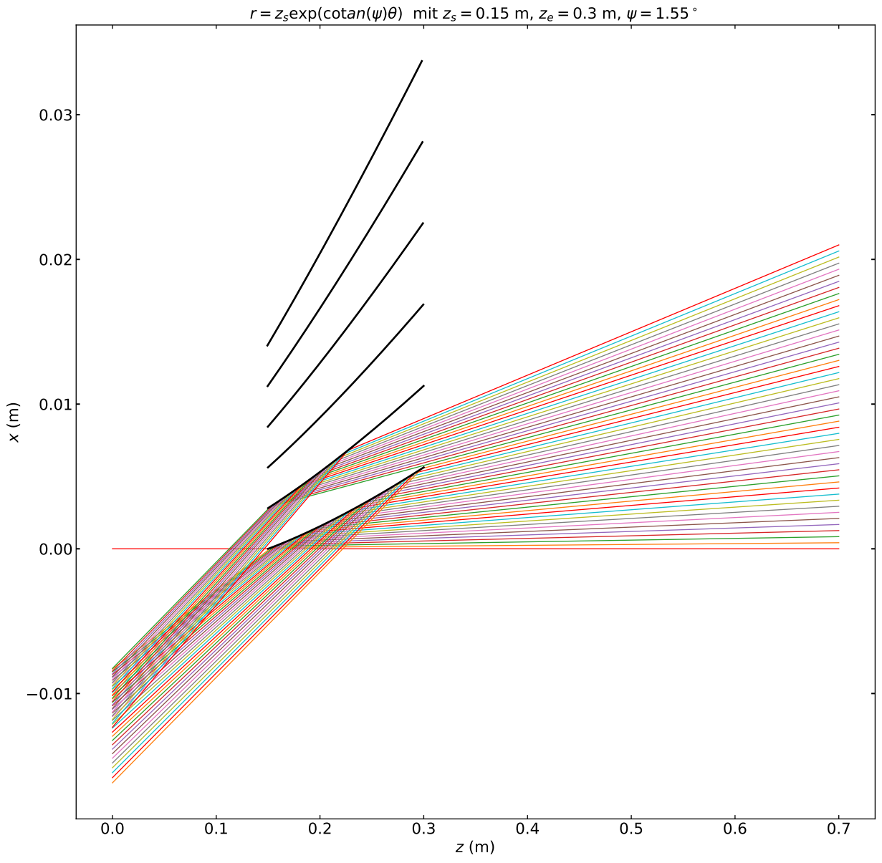
MIEZEFOC-geometry
better separation with
increasing z_{s}
Divergent incoming
neutrons?

