Slide 1
Crawling the Web
with Akka HTTP
Christoph Knabe
Dpt. Informatics and Media
14.03.2017

Slide 2
Content
Bio
Motivation
Technologies used
Communication between actors
Source Code, Demonstration
Lessons learned
Measure Results
Questions

Slide 3
Biography
1981-1990 Software Developer @ PSI GmbH:
Factory Automation, Software Engineering Tools
1990-… Prof. @ Beuth University of Applied Sciences Berlin:
Teaches Software Engineering, Programming
Main interests: Scala, Backend Development

Slide 4
Motivation
Learned in Coursera course „Reactive Programming“:
Massive parallelization only possible by asynchronous, event-oriented processing, not by threaded processing.
Wanted to demonstrate it for my students, who do not own big servers in the web.
⇒ Study massive parallelization on a web client.
App: Web Crawler, which gets hold of as many working web page addresses as possible.

Slide 5
Technologies used
Akka Actors for managing the web crawling, and the web page scanning.
Akka HTTP for sending a page request, and receiving a Stream with the HTML text.
Akka Streams for processing each web page.
Scala Futures for
- piping an HttpResponse into the Scanner Actor,
- awaiting the actor system termination.

Slide 6
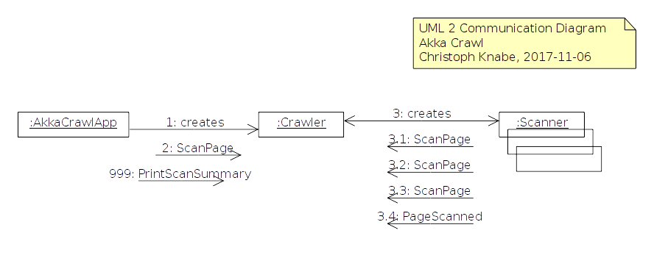
Communication
See this in source code.
Run it.

Slide 7
Lessons learned
Indeterministic:
- Run it often
- Run it in different environments
in order to understand the behavior.
Actors, Futures, Streams: Fully interoperable!!!
No problems with this.
But don't publish state to another thread!
Always set Timeout in order not to collect uncompleted actors:
context.setReceiveTimeout(responseTimeout)
Use property akka.loglevel in the beginning,
switch to off in the end.

Slide 8
Measure Results
At home (Laptop@DSL):
- Scanned 318 pages in 1 minute.
- About 10 unprocessed ScanPage commands.
- Page scans get slower and slower.
In University WLAN (Laptop@WLAN):
- Scanned 2,917 pages in 1 minute
- About 390 unprocessed ScanPage commands.
On University Server:
- Scanned 6,480 pages in 1 minute
- About 800,000 unprocessed ScanPage commands.

Slide 9
Questions
What is the limiting factor?
- Network bandwitdth!
- CPU?
- Number of open ports?
- JVM-RAM, …?
Would a streamed solution (with backpressure) work better?
Can I start an Akka HTTP request from a stream?
Can I feed multiple response streams into one crawler stream?

Slide 10
Thank You

