Slide 1



Slide 2
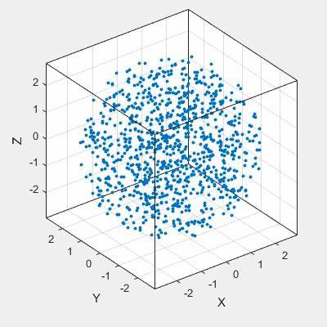
PointNet++
Decoder from AutoEncoder

Slide 3
