Slide 1

SOBEL FILTER IMPLEMENTATION AND OPTIMIZATION: A COMPARATIVE SOFTWARE AND HARDWARE APPROACH
Department of Electrical and Computer Engineering
University of Thessaly, Greece
Professor: Bellas Nikos
Students: Vasileiou Christos, PID: 1983
Voulgaris Dimitris, PID: 2052
CE435: Embedded Systems Course
Spring 2019

Slide 2
Software Implementation Optimizations (1)
Compiler optimizations (-O3)
Loop Unrolling
In function“Convolution2D”
Loop Interchange
Exploit 32KB cache of Cortex-A9 by computing elements row-by-row
Function Inlining
Get rid of function “Convolution2D”
24-Jun-19
ECE - University of Thessaly

Slide 3
Software Implementation Optimizations (2)
Strength reduction
Get rid of “math.h” functions
Replace them with mathematic operations
Common Sub-expression Elimination
In function“Convolution2D”
Algorithm Specific Optimizations
Get rid of filter kernels
Replace them with in lined math operations
24-Jun-19
ECE - University of Thessaly

Slide 4
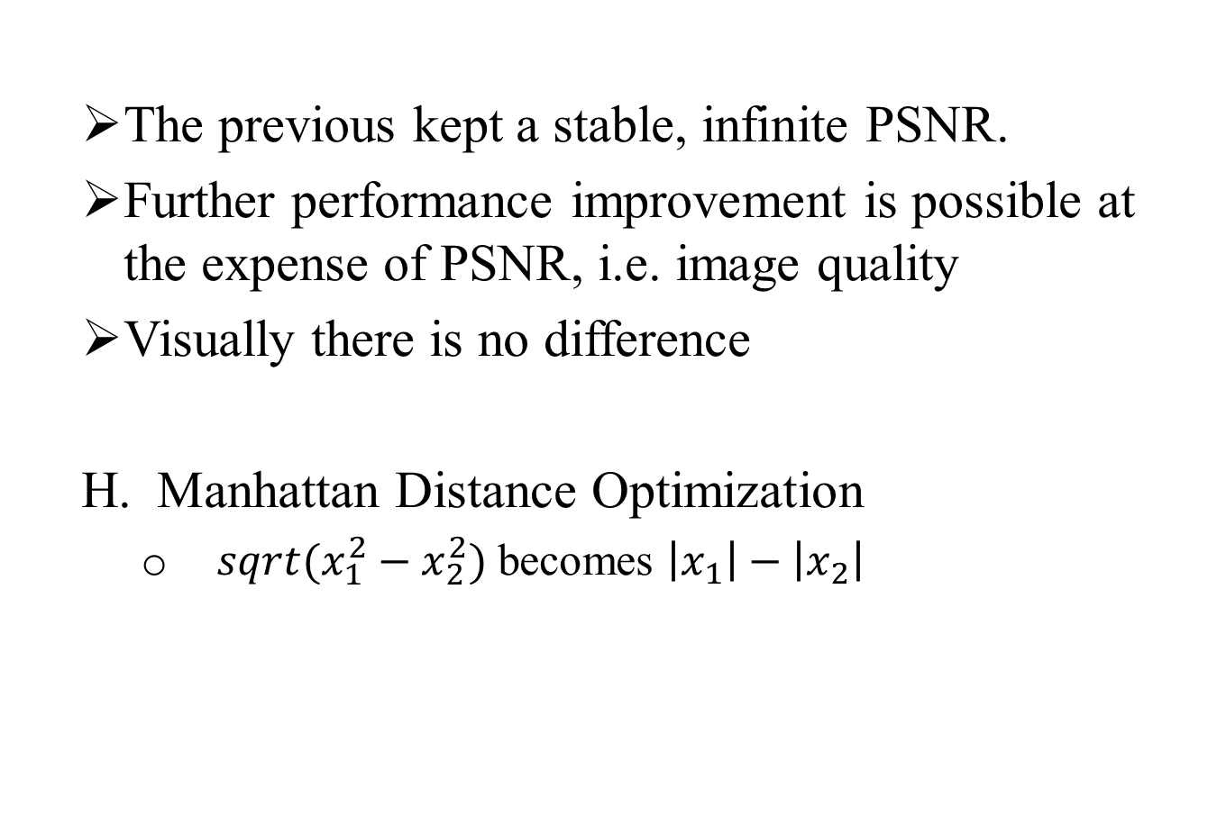
Software Implementation Optimizations (3)
The previous kept a stable, infinite PSNR.
Further performance improvement is possible at the expense of PSNR, i.e. image quality
Visually there is no difference
Manhattan Distance Optimization
$sqrt(x_{1}^{2}−x_{2}^{2})$ becomes $\left|x_{1}\right|−\left|x_{2}\right|$
24-Jun-19
ECE - University of Thessaly

Slide 5
Software Implementation Results (1)
Overall Time Reduction: ~99% (from –O0 @ 1.68 sec to final @ 0.0172)
Partial Time Reduction: ~80% (from –O3 @ 0.088 sec to final @ 0.0172)
25-Jun-19
ECE - University of Thessaly

Slide 6
Software Implementation Results (2)
24-Jun-19
ECE - University of Thessaly

Slide 7
Hardware Implementation The IP Creation (1)
Transfer optimized C/C++ code in Vivado HLS
BUT
Data size is too big to fit in FPGA memory
Decide the data transfer method:
stream
burst mode
Use “memcpy” to enable fast data transfer
24-Jun-19
ECE - University of Thessaly

Slide 8
Hardware Implementation The IP Creation (2)
How many elements are to be transferred each time?
Try-and-error
Compute output image in tiles (ROWS x COLS) of :
130x1024
66x1024
34x1024
18x1024
Opt for 130x1024 because of:
Better overall performance (will explain later)
More resource utilization (will explain later)
24-Jun-19
ECE - University of Thessaly

Slide 9
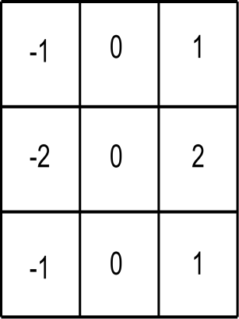
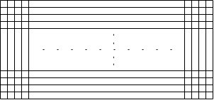
Christos Vasileiou
Dimitrios Voulgaris
Hardware Implementation The Algorithm (1)
1022
0 1 2 3
1021
1023
INPUT ARRAY
0
1
2
3
…
126
127
128
129
25-Jun-19
ECE - University of Thessaly

Slide 10
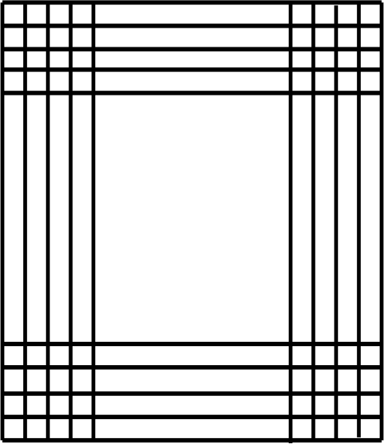
Christos Vasileiou
Dimitrios Voulgaris
Hardware Implementation The Algorithm (2)
Blocks are segments of initial image.
Each block is loaded in FPGA’s memory (BRAMs).
Each block is responsible for feeding the sobel filter.
Size is 130*1024 bytes
IBlock0
Input Image
IBlock1
…
IBlock7
25-Jun-19
ECE - University of Thessaly

Slide 11
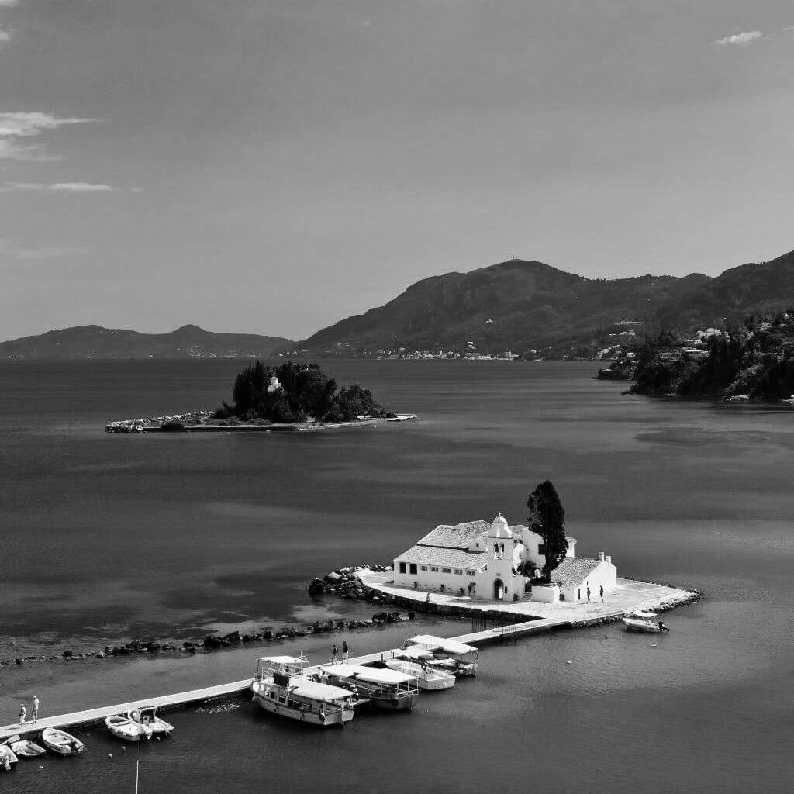
Christos Vasileiou
Dimitrios Voulgaris
Hardware Implementation The Algorithm (2)
IBlock0
1. Blocks are segments of initial image.
2. Each block is loaded in FPGA’s memory (BRAMs).
Input Image
IBlock1
…
3. Each block is responsible for feeding the sobel filter.
4. Size is 130*1024 bytes.
IBlock7
25-Jun-19
ECE - University of Thessaly

Slide 12
Christos Vasileiou
Dimitrios Voulgaris
Hardware Implementation The Algorithm (3)
Sobel filter processes each input block to extract an output block
Output blocks size is reduced by 1 row.
0
..
128
0
..
129
OBlock0
IBlock0
0
..
128
0
..
129
OBlock1
IBlock1
…
…
0
..
129
0
..
128
IBlock7
OBlock7
25-Jun-19
ECE - University of Thessaly

Slide 13
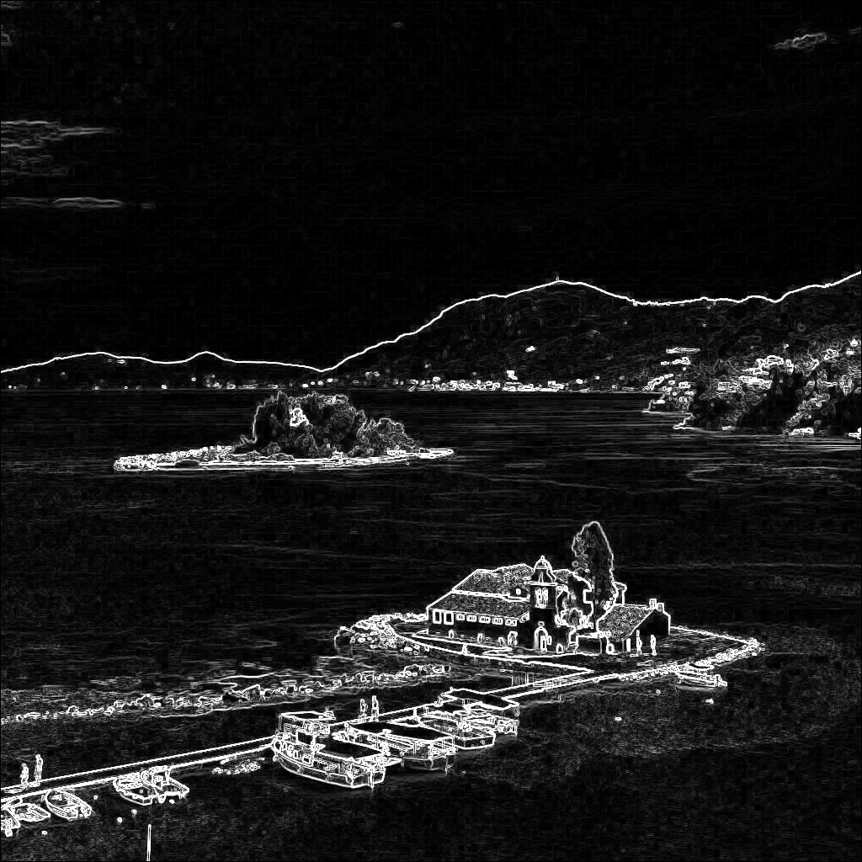
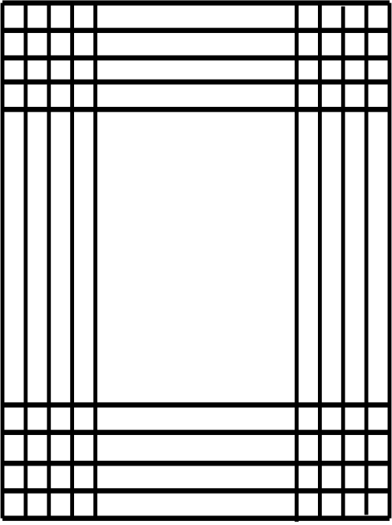
Christos Vasileiou
Dimitrios Voulgaris
Hardware Implementation The Algorithm (4)
0
..
129
IBlock0
0
..
129
IBlock1
1. Blocks are segments of initial image.
2. Each block is loaded in FPGA’s memory (BRAMs).
…
…
0
..
129
IBlock7
Output Image
25-Jun-19
ECE - University of Thessaly

Slide 14
Christos Vasileiou
Dimitrios Voulgaris
Hardware Implementation The Algorithm (5)
OUTPUT ARRAY
1022
0 1 2 3
1021
1023
0
1
2
3
…
Columns 0 and 1023 are always initialized with zeros.
For the first and last output segment the rows 0 and 128 are initialized with zeros.
126
127
128
129
25-Jun-19
ECE - University of Thessaly

Slide 15
Hardware Implementation The Block Diagram (1)
Zynq7 Processing System
Sobel IP
AXI Interconnect (x2)
Processor System Reset (by default)
Use AXI-Lite protocol with 3 communication channels:
1st to control IP operation
2nd to fetch input image segments
3rd to export output image segments
25-Jun-19
ECE - University of Thessaly

Slide 16
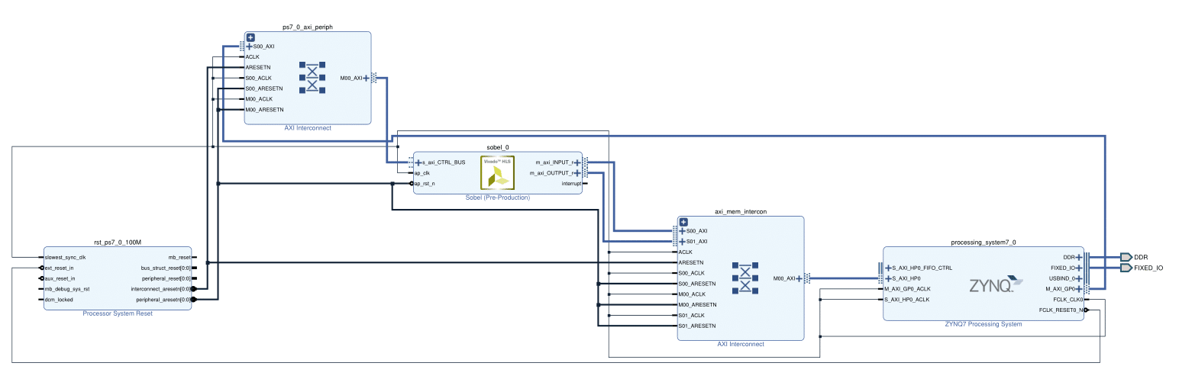
Hardware Implementation The Block Diagram (2)
25-Jun-19
ECE - University of Thessaly

Slide 17
Hardware Implementation Optimizations (1)
The main Sobel code consists of 3 loops:
BLOCK_LOOP
OUTER_LOOP
INNER_LOOP
We experimented with:
Different combinations of “loop unrolling” and “loop pipelining”
Different array sizes that affect all loop iterations
Array partitioning for parallel execution
Frequency modification
25-Jun-19
ECE - University of Thessaly

Slide 18
Hardware Implementation Optimizations (2)
Final optimizations:
Unroll BLOCK_LOOP by factor of 2
Pipeline INNER_LOOP
Unroll “zero-setting” loop complete
25-Jun-19
ECE - University of Thessaly

Slide 19
Hardware Implementation Optimizations (3)
Summary
Timing Summary | target | 10 | 10 | 10 | 10 | 10 | 10 | 8 | 7 | 6 | 5.5 | 7.3
 | estimated | 8.62 | 8.75 | 8.75 | 8.75 | 8.75 | 8.75 | 7 | 6.12 | 5.38 | 5.38 | 7.24
 | uncertainty | 1.25 | 1.25 | 1.25 | 1.25 | 1.25 | 1.25 | 1 | 0.88 | 0.75 | 0.69 | 0.91
Latency | min | 64762177 | 50239641 | 6320297 | 6448297 | 6361681 | 6452217 | 6453241 | 6452729 | 6455873 | 6456897 | 6296725
 | max | 64762177 | 50264217 | 6357145 | 6485145 | 6443537 | 6493145 | 6494169 | 6493657 | 6496801 | 6497825 | 6317189
 | avg | 64762177 | 50251929 | 6338721 | 6466721 | 6402609 | 6472681 | 6473705 | 6473193 | 6476337 | 6477361 | 6306957
Utilization (%) | BRAM | 0 | 92 | 92 | 92 | 24 | 12 | 12 | 12 | 12 | 12 | 92
 | DSP | 35 | 0 | 0 | 14 | 1 | 0 | 0 | 0 | 0 | 0 | 0
 | FF | 9 | 5 | 6 | 27 | 8 | 13 | 13 | 20 | 22 | 23 | 5
 | LUT | 22 | 11 | 26 | 42 | 29 | 30 | 30 | 38 | 39 | 39 | 21
Trip Count: |  | 1022 | 8 | 8 | 8 | 16 | 8 |  | 8 |  | 8 | 4
Info: | INNER |  |  | pipeline | Pipeline + unroll 16 | Pipeline | Pipeline | Pipeline | Pipeline | Pipeline | Pipeline | Pipeline
 | OUTER
 | BLOCK |  |  |  | no unroll | Unroll 2 | Unroll 8 | Unroll 8 | Unroll 8 | Unroll 8 | Unroll 8 | Unroll 2
 | ARRAY_ROWS |  |  | 130 | 130 | 34 | 18 | 18 | 18 | 18 | 18 | 130
25-Jun-19
ECE - University of Thessaly

Slide 20
Hardware Implementation Optimizations (4)
Overall Time Reduction: ~93% (from 0.25sec to final @ 0.0173)
25-Jun-19
ECE - University of Thessaly

Slide 21
Hardware Implementation C/C++ Code (2)
Configure timer
Disable interrupts
Prepare input/output files
Start timer
Call Sobel HW accelerator
Stop timer
Compute PSNR
Write output
25-Jun-19
ECE - University of Thessaly

Slide 22

Thank You
25-Jun-19
ECE - University of Thessaly

