Slide 1
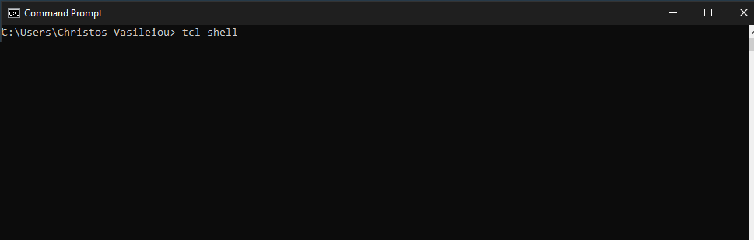
CE437: Αλγόριθμοι CAD I Homework 1 Tcl shell’s Implementation
By Vasileiou Christos, 1983

Slide 2
Files’ Structure
customTCL.c: Included function’s implementation and main thread.
char **custom_completer(const char *text, int start, int end);
char *instruction_generator (const char *text, int state);
int InitInterpreter (void);void get_history ();
void initParsingCommand( char* ch);
int main(int argc, char *argv[] )
Instructions.h: Included Tcl instructions in a string array.
static char *instructions[]
Makefile: Linking and Compilation.
gcc -g customTCL.c Instructions.h -o customTCL $(LDFLAGS) $(DIRS)

Slide 3
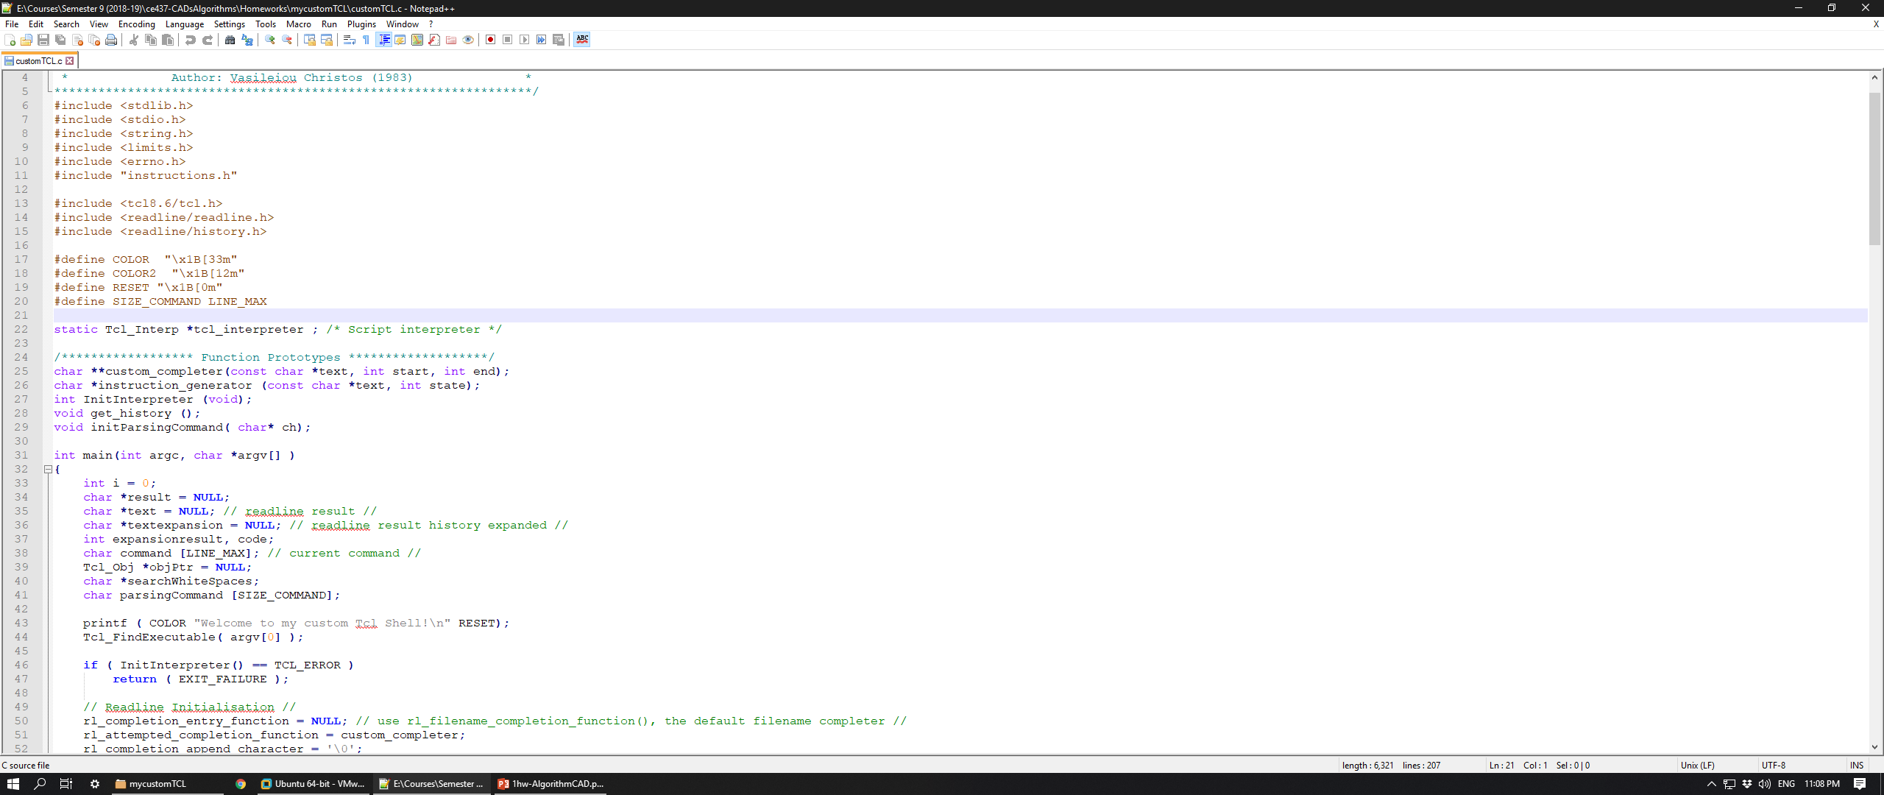
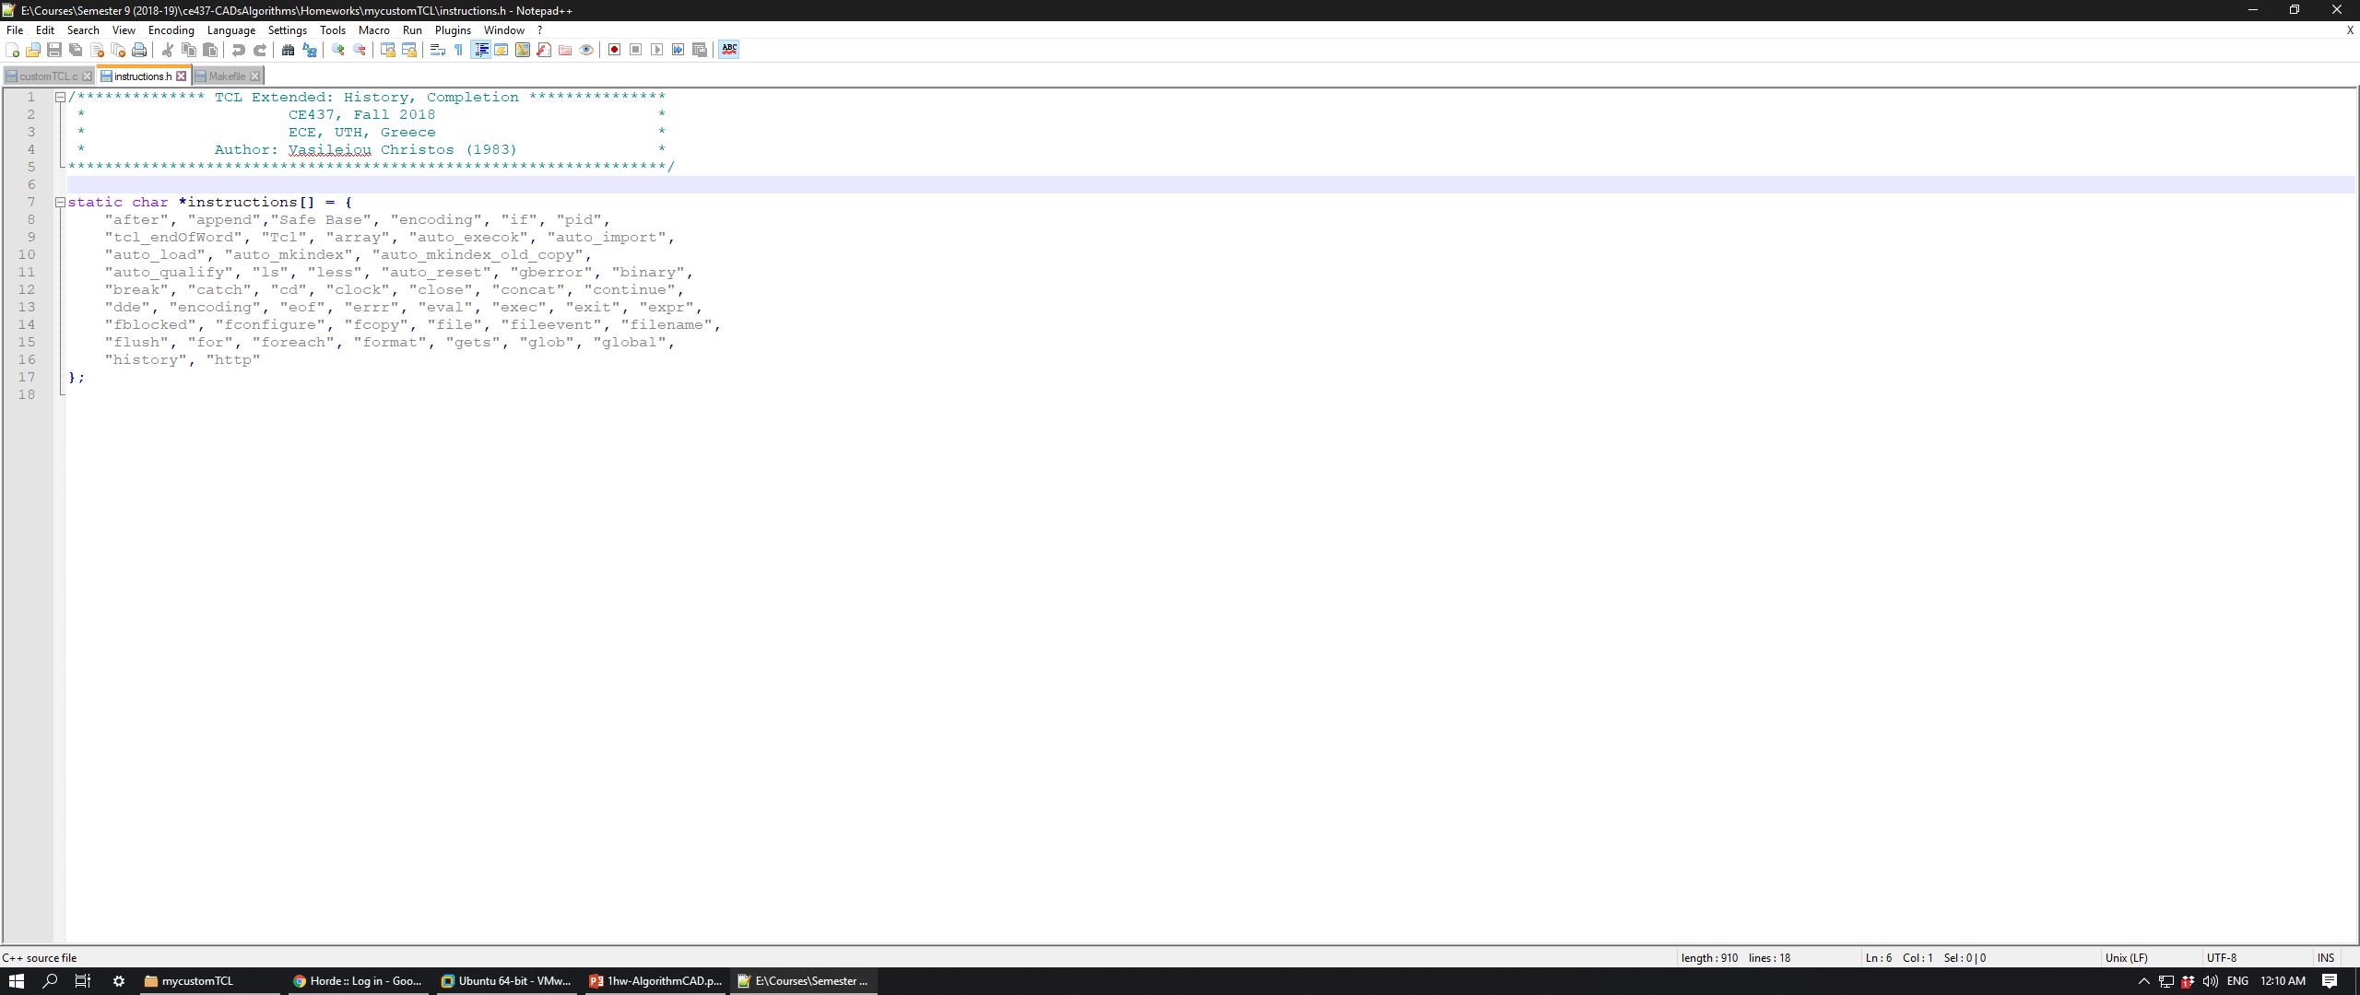
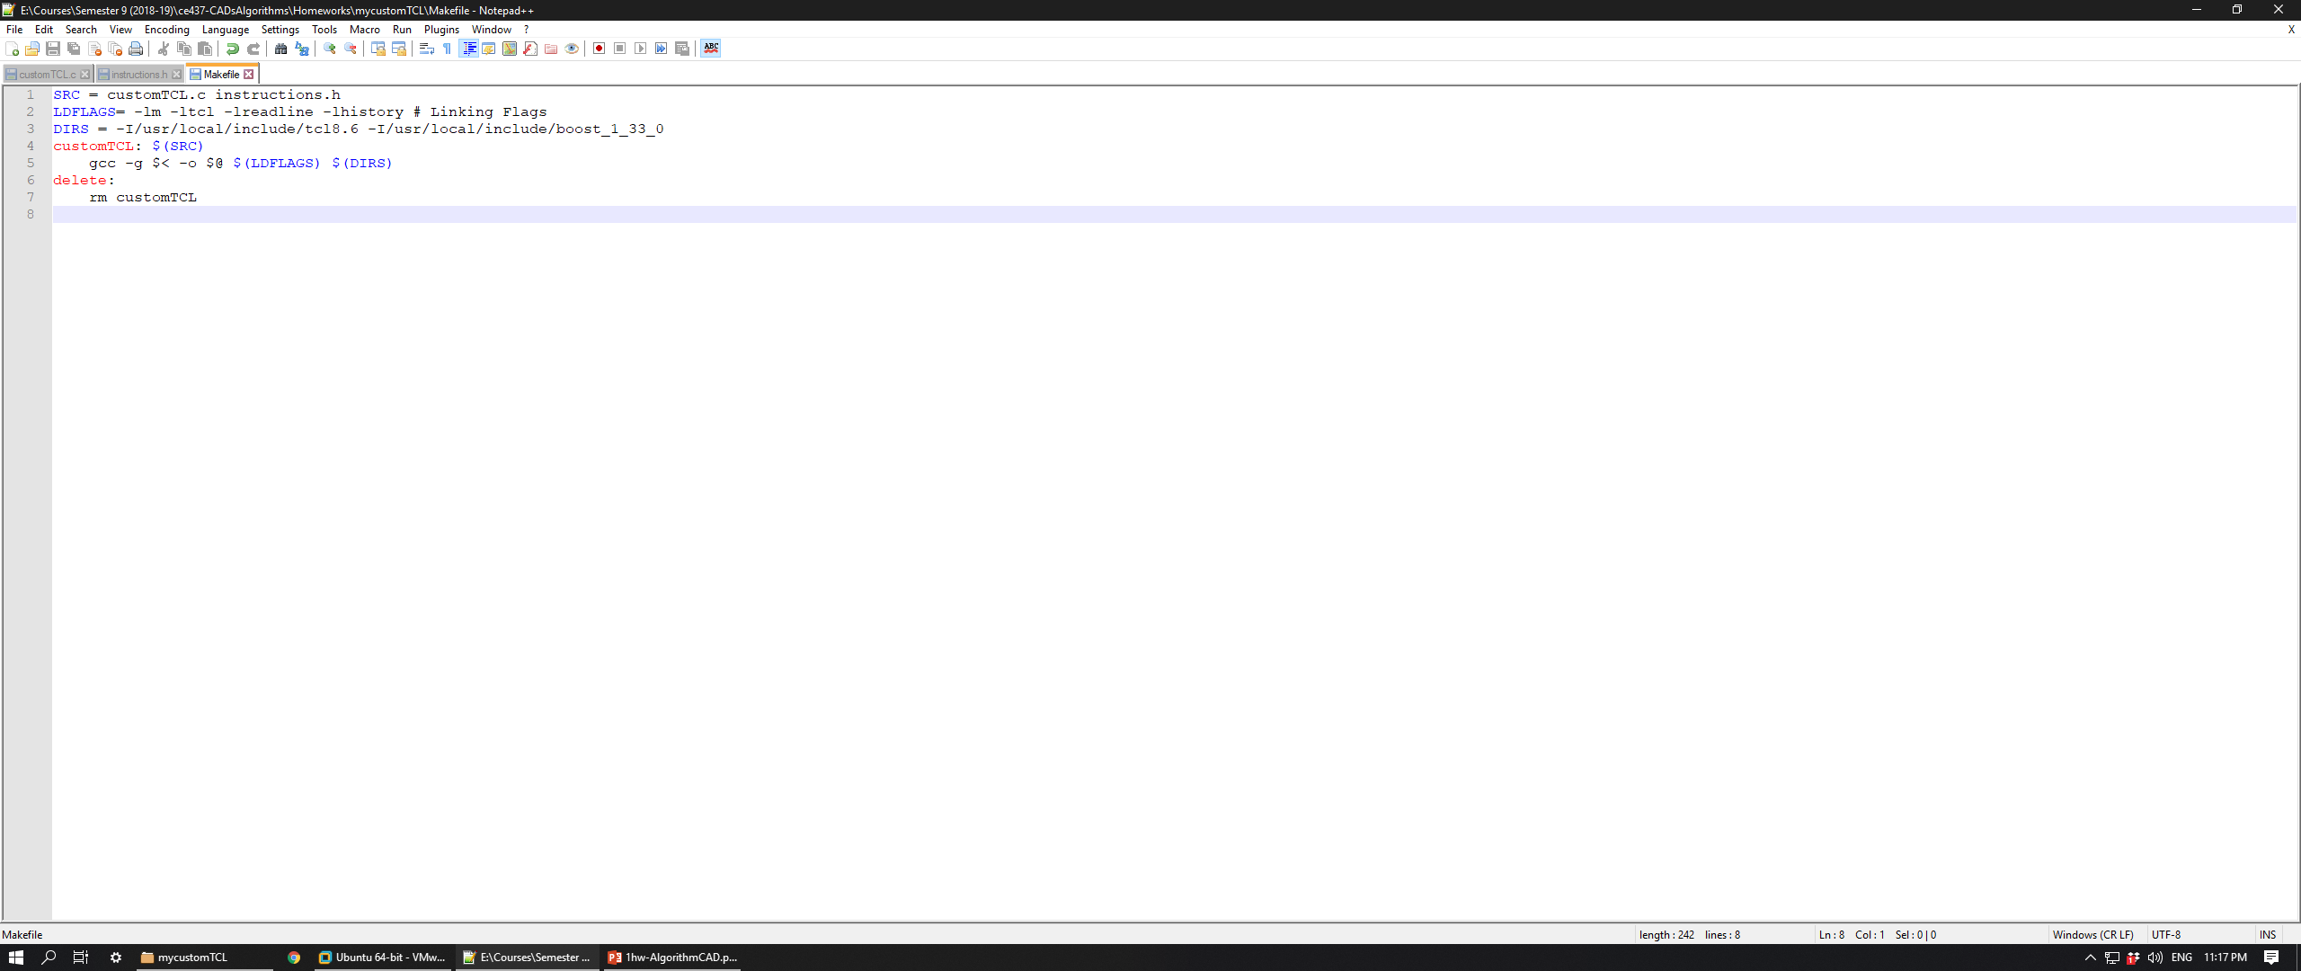
Files’ Structure
Functions’ prototypes
String array with instructions:
Makefile

Slide 4
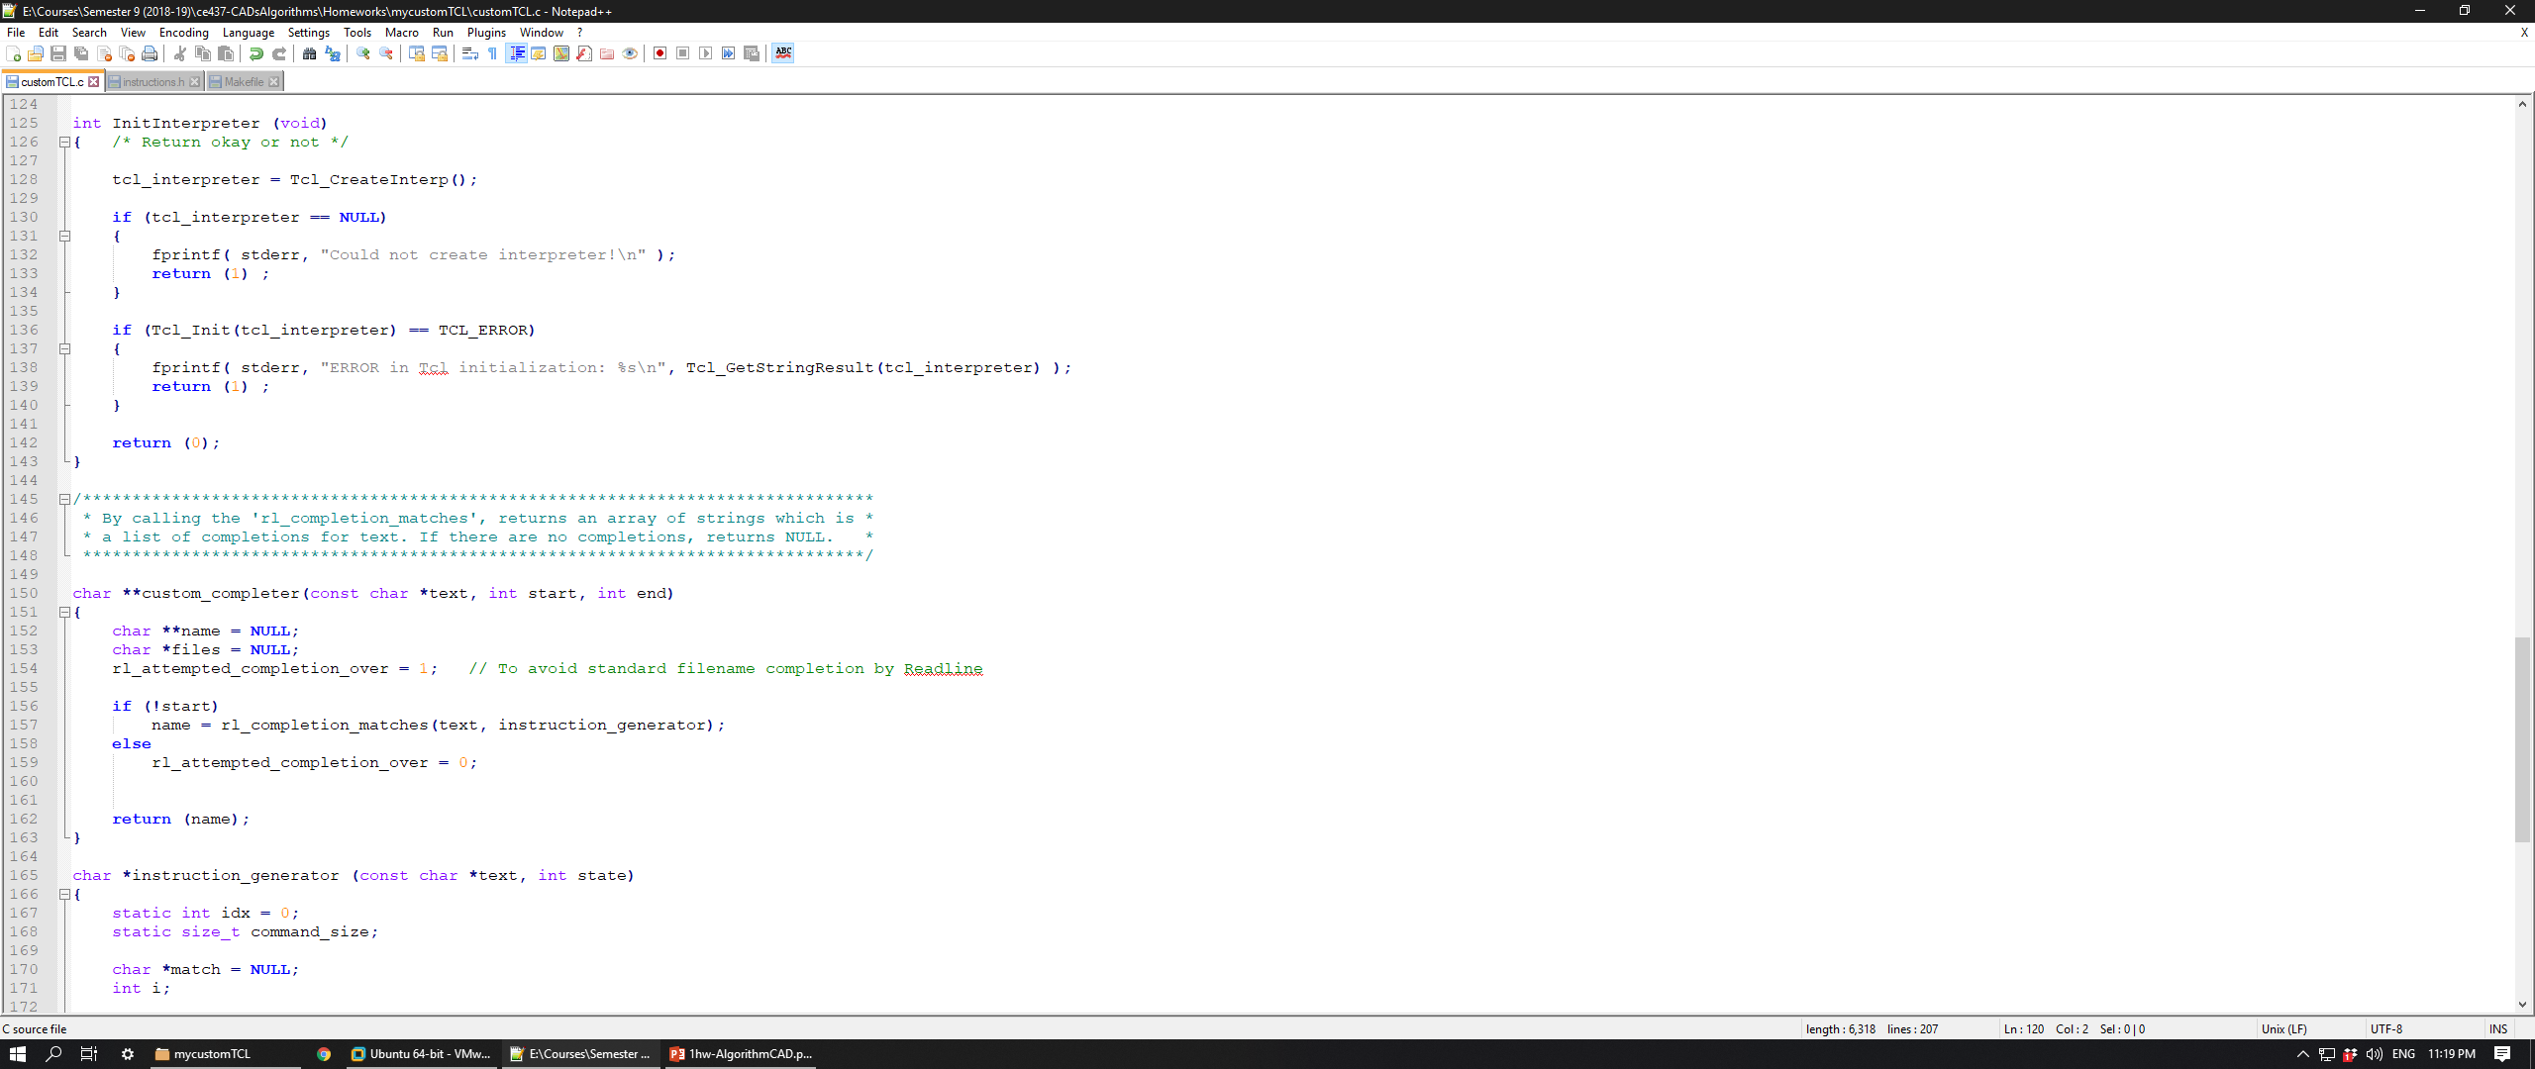
customTCL’s Functions
InitInterpreter:
In case of successful initialization function returns 0, otherwise 1.
Custom_completer:
Is responsible for completing words while tab is hitted.
When rl_attempted_completion_over is set to 1 function instruction_generator is called, otherwise standard file completion is enabled by Readline.

Slide 5
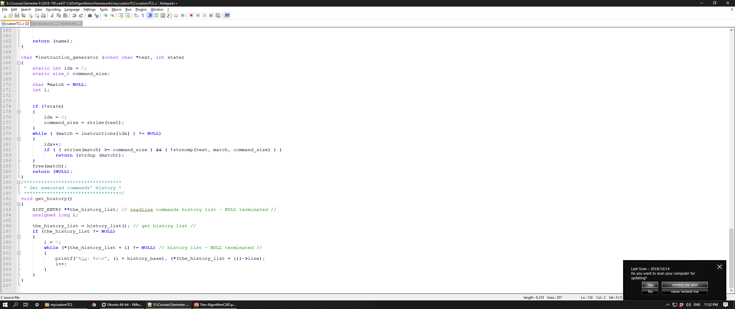
customTCL’s Functions
Instruction_generator:
Searches in instructions array in order to find a specific command of tcl.
get_history:
Prints all the commands that have been executed until the time it was called.

Slide 6
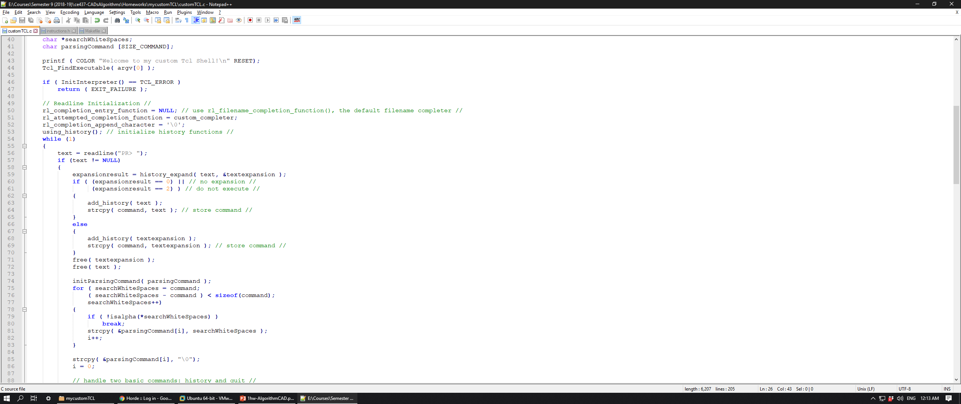
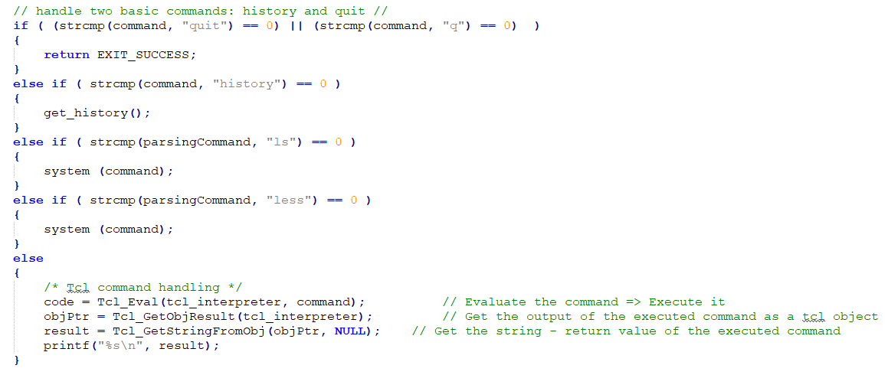
customTCL’s Functions
Main:
initialize all parameters of readline and history library.
Parsing command in order to print in bash shell.

Slide 7
End of presentation.
Thank you!

