Slide 1
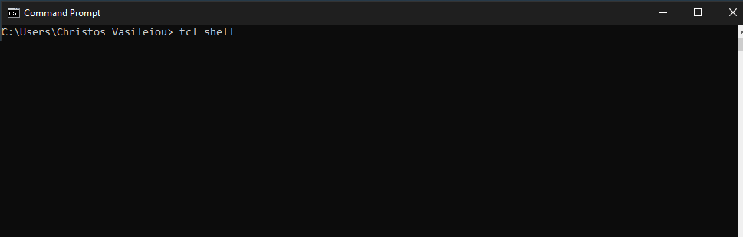
CE437: Αλγόριθμοι CAD I Homework 2 Tcl shell’s Implementation
By Vasileiou Christos, 1983

Slide 2
Files’ Structure
customTCL.c: Includes main implemenation.
int main(int argc, char *argv[] )
Instructions.h: Includes Tcl instructions in a string array.
static char *instructions[]
functions_1st.c: Includes 1st homework’s functions.
functions_2nd.c: Includes 2nd homework’s functions.
void *commandsCreation();
Tcl_ObjCmdProc *cube_intersect_2 ( ClientData clientData, Tcl_Interp *interp, int objc, Tcl_Obj *CONST objv[] )
Tcl_ObjCmdProc *supercube_2 ( ClientData clientData, Tcl_Interp *interp, int objc, Tcl_Obj *CONST objv[] );
void *distance_2 ( ClientData clientData, Tcl_Interp *interp, int objc, Tcl_Obj *CONST objv[] );
void *cube_cover_2 ( ClientData clientData, Tcl_Interp *interp, int objc, Tcl_Obj *CONST objv[] );
void *sharp_2 ( ClientData clientData, Tcl_Interp *interp, int objc, Tcl_Obj *CONST objv[] );
void *my_sharp ( ClientData clientData, Tcl_Interp *interp, int objc, Tcl_Obj *CONST objv[] );
void *sharp ( ClientData clientData, Tcl_Interp *interp, int objc, Tcl_Obj *CONST objv[] );
int checkIfValid ( char *checked, int size );
Makefile: Linking and Compilation.

Slide 3
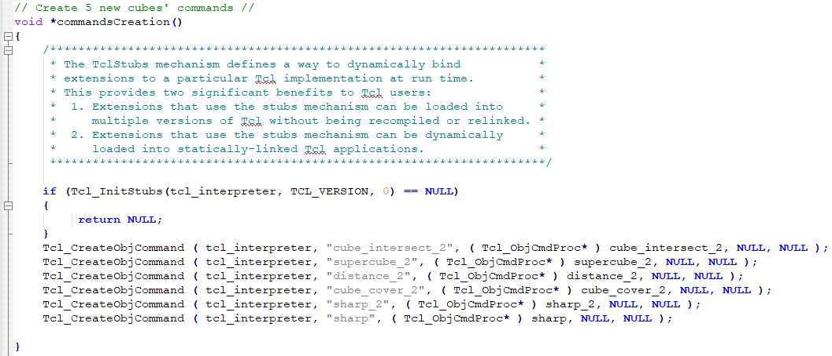
commandsCreation() function

Slide 4
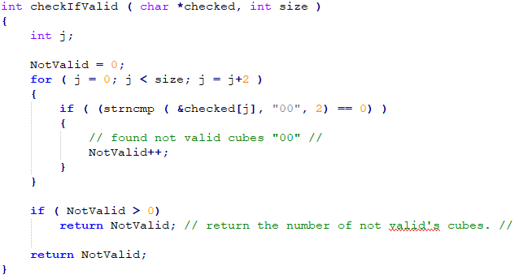
checkIfValid implementation
checkIfValid:
returns the number of invalid patterns.

Slide 5
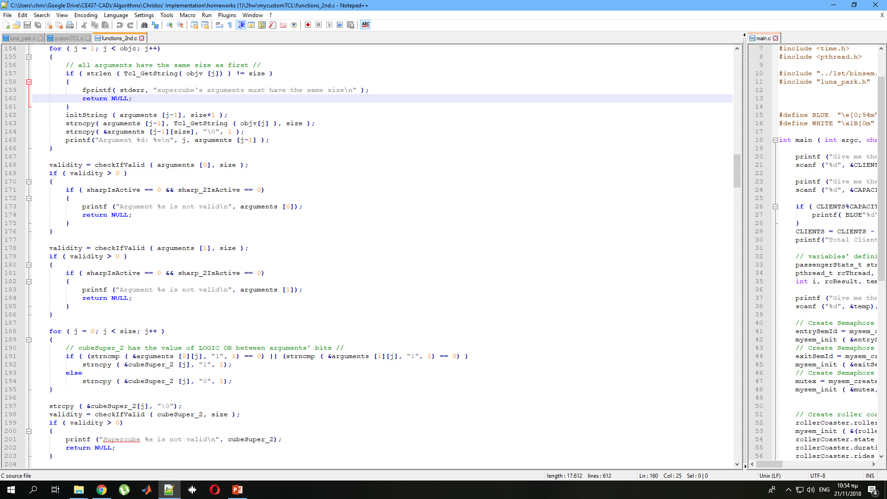
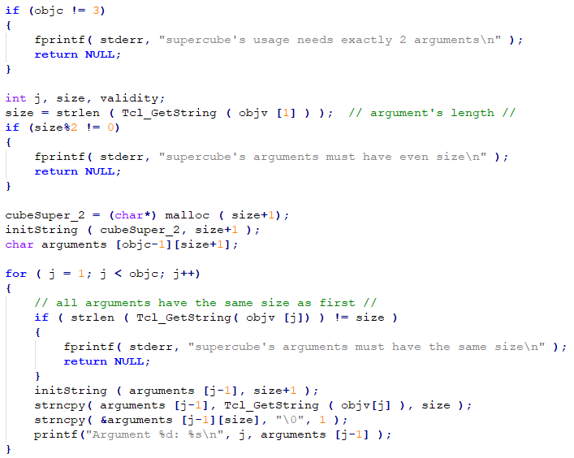
Reading arguments

Slide 6
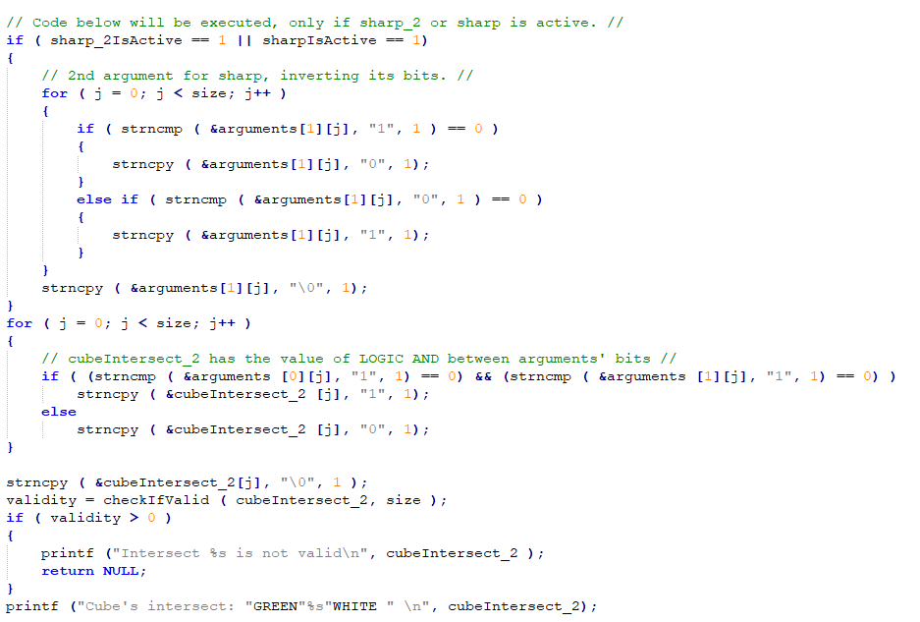
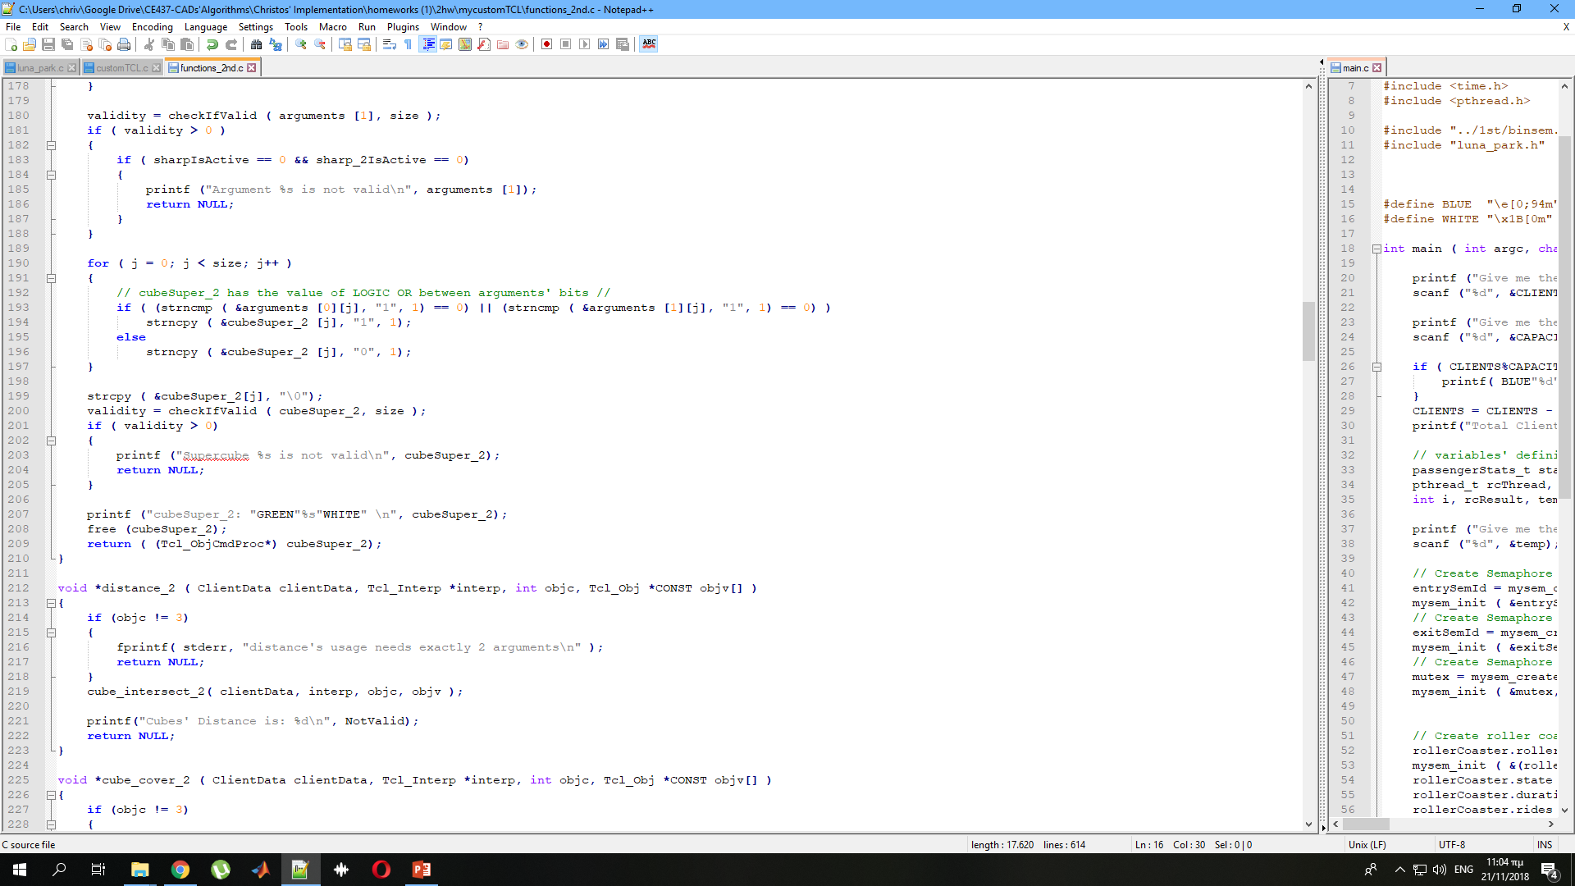
cube_intersect_2 and supercube_2 implementation

Slide 7
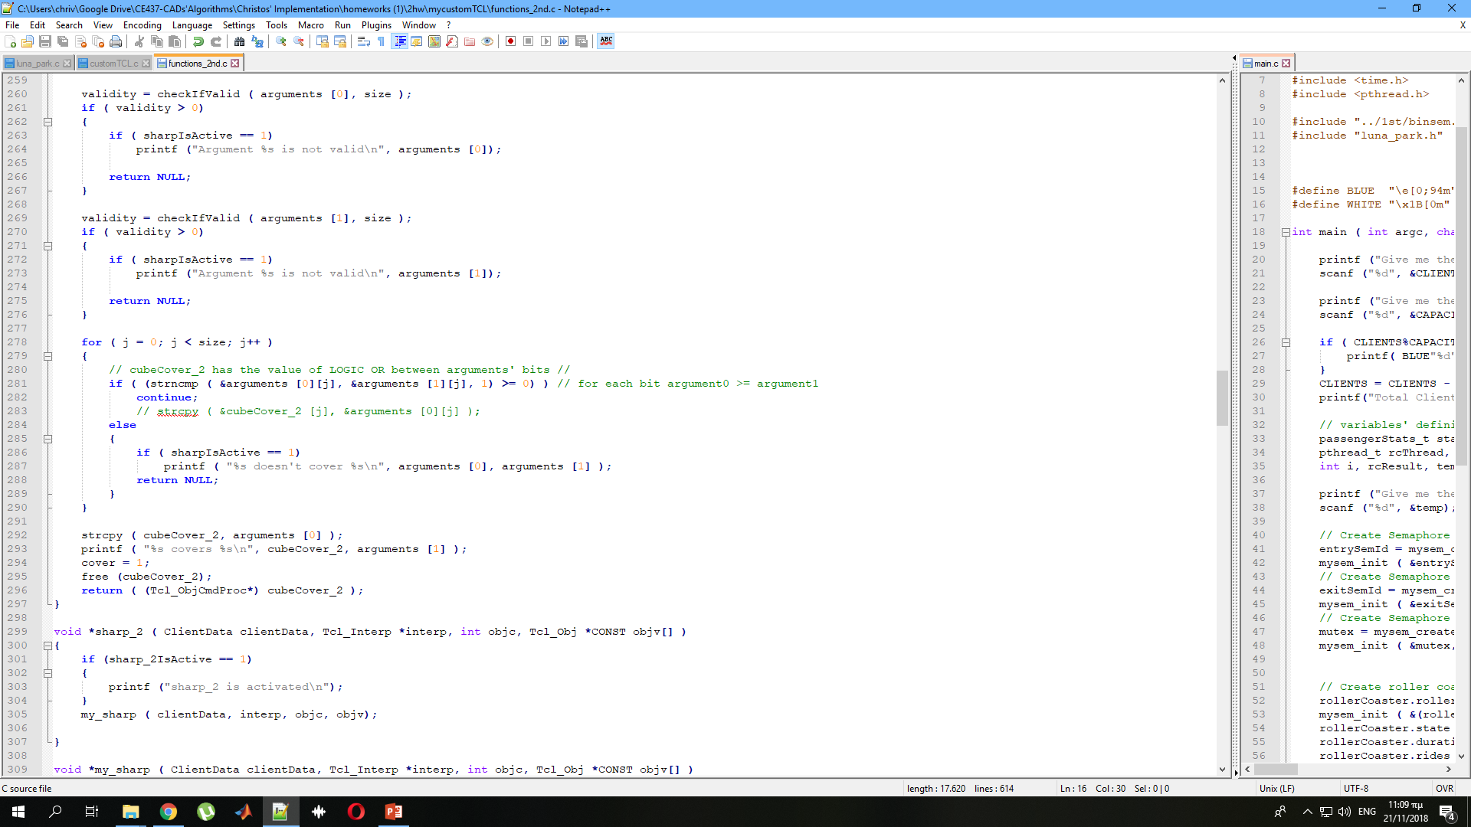
distance_2 and cube_cover_2 implementation
distance_2:
cube_cover_2:

Slide 8
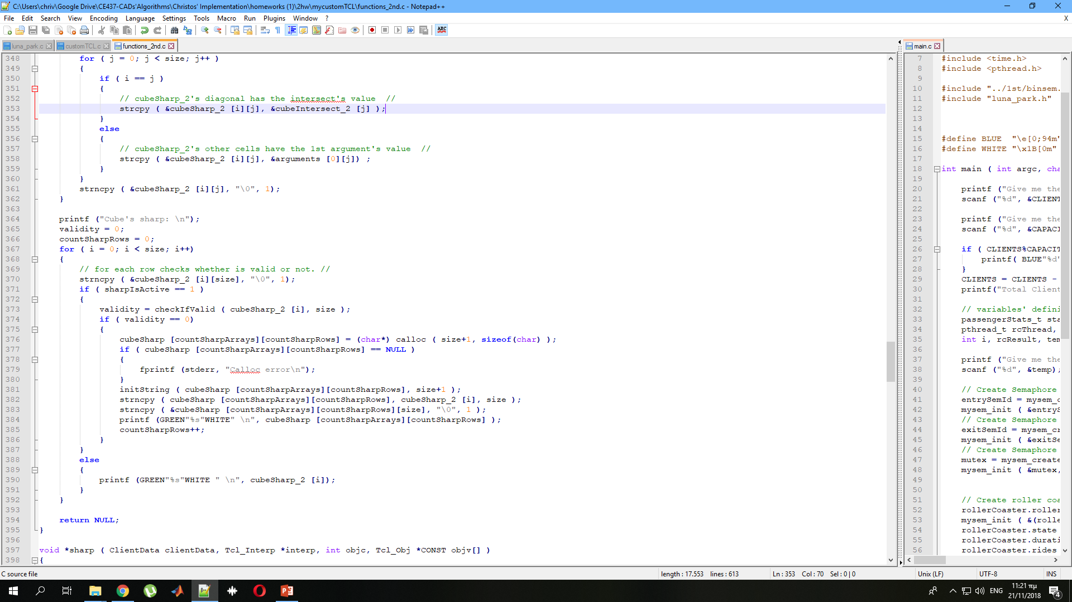
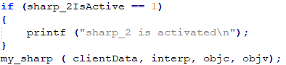
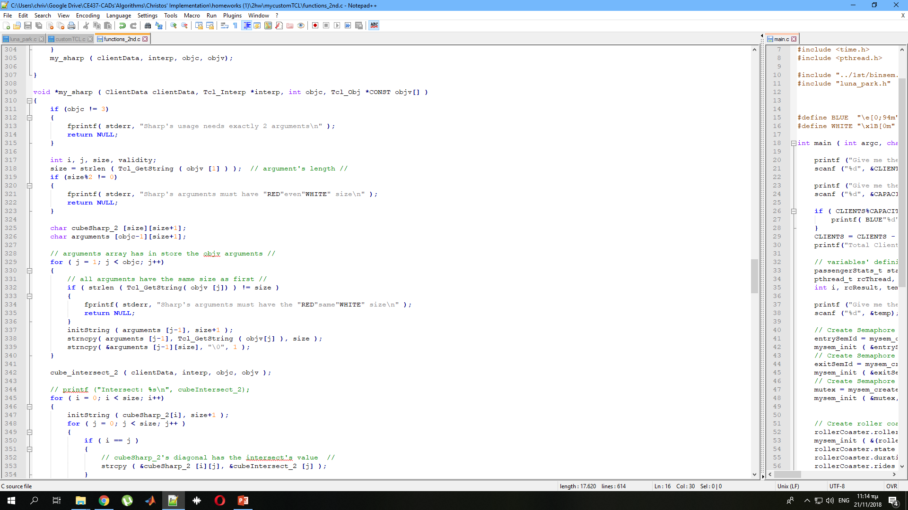
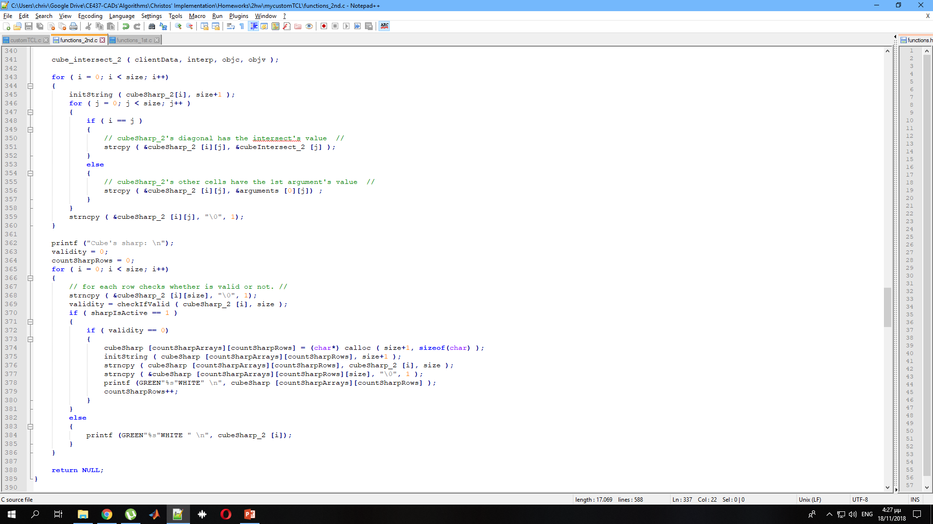
Sharp_2 implementation
sharp_2:
my_sharp:

Slide 9
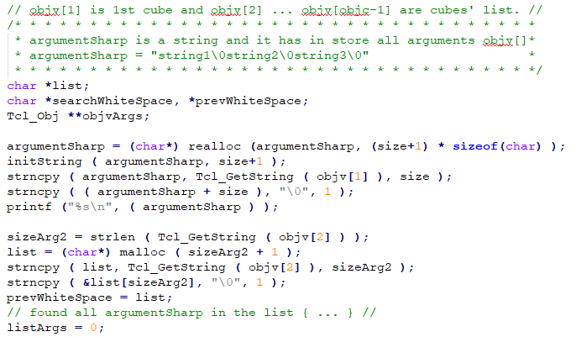
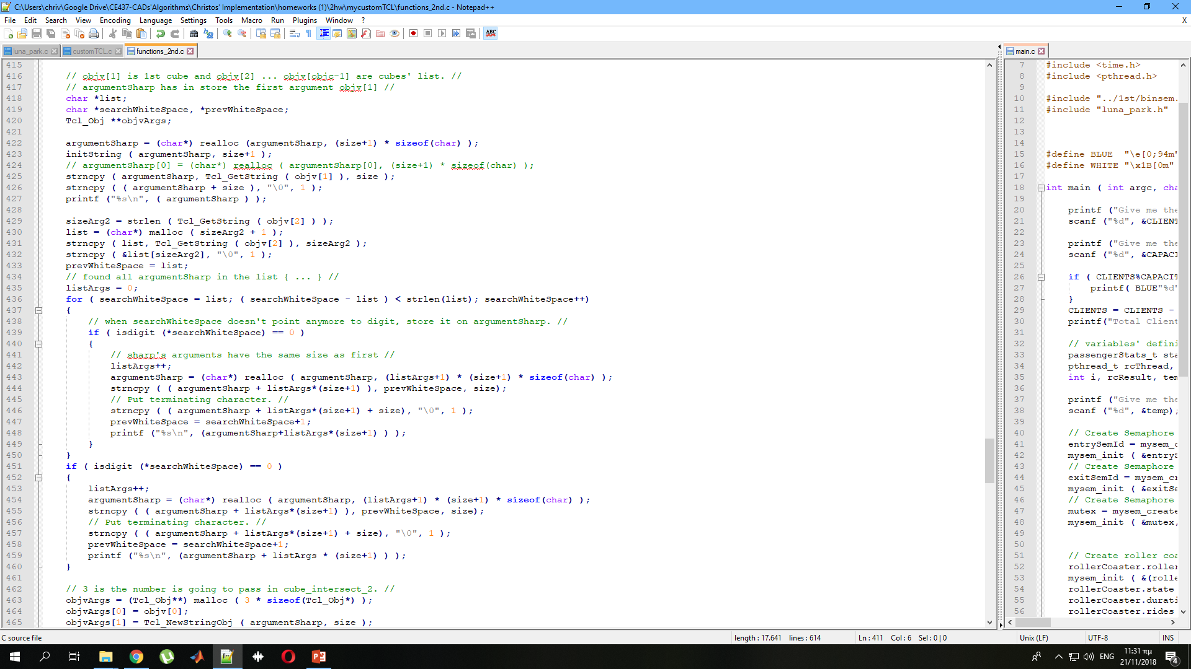
Sharp implementation: storing arguments from list

Slide 10
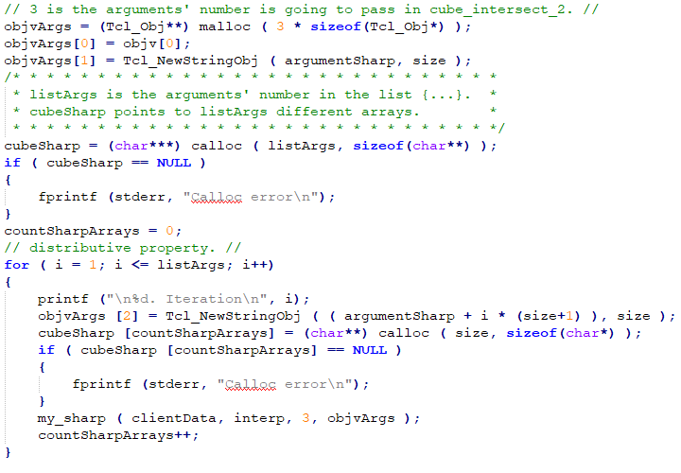
Sharp implementation: sharp_2 is activated.

Slide 11
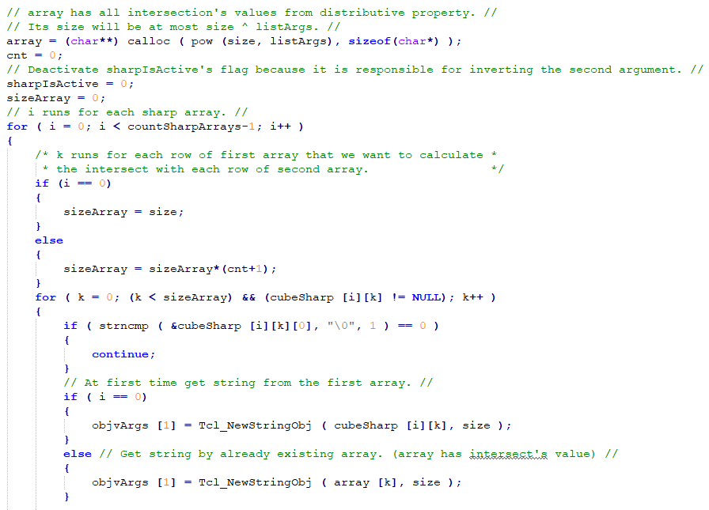
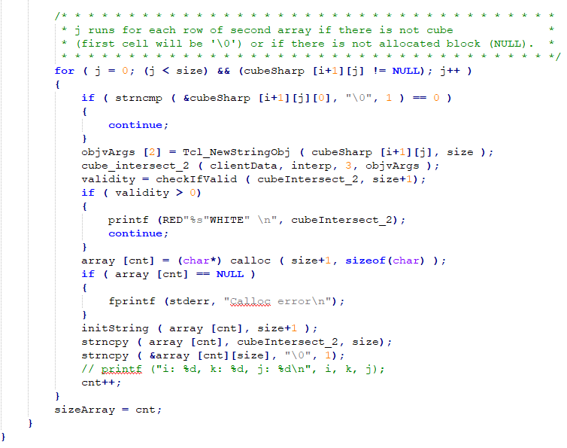
Sharp implementation: cube’s intersection

Slide 12
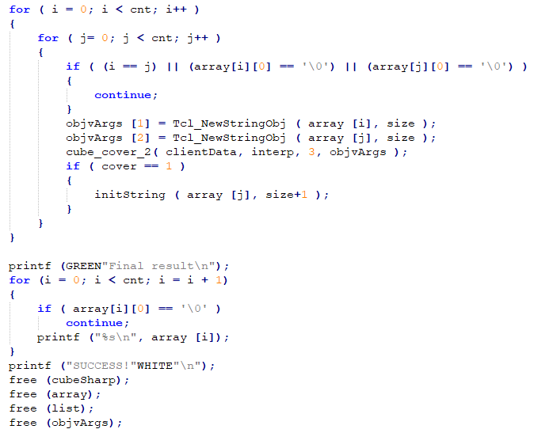
Sharp implementation: cube’s covering

Slide 13
End of presentation.
Thank you!

