Slide 1
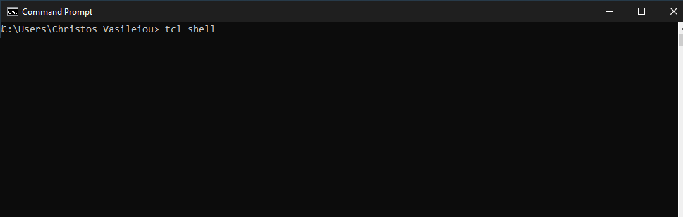
CE437: Αλγόριθμοι CAD I Homework 3 Tcl shell’s Implementation
By Vasileiou Christos, 1983

Slide 2
Files’ Structure
customTCL.c: Includes main implemenation.
int main(int argc, char *argv[] )
Instructions.h: Includes Tcl instructions in a string array.
static char *instructions[]
functions_1st.c: Includes 1st homework’s functions.
functions_2nd.c: Includes 2nd homework’s functions.
void *commandsCreation();
Tcl_ObjCmdProc *cube_intersect_2 ( ClientData clientData, Tcl_Interp *interp, int objc, Tcl_Obj *CONST objv[] )
Tcl_ObjCmdProc *supercube_2 ( ClientData clientData, Tcl_Interp *interp, int objc, Tcl_Obj *CONST objv[] );
void *distance_2 ( ClientData clientData, Tcl_Interp *interp, int objc, Tcl_Obj *CONST objv[] );
void *cube_cover_2 ( ClientData clientData, Tcl_Interp *interp, int objc, Tcl_Obj *CONST objv[] );
void *sharp_2 ( ClientData clientData, Tcl_Interp *interp, int objc, Tcl_Obj *CONST objv[] );
void *my_sharp ( ClientData clientData, Tcl_Interp *interp, int objc, Tcl_Obj *CONST objv[] );
void *sharp ( ClientData clientData, Tcl_Interp *interp, int objc, Tcl_Obj *CONST objv[] );
int checkIfValid ( char *checked, int size );
Makefile: Linking and Compilation.

Slide 3
Files’ Structure
functions_3rd.c: Includes 3rd homework’s functions.
void *do_read_graph ( ClientData clientData, Tcl_Interp *interp, int objc, Tcl_Obj *CONST objv[] );
void *initIntArray ( int x, int y, int array [x][y], int val );
void *initInt ( int x, int n[x], int val );
int searchNodes ( int x, int n[x], int n2 ); // return 1 if n2 is not in nD. //
void *printGraph ( int x, int graph [x][x] );
void *do_write_graph ( ClientData clientData, Tcl_Interp *interp, int objc, Tcl_Obj *CONST objv[] );
void *do_draw_graph ( ClientData clientData, Tcl_Interp *interp, int objc, Tcl_Obj *CONST objv[] );
nodesDist_t find_Shortest_Explored_Node ( int x, nodesDist_t *d );
int maximum ( int a, int b );
int graphIsNotEmpty ( nodesDist_t *n ); // return 0 if n is full. //
void sortGraph ( int x, nodesDist_t *n );
void *do_graph_critical_path ( ClientData clientData, Tcl_Interp *interp, int objc, Tcl_Obj *CONST objv[] );
int minimum (int a, int b);
nodesDist_t *back_trace ( nodesDist_t *Q, int arcWeight[size][size], int longest_path, int Rslack, int *previous, int maxDistanceNode, int *slack, nodesDist_t *criticalPath );

Slide 4
Variable’s Structure
enum nodeStatus { UNEXPLORED, EXPLORED }; typedef enum nodeStatus nodeStatus_t;
struct nodesDist { int node; int dist; nodeStatus_t status; }; typedef struct nodesDist nodesDist_t;
struct arc { int src; int dest; int weight; }; typedef struct arc arc_t;
arc_t *arcs; // all graph's arcs. //
int cntArcs; // number of arcs. //
int size; // number of nodes. //

Slide 5
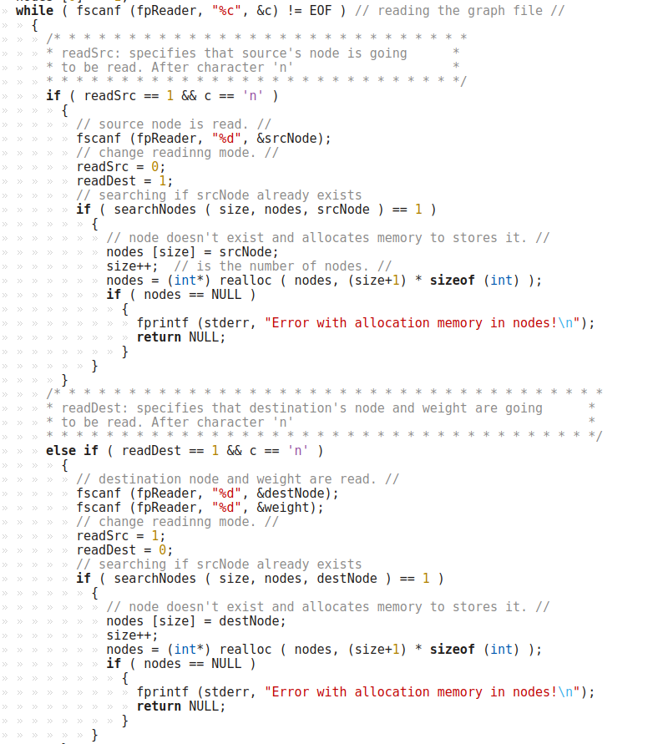
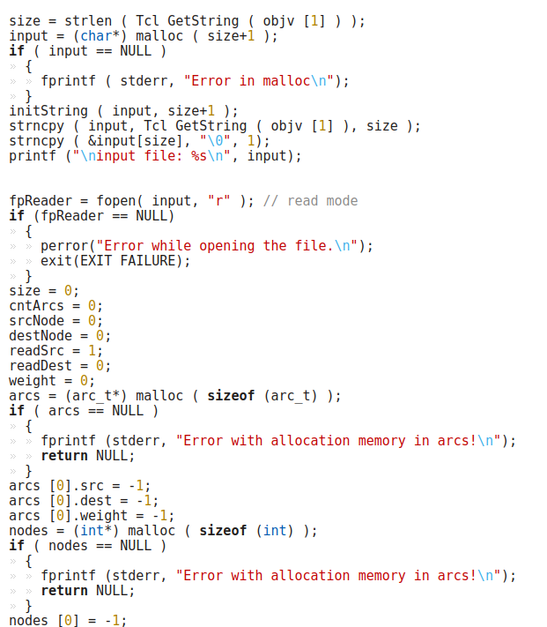
Read_graph

Slide 6
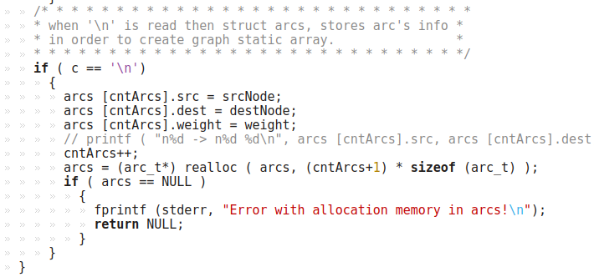
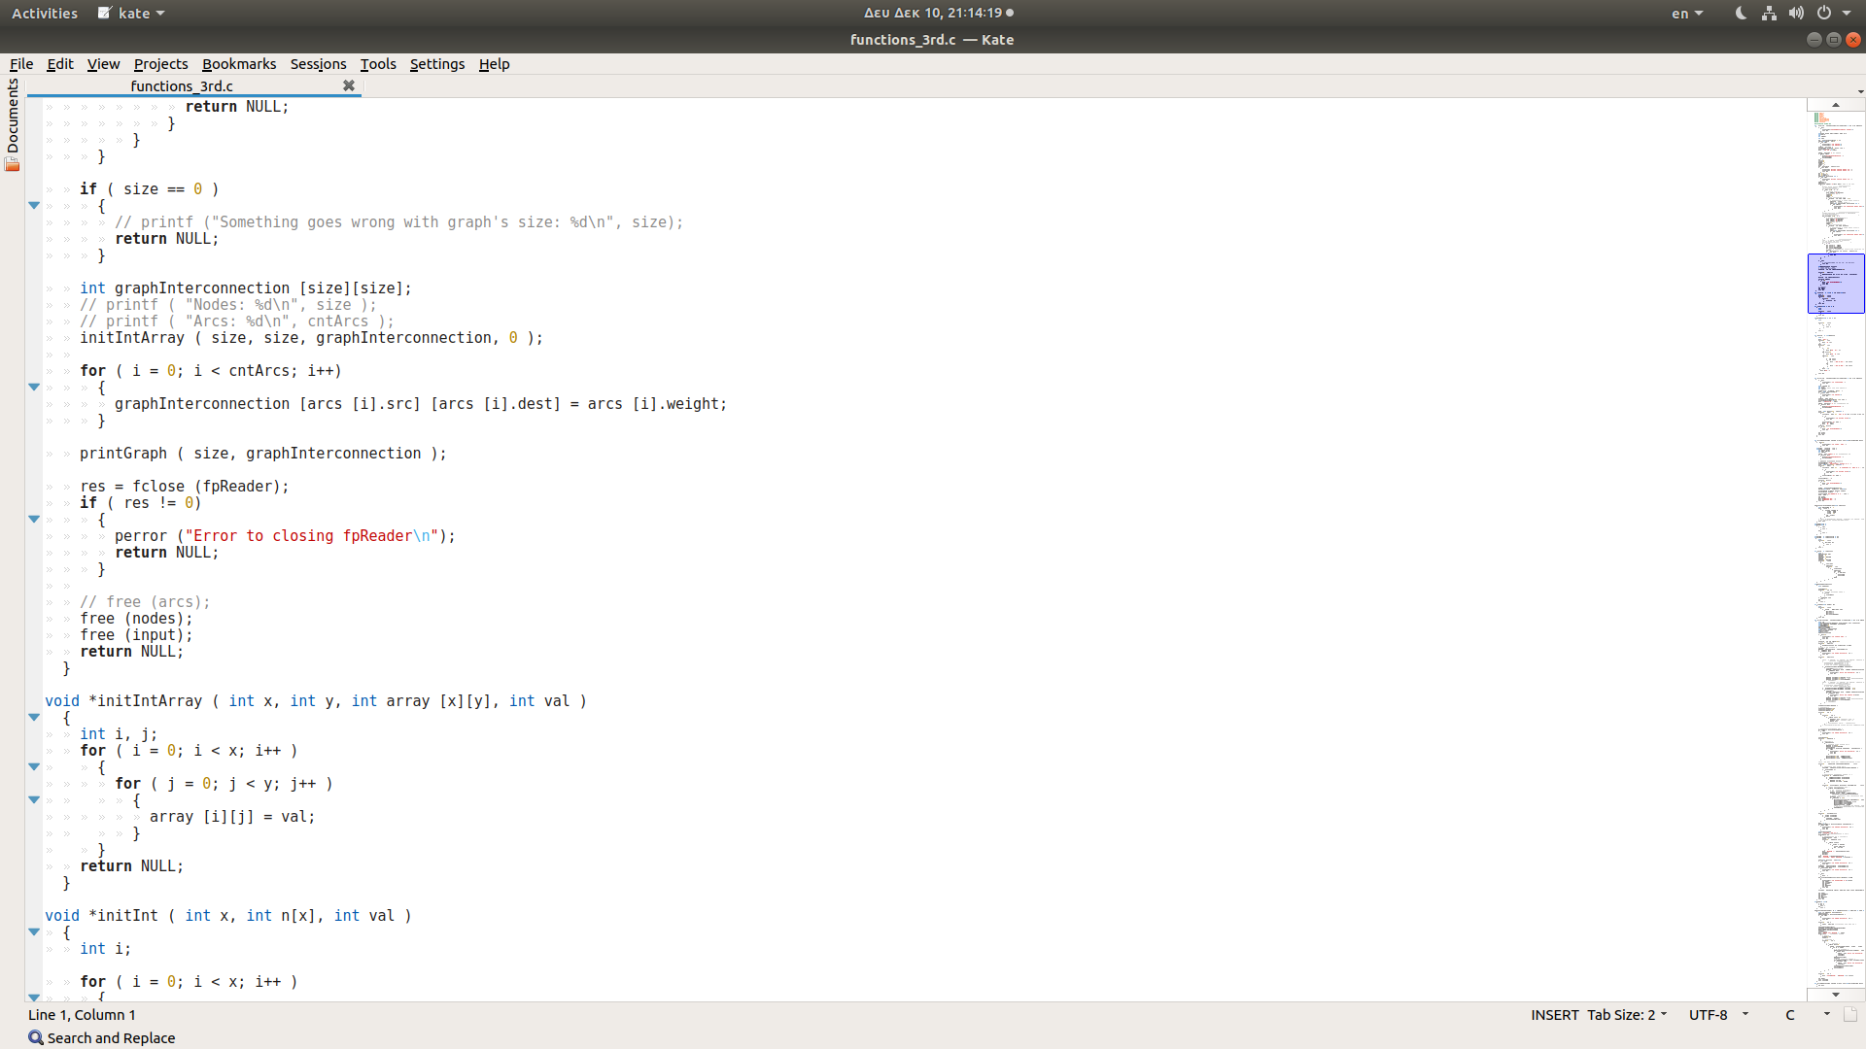
Read_graph

Slide 7
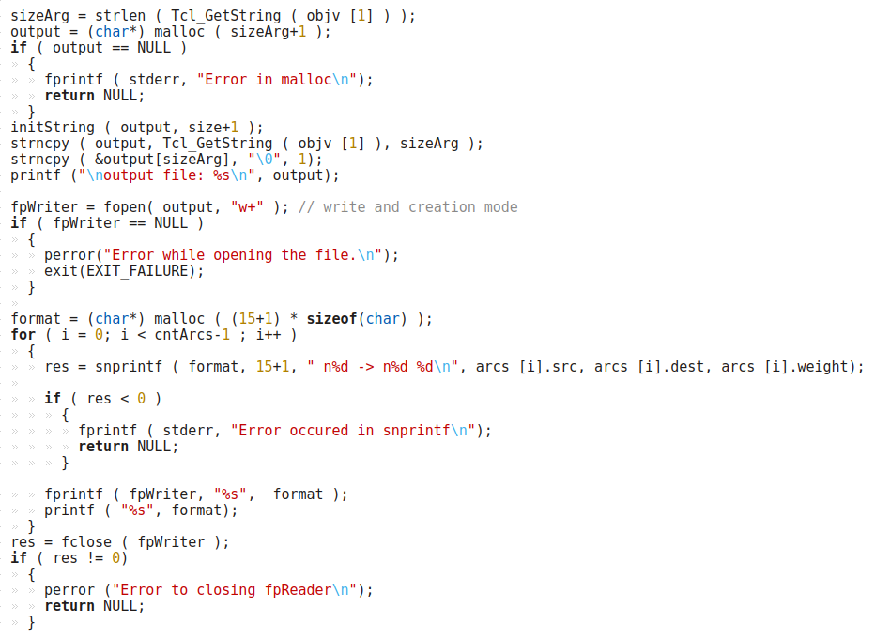
Write_graph

Slide 8
Write_graph

Slide 9
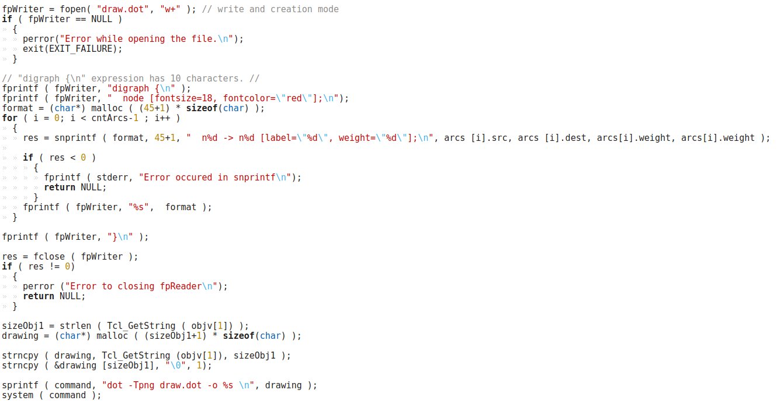
Draw_graph

Slide 10
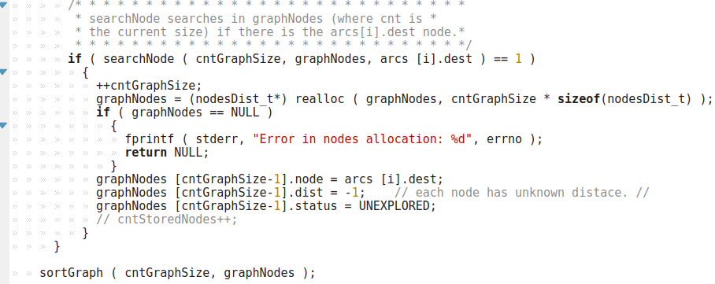
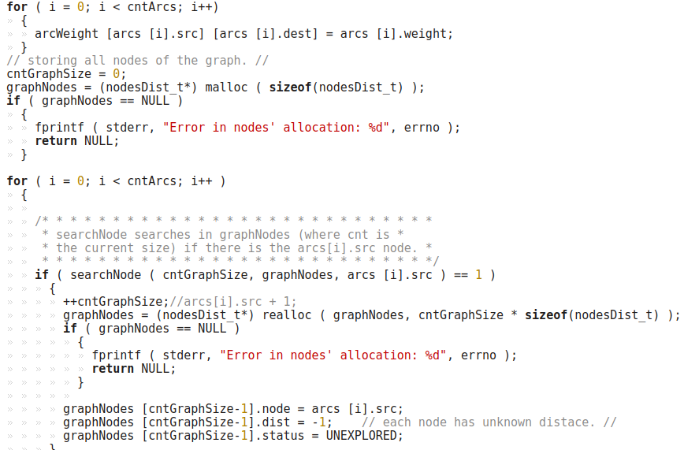
Graph_critical_path

Slide 11
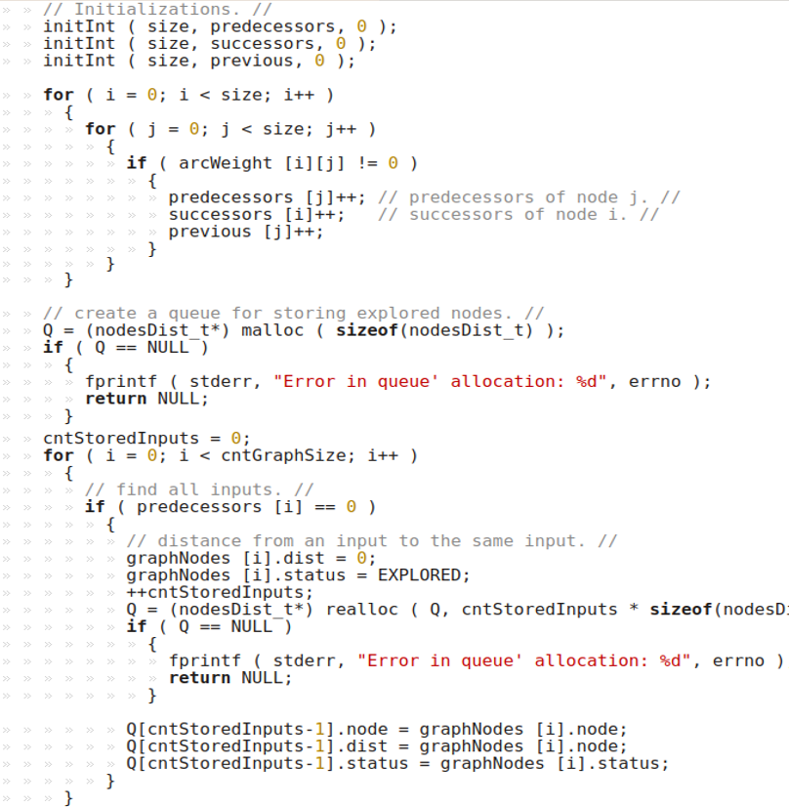
Graph_critical_path

Slide 12
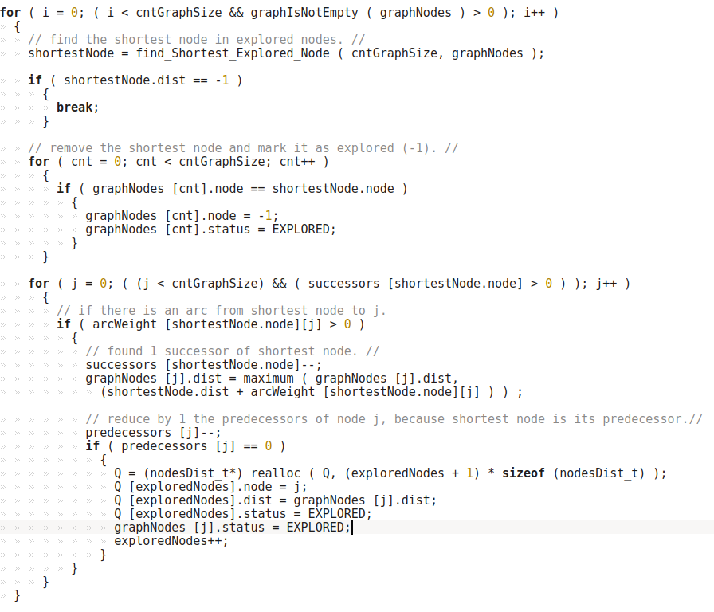
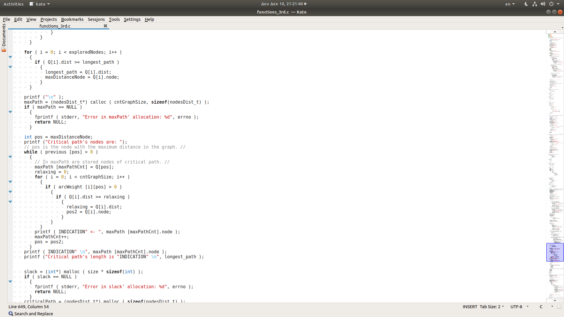
Graph_critical_path
Calculate the cost of longest path.

Slide 13
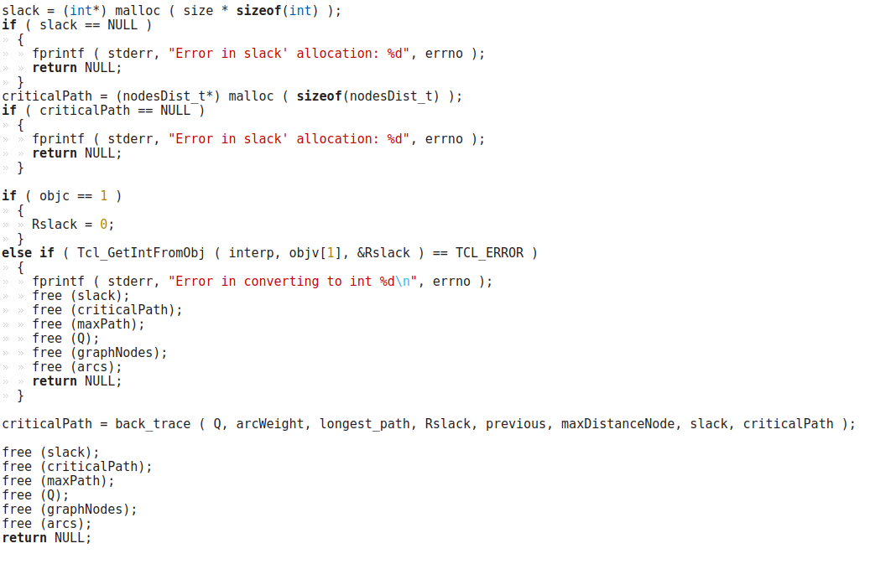
Graph_critical_path

Slide 14
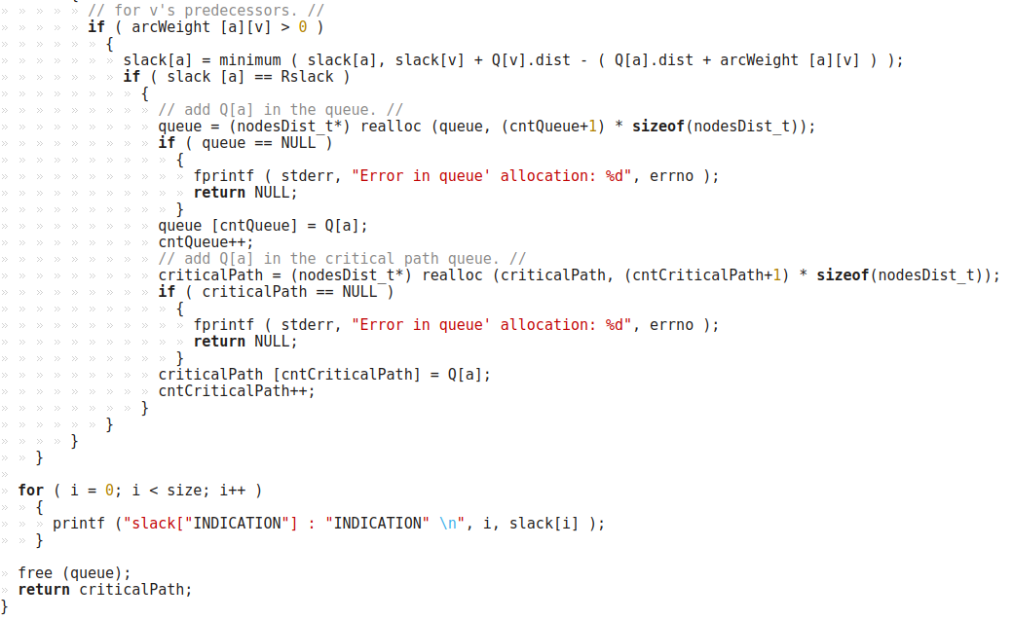
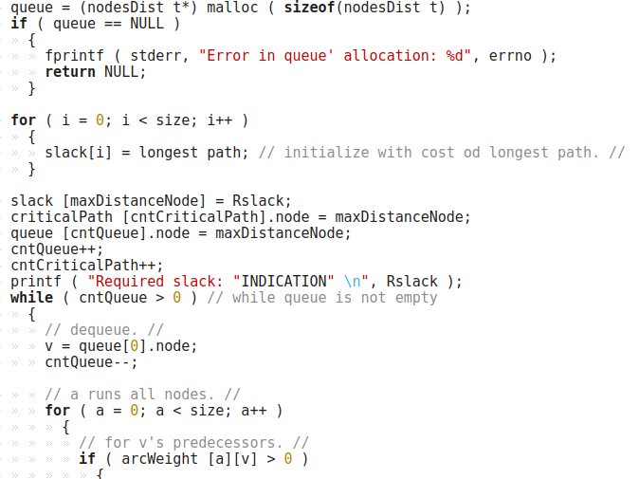
Back_trace
nodesDist_t *back_trace ( nodesDist_t *Q, int arcWeight[size][size], int longest_path, int Rslack, int *previous, int maxDistanceNode, int *slack, nodesDist_t *criticalPath );

Slide 15
End of presentation.
Thank you!

