Slide 1

Voice-Based Classification of Parkinson's Disease Using Classical Machine Learning
Research Demonstration — Not for clinical use
Author: Μάριος Χρήστος Συρμακέζης
MSc Thesis Defense
National Technical University of Athens
March 2026
Notes:
Welcome the committee. Wait for readiness before proceeding.

Slide 2
Presentation Outline
1. Introduction & Motivation
2. Related Work & Research Gap
3. Datasets
4. Methodology (Feature Extraction + ML Pipeline)
5. Experimental Design (2×2×5 Factorial)
6. Results (ROC-AUC, Ablation, Class Weighting)
7. Discussion & Feature Importance
8. Limitations, Conclusion & Future Work
Διπλωματική Εργασία - Μάρτιος 2026
Notes:
I'll spend about 25 minutes, with most time on methodology and results. I'll keep discussion of limitations honest and transparent. Transition: Let's start with why this problem matters.

Slide 3
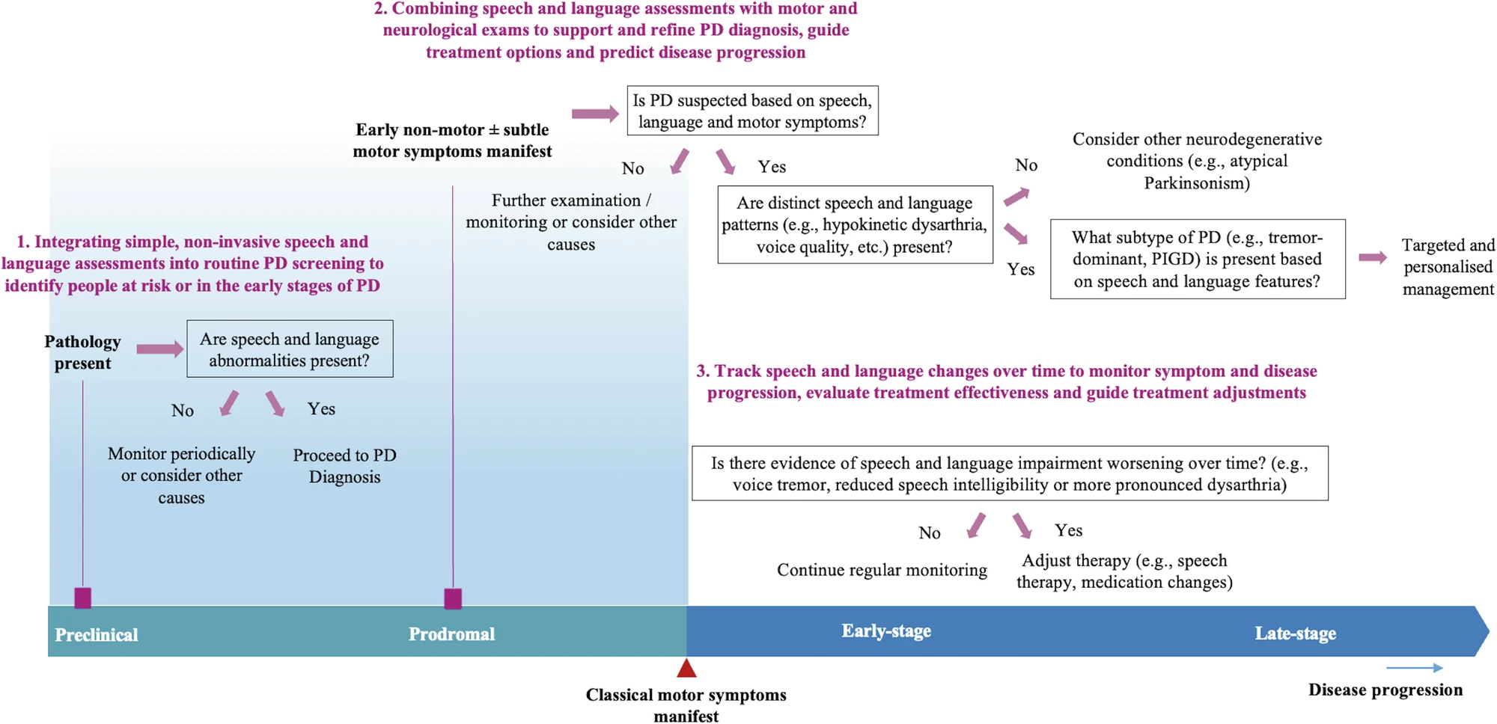
Parkinson's Disease & Speech Impairment
PD: 2nd most common neurodegenerative disease (~10M worldwide)
70–90% of PD patients develop measurable speech disorders
Hypokinetic dysarthria: reduced loudness, monotone pitch, breathy quality
Voice changes can precede motor symptoms by years (Harel et al. 2004)
Current diagnosis: subjective clinical assessment — no objective biomarker
Figure 1.1: Clinical speech-language assessment in PD | Ref: fig:speech-language-assessment-pd | Source: Adapted from Cao et al. (2025)
Διπλωματική Εργασία - Μάρτιος 2026
Notes:
Emphasize that voice is a non-invasive, low-cost, remotely collectible biomarker. The diagram shows clinical speech assessment across PD stages. Transition: This creates an opportunity for computational analysis.

Slide 4
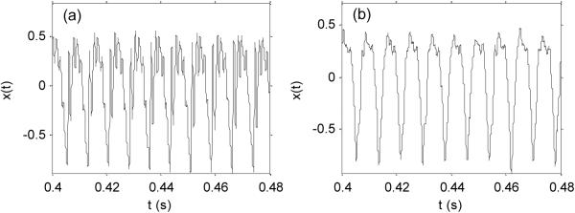
The Opportunity — Voice as a Biomarker
Voice recordings capture PD-related acoustic changes objectively
Can be collected via smartphone — scalable screening potential
Acoustic features (jitter, shimmer, MFCCs, F₀) are quantifiable
Classical ML can classify PD vs HC from feature vectors
Growing literature — but persistent methodological problems
Figure 2.1: Speech signal comparison (HC vs PD) | Ref: fig:speech-signal-hc-vs-pd | Source: Adapted from Little et al. (2009)
Διπλωματική Εργασία - Μάρτιος 2026
Notes:
The waveform comparison shows visible differences between HC and PD speech signals. Signal differences are real and measurable, but extracting reliable features and avoiding methodological pitfalls is harder than it looks. Transition: What does the literature say?

Slide 5
Research Questions
RQ1: How well do classical ML models perform on PD voice classification?
RQ2: Does increasing features from 47 → 78 improve performance?
RQ3: Does balanced class weighting help with imbalanced data?
RQ4: Are there differences between subject-level CV and standard CV?
RQ5: Is there a performance difference between read vs spontaneous speech?
Διπλωματική Εργασία - Μάρτιος 2026
Notes:
These five questions structure all 300 experiments. Each RQ will be answered with specific evidence in the results section. Transition: Before showing how I addressed these, let me summarize the literature gap.

Slide 6
Literature Review — Key Findings
SVM historically dominant (~91% accuracy — Little et al. 2009)
~42% of 2020–2025 studies now use deep learning
External validation in < 15% of studies
Interpretability (SHAP/LIME) in < 10% of studies
94% focus on detection; < 12% on progression monitoring
Reporting quality varies widely (Sedigh-Malekroodi 2025, Xavier 2025)
Διπλωματική Εργασία - Μάρτιος 2026
Notes:
The field has a reproducibility and overfitting problem. Many studies report inflated accuracy without proper validation. Transition: This is the gap I address.

Slide 7
Research Gap & Thesis Positioning
Common Practice | This Thesis
Random train/test split | Grouped Stratified 5-Fold CV
Report best result only | All 300 experimental runs reported
Tuned hyperparameters | Fixed a priori parameters
Single feature set | Controlled ablation: 47 vs 78 features
Ignore class imbalance | Systematic class weighting analysis
Minimal limitation discussion | Full transparency on all limitations
Table: Literature gap vs thesis positioning | [custom-placeholder] | Source: Thesis manuscript and computed results
Διπλωματική Εργασία - Μάρτιος 2026
Notes:
I'm not claiming to beat the state of the art. I'm claiming to do it correctly and transparently. This is the core differentiator. Transition: Let me describe the data.

Slide 8
Dataset A — MDVR-KCL (Raw Audio)
Property | Value
Source | King's College London (Zenodo)
Format | WAV PCM, mono, 16-bit, 44.1 kHz
ReadText Subjects | 37 (21 HC, 16 PD)
SpontaneousDialogue Subjects | 36 (21 HC, 15 PD)
Recording Device | Smartphone (Moto G4)
Subject IDs | ✓ Available → Grouped CV possible
Class Ratio | ~57:43 (HC:PD) — mild imbalance
Table 3.1: Dataset A summary | tab:dataset-a-summary | Source: Thesis manuscript and computed results
Διπλωματική Εργασία - Μάρτιος 2026
Notes:
The small sample is a limitation I'll address, but subject IDs are critical — they let us prevent data leakage. Transition: The second dataset is very different.

Slide 9
Dataset B & Cross-Dataset Comparison
Aspect | Dataset A (MDVR-KCL) | Dataset B (PD Speech)
Input | Raw audio (WAV) | Pre-extracted (CSV)
Samples | 37/36 subjects | 756 samples (252 subjects)
Subject IDs | ✓ Available | ✗ Not available
Validation | Grouped Stratified CV | Stratified CV
Speech Task | Read / Spontaneous | Sustained vowel /a/
Class Balance | 57:43 (HC:PD) | 25:75 (HC:PD)
Table 3.3: Cross-dataset comparison | tab:cross-dataset-comparison | Source: Thesis manuscript and computed results
Διπλωματική Εργασία - Μάρτιος 2026
Notes:
Dataset B gives us higher statistical power but weaker methodological guarantees. This contrast is itself a finding. Transition: Now, how did I process the data?

Slide 10
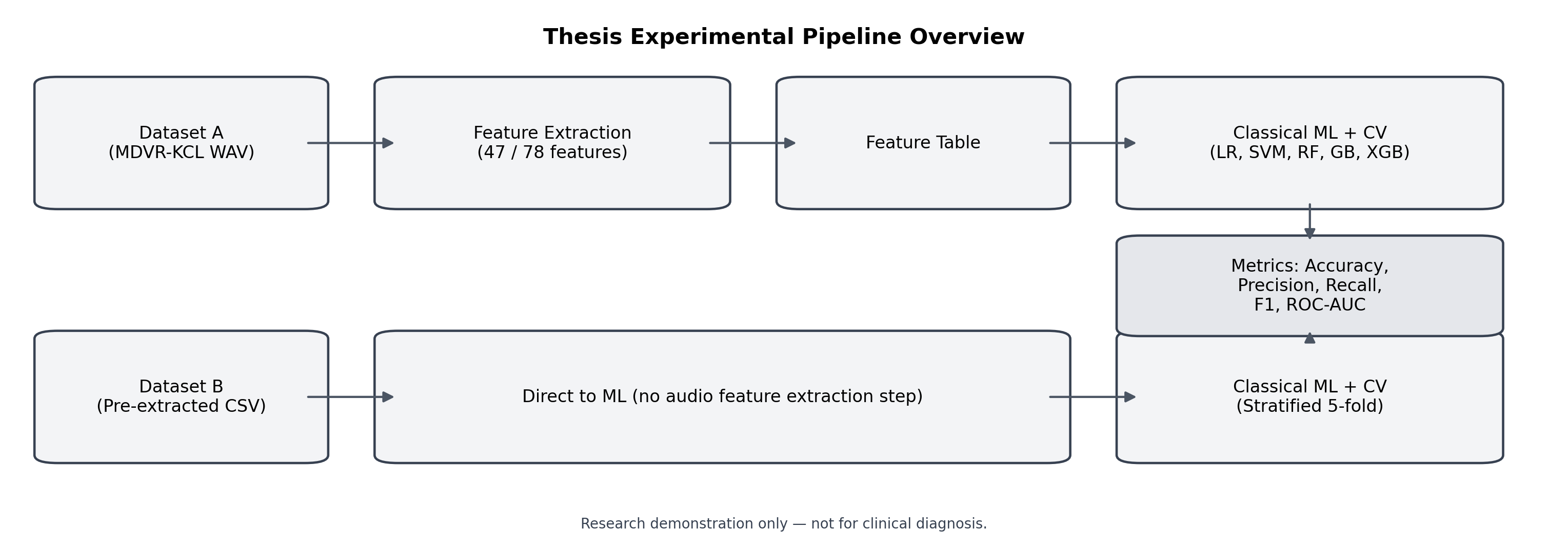
Experimental Pipeline Overview
Pipeline A: WAV → Preprocessing → Feature Extraction → ML → Metrics | Pipeline B: CSV → ML → Metrics | Ref: fig:pipeline-overview-thesis
Διπλωματική Εργασία - Μάρτιος 2026
Notes:
Two pipelines, kept strictly separate. Dataset A goes through our feature extraction; Dataset B skips it. Both feed into the same 5 classifiers with identical evaluation. Transition: Let me detail the feature extraction step.

Slide 11
Feature Extraction — Baseline (47) vs Extended (78)
Category | Count | Features
Prosodic | 21 | F₀ (4), Jitter (3), Shimmer (5), HNR (2), Intensity (3), Formants (6)
MFCC means | 13 | 13 cepstral coefficients (baseline spectral)
Δ-MFCC means | 13 | First-order temporal derivatives
— Baseline Total — | 47 | Prosodic + MFCC + Δ-MFCC
MFCC std | +13 | Cepstral variability (extended)
ΔΔ-MFCC means | +13 | Second-order dynamics (extended)
Spectral shape | +5 | Centroid, bandwidth, rolloff, flatness, ZCR
— Extended Total — | 78 | Baseline + 31 additional features
Table 4.4: Feature counts by configuration | tab:feature-counts | Source: Thesis manuscript and computed results
Διπλωματική Εργασία - Μάρτιος 2026
Notes:
The feature set captures phonatory dysfunction (jitter, shimmer) and spectral characteristics (MFCCs). The extension adds variability and higher-order dynamics. Tools: Parselmouth (Praat), librosa. Fixed parameters: 22050 Hz, seed 42. Transition: These features feed into five classifiers.

Slide 12
Models & Parameters (Fixed A Priori)
Model | Key Parameters | Notes
Logistic Regression | C=1.0, L2, lbfgs | Linear baseline
SVM (RBF kernel) | C=1.0, γ=scale | Non-linear, margin-based
Random Forest | 100 trees, depth=10 | Ensemble, robust to noise
Gradient Boosting | 100 trees, lr=0.1, depth=3 | Sequential ensemble
XGBoost | 100 trees, lr=0.1 | Regularized boosting
Table 4.5: Model specifications | tab:model-specs | Source: Thesis manuscript and computed results
Διπλωματική Εργασία - Μάρτιος 2026
Notes:
No hyperparameter tuning is a deliberate choice. At n=37, nested CV would be unreliable and introduce more variance than it reduces (Varma & Simon 2006). This is a conservative baseline. All pipelines include StandardScaler. Transition: How did I validate?

Slide 13
Cross-Validation Strategy
Dataset A: Grouped Stratified 5-Fold CV
All recordings from one subject → same fold
Prevents data leakage — the most important design choice
Dataset B: Stratified 5-Fold CV (sample-level)
Subject IDs unavailable → potential within-subject leakage
Results flagged as potentially optimistic
All metrics: mean ± std across 5 folds
Primary metric: ROC-AUC
Secondary: Accuracy, Precision, Recall, F1-Score
Διπλωματική Εργασία - Μάρτιος 2026
Notes:
This is the most important methodological decision. Grouped CV is what separates a reliable estimate from an inflated one. Most studies in the literature don't do this. Transition: Now let me describe the full experimental design.

Slide 14
Experimental Design — 2×2×5 Factorial (300 Runs)
Condition | Features | Weighting | Models
C1 | 47 (baseline) | None | LR, SVM, RF, GB, XGB
C2 | 47 (baseline) | Balanced | LR, SVM, RF, GB, XGB
C3 | 78 (extended) | None | LR, SVM, RF, GB, XGB
C4 | 78 (extended) | Balanced | LR, SVM, RF, GB, XGB
Total: 4 conditions × 5 models × 3 datasets/tasks × 5 folds = 300 experimental runs
Table 5.1: Experimental conditions C1–C4 | tab:conditions | Source: Thesis manuscript and computed results
Διπλωματική Εργασία - Μάρτιος 2026
Notes:
The factorial design lets me isolate the effect of each factor. 4 conditions × 5 models × 3 datasets/tasks × 5 folds = 300 total runs. I report ALL 300 runs, not just the best. Transition: What did we find?

Slide 15
Results
ROC-AUC · Ablation · Class Weighting · Variance
Διπλωματική Εργασία - Μάρτιος 2026
Notes:
Transition into the results section — the core of the defense.

Slide 16
Headline Results — Best ROC-AUC per Dataset
Dataset / Task | Best Model | ROC-AUC | Condition
Dataset A (Spontaneous) | Random Forest | 0.857 ± 0.171 | C3 (78, unweighted)
Dataset A (ReadText) | SVM (RBF) | 0.834 ± 0.153 | C3 (78, unweighted)
Dataset B (PD Speech) | XGBoost | 0.952 ± 0.015 | C1 (47, unweighted)
Key: Random Forest is the most consistent performer across all conditions
Dataset B scores substantially higher but with methodological caveats (no grouped CV)
Table 6.1: Best ROC-AUC summary | tab:best-results-summary | Source: Thesis manuscript and computed results
Διπλωματική Εργασία - Μάρτιος 2026
Notes:
Classical ML achieves meaningful discrimination. RF is most robust. Notice the variance: ±0.17 on Dataset A vs ±0.015 on Dataset B. Transition: Let me show the ROC curves.

Slide 17
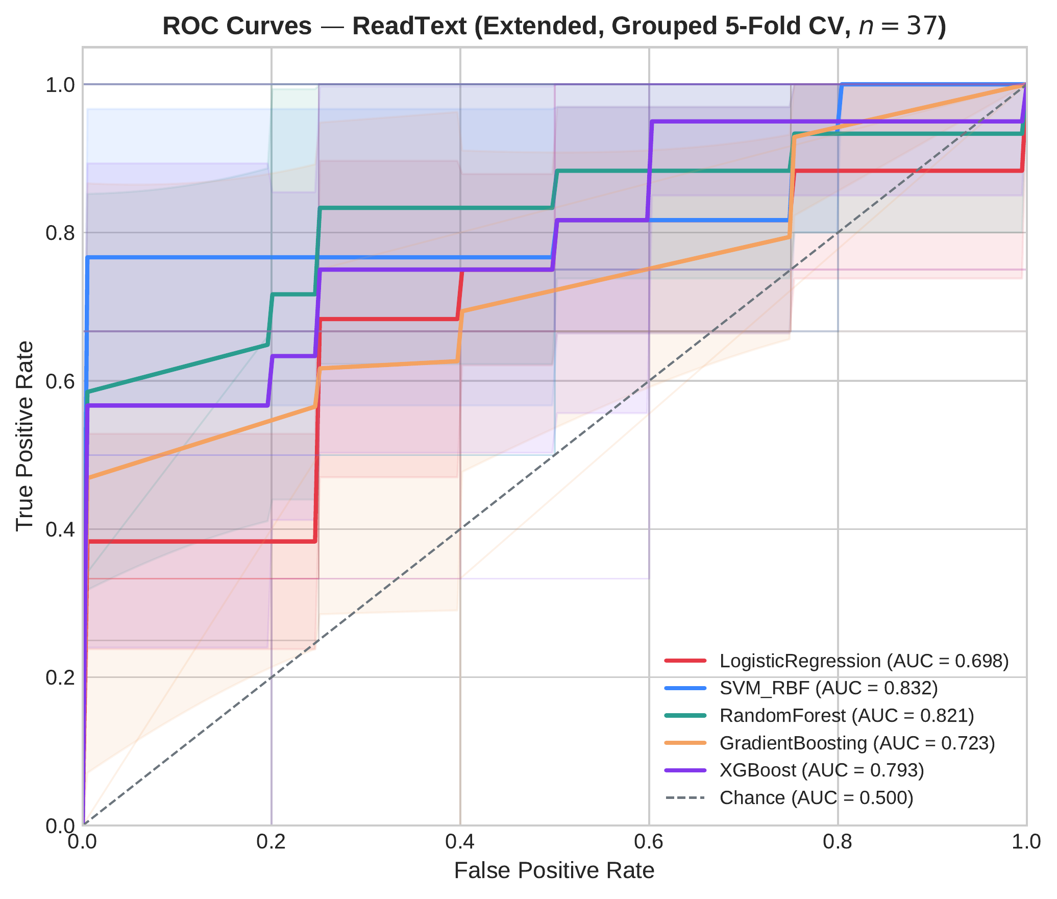
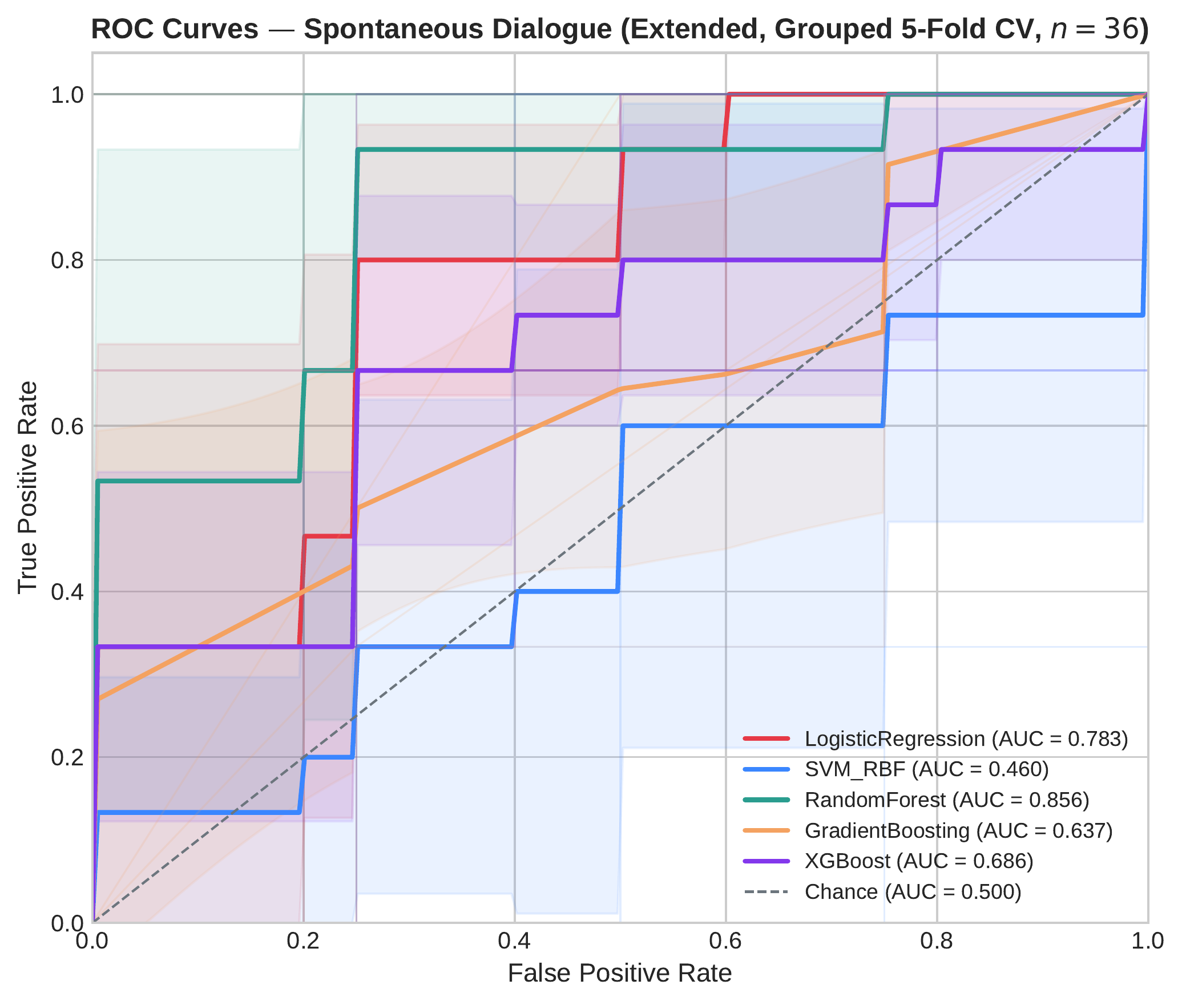
ROC Curves — Dataset A (Extended Features, Grouped 5-Fold CV)
(a) ReadText — SVM leads (0.834) | Ref: fig:roc-readtext-main
(b) SpontaneousDialogue — RF leads (0.857) | Ref: fig:roc-spontaneous-main
Διπλωματική Εργασία - Μάρτιος 2026
Notes:
ReadText: SVM and RF dominate; LR moderate; GB weakest. SpontaneousDialogue: RF clearly best; SVM collapses to ~0.46. The spread between curves shows model sensitivity to the task. Transition: What about Dataset B?

Slide 18
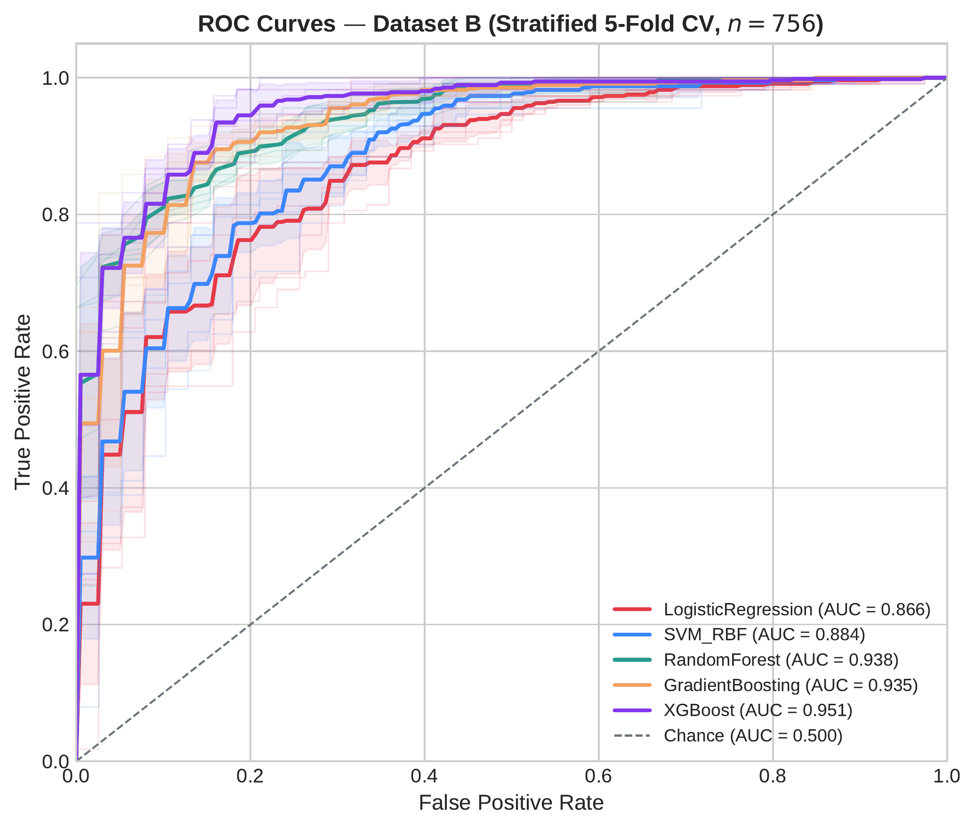
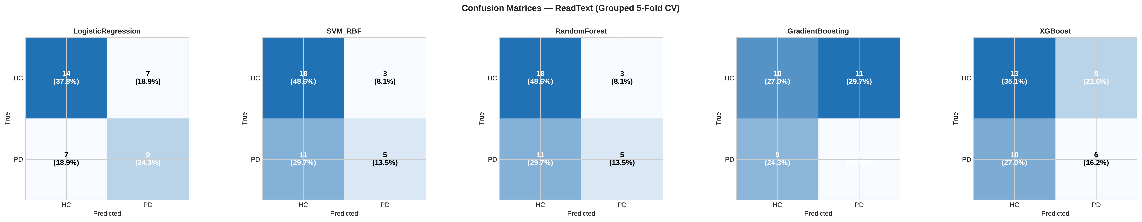
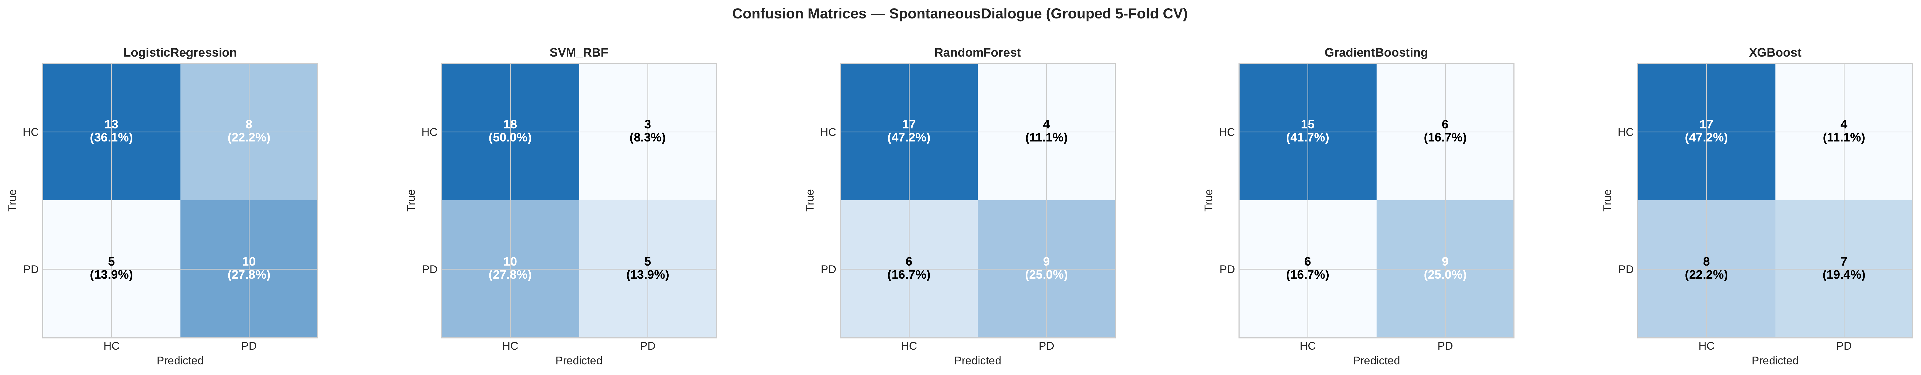
ROC Curve — Dataset B & Confusion Matrices (Best Models)
(b) CM: ReadText (RF) | Ref: fig:confusion-readtext
(c) CM: Spontaneous (RF) | Ref: fig:confusion-spontaneous
(a) Dataset B — All models > 0.86 | Ref: fig:roc-datasetb-main
Διπλωματική Εργασία - Μάρτιος 2026
Notes:
Dataset B curves are tightly clustered — easier task or data leakage. Confusion matrices show where errors cluster: false negatives (PD→HC) are the main issue — clinically the more dangerous error. Transition: Now let me isolate the feature extension effect — RQ2.

Slide 19
RQ2 — Feature Extension Effect (Δ ROC-AUC: C3 − C1)
Model | ReadText Δ | Spontaneous Δ | Interpretation
Logistic Regression | −0.019 | +0.023 | Minimal change
SVM (RBF) | +0.220 | +0.053 | ReadText: dramatic gain
Random Forest | +0.232 | +0.029 | ReadText: dramatic gain
Gradient Boosting | +0.224 | +0.023 | ReadText: dramatic gain
XGBoost | +0.166 | −0.036 | Mixed
Finding: Feature extension is task-dependent, not universal — up to +23.2 pp on ReadText, marginal on Spontaneous
Table 6.3: Feature ablation effect | tab:ablation-main | Source: Thesis manuscript and computed results
Διπλωματική Εργασία - Μάρτιος 2026
Notes:
Key finding: Feature extension dramatically improved ReadText (up to +23.2 pp) but had minimal effect on SpontaneousDialogue. Structured reading needs richer features; spontaneous speech naturally encodes PD cues through prosodic variation. Transition: What about class weighting?

Slide 20
RQ3 — Class Weighting Effect (Random Forest, Dataset A)
Task / Features | Δ ROC-AUC (Weighted − Unweighted) | Verdict
ReadText / Baseline (47) | +0.097 | Only positive case
ReadText / Extended (78) | −0.017 | Slightly harmful
Spontaneous / Baseline (47) | −0.001 | No effect
Spontaneous / Extended (78) | −0.034 | Slightly harmful
Conclusion: At ~1.3:1 class imbalance, balanced weighting is unnecessary
Other models (LR, SVM, GB, XGBoost): no benefit or slightly negative effect
Table 6.4: Class weighting effect | tab:weighting-main | Source: Thesis manuscript and computed results
Διπλωματική Εργασία - Μάρτιος 2026
Notes:
Class weighting provided no consistent benefit at ~1.3:1 imbalance. LR, SVM, GB, XGBoost all show negligible or negative effect. Useful negative evidence: practitioners shouldn't default to balanced weighting. Transition: Cross-dataset comparison and variance.

Slide 21
RQ4 — Cross-Dataset Comparison & Variance
Metric | Dataset A (MDVR-KCL) | Dataset B (PD Speech)
Best ROC-AUC | 0.857 ± 0.171 | 0.952 ± 0.015
ROC-AUC std range | ±0.15 – 0.30 | ±0.01 – 0.03
Accuracy std range | ±0.14 – 0.18 | ±0.008 – 0.024
F1 std range | ±0.21 – 0.39 | ±0.006 – 0.015
Confounders: sample size (37 vs 756), CV strategy, speech task, feature set, class balance
Dataset A's high variance is honest — ~7 subjects per fold with grouped CV
Dataset B results flagged as potentially optimistic (no grouped CV possible)
Table 6.5: Variance comparison | tab:variance-summary | Source: Thesis manuscript and computed results
Διπλωματική Εργασία - Μάρτιος 2026
Notes:
Performance gap is real but confounded: different sample size (37 vs 756), CV strategy, speech task, features, class balance. Cannot attribute to single factor. Dataset B's low variance suggests possible within-subject leakage.

Slide 22
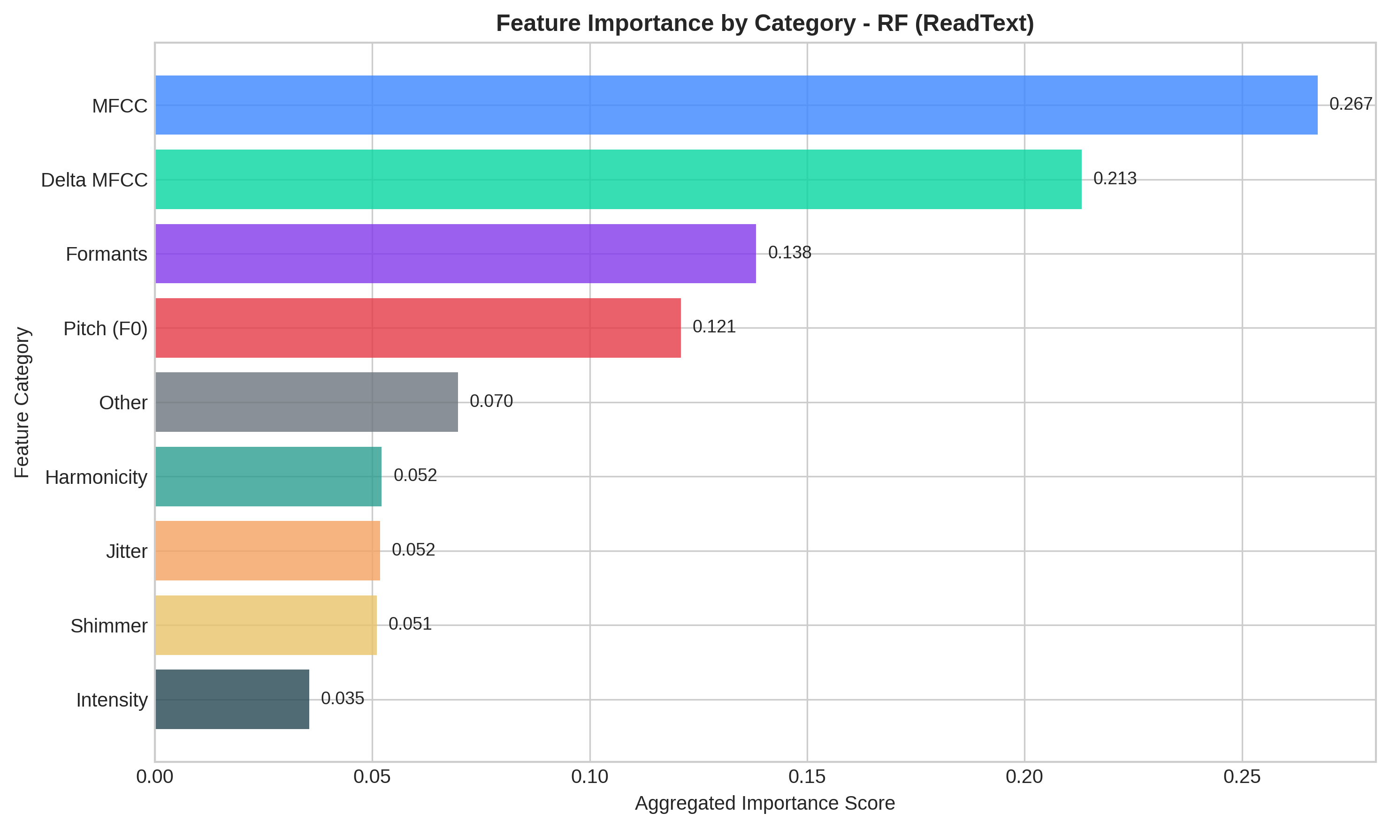
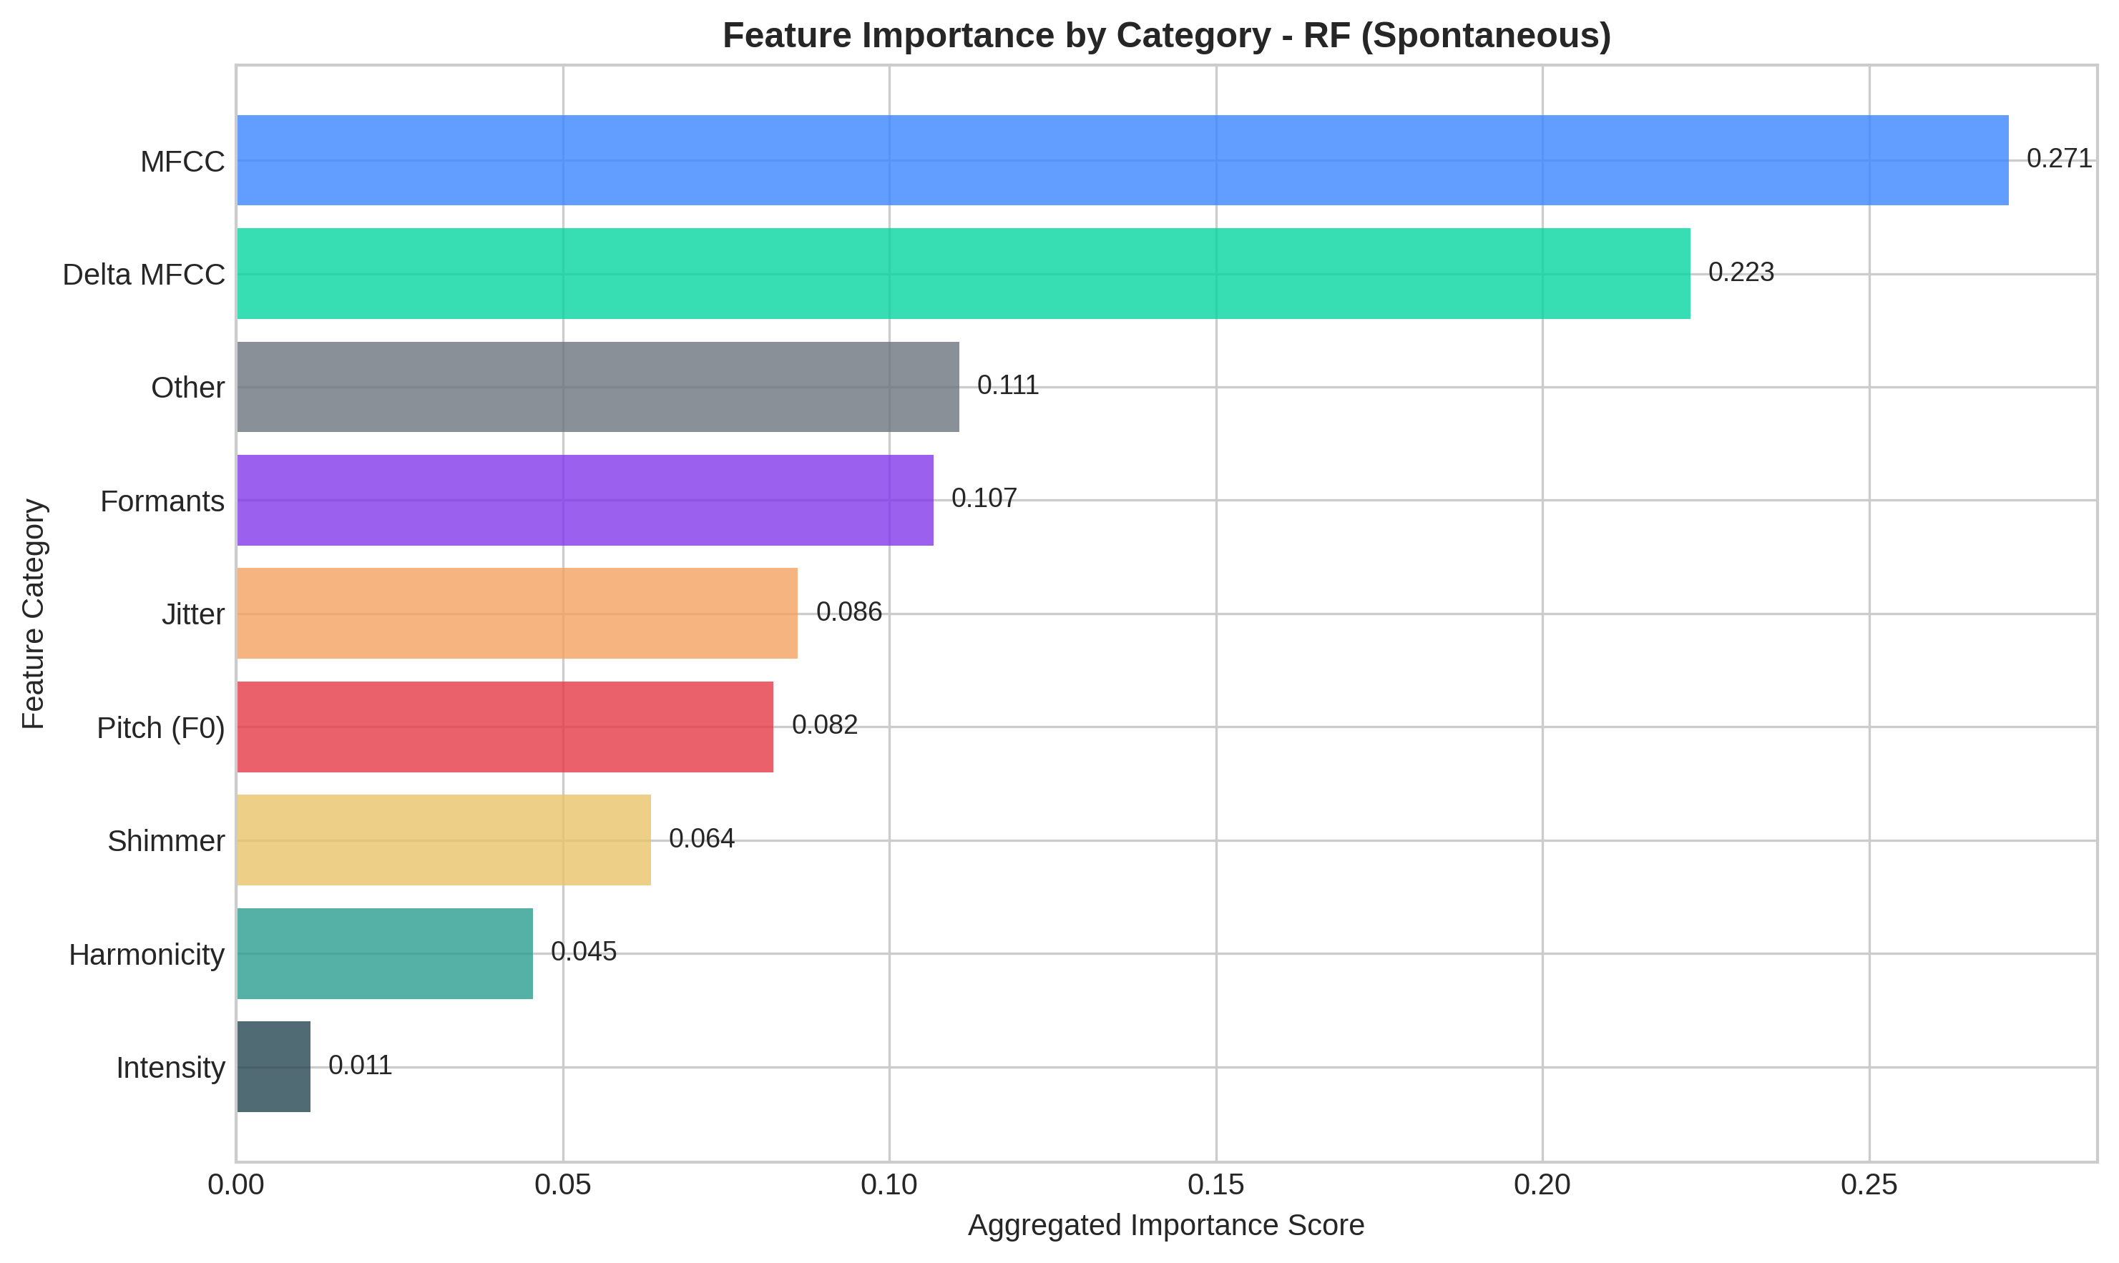
Feature Importance — Category-Level Aggregation (RF, Dataset A)
(a) ReadText — MFCCs + pitch dominate | Ref: fig:imp-categories-main
(b) SpontaneousDialogue — MFCCs + shimmer dominate | Ref: fig:imp-categories-main
Διπλωματική Εργασία - Μάρτιος 2026
Notes:
MFCCs dominate (~28–32% of total importance). Pitch (F₀ max) is top-1 for ReadText. Shimmer (APQ11) is top-2 for SpontaneousDialogue. Cross-task stable features: delta_mfcc_2, autocorr_harmonicity, f0_mean, shimmer_apq. Transition: Permutation importance heatmaps.

Slide 23
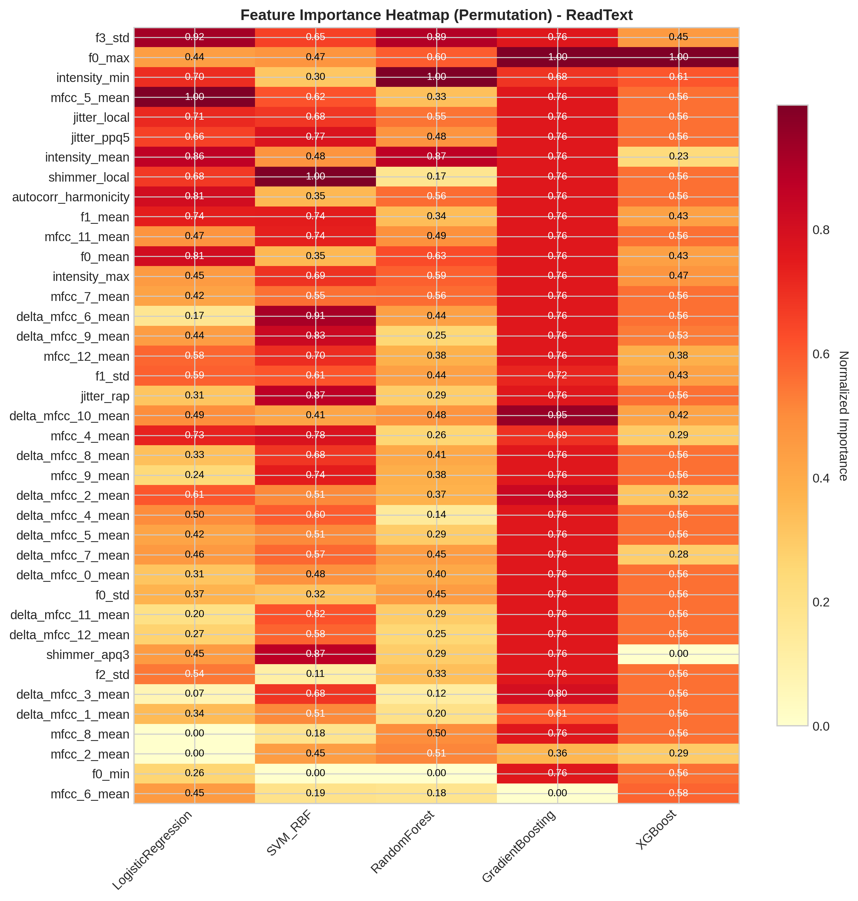
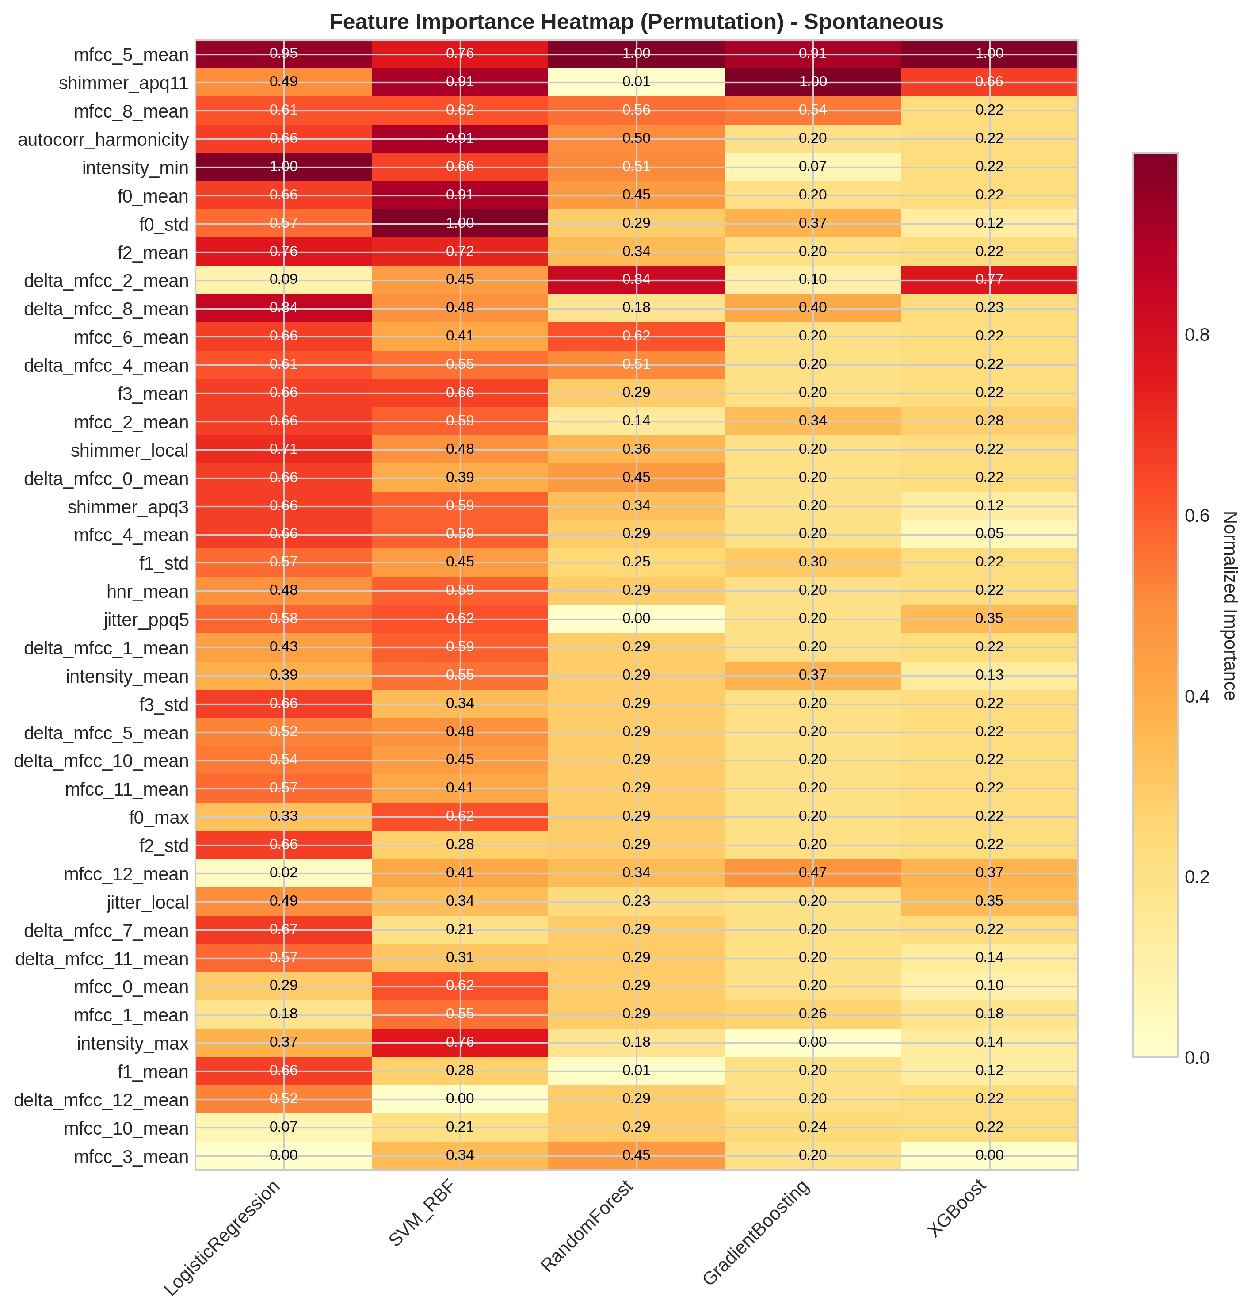
Permutation Importance Heatmaps (Model-Agnostic)
(a) ReadText — Feature × Model | Ref: fig:heatmap-readtext-permutation-main
(b) SpontaneousDialogue — Feature × Model | Ref: fig:heatmap-spontaneous-permutation-main
Διπλωματική Εργασία - Μάρτιος 2026
Notes:
Permutation importance measures actual predictive contribution. Sparse activation: a handful of features do most of the work. RF and XGBoost share similar importance profiles. GB importance is more concentrated on fewer features. Transition: Let me address the limitations honestly.

Slide 24
Limitations — Honest Self-Assessment
Limitation | Impact | Mitigation
Small sample (n=37, Dataset A) | High variance, limited power | Grouped CV is more honest than inflated n
No subject IDs (Dataset B) | Potential leakage/optimism | Clearly flagged throughout thesis
No hyperparameter tuning | May underestimate potential | At n=37, nested CV unreliable (Varma 2006)
No external validation | Unknown generalization | Explicitly listed as future work
Classical ML only | DL excluded by design | Data too small for DL; provides baseline
Single recording device | Unknown cross-device robustness | Standard research protocol
Table 8.2: Validity threats and mitigation | tab:validity-threats-summary | Source: Thesis manuscript and computed results
Διπλωματική Εργασία - Μάρτιος 2026
Notes:
Every limitation has a mitigation or justification documented in the thesis. Being explicit about what this study cannot claim is a strength. Transition: Despite these, the contributions are clear.

Slide 25
Contributions & Conclusion
Contributions
C1: Rigorous grouped CV preventing subject leakage
C2: Controlled feature ablation (47 vs 78) under identical conditions
C3: Full reproducibility — fixed seed, default params, open pipeline
C4: Permutation-based feature importance with cross-task analysis
Research Question Answers
RQ1: Classical ML is feasible (ROC-AUC 0.857)
RQ2: Feature extension is task-dependent (+23 pp ReadText)
RQ3: Class weighting provides no consistent benefit
RQ4: Cross-dataset differences confounded
RQ5: Spontaneous speech slightly stronger but task-specific
"Voice-based PD classification is scientifically substantiated but not yet ready for clinical use."
Notes:
Main message: voice-based PD classification is feasible with classical ML, but methodological rigor matters more than model sophistication. This work provides a transparent, reproducible baseline.

Slide 26
Future Work
Short-term
Medium-term
Long-term
• Nested CV for hyperparameter tuning
• Feature selection (RFE, L1)
• Multi-task fusion (Read + Spontaneous)
• External validation on independent cohorts
• Deep learning comparison (with regularization)
• Longitudinal disease progression tracking
• Smartphone-based screening integration
• Multi-modal fusion (voice + gait + tremor)
• Formal clinical validation
Thank You
Questions?
Notes:
The thesis concludes that voice-based PD classification is scientifically substantiated but not yet ready for clinical use. Open for questions.

Slide 27
Full Results — C4: Extended + Weighted (Dataset A)
Model | Task | Accuracy | Precision | Recall | F1 | ROC-AUC
LR | ReadText | 73.2 ± 14.6 | 0.63 ± 0.20 | 0.78 ± 0.25 | 0.67 ± 0.19 | 0.698 ± 0.132
SVM | ReadText | 78.6 ± 10.8 | 0.73 ± 0.15 | 0.75 ± 0.25 | 0.72 ± 0.16 | 0.834 ± 0.153
RF | ReadText | 81.8 ± 14.0 | 0.77 ± 0.18 | 0.75 ± 0.25 | 0.73 ± 0.21 | 0.805 ± 0.182
GB | ReadText | 71.1 ± 14.8 | 0.59 ± 0.18 | 0.78 ± 0.25 | 0.65 ± 0.18 | 0.724 ± 0.214
XGB | ReadText | 77.1 ± 13.1 | 0.67 ± 0.18 | 0.78 ± 0.25 | 0.70 ± 0.18 | 0.794 ± 0.186
LR | Spont. | 69.3 ± 13.9 | 0.61 ± 0.21 | 0.70 ± 0.33 | 0.59 ± 0.22 | 0.783 ± 0.139
SVM | Spont. | 55.0 ± 17.7 | 0.40 ± 0.21 | 0.47 ± 0.42 | 0.38 ± 0.30 | 0.403 ± 0.347
RF | Spont. | 72.1 ± 20.3 | 0.63 ± 0.28 | 0.60 ± 0.42 | 0.55 ± 0.32 | 0.823 ± 0.209
GB | Spont. | 63.6 ± 10.1 | 0.50 ± 0.11 | 0.60 ± 0.22 | 0.53 ± 0.15 | 0.638 ± 0.146
XGB | Spont. | 61.4 ± 13.3 | 0.45 ± 0.15 | 0.47 ± 0.25 | 0.43 ± 0.17 | 0.687 ± 0.146
Table 6.7: Full C4 results — Dataset A | tab:results-c4-dataset-a | Source: Thesis manuscript and computed results
Διπλωματική Εργασία - Μάρτιος 2026
Notes:
Backup: Full C4 results for all 5 models across both Dataset A tasks.

Slide 28
Full Results — C4: Extended + Weighted (Dataset B)
Model | Accuracy | Precision | Recall | F1 | ROC-AUC
Logistic Regression | 0.805 ± 0.024 | 0.862 ± 0.023 | 0.875 ± 0.023 | 0.868 ± 0.015 | 0.867 ± 0.029
SVM (RBF) | 0.839 ± 0.018 | 0.891 ± 0.014 | 0.889 ± 0.020 | 0.890 ± 0.013 | 0.900 ± 0.023
Random Forest | 0.897 ± 0.016 | 0.933 ± 0.011 | 0.921 ± 0.017 | 0.927 ± 0.012 | 0.949 ± 0.012
Gradient Boosting | 0.889 ± 0.020 | 0.930 ± 0.014 | 0.916 ± 0.019 | 0.923 ± 0.014 | 0.937 ± 0.019
XGBoost | 0.900 ± 0.008 | 0.935 ± 0.006 | 0.925 ± 0.013 | 0.930 ± 0.006 | 0.952 ± 0.015
Table 6.8: Full C4 results — Dataset B | tab:results-c4-dataset-b | Source: Thesis manuscript and computed results
Διπλωματική Εργασία - Μάρτιος 2026
Notes:
Backup: Full results for Dataset B. XGBoost achieves best ROC-AUC 0.952.

Slide 29
SVM Collapse on SpontaneousDialogue
SVM (RBF) ROC-AUC drops to 0.407–0.460 on SpontaneousDialogue
SVM is sensitive to curse of dimensionality at small n
Spontaneous speech features have higher within-class variance
At n=36, 47–78 features: margin-based boundary becomes unstable
Expected behavior documented, not hidden
Διπλωματική Εργασία - Μάρτιος 2026
Notes:
Use this slide if committee asks about the SVM anomaly. Key point: SVM-RBF collapses when feature-to-sample ratio is unfavorable AND the data has high within-class variance.

Slide 30
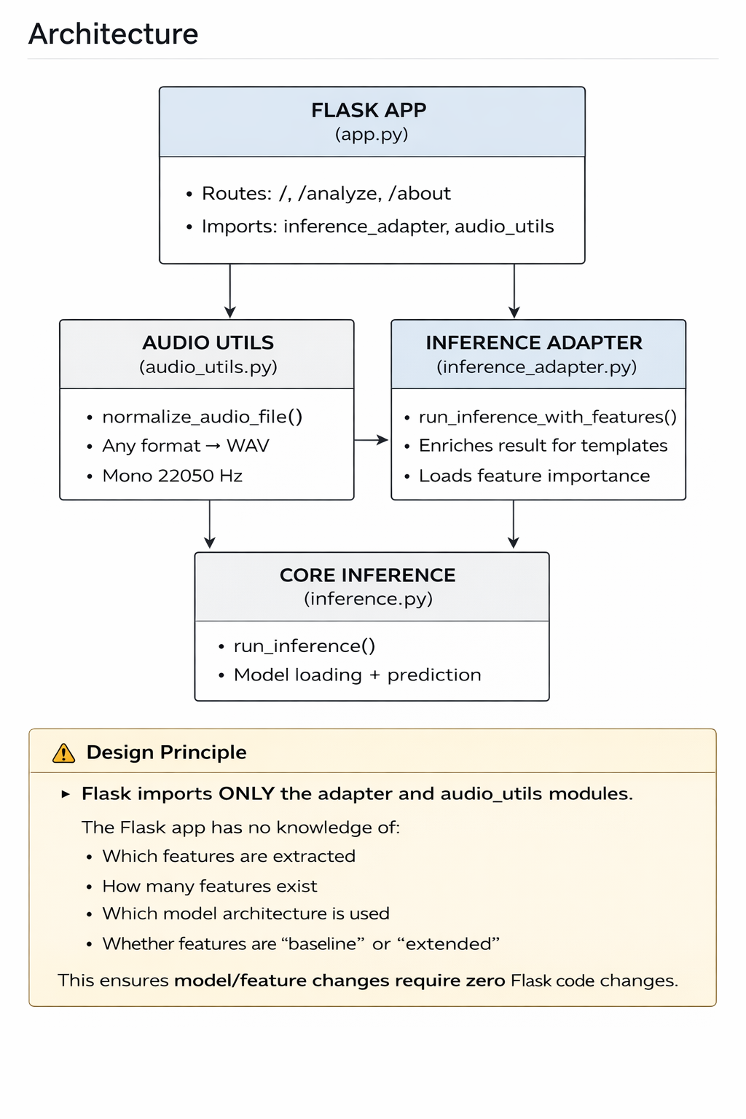
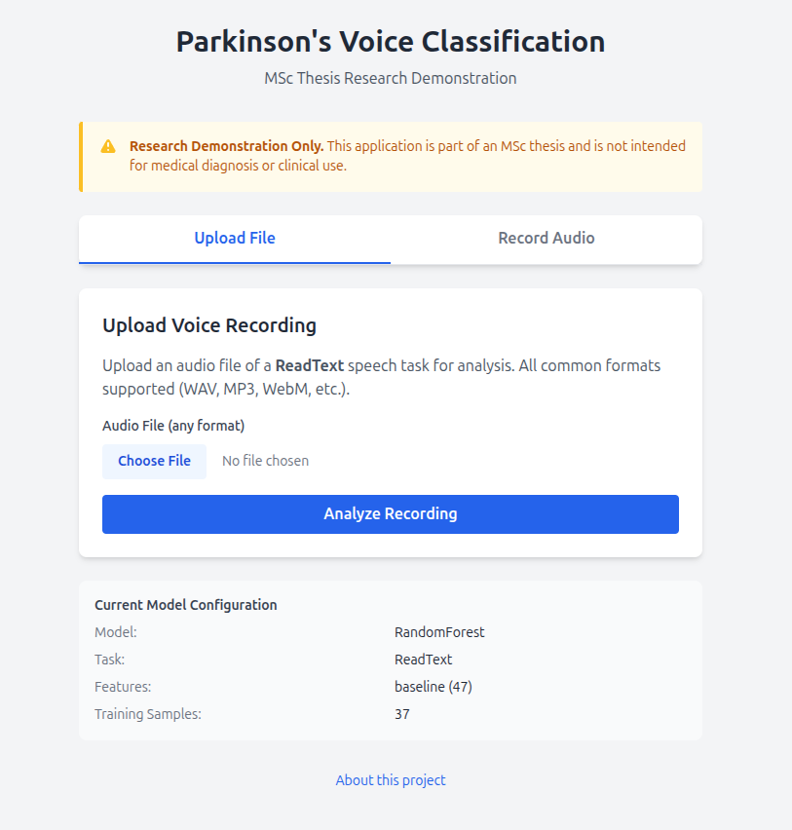
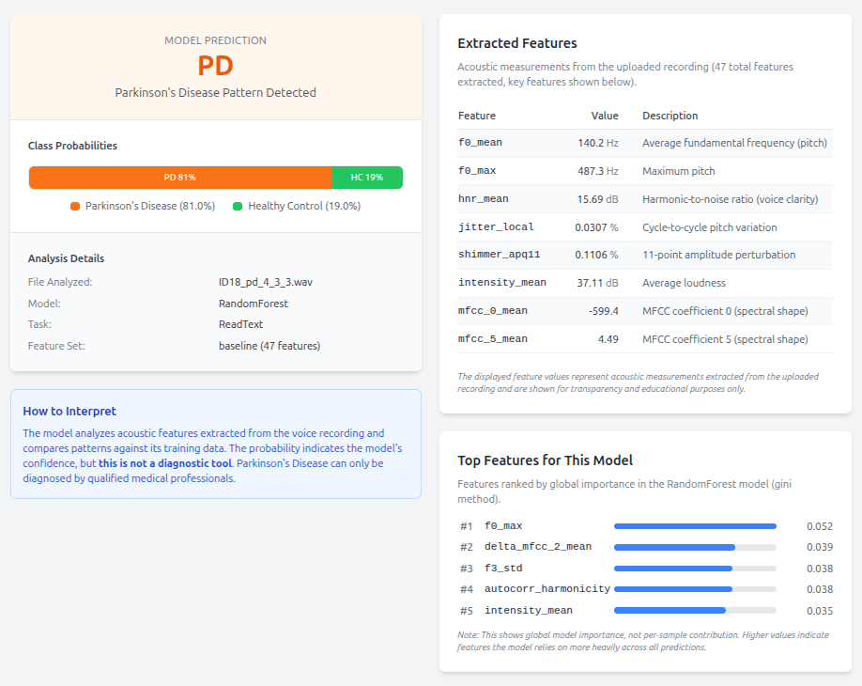
Demo Application — Research Prototype
Analysis result | Ref: fig:demo-screens-main
Upload interface | Ref: fig:demo-screens-main
Figure 1.3: Demo application architecture | Ref: fig:demo-architecture-simple
⚠ Research Demonstration Only — Not for clinical use
Notes:
Flask web app wrapping the trained RF model. Accepts audio upload or microphone recording. Extracts features → runs inference → displays result with confidence. Research prototype for thesis defense demonstration only.

Slide 31
Full ROC-AUC — Dataset A ReadText (All Conditions)
Model | C1 (47, unw) | C2 (47, wt) | C3 (78, unw) | C4 (78, wt)
Logistic Reg. | 0.717 ± 0.139 | 0.717 ± 0.139 | 0.698 ± 0.132 | 0.698 ± 0.132
SVM (RBF) | 0.614 ± 0.312 | 0.542 ± 0.312 | 0.834 ± 0.153 | 0.834 ± 0.153
Random Forest | 0.590 ± 0.302 | 0.687 ± 0.258 | 0.822 ± 0.166 | 0.805 ± 0.182
Gradient Boost | 0.500 ± 0.159 | 0.500 ± 0.159 | 0.724 ± 0.214 | 0.724 ± 0.214
XGBoost | 0.628 ± 0.203 | 0.628 ± 0.203 | 0.794 ± 0.186 | 0.794 ± 0.186
Appendix Table: ReadText ROC-AUC all conditions | [appendix-b-placeholder] | Source: Thesis manuscript and computed results
Διπλωματική Εργασία - Μάρτιος 2026
Notes:
Full ReadText ROC-AUC table across all 4 conditions. Shows C1→C3 improvement clearly for SVM, RF, GB.

