Slide 1
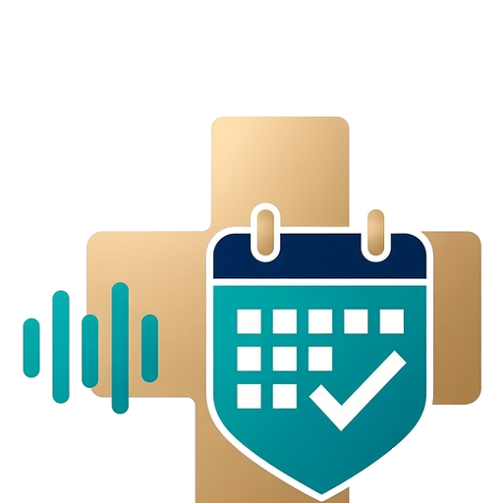
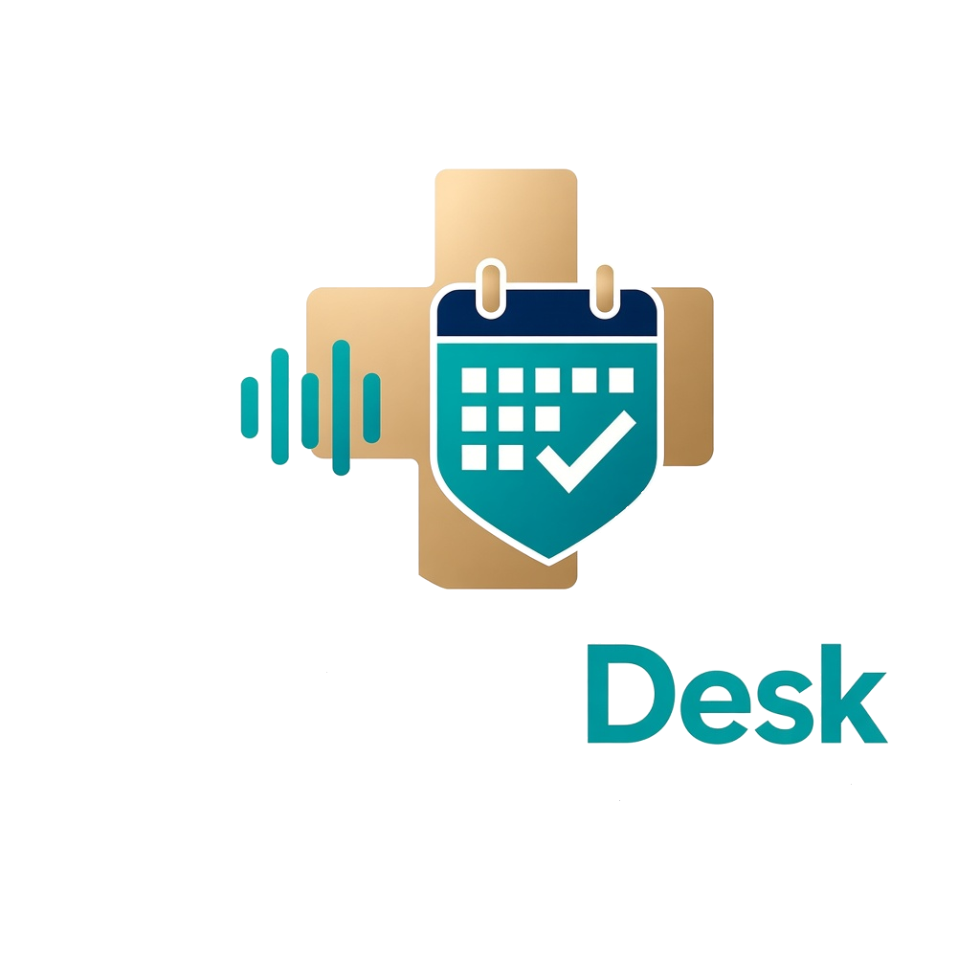
MyDocDesk
MyDocDesk: Intelligent Medical & Dental Reception
24/7 AI Voice & WhatsApp Triage • Structured Pre-Visit Case Notes • Smart Schedule Protection
Built for Cyprus & Greece
GeSY doctors, private specialists & dental clinics
mydocdesk.com • Sister platform to myvacai.com
Notes:
MyDocDesk title slide.
Sources: https://mydocdesk.com ; product files /workspace/mydocdesk/index.html, app.js. Crest: official MyDocDesk logo (user-supplied attachment).

Slide 2
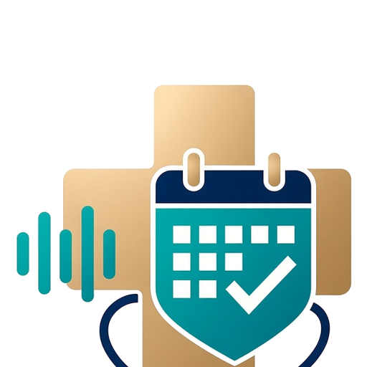
MyDocDesk
Page 2
Why Solo & Specialist Clinics Lose Hours and Revenue Every Day
CALLS PER DAY
LOST PER MISSED CALL
GeSY ADMIN NOISE
40–100+
€60–€500+
30–40%
Constant phone & WhatsApp interruptions while the doctor is examining a patient or the dentist is chairside with gloves on.
A single missed private consultation, dermatology procedure, crown repair, or implant inquiry goes straight to the next clinic that answers.
Repeat GeSY prescriptions and specialist referral requests clog up the phone line and consume valuable in-person exam slots.
Notes:
The daily clinic bottleneck: call volume, revenue lost per missed call, GeSY admin noise.
Figures as approved in the MyDocDesk pitch outline (owner estimates). Sources: https://mydocdesk.com ; /workspace/mydocdesk/index.html, app.js.

Slide 3
MyDocDesk
Page 3
Meet Anastasia — Answers Every Call & WhatsApp in Under 1 Second
HOW A CLINIC CALL FLOWS
1 · Patient calls your normal number
Busy or unanswered → forwarded (*67* / *61*)
2 · Anastasia answers in under 1 sec
Greek · English · Russian, 24/7
Normal Phone Calls + WhatsApp + SMS
Works with your existing Cyta, Epic, or Cablenet clinic landline or mobile via simple "Forward When Busy / Unanswered" (*67* / *61*) — no new hardware or number change required.
3 · Pass sent on WhatsApp / SMS
Appointment pass + photo/lab upload link
Trilingual Fluency: Greek · English · Russian
Speaks natural Cypriot/Standard Greek, English, and Russian over normal phone lines and transcribes WhatsApp voice notes automatically.
4 · Smart Calendar & Case Note
Reads busy blocks on all calendars, books into a color-coded “Anastasia AI” layer
Instant WhatsApp / SMS Handoff
Sends the appointment pass and optional photo/lab upload link while still on the call (or a standard SMS for landline/non-WhatsApp patients).
Private details never shared • No new hardware
Notes:
Meet Anastasia, the 24/7 AI medical & dental receptionist.
Step 4 — Smart Calendar & Case Note: Anastasia reads busy blocks across all of the doctor's connected calendars (personal, hospital rounds, clinic) without exposing private event details, then books confirmed appointments onto a dedicated color-coded "Anastasia AI" Google Calendar sub-calendar, so AI-booked vs. manual slots are visible at a glance.
Every booking also triggers the Zero-App WhatsApp quick-approval flow on slide 5 (Reply A / B / C / D) for Priority 2/3 and GeSY admin requests.
Source for the calendar layer and A/B/C/D approval features: product decision approved by Christos (Oct 2026).
Sources: https://mydocdesk.com ; /workspace/mydocdesk/index.html (How Anastasia Works: Cyta/Epic/Cablenet, *67*/*61* forwarding, EL/EN/RU, WhatsApp/SMS), app.js.

Slide 4
MyDocDesk
Page 4
3-Tier Clinical & Dental Priority Triage (P1 / P2 / P3)
P1
Priority 1 — Urgent Same-Day
High pediatric fever (>39°C), acute otalgia, broken front crown, or severe toothache → Anastasia screens red flags and unlocks your protected 12:30 PM / 5:00 PM Emergency Buffer Slot.
Protects Same-Day Emergency Capacity While Filtering Out Routine Admin
P2
Priority 2 — Standard 24–48h + Photo Intake
YOUR PROTECTED DAILY SCHEDULE
Spreading skin rash, lab review, lost filling, or implant consult → Anastasia requests a smartphone photo or PDF on WhatsApp and books the right slot duration (15m / 30m / 45m / 60m).
12:30 PM
Emergency buffer (P1 only)
5:00 PM
Emergency buffer (P1 only)
P3
Priority 3 — Routine & GeSY Async Queue
End of day
5-minute GeSY batch queue (P3)
Repeat GeSY prescriptions, specialist referrals, or dental scaling & hygiene every 6 months → routed to your 5-Minute End-of-Day GeSY Batch Queue or to off-peak hygiene hours, never a prime exam slot.
Off-peak
Hygiene & scaling hours (P3)
Notes:
3-tier clinical & dental priority triage: P1 urgent same-day (emergency buffer slots), P2 24-48h with photo intake, P3 routine/GeSY async batch queue.
Sources: https://mydocdesk.com ; /workspace/mydocdesk/index.html, app.js, leave-behind.html.

Slide 5
MyDocDesk
Page 5
Every Calendar Event Arrives With a 3-Bullet Case Note
WhatsApp · P2 GeSY repeat script — Reply A / B / C / D
[A] Approve & Send [B] Book Morning Slot
[C] Request Photo/Labs [D] Doctor Call Back
Dedicated “Anastasia AI” Calendar Layer
Reads busy blocks across personal, hospital-rounds and clinic calendars (no private details shared) and books onto a color-coded sub-calendar, so AI-booked vs. manual slots stand out.
TODAY • ■ Anastasia AI layer
3-Bullet Clinical & Dental Summary
10:30 Case #MD-409 • P1 Same-day
• Chief complaint & duration
• Medication / sensitivity history
• Red-flag screen done (112 / A&E)
Photo attached: thermometer reading
Chief complaint & duration, medication/sensitivity history, and a completed red-flag screen (112 / A&E auto-deflection for chest pain or breathing distress).
Zero-App “Reply A / B / C / D” Approval
16:00 Case #MD-415 • Dental
• WhatsApp photo: fractured tooth #14
• Nurse: chairside tray prep notes
• Thermal sensitivity history
Priority 2/3 bookings and GeSY admin (repeat prescriptions, referrals, lab reviews) arrive as a WhatsApp digest the doctor answers in 1 second from the lock screen.
Pre-Attached Photos & Nurse Tray Prep
Patient WhatsApp photos (rash, thermometer, fractured tooth #14) and chairside tray-prep notes are linked directly to the event.
Notes:
Structured pre-visit case notes and dental chair prep, synced to the doctor calendar. Case numbers in the mockup are demo examples.
Calendar layer: confirmed bookings land on a dedicated color-coded "Anastasia AI" sub-calendar (teal badge on the phone mock), after Anastasia reads busy blocks across personal, hospital-rounds and clinic calendars without leaking private details — the same layer shown in step 4 on slide 3.
Zero-App quick approval: for Priority 2/3 bookings and GeSY admin requests (repeat prescriptions, referrals, lab reviews), Anastasia sends a compact WhatsApp digest — Reply [A] Approve & Send, [B] Book Morning Slot, [C] Request Photo/Labs, [D] Doctor Call Back. The doctor acts in 1 second from the lock screen, no dashboard needed.
Source for both features: product decision approved by Christos (Oct 2026); not yet described on mydocdesk.com.
Sources: https://mydocdesk.com ; /workspace/mydocdesk/index.html, app.js, leave-behind.html.

Slide 6
MyDocDesk
Page 6
Tailored Triage Rules Across Medical & Dental Specialties
Pediatrics & GeSY Personal Doctors
Dermatology & Aesthetic Clinics
Cardiology & Internal Medicine
FEATURED
Primary Care & Pediatric Clinics
Clinical & Cosmetic Dermatology
Cardiology & Internal Medicine
Dentistry & Implantology
Fever & red-flag triage, working-parent WhatsApp handoff, and automatic deflection of daily GeSY repeat prescriptions & referrals.
High-resolution WhatsApp photo intake before the visit, so urgent rashes are seen fast and cosmetic/laser slots stay organized.
Pre-visit BP/ECG log collection and structured chronic GeSY medication renewal batching.
General, Cosmetic & Implant Dentistry
Hands-free answering while chairside with gloves on; 30m emergency toothache/crown buffer slots, WhatsApp tooth photo intake, and variable 30m/45m/60m block booking.
Notes:
Built for Cyprus specialties: dentistry (featured), pediatrics & GeSY personal doctors, dermatology, cardiology & internal medicine.
Sources: https://mydocdesk.com ; /workspace/mydocdesk/index.html, app.js, leave-behind.html.

Slide 7
MyDocDesk
Page 7
“Come for the Receptionist, Stay for the Patient Network”
How Your AI Calendar Unlocks Phase 2 Patient Discovery Across Cyprus
PHASE 2
FOUNDING 20
The Live Cyprus Doctor & Dentist Finder App
Founding Clinic Network Advantage
Once clinics use MyDocDesk as their real-time calendar source of truth, patients across Nicosia, Limassol, Larnaca, and Paphos can search by symptom or specialty and book verified open slots directly—with zero double-bookings and pre-triaged priority rules still enforced.
The first 20 Founding Clinics in Cyprus lock in permanent priority placement in specialty search results, automatic cross-referral intake from participating GeSY Personal Doctors, and €0 marketplace commission on patient bookings.
Notes:
Phase 2 vision: the live patient discovery & booking network, and the Founding Clinic advantage (first 20 clinics).
Sources: https://mydocdesk.com ; /workspace/mydocdesk/index.html, app.js, leave-behind.html.

Slide 8
MyDocDesk
Start Your 14-Day Free Clinic Pilot in 5 Minutes
FULL-TIME FRONT-DESK SECRETARY
€1,400+ / month
8 hours/day, 1 call at a time, holidays & sick leave.
MYDOCDESK FOUNDING DOCTOR RATE
€99 / month
Locked in for the first 20 clinics (Standard: €149/month) — 24/7 coverage, unlimited simultaneous calls & WhatsApp triage, 14-Day Free Pilot.
vs
Zero-Disruption Setup: keep your existing Cyta/Epic/Cablenet clinic number (activate *67* / *61* forwarding on busy/unanswered) and sync with your existing Google, Apple, or Outlook Calendar in 5 minutes.
mydocdesk.com
Live interactive demo
+357 99 429249
hello@mydocdesk.com
Christos Taliadoros
Engineered & Supported by T-Knights Consulting Ltd (Cyprus)
Notes:
Closing: ROI comparison (front-desk secretary vs MyDocDesk founding rate), 14-day free pilot, zero-disruption setup, contact.
Contact: Christos Taliadoros, hello@mydocdesk.com, +357 99 429249. Attribution confirmed by Christos: Engineered & Supported by T-Knights Consulting Ltd (Cyprus).
Sources: https://mydocdesk.com ; /workspace/mydocdesk/index.html, app.js, leave-behind.html.

