Slide 1
Kecenderungan Pilihan Konsumen dalam Menggunakan Layanan Social Network dalam Melakukan Social Shopping
Christovito Hidajat
18218043
Sistem dan Teknologi Informasi

Slide 2
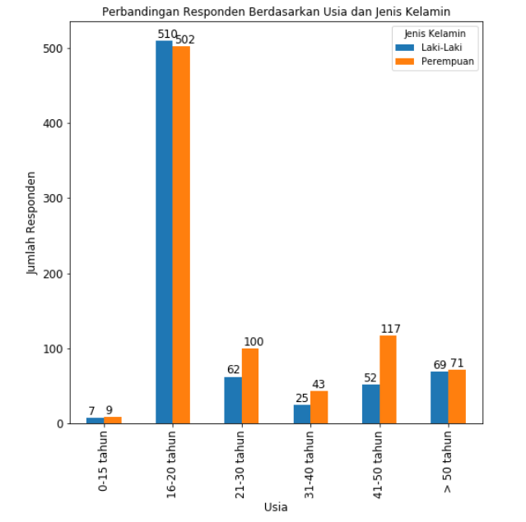
About Survey Responden
Data Cleaning 1643 rows x 522 columns
TO
1567 rows x 100 columns

Slide 3
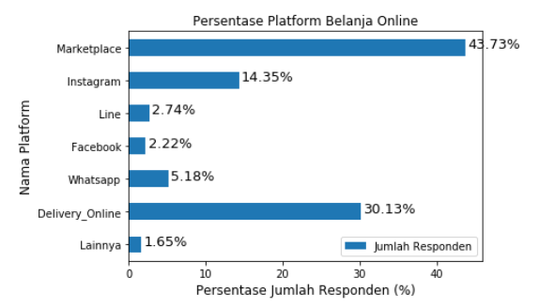
Top 3
Platform Belanja Online
Marketplace
Delivery Online
Instagram
Multivote System
From 2662 Inputs

Slide 4
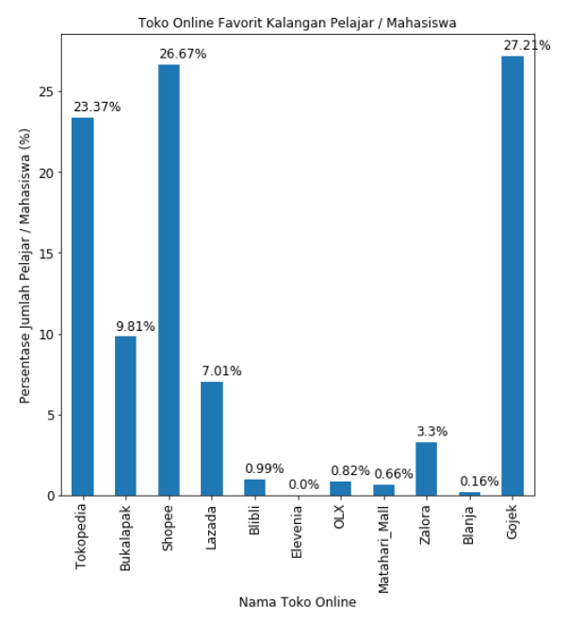
Toko Online Favorit Kalangan Pelajar Mahasiswa
GOJEK
SHOPEE

Slide 5
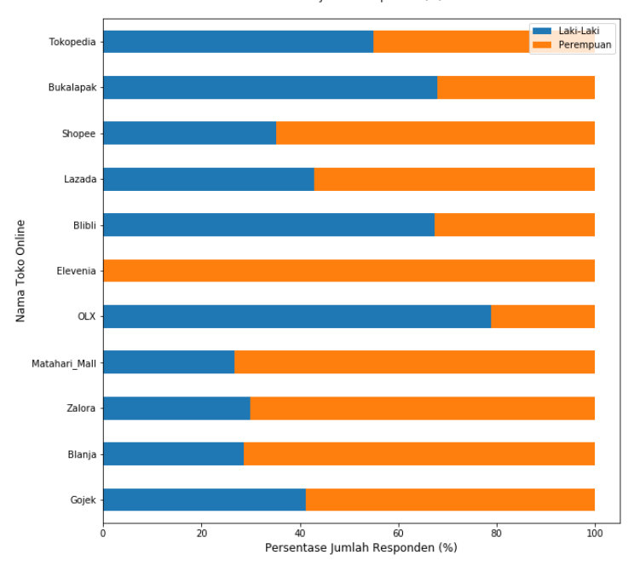
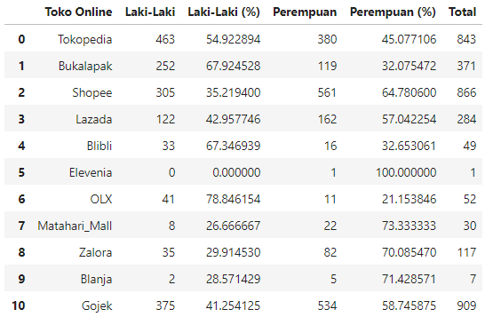
Toko Online Favorit Berdasarkan Jenis Kelamin

Slide 6
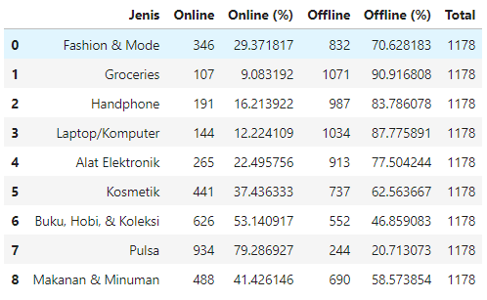
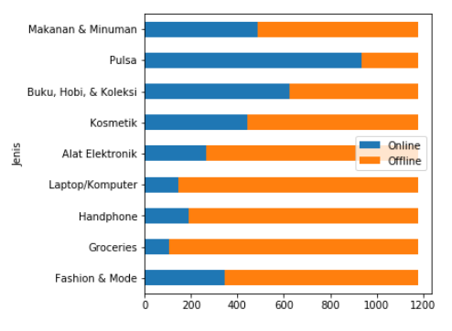
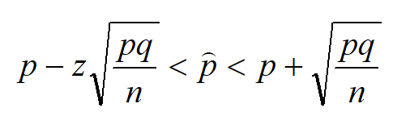

CONFIDENCE INTERVAL 95% (z = 1.96)
CI dari proporsi belanja makanan dan minuman secara ONLINE

Slide 7
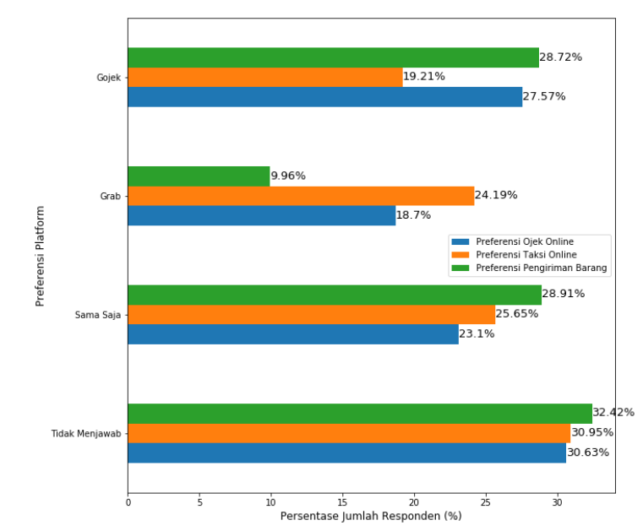
Gojek vs Grab
GoRide vs GrabBike
GoCar vs GrabCar
GoSend vs GrabExpress
WHICH IS BETTER AND WHY?

Slide 8
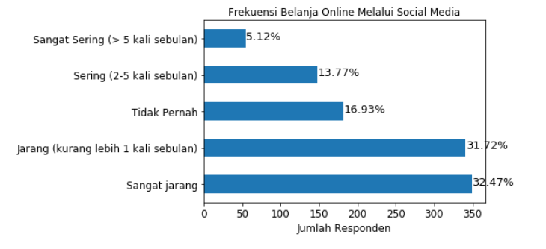
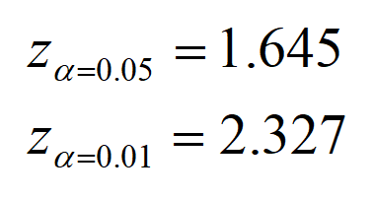
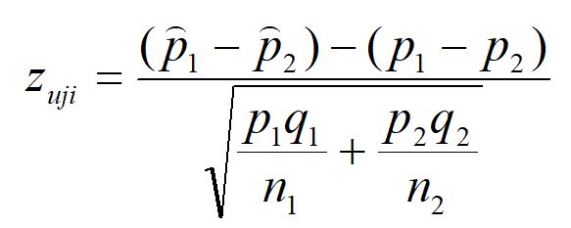
Uji Hipotesis
Selisih
Dua Proporsi
Apakah proporsi populasi yang tidak pernah belanja online lebih besar daripada yang sering belanja online?
H0 : pTdkPernah = pSering
H1 : pTdkPernah > pSering
Zuji = 2.456
Tolak H0

Slide 9
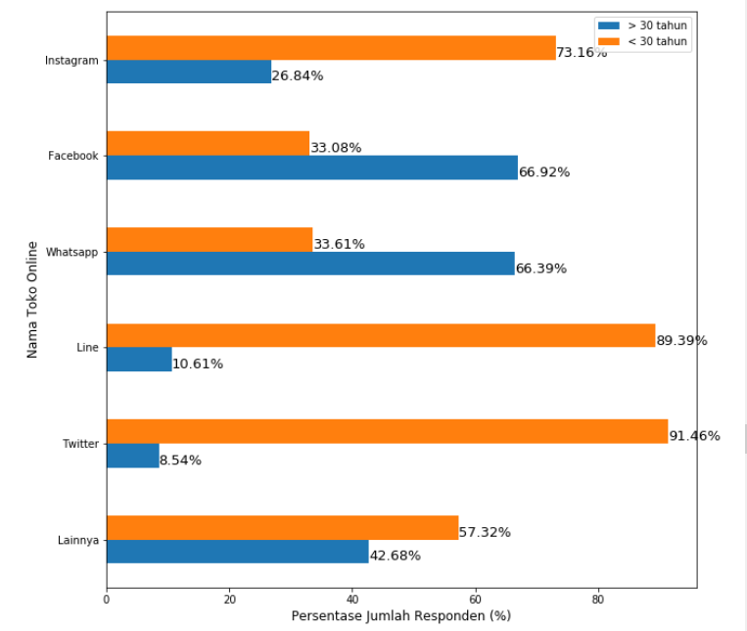
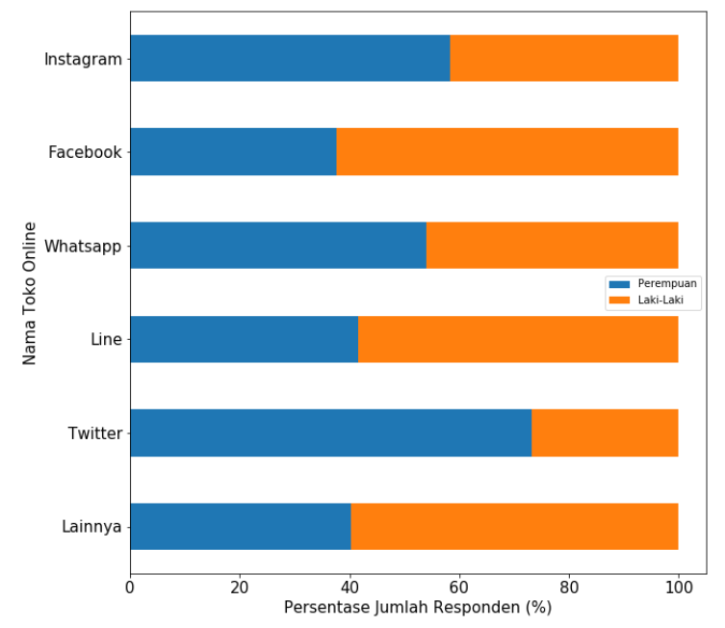
Know which social media platform you would use for promotion based on the consumers’ preferences !

Slide 10
CONCLUSION
As an online shop, always know what kind of products you would sell
Learn the target market, find the most effective way to reach them !

Slide 11
“If your business is not on the internet, then your business will be out of business”
– Bill Gates, Microsoft Founder

