Slide 1
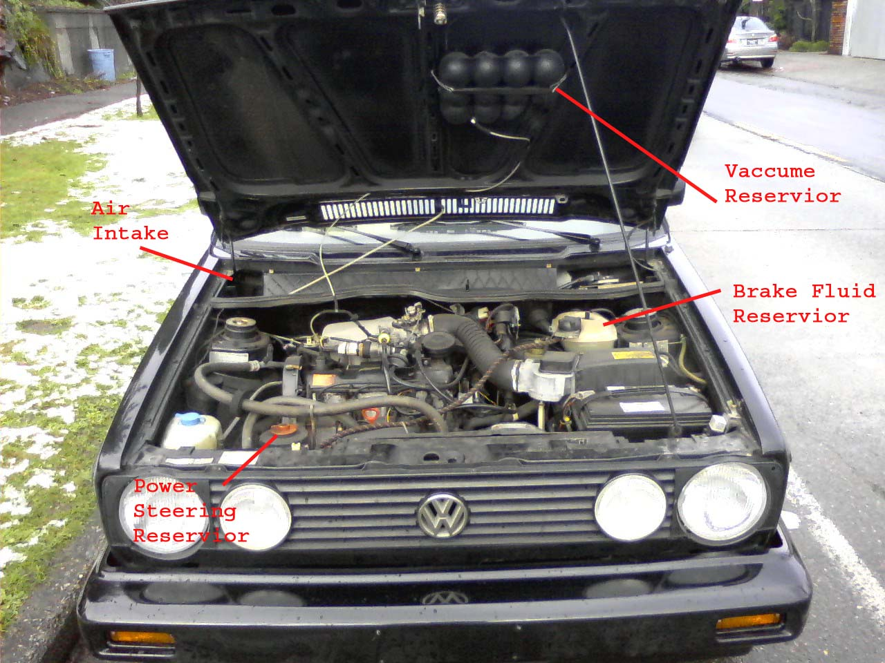

Slide 2
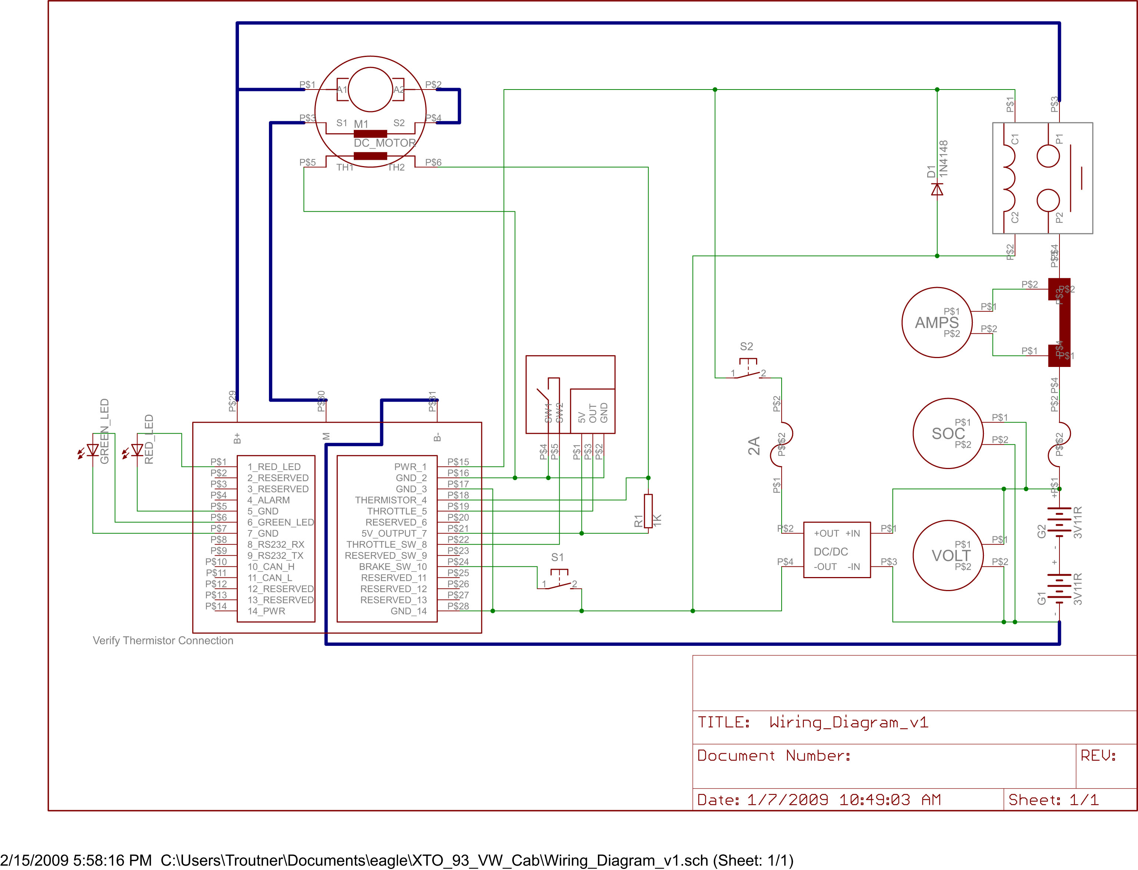

Slide 3


Slide 4
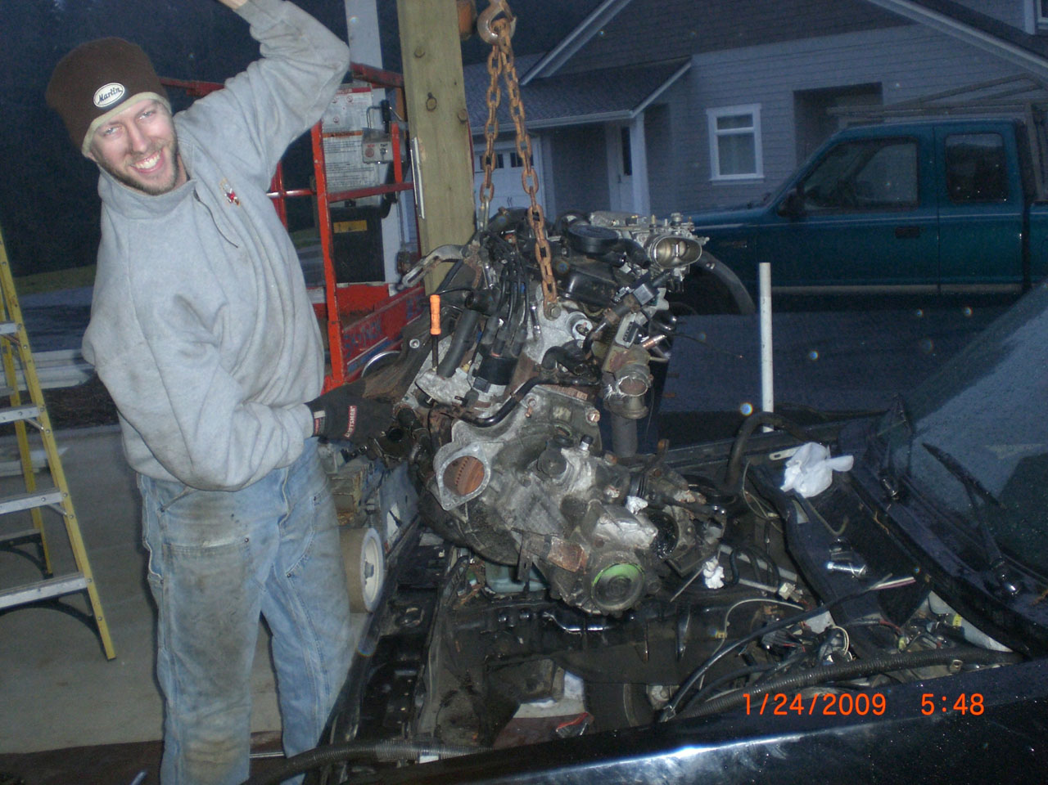

Slide 5
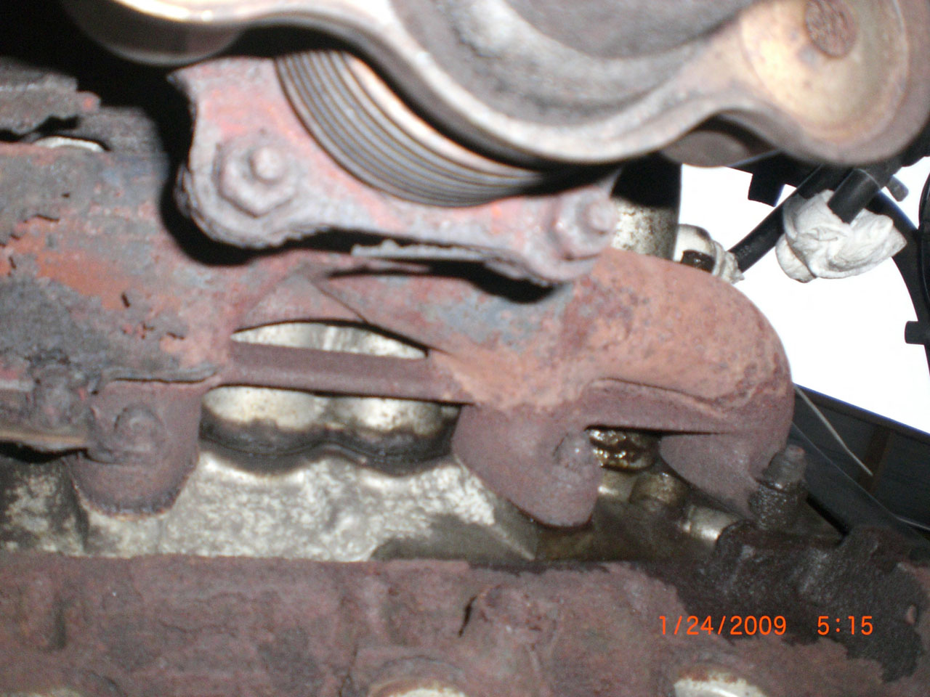

Slide 6
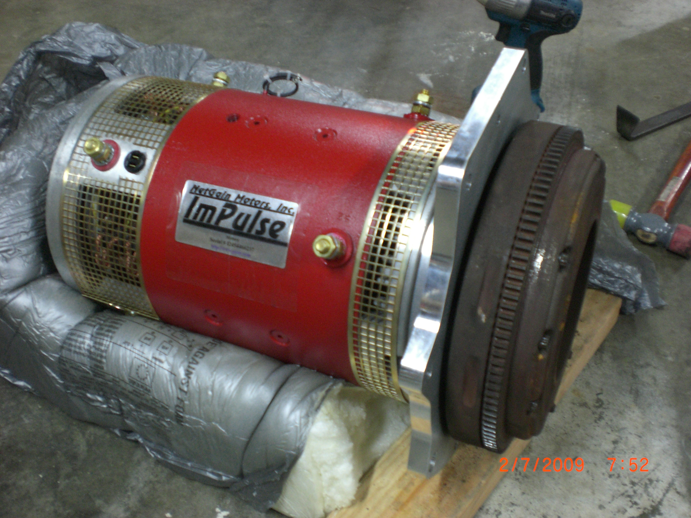

Slide 7
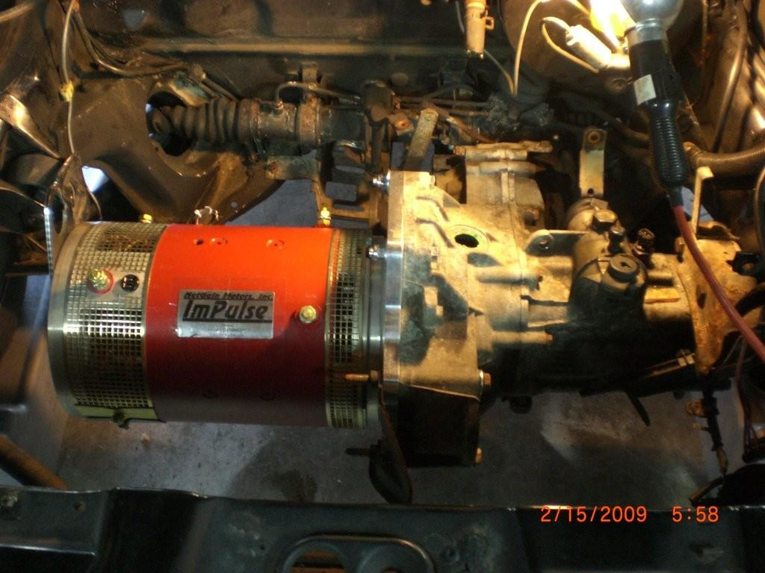

Slide 8
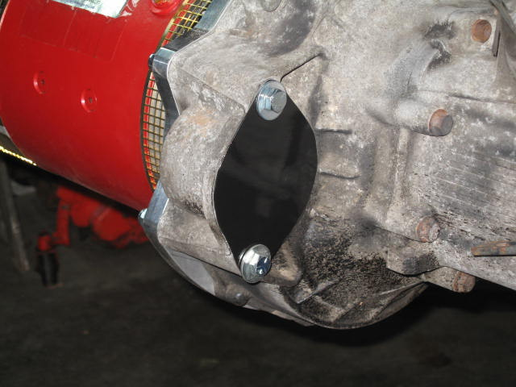

Slide 9
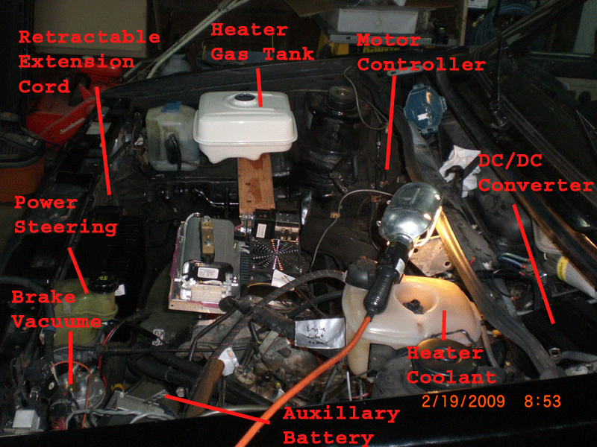

Slide 10
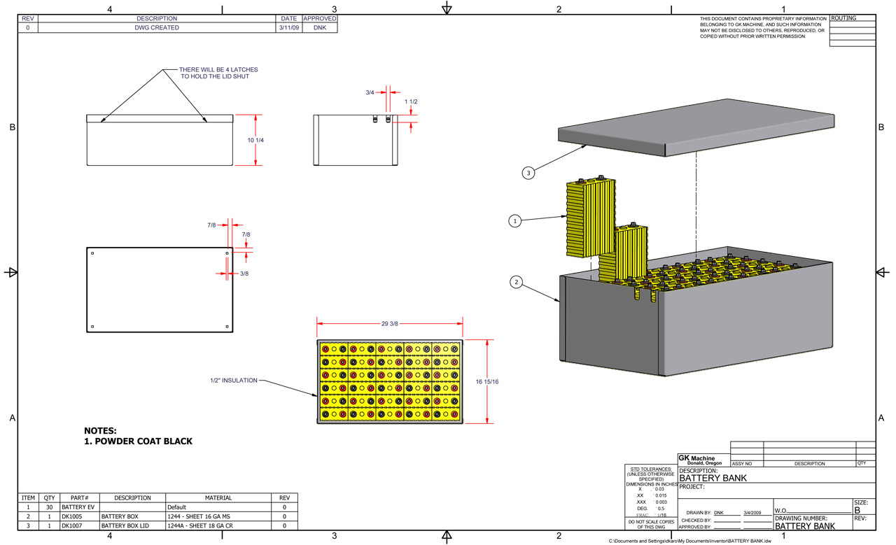

Slide 11
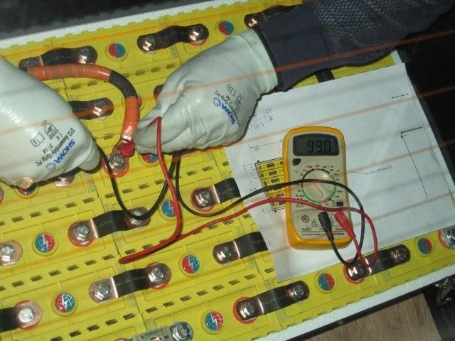

Slide 12
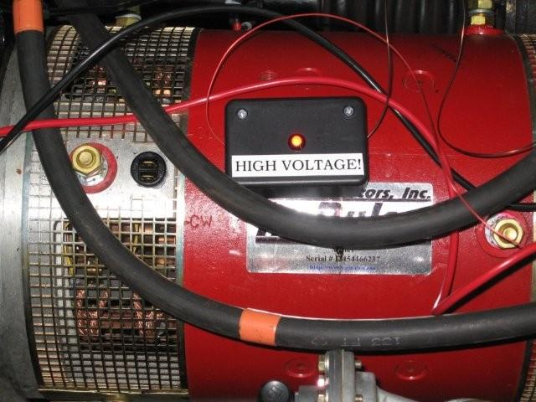

Slide 14
Videos
Spinning the tires:
TiresSpinning.3g2
YouTube Video of First Test Drive:
http://www.youtube.com/watch?v=Oyl_0O8-TYc
YouTube video in downloaded format:
video.flv
video.mp4

