Slide 1
1. Dependencies

Slide 2
Filters

Slide 3
1. Parameters
=== Run parameters === region_analysis = 'Japan' esg_choice = 'refinitiv' no_simple_quantiles = 4 add_accounting_data = True show_sector_portfolio = False start_year = 2013 end_year = 2022 top_x_by_industry_even_split = 6 use_alpha_bound = True alpha_bound = 0.1 mktcap_covered = 0.95 drop_real_estate = True fama_factor_region = 'Japan' currency_filter = ['JPY'] convert_to_USD = False ======================
Signal Design
Signal Choice
2. Data
Golden Data
2.1 LC dataset
clean below
count 19332.000000 mean 28.361318 std 30.302632 min 0.000000 25% 9.000000 50% 19.000000 75% 36.000000 max 465.000000 Name: sum_activities, dtype: float64
count 17035.000000 mean 24.953566 std 18.769500 min 4.000000 25% 11.000000 50% 19.000000 75% 34.000000 max 129.000000 Name: sum_activities, dtype: float64
Create the signal
Num stocks in USA and EU prior to some more filters
0
2.2 WRDS, Fama-French and FX data
Get and Process: 1- FX data
2- USA Universe
3- ROW Universe
4 - Japan
5 - ESG
4- Fama-French
5- Global Universe
6- Accounting Data
columns with year ['year_x', 'year_y', 'year']
3. Univariate Portfolio sorting
% Nan in accounting data
3.1 Univariate sorting

Slide 4
4. Sector Split
Add Market Portfolios
Transform in excess returns using the risk free rate
Make sure the first row is 0, so they all start at the same date

Slide 5
5. Fama-French
 | Low advocacy | High advocacy | Low preparation | High preparation | Low transformation | High transformation | Low esg_refinitive | High esg_refinitive | Sample
alpha | 0.33 | 0.29 | 0.23 | 0.49 | 0.45 | 0.26 | 0.24 | 0.42 | 0.39
beta_mkt | 1.06 | 0.96 | 0.95 | 1.10 | 1.02 | 1.01 | 0.85 | 1.05 | 1.00
beta_smb | -0.18 | -0.04 | -0.07 | -0.15 | -0.06 | -0.08 | 0.04 | -0.26 | -0.12
beta_hml | 0.35 | 0.32 | 0.31 | 0.40 | 0.38 | 0.33 | 0.33 | 0.35 | 0.34
p-value(alpha) | 0.31 | 0.33 | 0.46 | 0.14 | 0.15 | 0.40 | 0.45 | 0.20 | 0.20

Slide 6
6. Performance Metrics

Slide 7
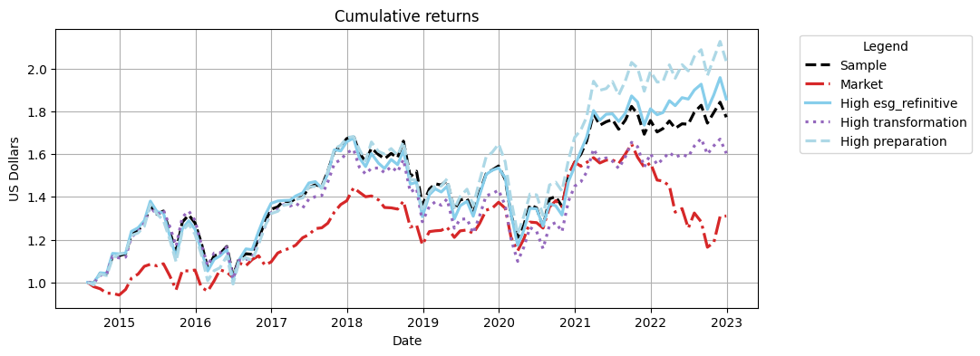
Cumulative Returns Plot

Slide 8
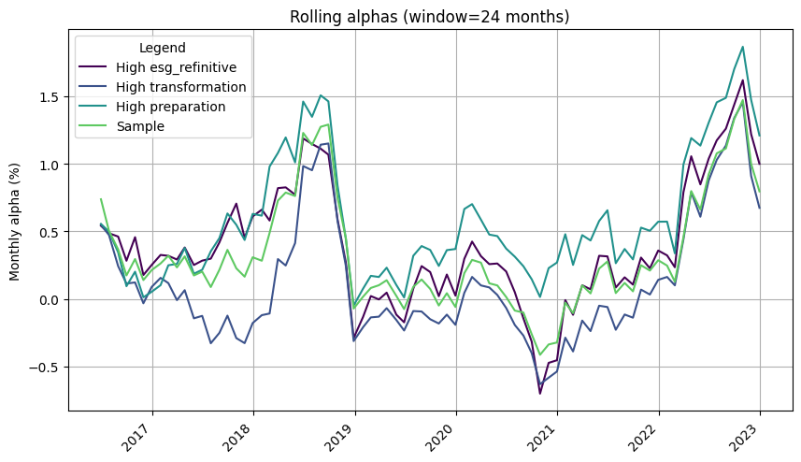

Slide 9
 | 1m | 3m | YTD | 1yr | 3yr | 5yr | 10yr | Since launch
Sample | -3.82% | 1.58% | 0.87% | 0.87% | 14.76% | 5.98% | 77.25% | 77.25%
Market | 0.17% | 12.54% | -15.93% | -15.93% | -4.69% | -5.15% | 31.03% | 31.03%
High esg_refinitive | -5.10% | 2.69% | 2.55% | 2.55% | 21.02% | 12.11% | 85.80% | 85.80%
High transformation | -3.98% | 0.25% | 0.12% | 0.12% | 12.01% | -0.12% | 60.36% | 60.36%
High preparation | -4.41% | 3.35% | 2.33% | 2.33% | 23.43% | 21.30% | 103.34% | 103.34%

Slide 10
 | Sharpe | VaR 1% | Max Drawdown | Alpha | p-value(alpha)
Sample | 0.49 | -11.16% | -28.14% | 0.39 | 0.200
Market | 0.30 | -9.27% | -29.34%
High esg_refinitive | 0.50 | -11.49% | -29.94% | 0.42 | 0.200
High transformation | 0.41 | -11.59% | -32.30% | 0.26 | 0.400
High preparation | 0.54 | -11.59% | -27.34% | 0.49 | 0.140

Slide 11
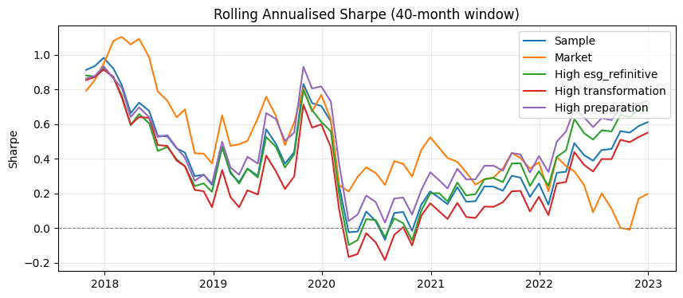

Slide 12
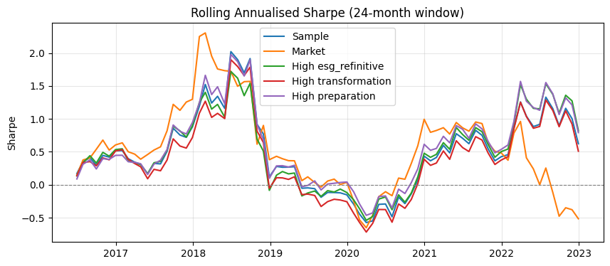

Slide 13
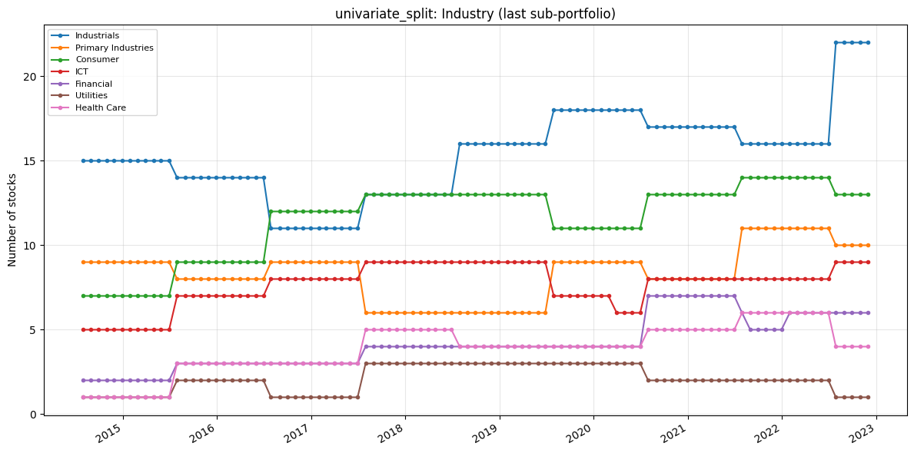
7. Portfolio Constituents
Portfolio constituents — category mix (PortfolioConstituents)
Uses signal_2_simple_quantiles_constituents and global_universe to inspect Industry, loc, and MacroRegion: line charts of stock counts over time (default = last quantile p_k, same as constituents[i][-1]) and donut charts for the final formation month. Optional: analyse_all_portfolios_at_once=True unions all p_1…p_k; all_sub_portfolios=True plots one subplot per quantile.
The following only inspects the high transformation

Slide 14
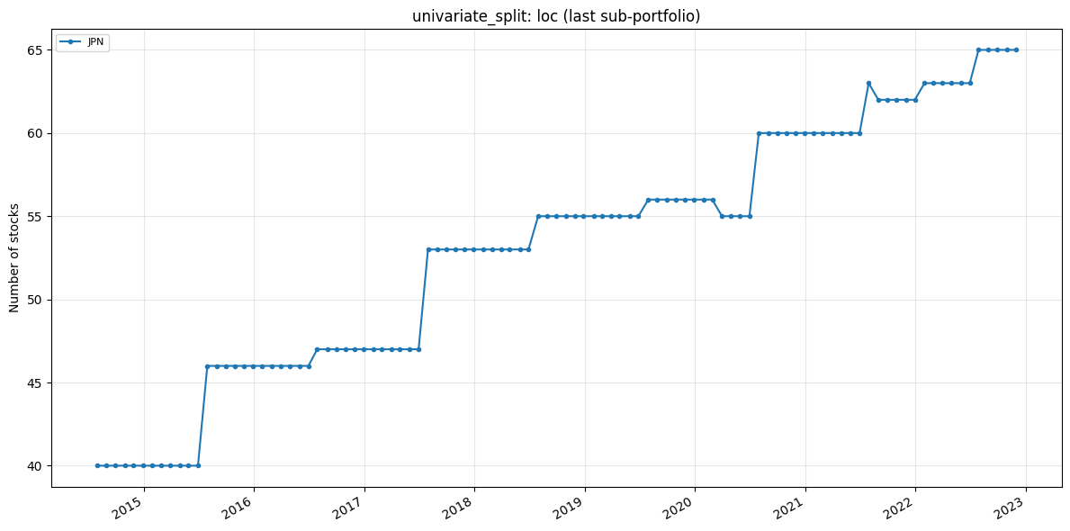

Slide 15
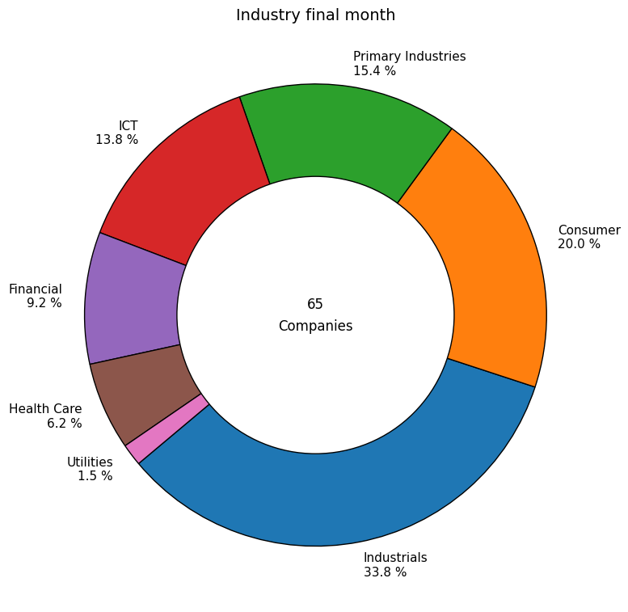

Slide 16
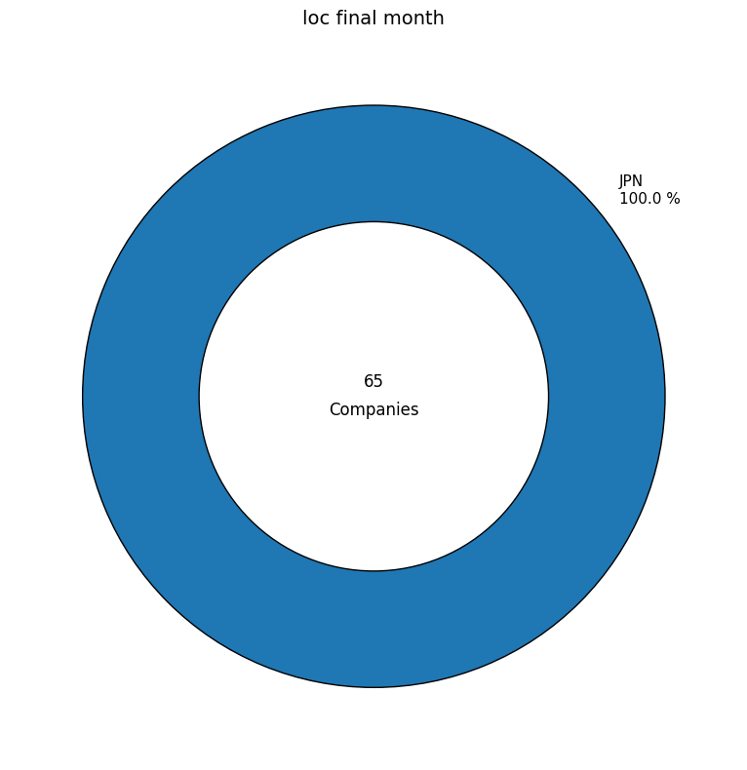

Slide 17
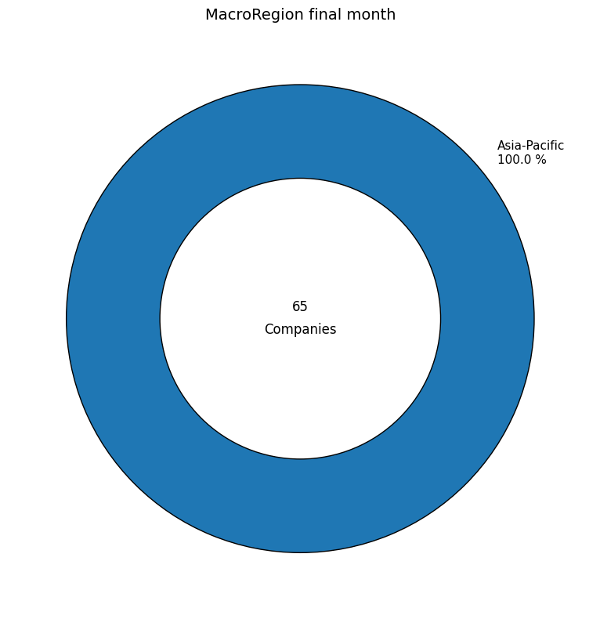

Slide 18
