Slide 1
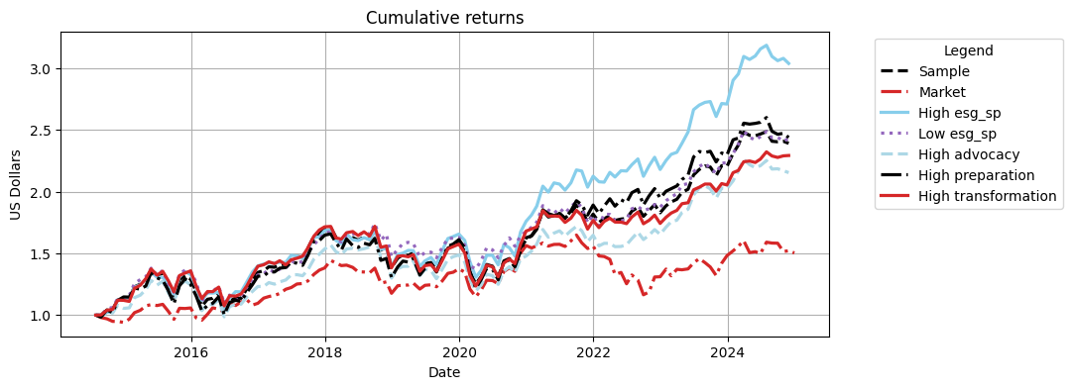
SNP global

Slide 2
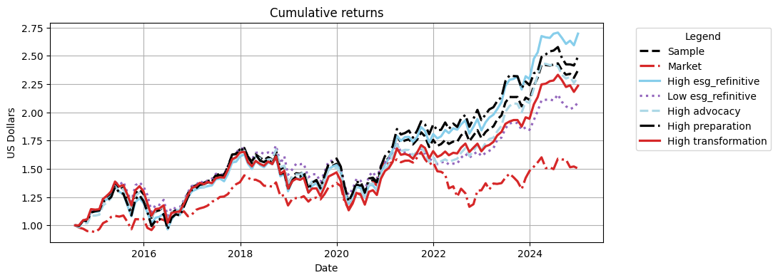
refinitve

Slide 3
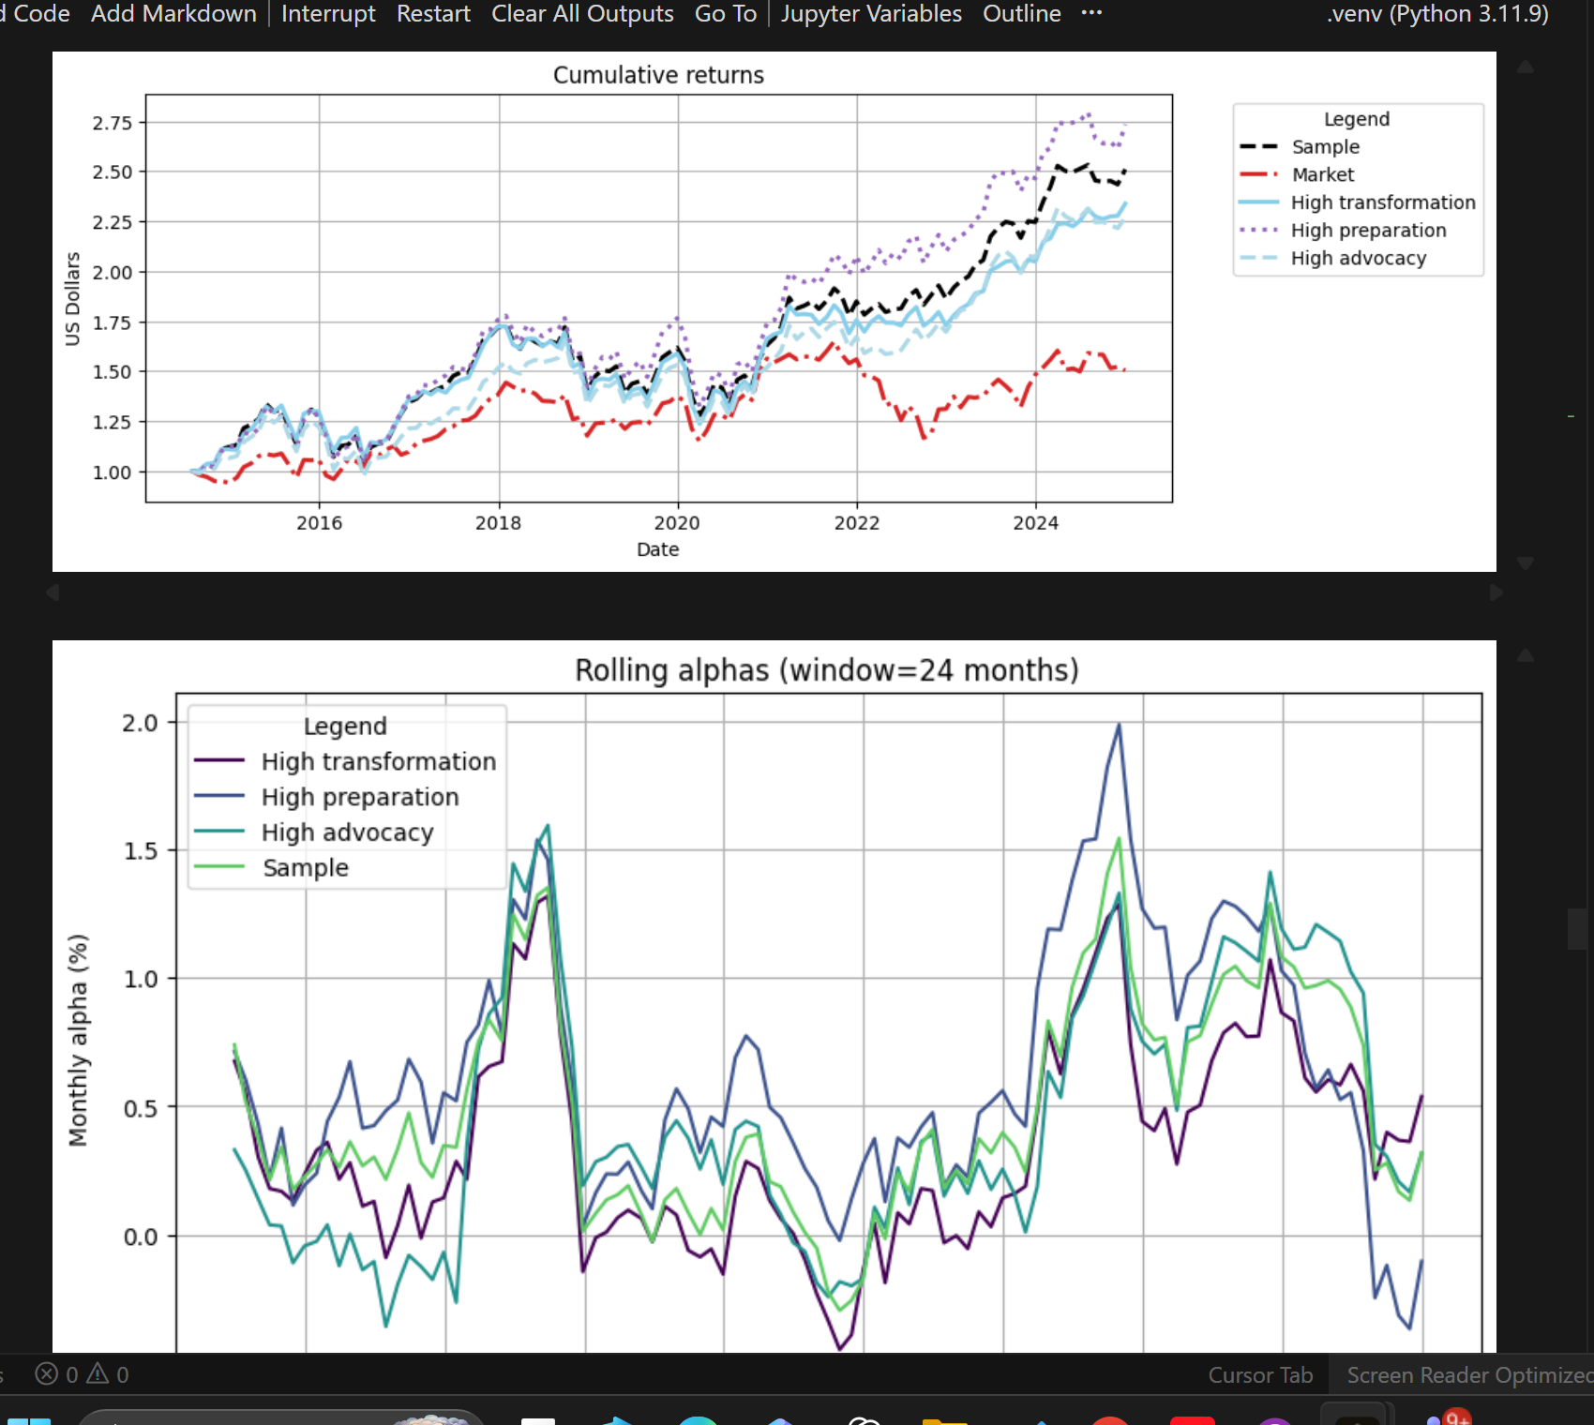

Slide 4
Selection/universe effects: before sorting, your preprocessing tends to align signals and returns on a common non-missing universe. If ESG coverage is better for larger / higher-quality firms, the “High ESG” portfolio may end up drawing from a systematically stronger subset than other signals.

