Slide 1
1. Dependencies

Slide 2
1. Parameters
=== Run parameters === region_analysis = 'Japan' esg_choice = 'none' no_simple_quantiles = 6 add_accounting_data = True show_sector_portfolio = False start_year = 2020 end_year = 2024 top_x_by_industry_even_split = 6 use_alpha_bound = True alpha_bound = 0.1 mktcap_covered = 0.95 drop_real_estate = True fama_factor_region = 'Japan' currency_filter = ['JPY'] convert_to_USD = False ======================
Signal Design
Signal Choice
2. Data
Golden Data
2.1 LC dataset
clean below
count 15253.000000 mean 27.001377 std 28.883547 min 0.000000 25% 9.000000 50% 18.000000 75% 34.000000 max 465.000000 Name: sum_activities, dtype: float64
count 13412.000000 mean 23.711303 std 17.614447 min 4.000000 25% 10.000000 50% 18.000000 75% 32.000000 max 86.000000 Name: sum_activities, dtype: float64
Create the signal
Num stocks in USA and EU prior to some more filters
0
2.2 WRDS, Fama-French and FX data
Get and Process: 1- FX data
2- USA Universe
3- ROW Universe
4 - Japan
5 - ESG
4- Fama-French
5- Global Universe
6- Accounting Data
columns with year ['year']
3. Univariate Portfolio sorting
% Nan in accounting data
3.1 Univariate sorting

Slide 3
4. Sector Split

Slide 4
5. Fama-French
 | Low advocacy | High advocacy | Low preparation | High preparation | Low transformation | High transformation | Sample
alpha | 0.58 | 0.69 | 0.72 | 0.65 | 0.68 | 0.59 | 0.60
beta_mkt | 0.40 | 0.41 | 0.39 | 0.47 | 0.43 | 0.39 | 0.40
beta_smb | -0.28 | 0.02 | -0.00 | -0.40 | -0.04 | -0.11 | -0.22
beta_hml | 0.02 | 0.06 | 0.06 | 0.02 | 0.09 | 0.07 | 0.04
p-value(alpha) | 0.14 | 0.06 | 0.02 | 0.11 | 0.05 | 0.07 | 0.08

Slide 5
6. Performance Metrics

Slide 6
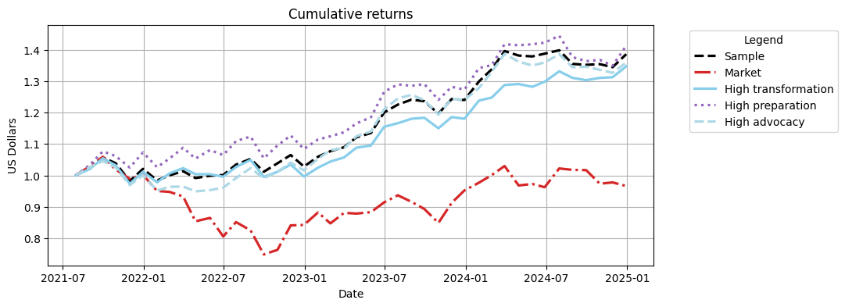
Cumulative Returns Plot

Slide 7
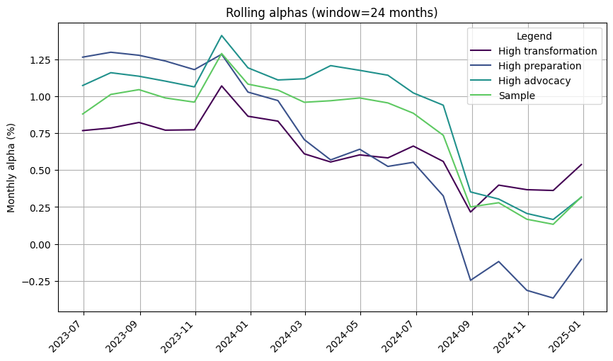

Slide 8
 | 1m | 3m | YTD | 1yr | 3yr | 5yr | 10yr | Since launch
Sample | 3.09% | 2.52% | 11.77% | 11.77% | 35.76% | 38.58% | 38.58% | 38.58%
Market | -1.19% | -4.99% | 1.45% | 1.45% | -3.58% | -3.40% | -3.40% | -3.40%
High transformation | 2.65% | 3.39% | 14.14% | 14.14% | 33.16% | 34.71% | 34.71% | 34.71%
High preparation | 4.72% | 3.61% | 11.00% | 11.00% | 31.66% | 41.26% | 41.26% | 41.26%
High advocacy | 2.47% | 1.01% | 9.63% | 9.63% | 35.81% | 35.91% | 35.91% | 35.91%

Slide 9
 | Sharpe | VaR 1% | Max Drawdown | Alpha | p-value(alpha)
Sample | 1.09 | -4.82% | -7.10% | 0.60 | 0.080
Market | 0.00 | -8.94% | -29.34%
High transformation | 1.02 | -5.47% | -7.69% | 0.59 | 0.070
High preparation | 0.99 | -5.57% | -6.61% | 0.65 | 0.110
High advocacy | 1.00 | -5.27% | -9.22% | 0.69 | 0.060

Slide 10
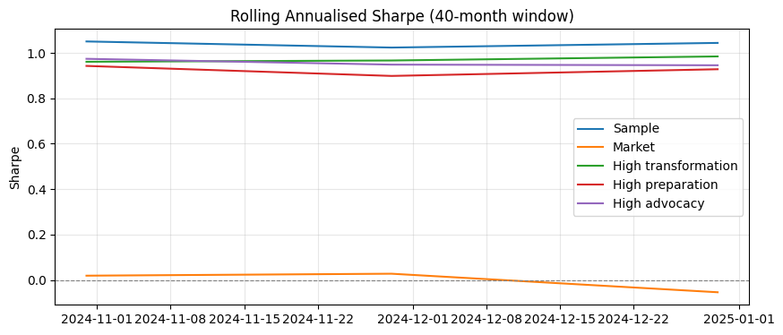

Slide 11
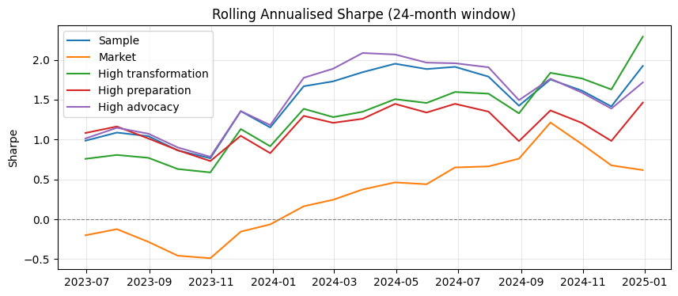

Slide 12
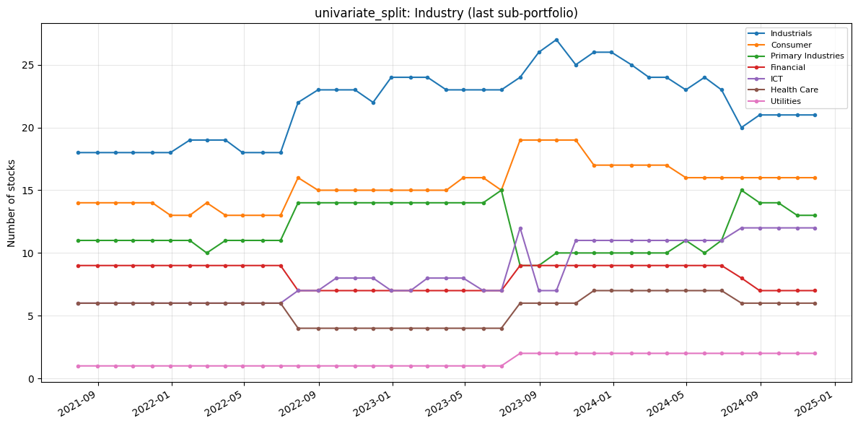
7. Portfolio Constituents
Portfolio constituents — category mix (PortfolioConstituents)
Uses signal_2_simple_quantiles_constituents and global_universe to inspect Industry, loc, and MacroRegion: line charts of stock counts over time (default = last quantile p_k, same as constituents[i][-1]) and donut charts for the final formation month. Optional: analyse_all_portfolios_at_once=True unions all p_1…p_k; all_sub_portfolios=True plots one subplot per quantile.
The following only inspects the high transformation

Slide 13
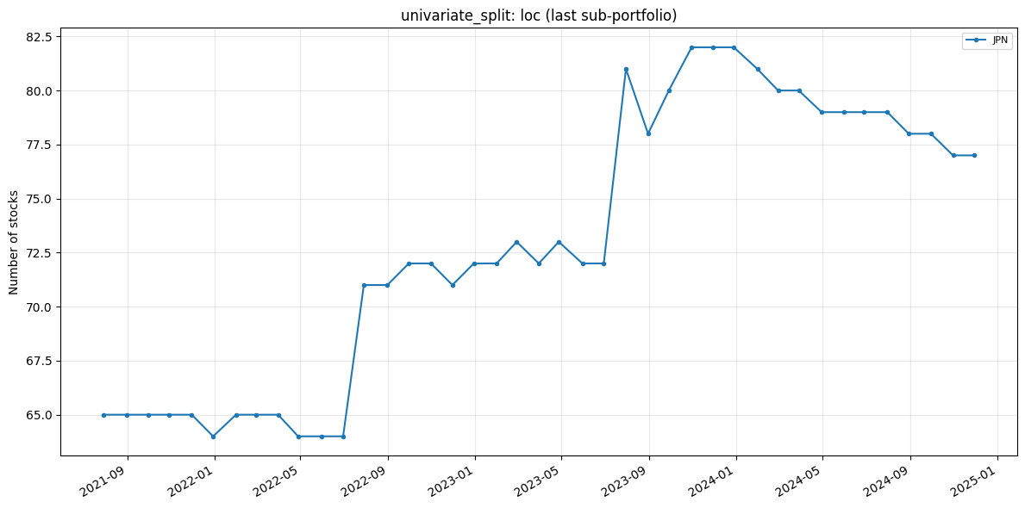

Slide 14
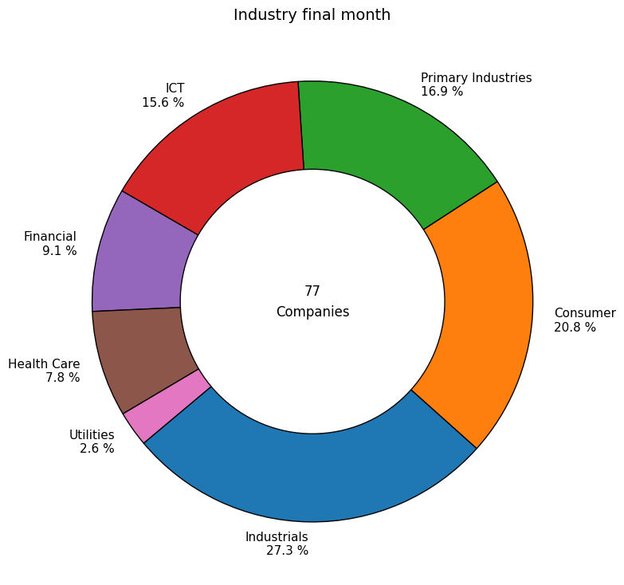

Slide 15
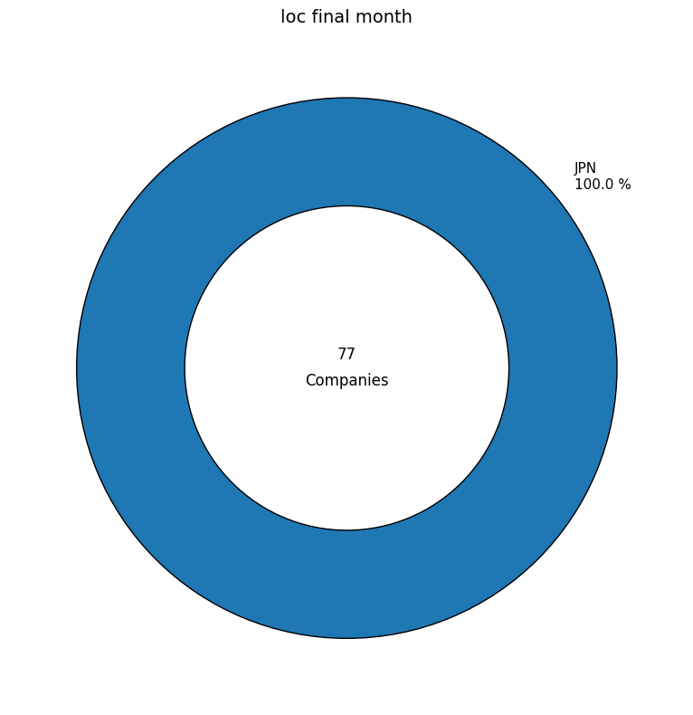

Slide 16
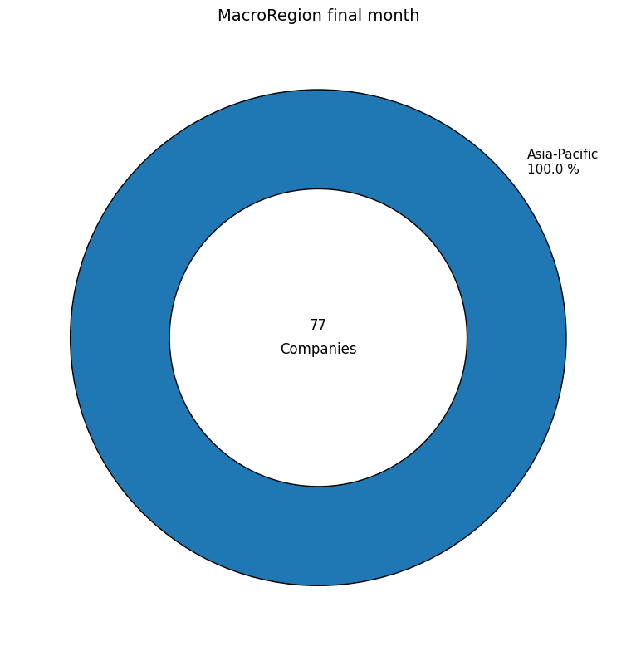

Slide 17
