Slide 1
1. Dependencies

Slide 2
Filters

Slide 3
Parameters
Signal Design
Signal Choice
2. Data
Golden Data
2.1 LC dataset
clean below
array(['Industrials', 'Primary Industries', 'Consumer', 'Utilities', 'Financial', 'Health Care', 'ICT'], dtype=object)
count 24461.000000 mean 28.322227 std 30.218086 min 0.000000 25% 9.000000 50% 19.000000 75% 36.000000 max 465.000000 Name: sum_activities, dtype: float64
count 21525.000000 mean 24.935006 std 18.711493 min 4.000000 25% 11.000000 50% 19.000000 75% 34.000000 max 129.000000 Name: sum_activities, dtype: float64
Create the signal
Num stocks in USA and EU prior to some more filters
0
2.2 WRDS, Fama-French and FX data
Get and Process: 1- FX data
2- USA Universe
3- ROW Universe
4 - Japan
5 - ESG
4- Fama-French
5- Global Universe
6- Accounting Data
columns with year ['year_x', 'year_y', 'year']
gvkey 6 2913889 Name: count, dtype: int64
gvkey 6 21525 Name: count, dtype: int64
3. Univariate Portfolio sorting
% Nan in accounting data
3.1 Univariate sorting

Slide 4
4. Sector Split
Store constituents over time + compute “next-month return” by Industry
Add Market Portfolios
Transform in excess returns using the risk free rate
Make sure the first row is 0, so they all start at the same date

Slide 5
5. Fama-French
 | Low advocacy | High advocacy | Low preparation | High preparation | Low transformation | High transformation | Low esg_refinitive | High esg_refinitive | Sample
alpha | 0.32 | 0.33 | 0.27 | 0.35 | 0.37 | 0.29 | 0.27 | 0.42 | 0.36
beta_mkt | 0.96 | 0.88 | 0.87 | 0.98 | 0.92 | 0.92 | 0.83 | 0.97 | 0.91
beta_smb | -0.23 | -0.17 | -0.12 | -0.19 | -0.15 | -0.18 | -0.05 | -0.31 | -0.18
beta_hml | 0.36 | 0.33 | 0.30 | 0.40 | 0.32 | 0.33 | 0.31 | 0.35 | 0.34
p-value(alpha) | 0.26 | 0.21 | 0.30 | 0.22 | 0.18 | 0.28 | 0.32 | 0.14 | 0.18

Slide 6
6. Performance Metrics

Slide 7
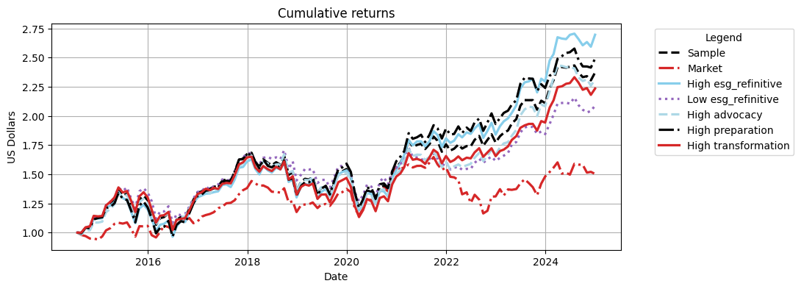
Cumulative Returns Plot

Slide 8
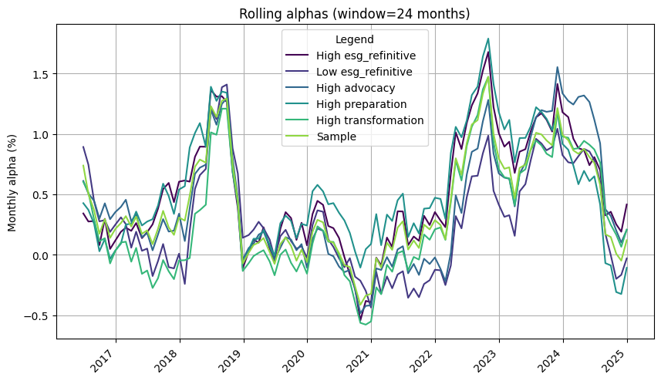

Slide 9
 | 1m | 3m | YTD | 1yr | 3yr | 5yr | 10yr | Since launch
Sample | 2.93% | 1.71% | 12.41% | 12.41% | 35.04% | 53.63% | 110.99% | 137.29%
Market | -1.19% | -4.99% | 1.45% | 1.45% | -3.58% | 9.31% | 59.76% | 50.28%
High esg_refinitive | 3.95% | 3.47% | 17.47% | 17.47% | 49.15% | 75.82% | 140.94% | 169.63%
Low esg_refinitive | 2.29% | 1.72% | 13.26% | 13.26% | 29.95% | 31.70% | 84.82% | 108.90%
High advocacy | 2.33% | 0.59% | 11.04% | 11.04% | 44.26% | 52.87% | 113.00% | 131.30%
High preparation | 3.25% | 2.82% | 11.28% | 11.28% | 31.83% | 56.69% | 121.51% | 149.32%
High transformation | 2.47% | 0.47% | 15.01% | 15.01% | 34.91% | 52.15% | 96.21% | 123.50%

Slide 10
 | Sharpe | VaR 1% | Max Drawdown | Alpha | p-value(alpha)
Sample | 0.61 | -10.99% | -28.14% | 0.36 | 0.180
Market | 0.36 | -9.16% | -29.34%
High esg_refinitive | 0.65 | -11.51% | -28.41% | 0.42 | 0.140
Low esg_refinitive | 0.55 | -11.52% | -25.65% | 0.27 | 0.320
High advocacy | 0.60 | -10.69% | -27.47% | 0.33 | 0.210
High preparation | 0.60 | -11.22% | -27.99% | 0.35 | 0.220
High transformation | 0.57 | -11.30% | -31.36% | 0.29 | 0.280

Slide 11
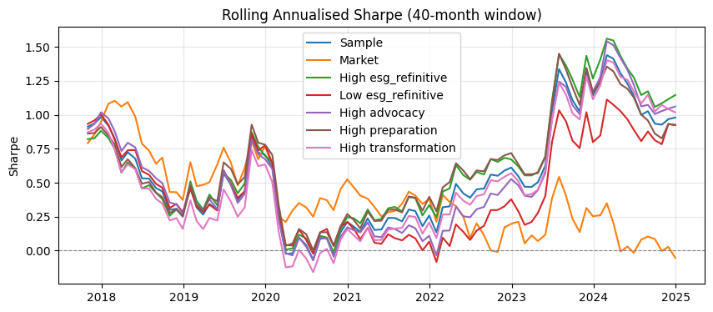

Slide 12
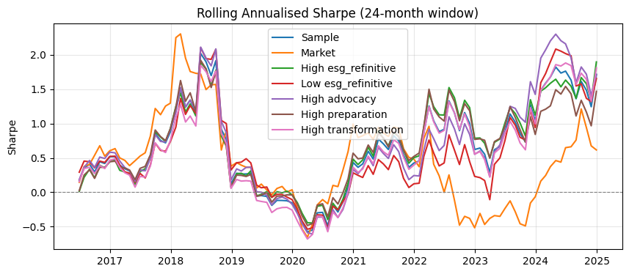

Slide 13
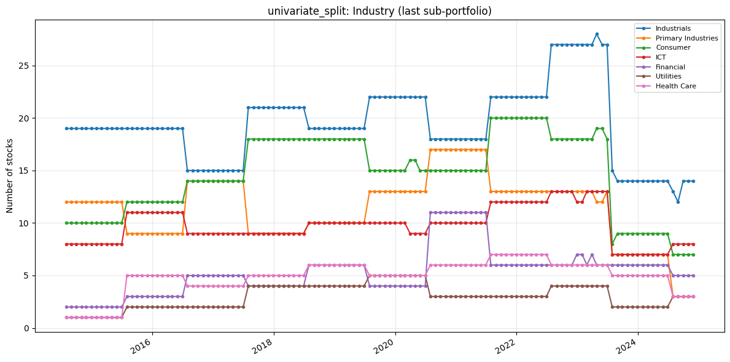
7. Portfolio Constituents
Portfolio constituents — category mix (PortfolioConstituents)
Uses signal_2_simple_quantiles_constituents and global_universe to inspect Industry, loc, and MacroRegion: line charts of stock counts over time (default = last quantile p_k, same as constituents[i][-1]) and donut charts for the final formation month. Optional: analyse_all_portfolios_at_once=True unions all p_1…p_k; all_sub_portfolios=True plots one subplot per quantile.
The following only inspects the high transformation

Slide 14
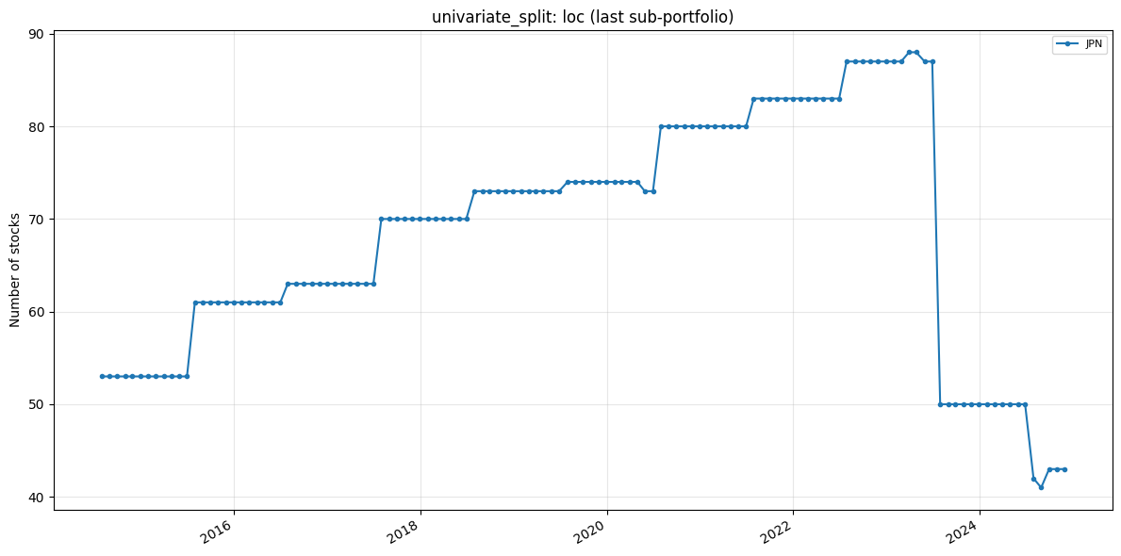

Slide 15
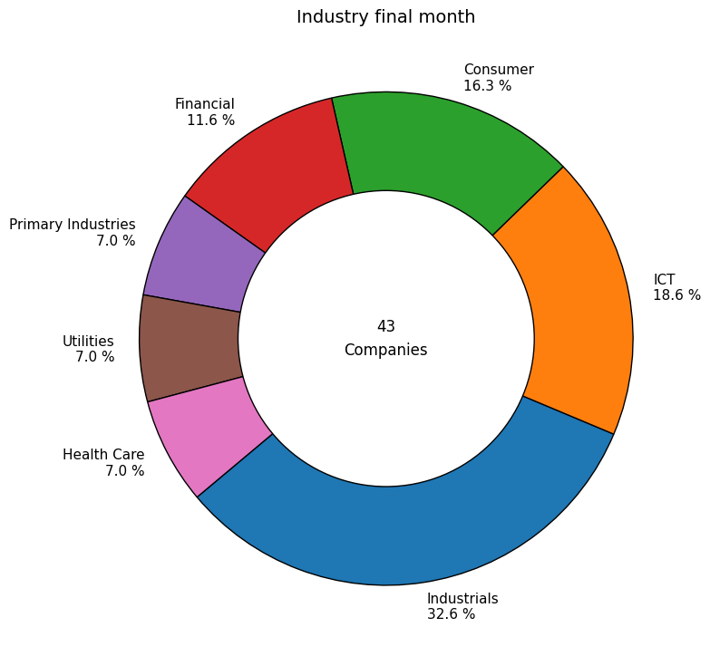

Slide 16
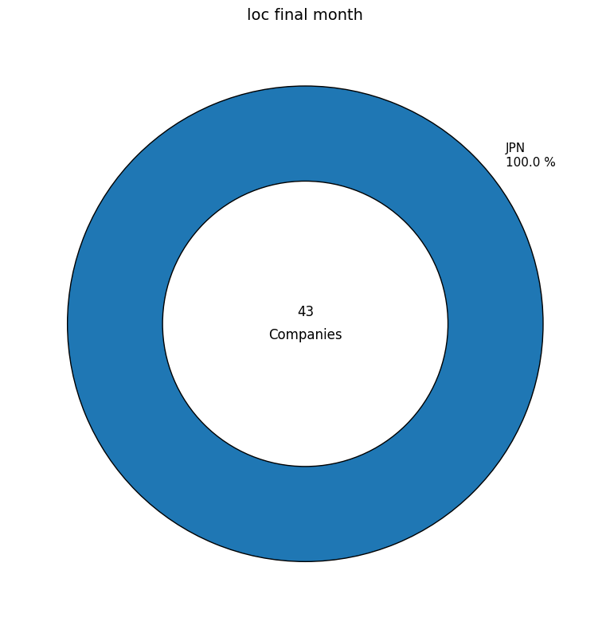

Slide 17
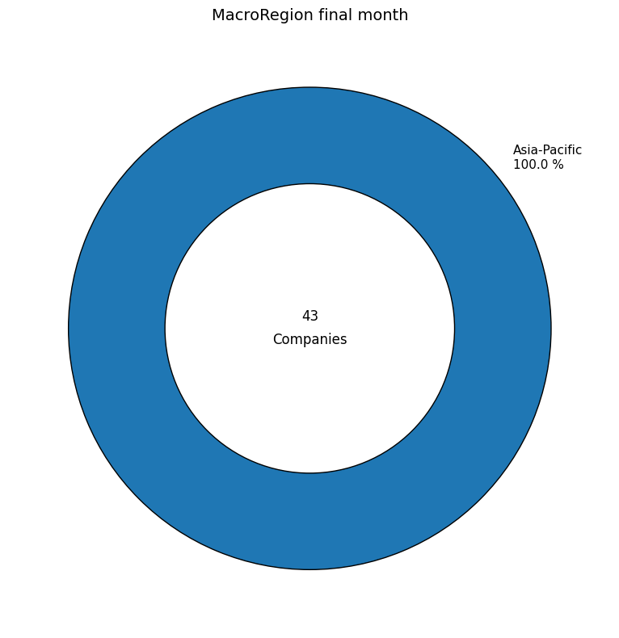

Slide 18
