Slide 1
1. Dependencies

Slide 2
1. Parameters
=== Run parameters === region_analysis = 'Japan' esg_choice = 'none' no_simple_quantiles = 6 add_accounting_data = True show_sector_portfolio = False start_year = 2014 end_year = 2024 top_x_by_industry_even_split = 6 use_alpha_bound = True alpha_bound = 0.1 mktcap_covered = 0.95 drop_real_estate = True fama_factor_region = 'Japan' currency_filter = ['JPY'] convert_to_USD = False golden_data = 'v_2B1' ======================
Signal Design
Signal Choice
2. Data
Golden Data
2.1 LC dataset
clean below
count 28171.000000 mean 25.866778 std 29.869511 min 0.000000 25% 7.000000 50% 16.000000 75% 33.000000 max 465.000000 Name: sum_activities, dtype: float64
count 24968.000000 mean 22.175625 std 18.301051 min 3.000000 25% 8.000000 50% 16.000000 75% 31.000000 max 133.000000 Name: sum_activities, dtype: float64
Create the signal
Num stocks in USA and EU prior to some more filters
0
2.2 WRDS, Fama-French and FX data
Get and Process: 1- FX data
2- USA Universe
3- ROW Universe
4 - Japan
5 - ESG
4- Fama-French
5- Global Universe
6- Accounting Data
columns with year ['year']
3. Univariate Portfolio sorting
% Nan in accounting data
3.1 Univariate sorting

Slide 3
4. Sector Split

Slide 4
5. Fama-French
 | Low advocacy | High advocacy | Low preparation | High preparation | Low transformation | High transformation | Sample
alpha | 0.17 | 0.20 | 0.25 | 0.31 | 0.32 | 0.24 | 0.27
beta_mkt | 1.01 | 0.85 | 0.86 | 1.00 | 0.89 | 0.89 | 0.91
beta_smb | -0.02 | 0.16 | 0.10 | 0.01 | 0.15 | 0.07 | 0.05
beta_hml | 0.36 | 0.31 | 0.33 | 0.36 | 0.39 | 0.37 | 0.36
p-value(alpha) | 0.56 | 0.45 | 0.36 | 0.28 | 0.24 | 0.38 | 0.30

Slide 5
6. Performance Metrics

Slide 6
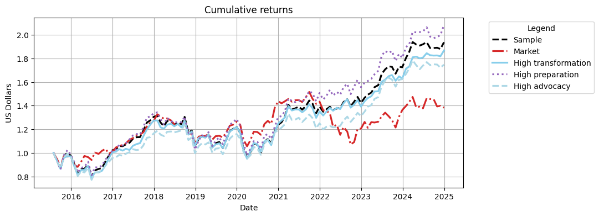
Cumulative Returns Plot

Slide 7
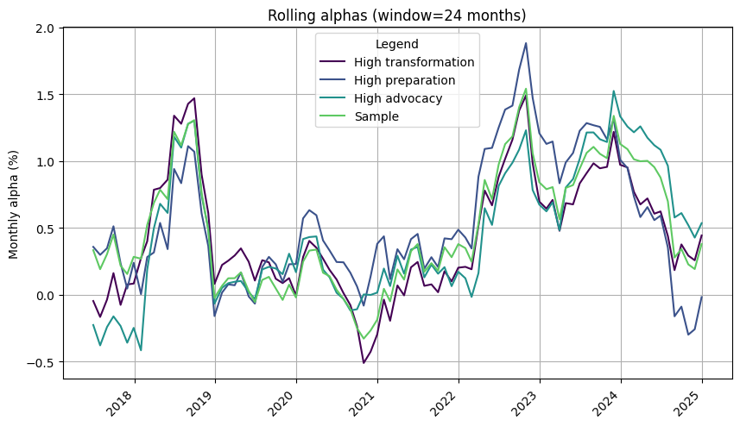

Slide 8
 | 1m | 3m | YTD | 1yr | 3yr | 5yr | 10yr | Since launch
Sample | 3.05% | 2.58% | 12.28% | 12.28% | 39.12% | 58.66% | 93.64% | 93.64%
Market | -1.19% | -4.99% | 1.45% | 1.45% | -3.58% | 9.31% | 38.24% | 38.24%
High transformation | 2.68% | 2.34% | 14.50% | 14.50% | 38.08% | 52.99% | 86.65% | 86.65%
High preparation | 4.16% | 5.55% | 15.28% | 15.28% | 38.06% | 61.56% | 108.06% | 108.06%
High advocacy | 1.50% | -0.16% | 7.59% | 7.59% | 39.68% | 50.71% | 74.71% | 74.71%

Slide 9
 | Sharpe | VaR 1% | Max Drawdown | Alpha | p-value(alpha)
Sample | 0.53 | -11.28% | -26.95% | 0.27 | 0.300
Market | 0.32 | -9.21% | -29.34%
High transformation | 0.51 | -11.74% | -25.41% | 0.24 | 0.380
High preparation | 0.54 | -11.97% | -27.09% | 0.31 | 0.280
High advocacy | 0.47 | -11.63% | -23.44% | 0.20 | 0.450

Slide 10
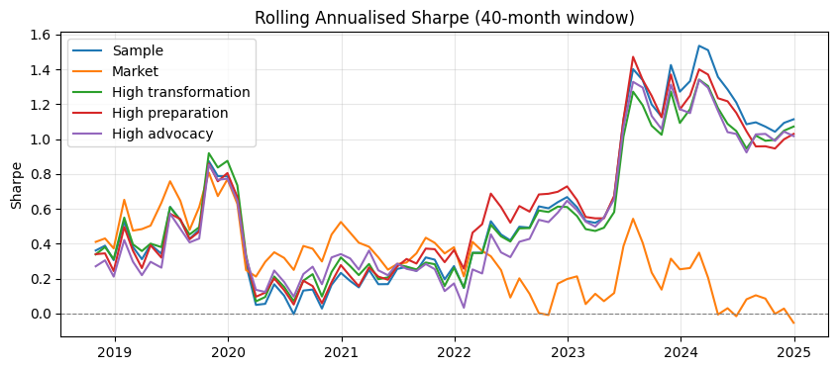

Slide 11
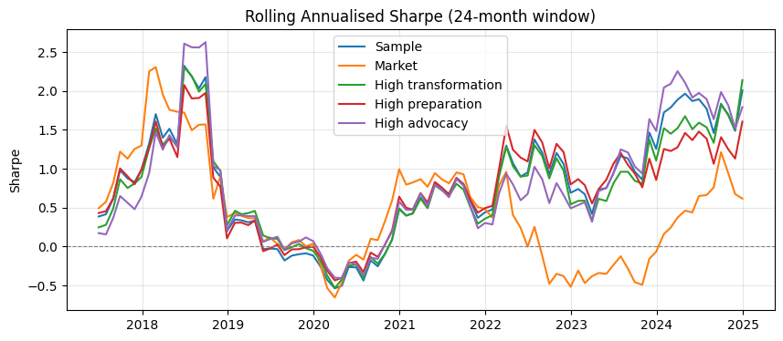

Slide 12
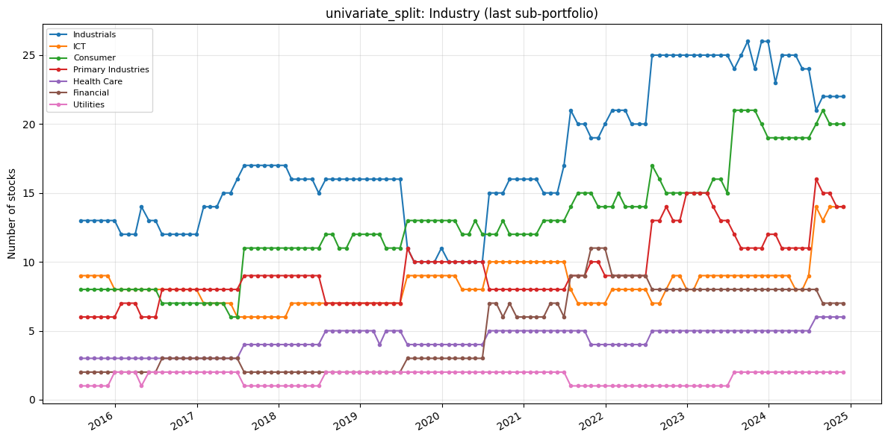
7. Portfolio Constituents
Portfolio constituents — category mix (PortfolioConstituents)
Uses signal_2_simple_quantiles_constituents and global_universe to inspect Industry, loc, and MacroRegion: line charts of stock counts over time (default = last quantile p_k, same as constituents[i][-1]) and donut charts for the final formation month. Optional: analyse_all_portfolios_at_once=True unions all p_1…p_k; all_sub_portfolios=True plots one subplot per quantile.
The following only inspects the high transformation

Slide 13
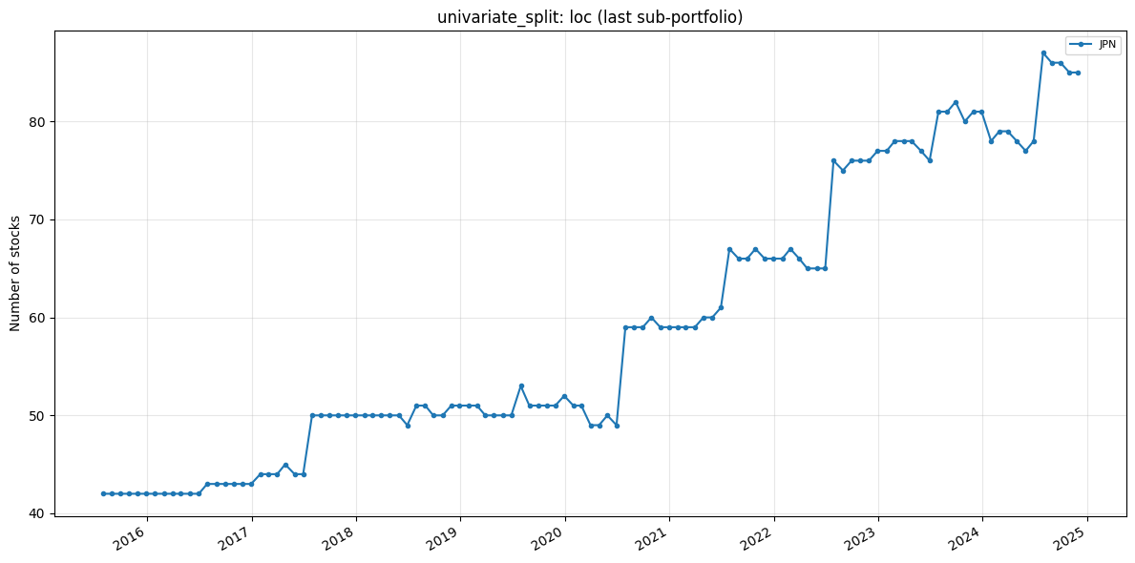

Slide 14
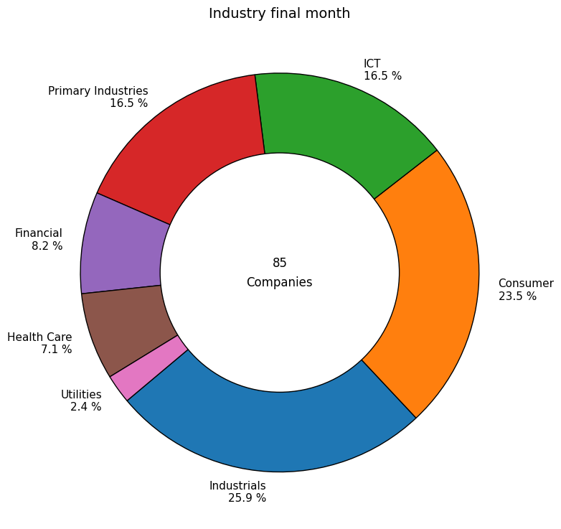

Slide 15
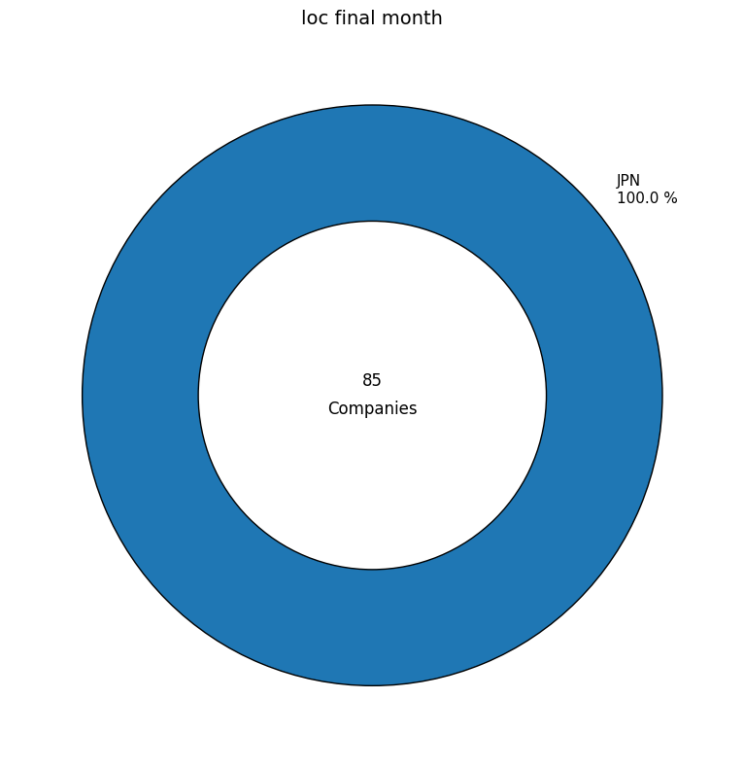

Slide 16
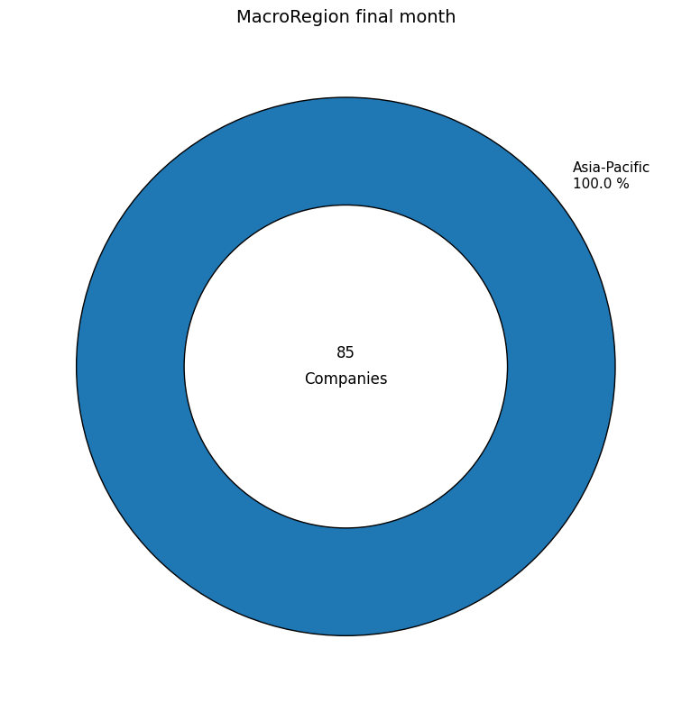

Slide 17
