Slide 1
1. Dependencies

Slide 2
1. Parameters
=== Run parameters === region_analysis = 'Japan' esg_choice = 'none' no_simple_quantiles = 6 add_accounting_data = True show_sector_portfolio = False start_year = 2020 end_year = 2024 top_x_by_industry_even_split = 6 use_alpha_bound = True alpha_bound = 0.1 mktcap_covered = 0.95 drop_real_estate = True fama_factor_region = 'Japan' currency_filter = ['JPY'] convert_to_USD = False golden_data = 'v_2B1' ======================
Signal Design
Signal Choice
2. Data
Golden Data
2.1 LC dataset
clean below
count 19278.000000 mean 24.762320 std 28.631123 min 0.000000 25% 7.000000 50% 15.000000 75% 31.000000 max 465.000000 Name: sum_activities, dtype: float64
count 17160.000000 mean 21.075874 std 17.474411 min 3.000000 25% 8.000000 50% 15.000000 75% 29.000000 max 82.000000 Name: sum_activities, dtype: float64
Create the signal
Num stocks in USA and EU prior to some more filters
0
2.2 WRDS, Fama-French and FX data
Get and Process: 1- FX data
2- USA Universe
3- ROW Universe
4 - Japan
5 - ESG
4- Fama-French
5- Global Universe
6- Accounting Data
columns with year ['year']
3. Univariate Portfolio sorting
% Nan in accounting data
3.1 Univariate sorting

Slide 3
4. Sector Split

Slide 4
5. Fama-French
 | Low advocacy | High advocacy | Low preparation | High preparation | Low transformation | High transformation | Sample
alpha | 0.66 | 0.76 | 0.77 | 0.69 | 0.79 | 0.62 | 0.64
beta_mkt | 0.44 | 0.41 | 0.42 | 0.48 | 0.43 | 0.39 | 0.41
beta_smb | -0.27 | 0.12 | 0.02 | -0.39 | -0.00 | -0.11 | -0.20
beta_hml | 0.02 | 0.07 | 0.08 | 0.04 | 0.10 | 0.09 | 0.06
p-value(alpha) | 0.09 | 0.03 | 0.03 | 0.08 | 0.03 | 0.07 | 0.06

Slide 5
6. Performance Metrics

Slide 6
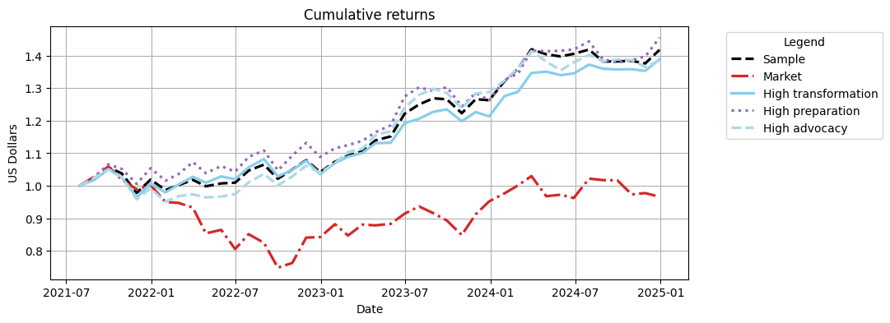
Cumulative Returns Plot

Slide 7
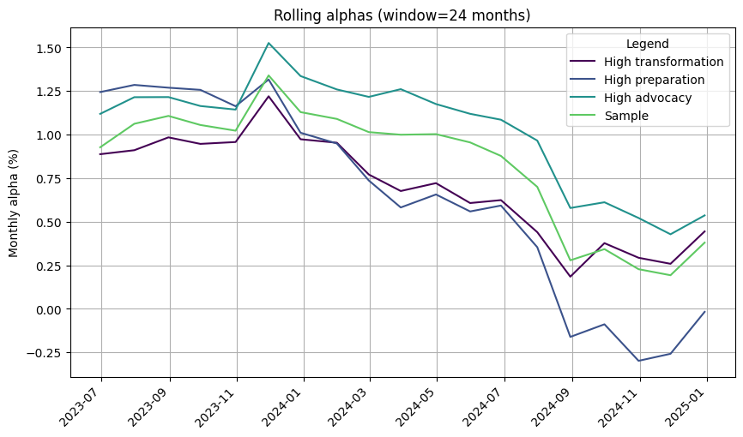

Slide 8
 | 1m | 3m | YTD | 1yr | 3yr | 5yr | 10yr | Since launch
Sample | 3.05% | 2.58% | 12.28% | 12.28% | 39.12% | 41.77% | 41.77% | 41.77%
Market | -1.19% | -4.99% | 1.45% | 1.45% | -3.58% | -3.40% | -3.40% | -3.40%
High transformation | 2.68% | 2.34% | 14.50% | 14.50% | 38.08% | 38.90% | 38.90% | 38.90%
High preparation | 4.16% | 5.55% | 15.28% | 15.28% | 38.06% | 45.52% | 45.52% | 45.52%
High advocacy | 1.50% | -0.16% | 7.59% | 7.59% | 39.68% | 38.54% | 38.54% | 38.54%

Slide 9
 | Sharpe | VaR 1% | Max Drawdown | Alpha | p-value(alpha)
Sample | 1.15 | -5.08% | -7.44% | 0.64 | 0.060
Market | 0.00 | -8.94% | -29.34%
High transformation | 1.10 | -5.53% | -8.18% | 0.62 | 0.070
High preparation | 1.07 | -5.13% | -5.62% | 0.69 | 0.080
High advocacy | 1.06 | -5.59% | -9.51% | 0.76 | 0.030

Slide 10
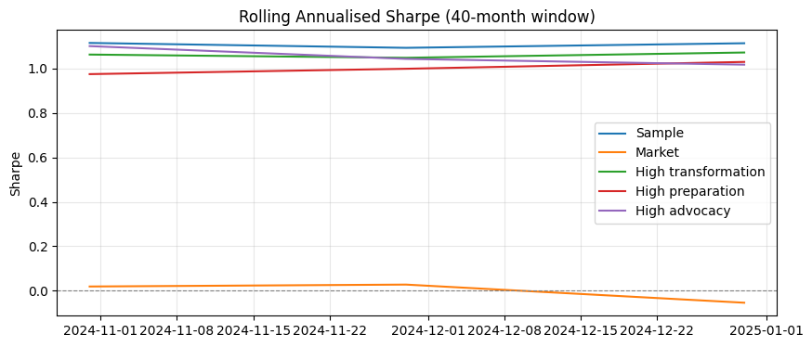

Slide 11
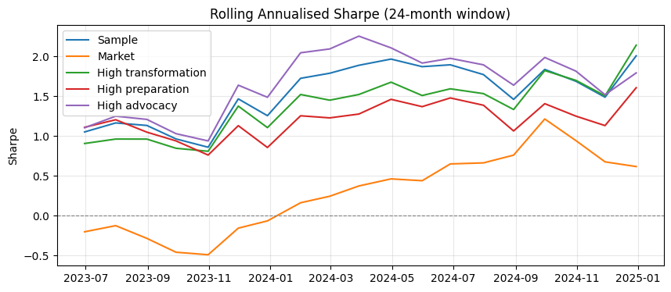

Slide 12
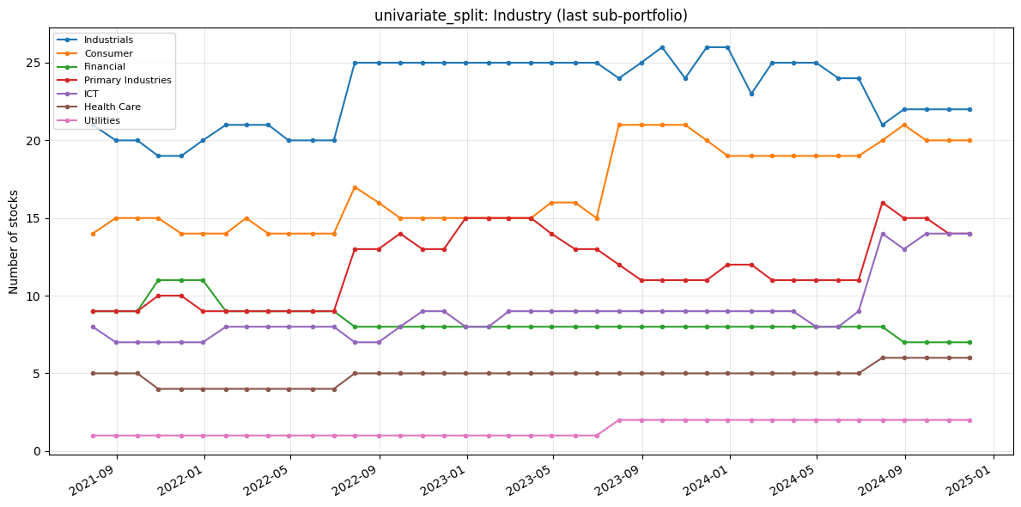
7. Portfolio Constituents
Portfolio constituents — category mix (PortfolioConstituents)
Uses signal_2_simple_quantiles_constituents and global_universe to inspect Industry, loc, and MacroRegion: line charts of stock counts over time (default = last quantile p_k, same as constituents[i][-1]) and donut charts for the final formation month. Optional: analyse_all_portfolios_at_once=True unions all p_1…p_k; all_sub_portfolios=True plots one subplot per quantile.
The following only inspects the high transformation

Slide 13
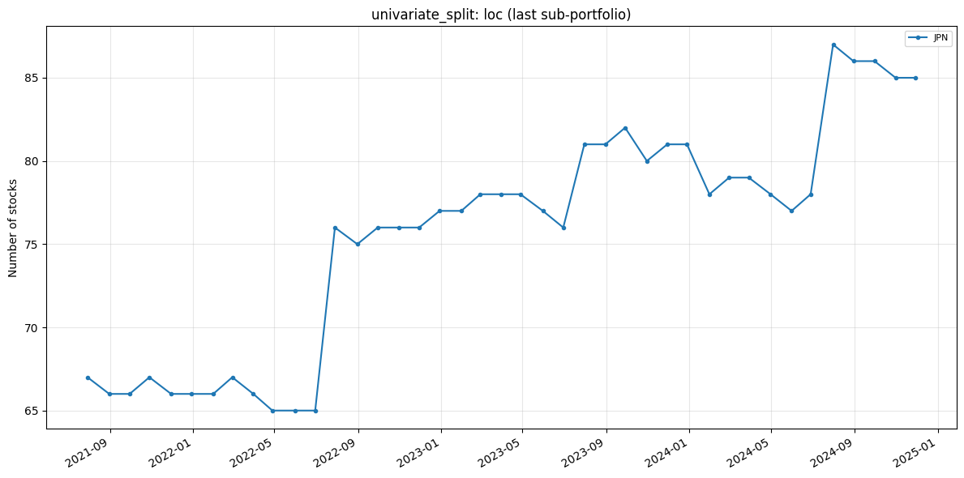

Slide 14
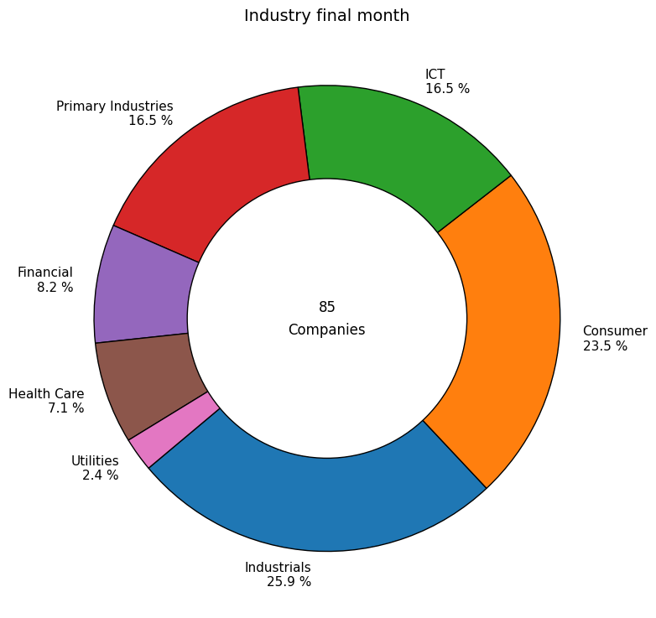

Slide 15
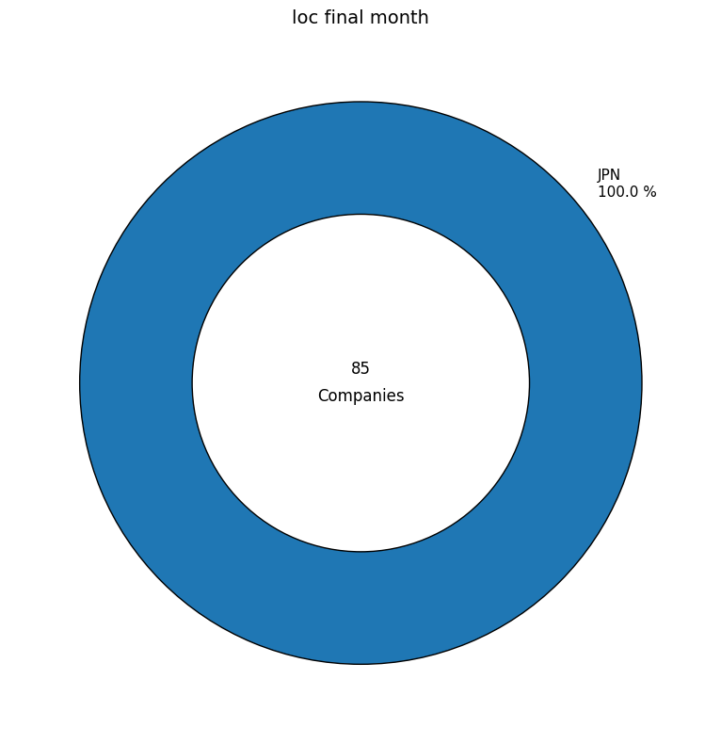

Slide 16
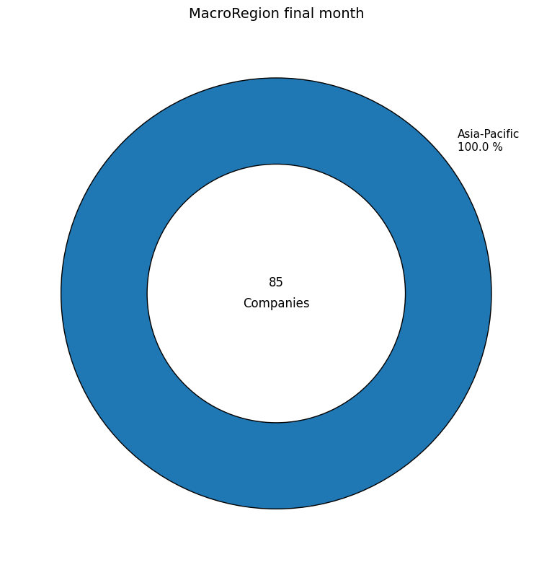

Slide 17
