Slide 1
1. Dependencies

Slide 2
1. Parameters
=== Run parameters === region_analysis = 'Japan' esg_choice = 'refinitiv' no_simple_quantiles = 4 add_accounting_data = True show_sector_portfolio = False start_year = 2014 end_year = 2022 top_x_by_industry_even_split = 6 use_alpha_bound = True alpha_bound = 0.1 mktcap_covered = 0.95 drop_real_estate = True fama_factor_region = 'Japan' currency_filter = ['JPY'] convert_to_USD = False golden_data = 'v_2B1' ======================
Signal Design
Signal Choice
2. Data
Golden Data
2.1 LC dataset
clean below
Create the signal
Num stocks in USA and EU prior to some more filters
0
2.2 WRDS, Fama-French and FX data
Get and Process: 1- FX data
2- USA Universe
3- ROW Universe
4 - Japan
5 - ESG
4- Fama-French
5- Global Universe
6- Accounting Data
columns with year ['year_x', 'year_y', 'year']
3. Univariate Portfolio sorting
% Nan in accounting data
3.1 Univariate sorting

Slide 3
4. Sector Split

Slide 4
5. Fama-French
 | Low advocacy | High advocacy | Low preparation | High preparation | Low transformation | High transformation | Low esg_refinitive | High esg_refinitive | Sample
alpha | 0.22 | 0.17 | 0.10 | 0.31 | 0.31 | 0.15 | 0.02 | 0.31 | 0.21
beta_mkt | 1.10 | 0.97 | 0.97 | 1.11 | 1.01 | 1.03 | 0.89 | 1.07 | 1.02
beta_smb | -0.07 | 0.07 | 0.08 | -0.08 | 0.04 | 0.02 | 0.20 | -0.17 | -0.02
beta_hml | 0.37 | 0.35 | 0.36 | 0.38 | 0.38 | 0.39 | 0.39 | 0.37 | 0.37
p-value(alpha) | 0.52 | 0.60 | 0.75 | 0.37 | 0.32 | 0.66 | 0.96 | 0.35 | 0.52

Slide 5
6. Performance Metrics

Slide 6
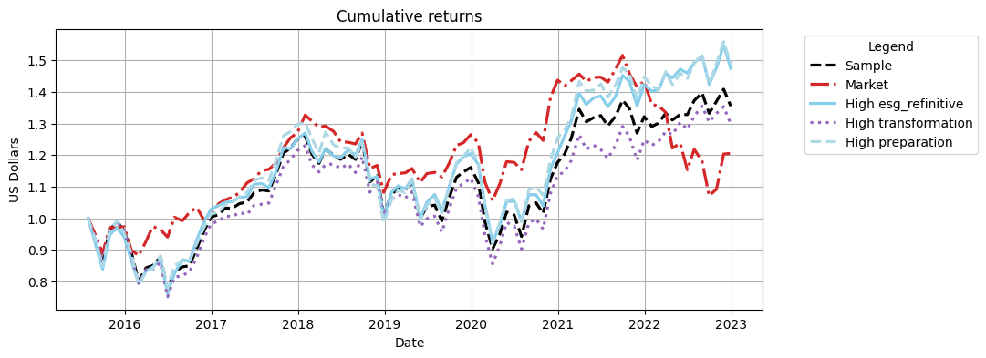
Cumulative Returns Plot

Slide 7
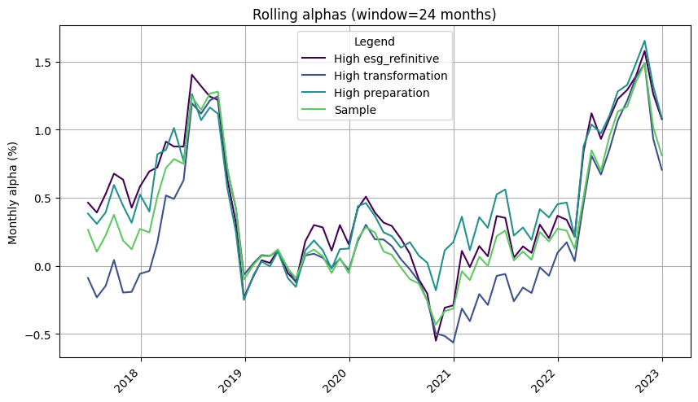

Slide 8
 | 1m | 3m | YTD | 1yr | 3yr | 5yr | 10yr | Since launch
Sample | -3.78% | 1.72% | 2.52% | 2.52% | 16.73% | 8.43% | 35.52% | 35.52%
Market | 0.17% | 12.54% | -15.93% | -15.93% | -4.69% | -5.15% | 20.54% | 20.54%
High esg_refinitive | -4.74% | 3.54% | 3.68% | 3.68% | 22.44% | 17.94% | 47.46% | 47.46%
High transformation | -4.04% | -0.47% | 4.07% | 4.07% | 15.27% | 6.95% | 29.86% | 29.86%
High preparation | -4.60% | 4.25% | 2.77% | 2.77% | 21.56% | 14.70% | 48.75% | 48.75%

Slide 9
 | Sharpe | VaR 1% | Max Drawdown | Alpha | p-value(alpha)
Sample | 0.32 | -11.24% | -28.37% | 0.21 | 0.520
Market | 0.25 | -9.36% | -29.34%
High esg_refinitive | 0.38 | -11.40% | -27.28% | 0.31 | 0.350
High transformation | 0.29 | -11.59% | -30.46% | 0.15 | 0.660
High preparation | 0.38 | -11.59% | -29.37% | 0.31 | 0.370

Slide 10
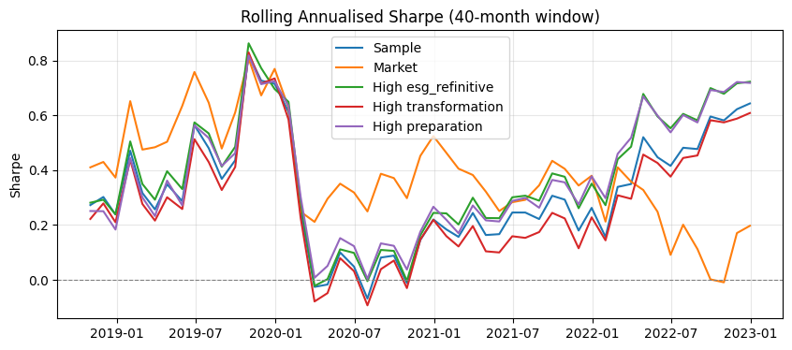

Slide 11
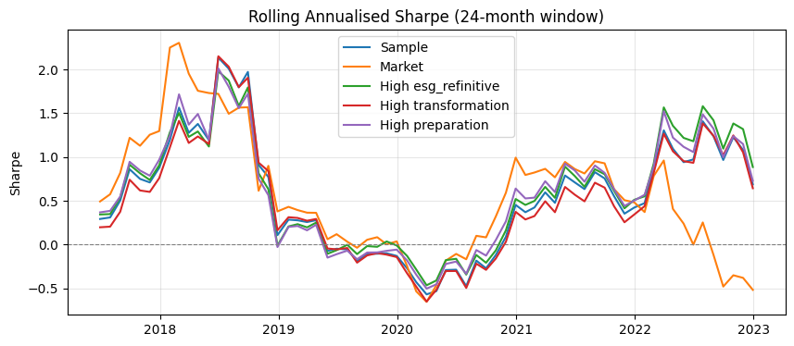

Slide 12
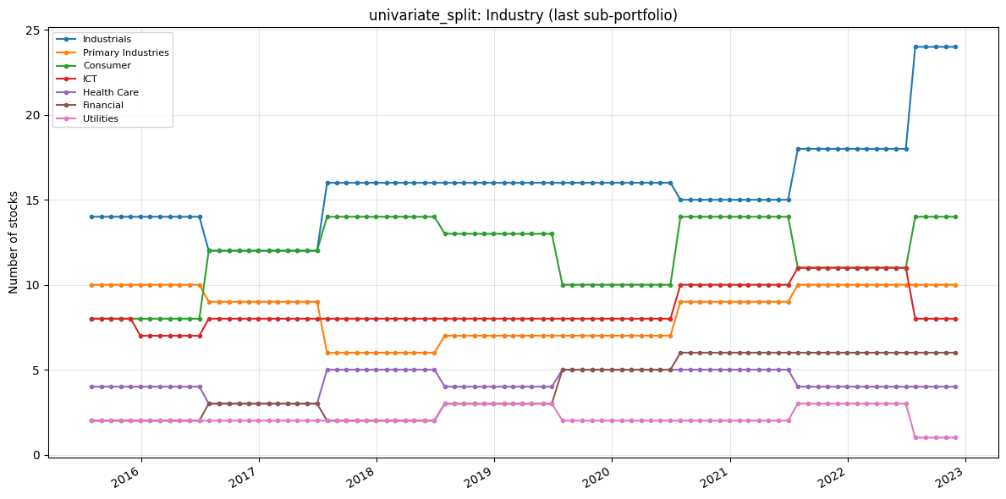
7. Portfolio Constituents
Portfolio constituents — category mix (PortfolioConstituents)
Uses signal_2_simple_quantiles_constituents and global_universe to inspect Industry, loc, and MacroRegion: line charts of stock counts over time (default = last quantile p_k, same as constituents[i][-1]) and donut charts for the final formation month. Optional: analyse_all_portfolios_at_once=True unions all p_1…p_k; all_sub_portfolios=True plots one subplot per quantile.
The following only inspects the high transformation

Slide 13
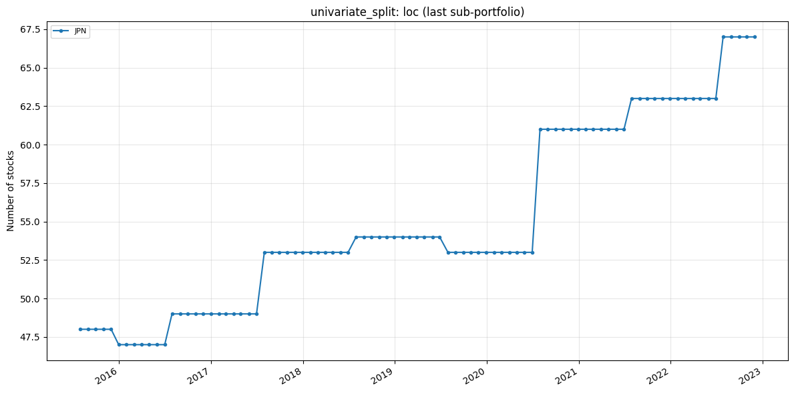

Slide 14
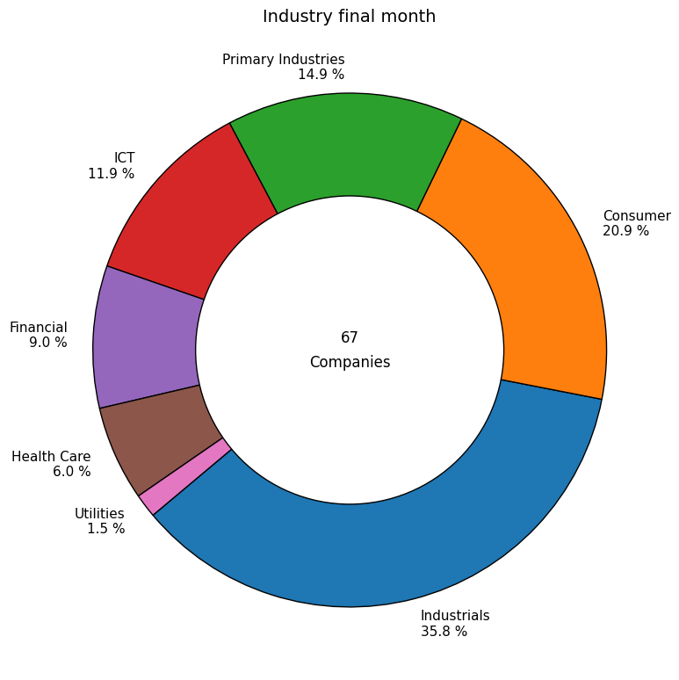

Slide 15
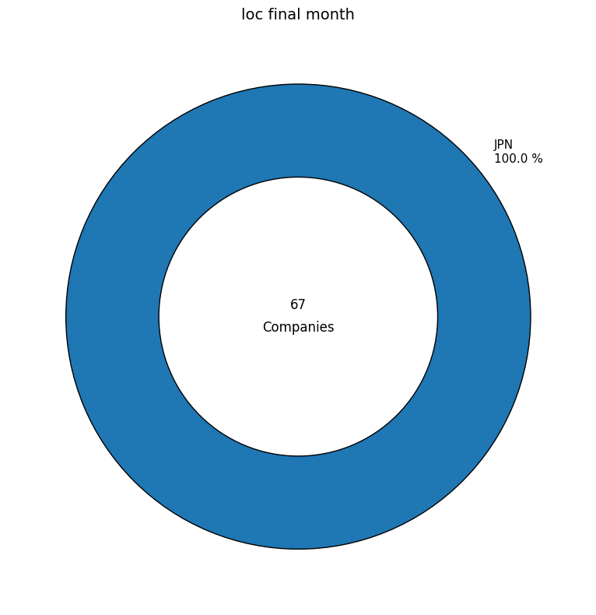

Slide 16
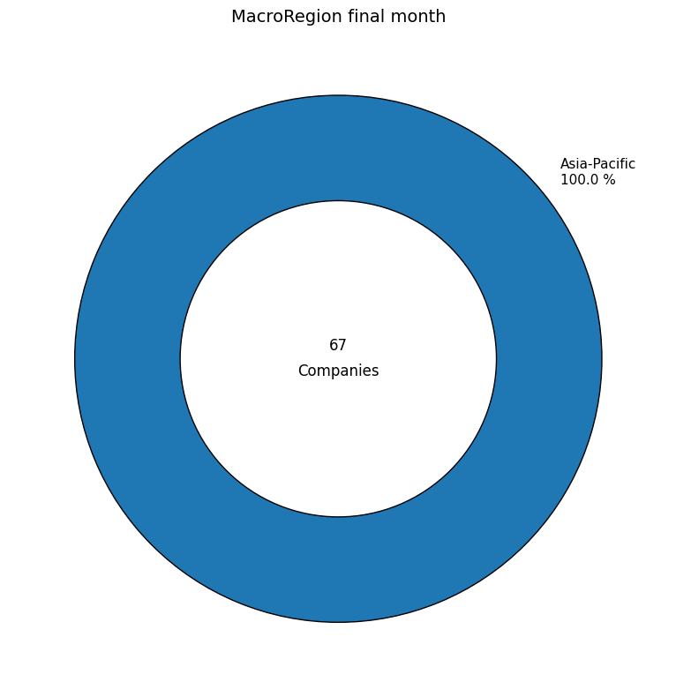

Slide 17
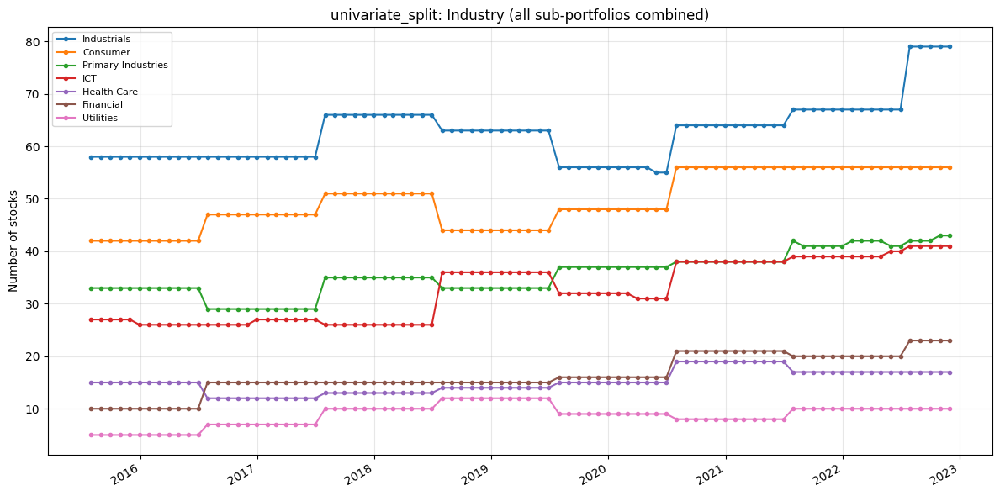

Slide 18
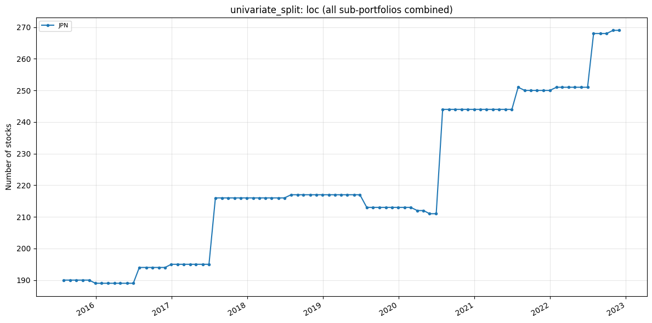

Slide 19
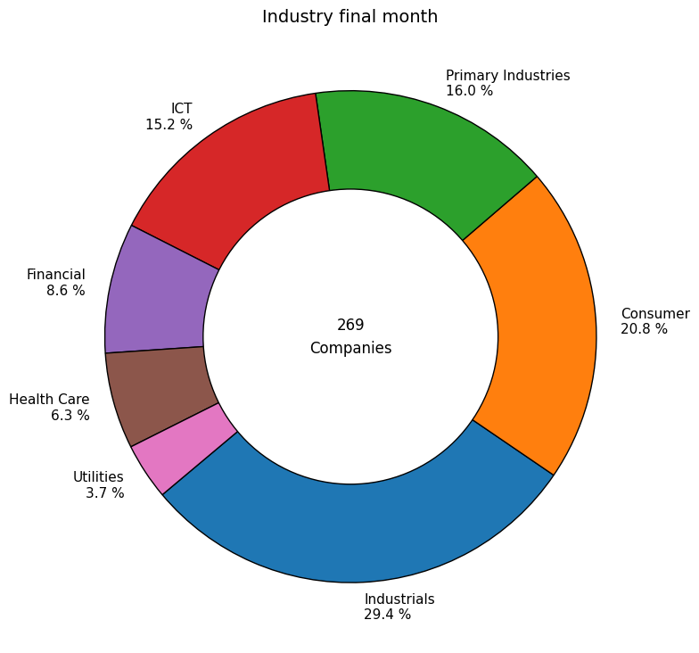

Slide 20


Slide 21


Slide 22
