Slide 1
1. Dependencies

Slide 2
1. Parameters
=== Run parameters === region_analysis = 'Japan' esg_choice = 'none' no_simple_quantiles = 6 add_accounting_data = True show_sector_portfolio = True start_year = 2014 end_year = 2024 top_x_by_industry_even_split = 6 use_alpha_bound = True alpha_bound = 0.1 mktcap_covered = 0.95 drop_real_estate = True fama_factor_region = 'Japan' currency_filter = ['JPY'] convert_to_USD = False golden_data = 'v_2B1' ======================
Signal Design
Signal Choice
2. Data
Golden Data
2.1 LC dataset
clean below
count 28171.000000 mean 25.866778 std 29.869511 min 0.000000 25% 7.000000 50% 16.000000 75% 33.000000 max 465.000000 Name: sum_activities, dtype: float64
count 24968.000000 mean 22.175625 std 18.301051 min 3.000000 25% 8.000000 50% 16.000000 75% 31.000000 max 133.000000 Name: sum_activities, dtype: float64
Create the signal
Num stocks in USA and EU prior to some more filters
0
2.2 WRDS, Fama-French and FX data
Get and Process: 1- FX data
2- USA Universe
3- ROW Universe
4 - Japan
5 - ESG
4- Fama-French
5- Global Universe
6- Accounting Data
columns with year ['year']
3. Univariate Portfolio sorting
% Nan in accounting data
3.1 Univariate sorting

Slide 3
4. Sector Split

Slide 4
5. Fama-French
 | Low advocacy | High advocacy | Low preparation | High preparation | Low transformation | High transformation | Sector equal split transformation | Sample
alpha | 0.17 | 0.20 | 0.25 | 0.31 | 0.32 | 0.24 | 0.13 | 0.27
beta_mkt | 1.01 | 0.85 | 0.86 | 1.00 | 0.89 | 0.89 | 0.82 | 0.91
beta_smb | -0.02 | 0.16 | 0.10 | 0.01 | 0.15 | 0.07 | -0.04 | 0.05
beta_hml | 0.36 | 0.31 | 0.33 | 0.36 | 0.39 | 0.37 | 0.31 | 0.36
p-value(alpha) | 0.56 | 0.45 | 0.36 | 0.28 | 0.24 | 0.38 | 0.62 | 0.30

Slide 5
6. Performance Metrics

Slide 6
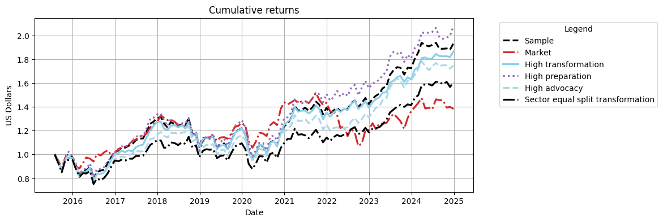
Cumulative Returns Plot

Slide 7
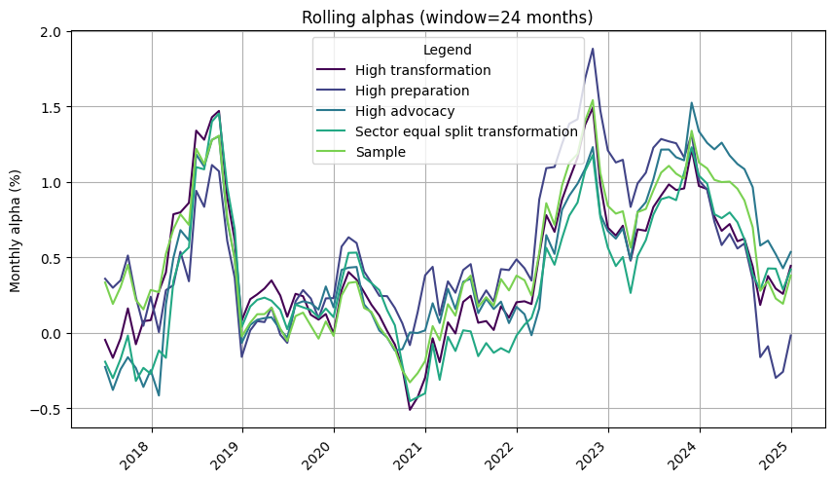

Slide 8
 | 1m | 3m | YTD | 1yr | 3yr | 5yr | 10yr | Since launch
Sample | 3.05% | 2.58% | 12.28% | 12.28% | 39.12% | 58.66% | 93.64% | 93.64%
Market | -1.19% | -4.99% | 1.45% | 1.45% | -3.58% | 9.31% | 38.24% | 38.24%
High transformation | 2.68% | 2.34% | 14.50% | 14.50% | 38.08% | 52.99% | 86.65% | 86.65%
High preparation | 4.16% | 5.55% | 15.28% | 15.28% | 38.06% | 61.56% | 108.06% | 108.06%
High advocacy | 1.50% | -0.16% | 7.59% | 7.59% | 39.68% | 50.71% | 74.71% | 74.71%
Sector equal split transformation | 2.58% | 1.03% | 13.68% | 13.68% | 40.77% | 46.93% | 60.69% | 60.69%

Slide 9
 | Sharpe | VaR 1% | Max Drawdown | Alpha | p-value(alpha)
Sample | 0.53 | -11.28% | -26.95% | 0.27 | 0.300
Market | 0.32 | -9.21% | -29.34%
High transformation | 0.51 | -11.74% | -25.41% | 0.24 | 0.380
High preparation | 0.54 | -11.97% | -27.09% | 0.31 | 0.280
High advocacy | 0.47 | -11.63% | -23.44% | 0.20 | 0.450
Sector equal split transformation | 0.42 | -11.38% | -24.90% | 0.13 | 0.620

Slide 10
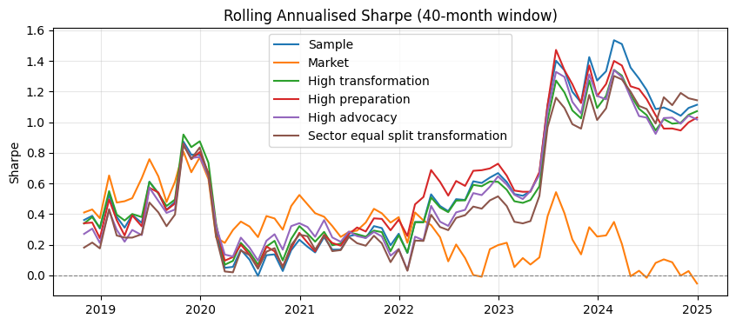

Slide 11
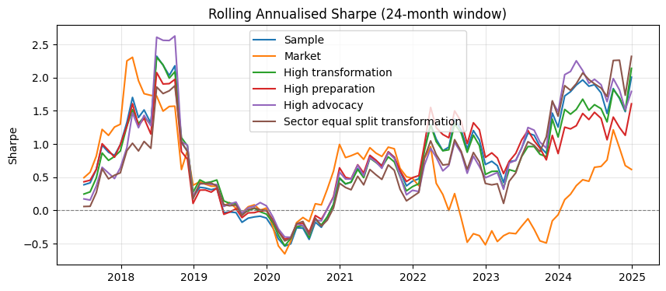

Slide 12
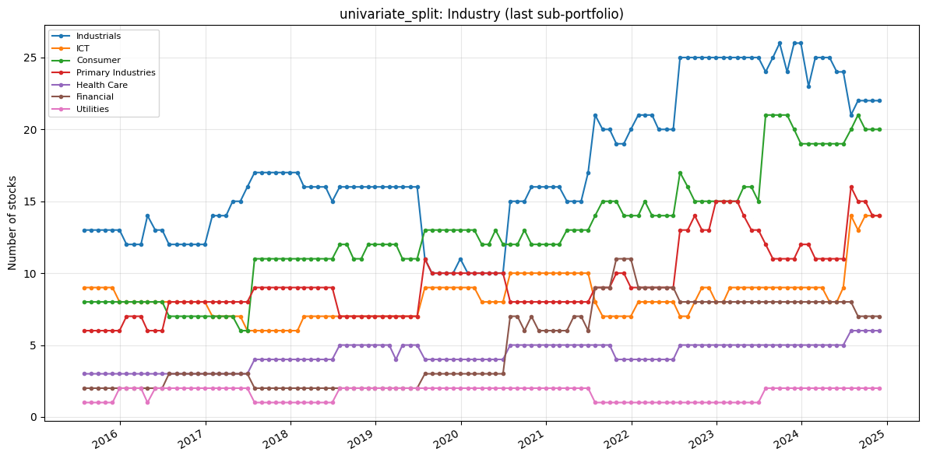
7. Portfolio Constituents
Portfolio constituents — category mix (PortfolioConstituents)
Uses signal_2_simple_quantiles_constituents and global_universe to inspect Industry, loc, and MacroRegion: line charts of stock counts over time (default = last quantile p_k, same as constituents[i][-1]) and donut charts for the final formation month. Optional: analyse_all_portfolios_at_once=True unions all p_1…p_k; all_sub_portfolios=True plots one subplot per quantile.
The following only inspects the high transformation

Slide 13
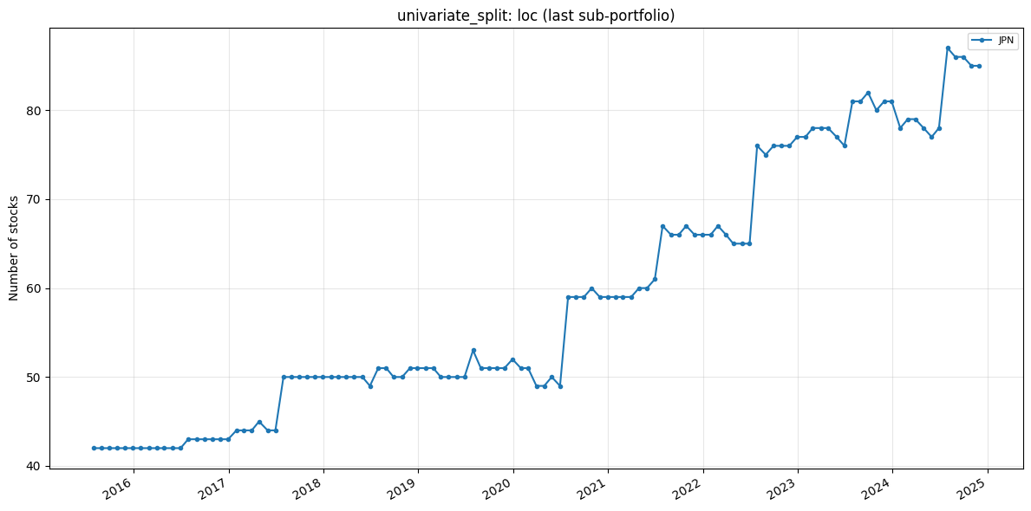

Slide 14
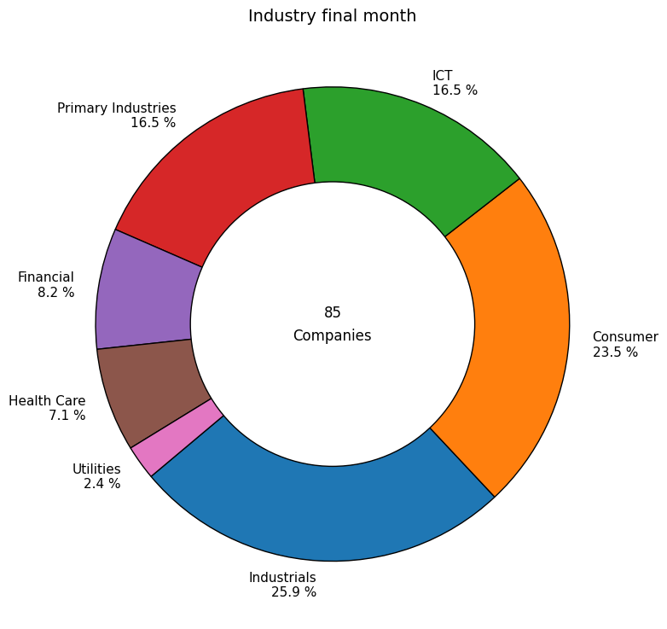

Slide 15
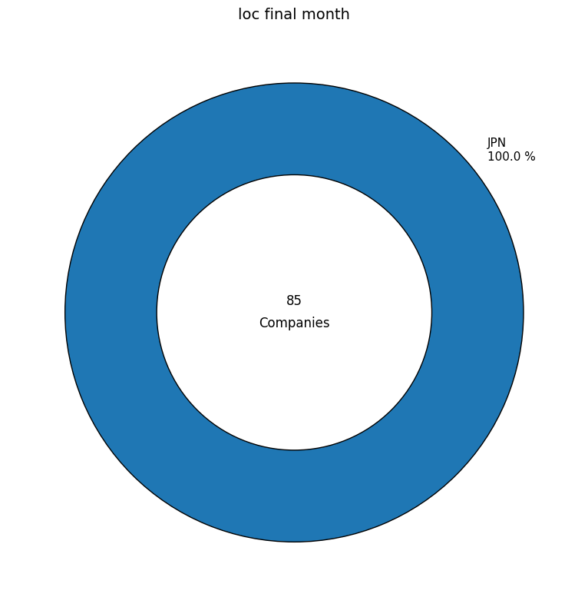

Slide 16
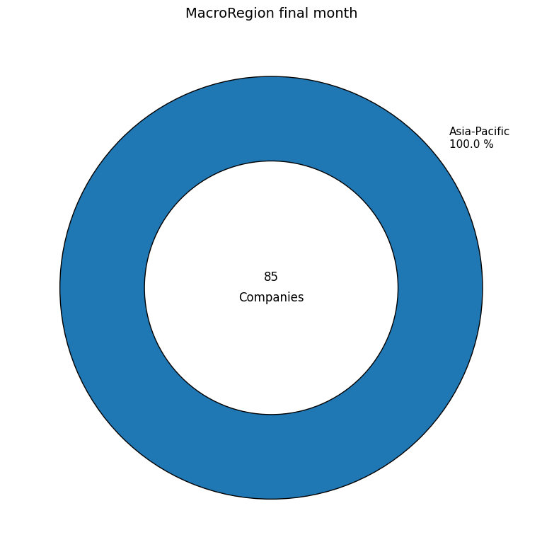

Slide 17
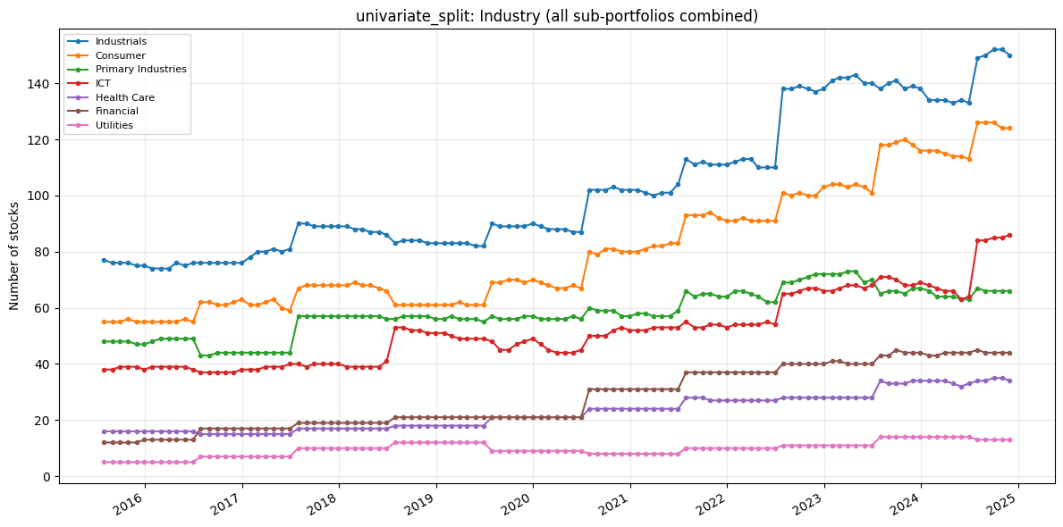

Slide 18
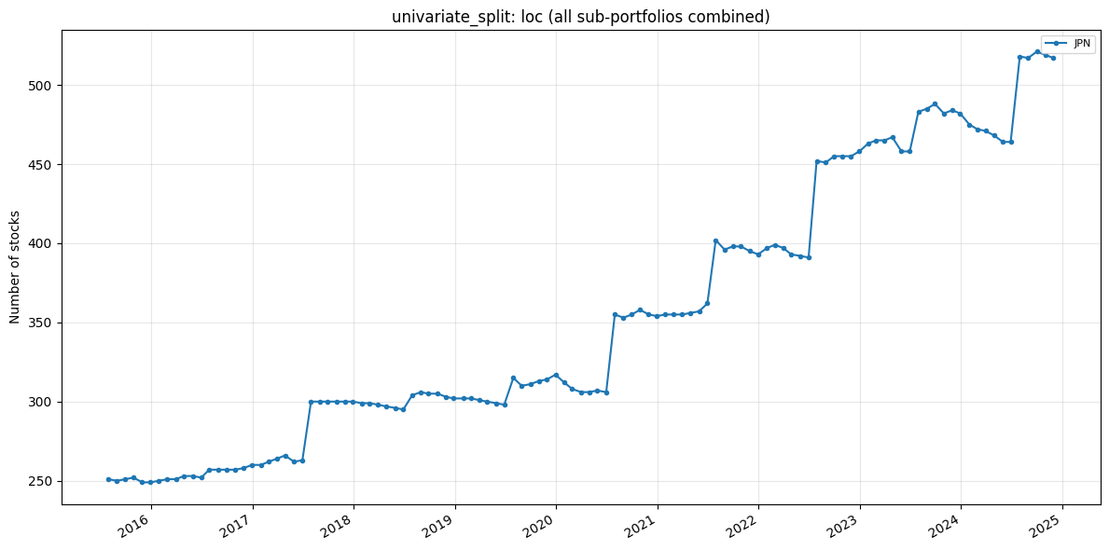

Slide 19
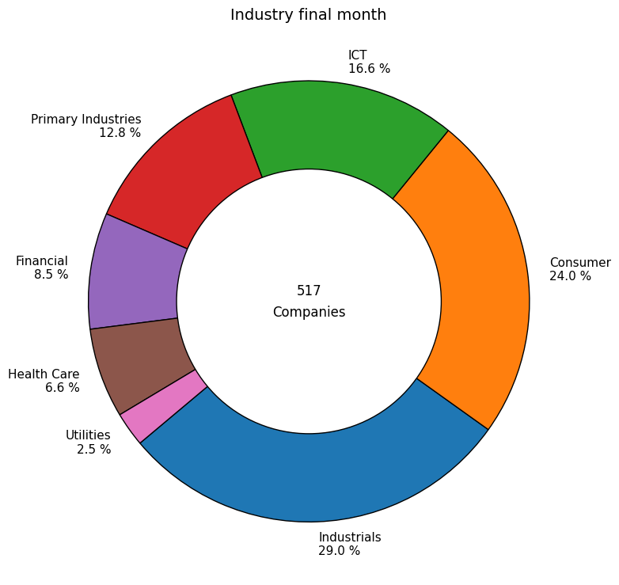

Slide 20


Slide 21


Slide 22
