Slide 1




NEXT GEN EMPLOYABILITY PROGRAM
Creating a future-ready workforce
Loyola-ICAM College of engineering and technology
Team Members
Student Name :Jeffrina R
Student ID :au311121205027
Chennai

Slide 2

CAPSTONE PROJECT SHOWCASE
Project Title
Music Web Application using Django Framework
Abstract | Problem Statement | Project Overview | Proposed Solution | Technology Used | Modelling & Results | Conclusion

Slide 3
Abstract
TuneTrek is a web application powered by Django, aiming to transform music interaction. It offers a wide song library and personalized playlists, tailored to each user's taste. Social sharing features foster community engagement. The platform prioritizes user privacy and offers a seamless, responsive design. By combining technology and user-centric design, TuneTrek aims to redefine online music platforms. With its intuitive interface and robust recommendation system, users can easily discover new music. Join us on this musical journey and experience the future of music streaming.
TuneTrek is a modern web application crafted with Django, revolutionizing the music listening experience. Featuring a diverse array of songs spanning multiple genres, it offers personalized playlists tailored to individual preferences. Users can engage with friends through social sharing functionalities, fostering a vibrant music community. The platform prioritizes security and privacy, ensuring user data remains protected. With its sleek design and intuitive interface, Tune Trek provides a seamless and immersive music streaming experience. Experience the next generation of music discovery with TuneTrek.
Source :

Slide 4
Problem Statement
In today's digital age, music has become an integral part of our lives, yet many music streaming platforms fall short in delivering a truly personalized and engaging experience. Users often struggle to discover new music that resonates with their tastes, and existing platforms may lack social features for community interaction. Additionally, concerns about data privacy and security are growing among users.
To address these challenges, there is a need for a modern music player that offers a diverse and extensive library of songs, personalized recommendations based on user preferences, robust social sharing features for community engagement, and stringent measures to protect user data privacy and security. The goal is to develop a web application, [Your Music Player], leveraging the Django framework, that not only meets these needs but also sets a new standard for online music platforms by prioritizing user satisfaction, fostering music discovery, and ensuring user privacy and security.
Source :

Slide 5
Project Overview
To develop a user-friendly and feature-rich music player that caters to the diverse needs and preferences of music enthusiasts.
To provide a platform for users to discover new music, connect with friends, and share their favorite tracks in a secure and privacy-conscious environment.
To leverage advanced technology and best practices in software development to deliver a high-quality and reliable music streaming service.
Develop a modern and user-friendly music player that sets a new standard for online music platforms.
Provide users with a comprehensive music library and personalized playlists tailored to their preferences.
Foster community engagement through social sharing features, creating a vibrant music community.
Prioritize user privacy and data security, ensuring a safe and secure music streaming environment.
Deliver a seamless and immersive music listening experience across devices, enhancing user satisfaction and enjoyment.
Source :

Slide 6
Proposed Solution
TuneTrek aims to address the shortcomings of existing music streaming platforms and offer an immersive platform for music discovery and enjoyment.
Key Features:
Comprehensive Music Library: TuneTrek will feature a vast and diverse collection of songs spanning various genres, ensuring that users have access to a wide range of music options.
Personalized Recommendations: Utilizing sophisticated recommendation algorithms, TuneTrek will generate personalized playlists for users based on their listening history, preferences, and behavior.
Social Sharing and Community Engagement: TuneTrek will include social sharing functionalities, allowing users to connect with friends, share favorite tracks, and discover new music together, fostering a vibrant and interactive music community.
Intuitive User Interface: With a sleek and user-friendly interface, TuneTrek will make it easy for users to navigate the platform, discover new music, and enjoy their favorite tracks.
Privacy and Security: TuneTrek will prioritize user privacy and data security, implementing robust authentication mechanisms and encrypted data transmission to protect user information.
Source :

Slide 7
SOLUTION:
Research and Planning:
Conducted market research to understand user preferences and pain points in existing music streaming platforms.
Developed a detailed project plan outlining scope, requirements, milestones, and timeline.
Development:
Created a robust backend infrastructure using the Django framework.
Integrated a diverse music library and implemented advanced recommendation algorithms for personalized playlists.
Testing:
Conducted rigorous testing procedures including unit tests, integration tests, and end-to-end testing.
Performed user acceptance testing (UAT) to gather feedback and ensure usability.
Deployment:
Deployed TuneTrek to a reliable web hosting platform and implemented continuous monitoring and optimization
Executed marketing and promotional strategies including social media campaigns and partnerships to attract
Source :

Slide 8
SOLUTION:
Iterative Development:
Prioritized user feedback to continuously enhance and refine the application's features and functionalities.
Gathered insights through user testing and analytics to optimize the user experience, improve recommendation accuracy, and address usability issues.
Regular Updates and Maintenance:
Implemented regular updates and maintenance to ensure the application remains secure and up-to-date with industry standards.
Ensured the application is capable of meeting evolving user needs by incorporating agile development principles and user-centric design.
Moreover, the project will prioritize user feedback and iterative development to continuously enhance and refine the application's features and functionalities. Through user testing and analytics, the team will gather insights to optimize the user experience, improve recommendation accuracy, and address any usability issues. Additionally, regular updates and maintenance will ensure the application remains secure, up-to-date with industry standards, and capable of meeting evolving user needs. By adopting an agile development approach and incorporating user-centric design principles, the proposed solution aims to deliver a cutting-edge music web application that sets new standards for personalized music discovery and engagement.

Slide 9


Technology Used
Front-end
Back-end
Source :

Slide 10
Modelling & Results
Data Modelling:
The project begins with data modelling, defining the database schema using Django's ORM (Object-Relational Mapping).
Entities such as User, Playlist, Song, and Artist are modelled, with appropriate relationships established to represent user interactions and music content organization.
Customizations such as defining primary keys and optimizing database queries are implemented to ensure efficient data storage and retrieval.
Implementation and Results:
Following data modelling, the implementation phase focuses on building features to enable music discovery, organization, and social interaction.
User registration and authentication functionalities are developed to provide personalized experiences and secure access to the application.
A comprehensive music library is implemented, allowing users to browse, search, and explore a vast collection of songs, albums, and artists.
Personalized playlist creation features enable users to curate their own collections of favorite songs, while recommendation systems suggest relevant music based on user preferences and listening history.
Source :

Slide 11
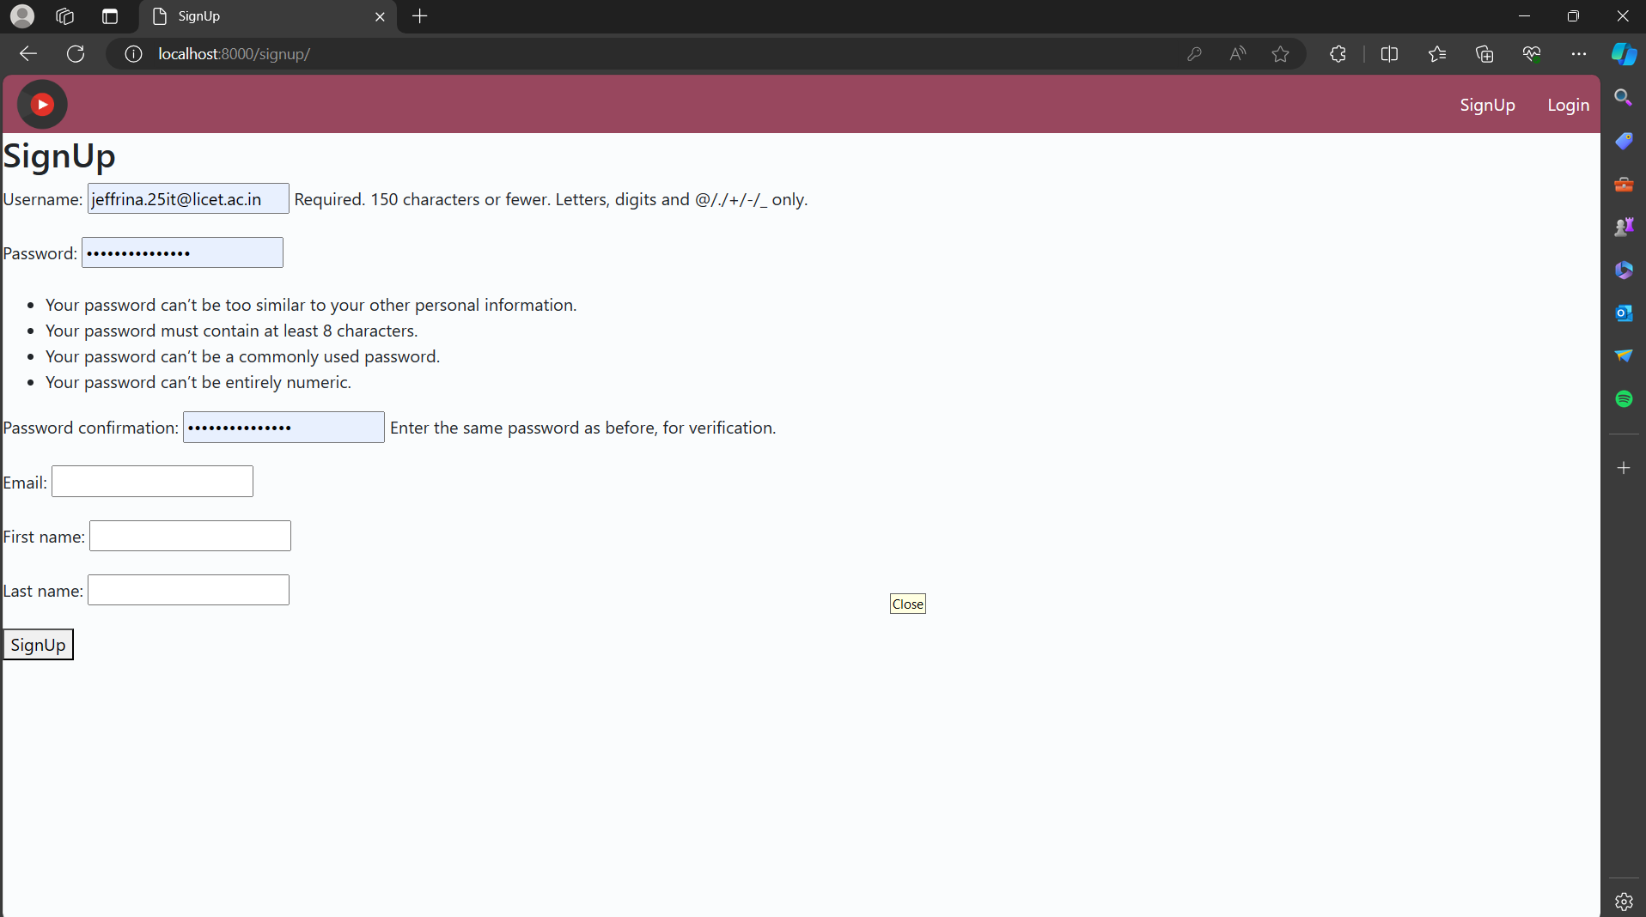
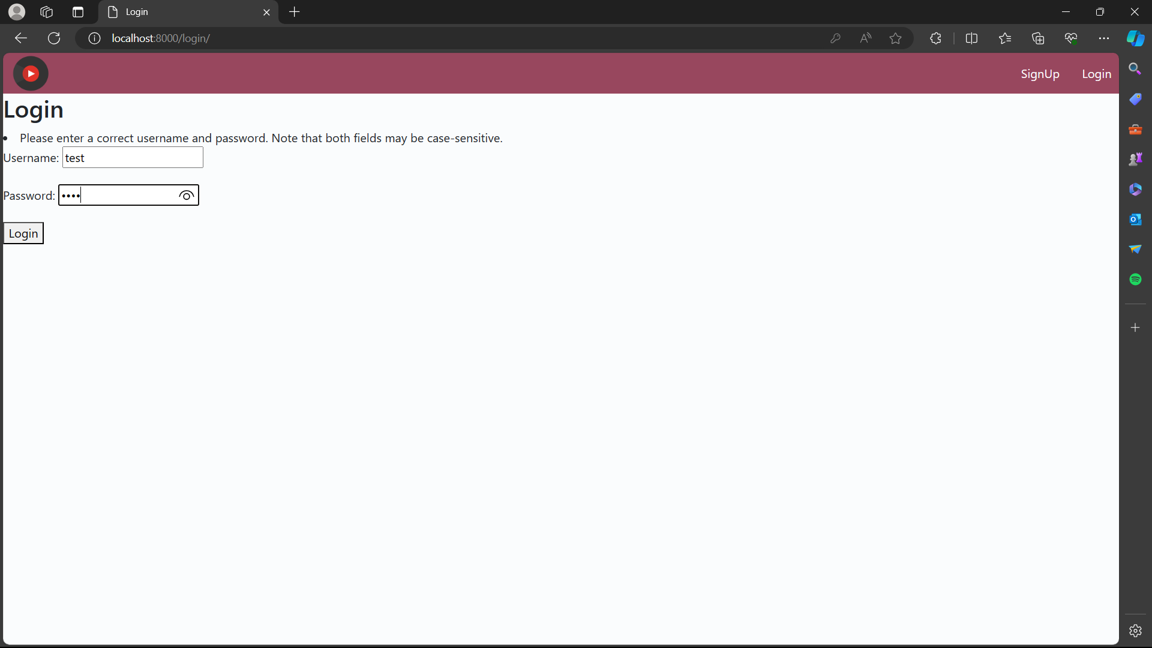
Homepage

Slide 12
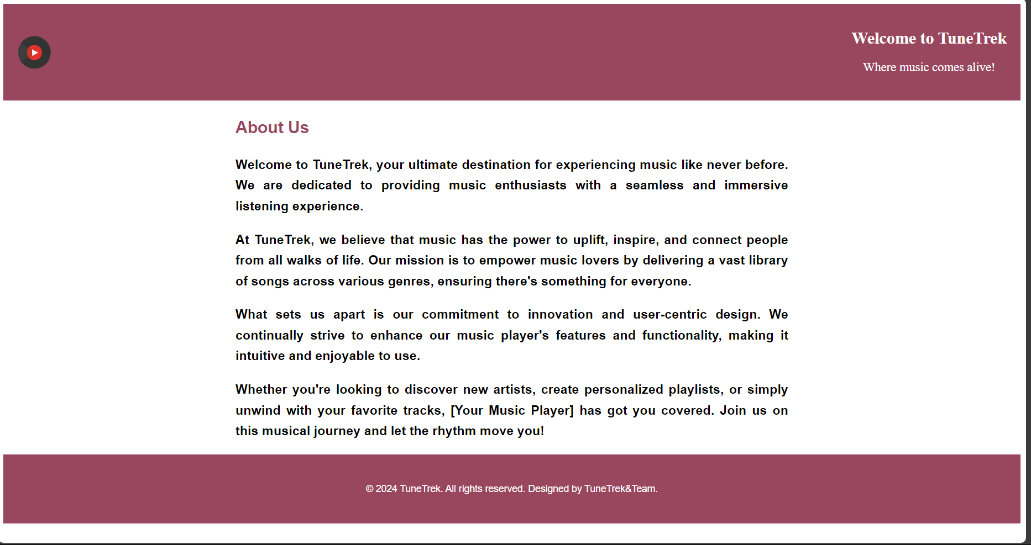
About-Us-Page

Slide 13
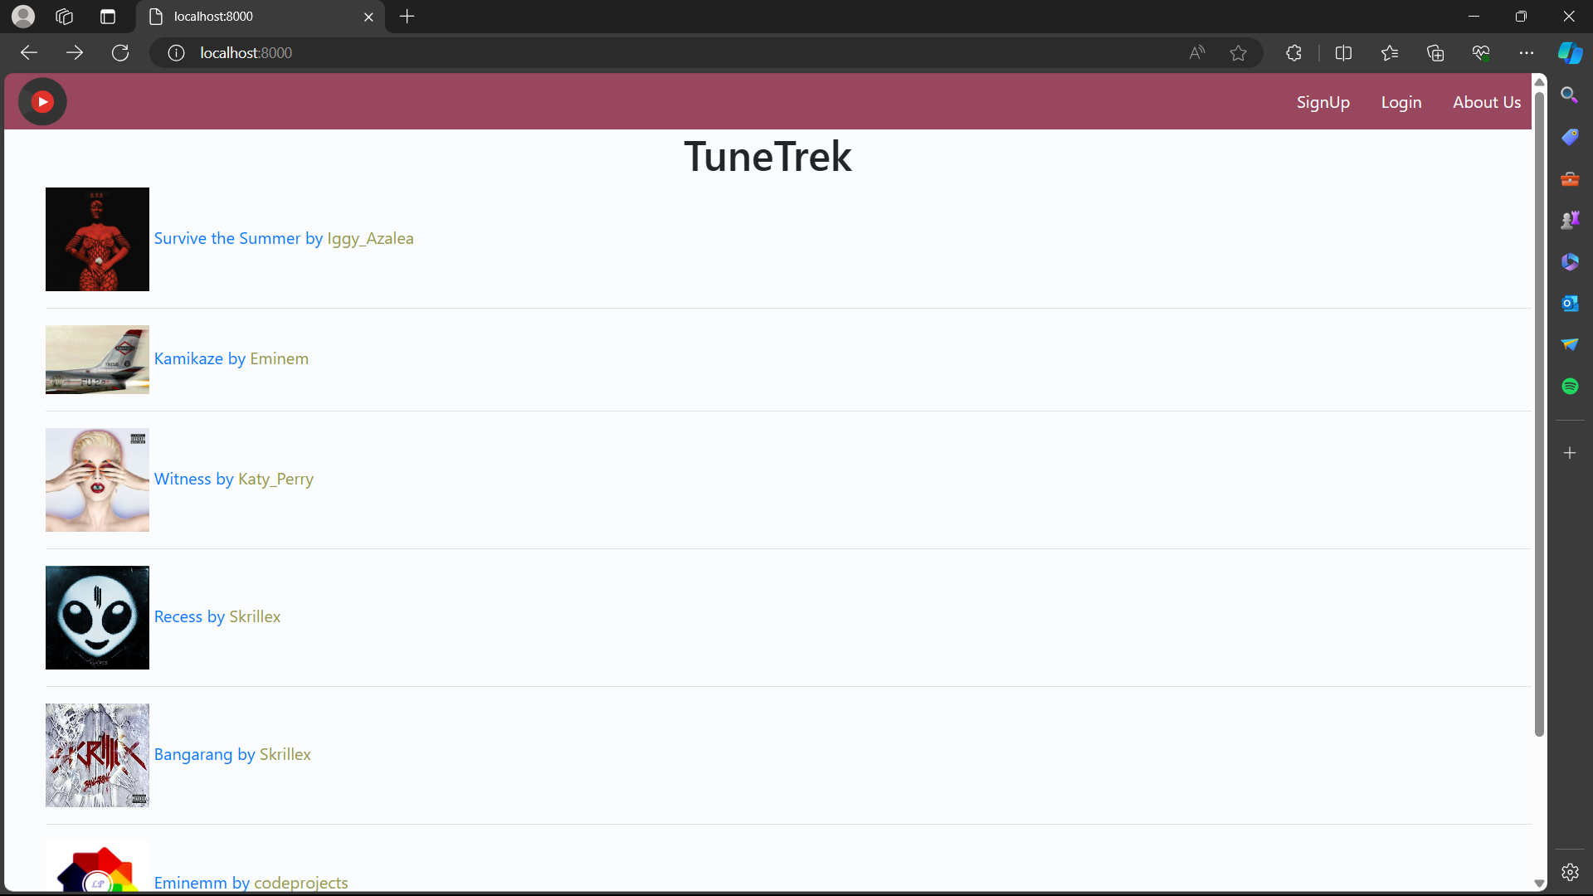
Service-Page

Slide 14
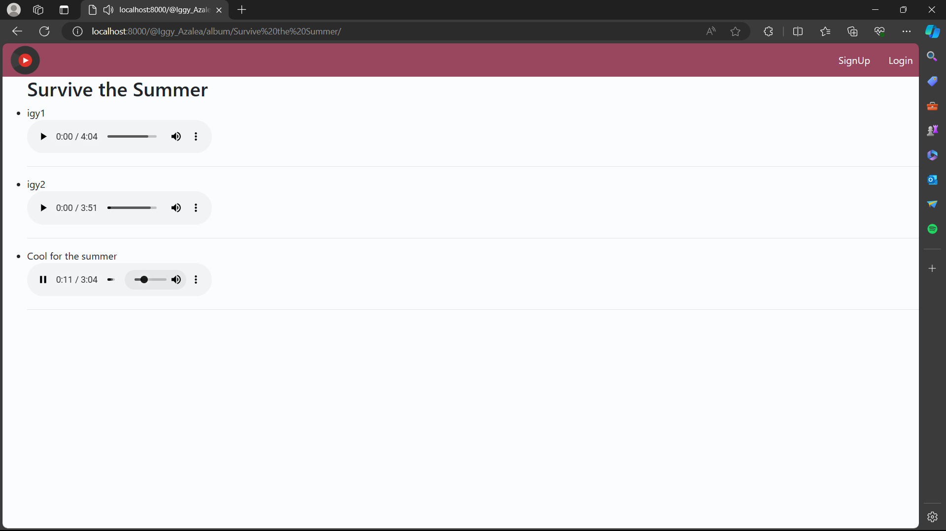

Slide 15
Future Enhancements:
Personalized Recommendations: Utilize advanced algorithms to analyze user listening habits, preferences, and contextual data to offer tailored music recommendations.
Social Integration: Implement features that enable users to connect with friends, share playlists, view what others are listening to, and collaborate on music discovery.
AI-Driven Playlist Creation: Employ artificial intelligence algorithms to curate playlists based on user preferences, mood, activity, and even contextual factors like weather or location.
Enhanced Discovery Tools: Develop tools such as interactive maps showcasing local music scenes, virtual concerts, or immersive experiences for users to explore new genres and artists.
Lyric Integration: Integrate lyrics into the app, allowing users to follow along with songs, search based on specific lyrics, and even provide translations for multilingual lyrics.
Live Streaming and Virtual Concerts: Partner with artists and venues to offer live streaming of concerts, virtual reality experiences, and exclusive behind-the-scenes content for users.
Music Education Resources: Provide tutorials, instrument lessons, music theory quizzes, and interactive challenges to help users learn more about music and improve their skills.
Voice Control and Integration: Enable voice-controlled commands for hands-free operation, allowing users to search for songs, control playback, and navigate the app using voice commands.

Slide 16
Conclusion
As Tune Trek continues to evolve and grow, it remains committed to its mission of providing users with a seamless and immersive music streaming experience, fostering community engagement, and setting new benchmarks for personalized music discovery and engagement. Join us on this musical journey and experience the future of music streaming with TuneTrek Music Player.
TuneTrek Music Player represents the culmination of meticulous planning, diligent development, and strategic deployment to create a robust and user-friendly music streaming platform. With its comprehensive music library, personalized playlists, social sharing features, and robust privacy and security measures, TuneTrek offers users an immersive and dynamic music discovery experience.
Throughout the development process, user feedback has been prioritized, leading to iterative improvements and refinements to enhance the application's features and functionalities. By gathering insights through user testing and analytics, TuneTrek continuously optimizes the user experience, improves recommendation accuracy, and addresses usability issues, ensuring that it remains at the forefront of personalized music discovery and engagement.
Source :

Slide 17
Thank You!
Notes:
Thank You !!

