Slide 1
An introductory workshop for analyzing Fiber-seq data
Christy LaFlamme, PhD (Teaching Assistant)
Postdoctoral Scholar
Laboratory of Andrew Stergachis, MD, PhD
Cold Spring Harbor Laboratories (CSHL) Computational Genomics Course
Thursday November 19th, 2026

Slide 2
Lecture (~10-15 minutes)

Slide 3

What is Fiber-seq?
Fiber-seq is short for single-molecule chromatin fiber-sequencing.
Fiber-seq is a long-read sequencing-based method for stenciling the chromatin epigenome on individual long-read DNA molecules.
Developed by Andrew Stergachis, MD, PhD at the University of Washington.

Slide 4
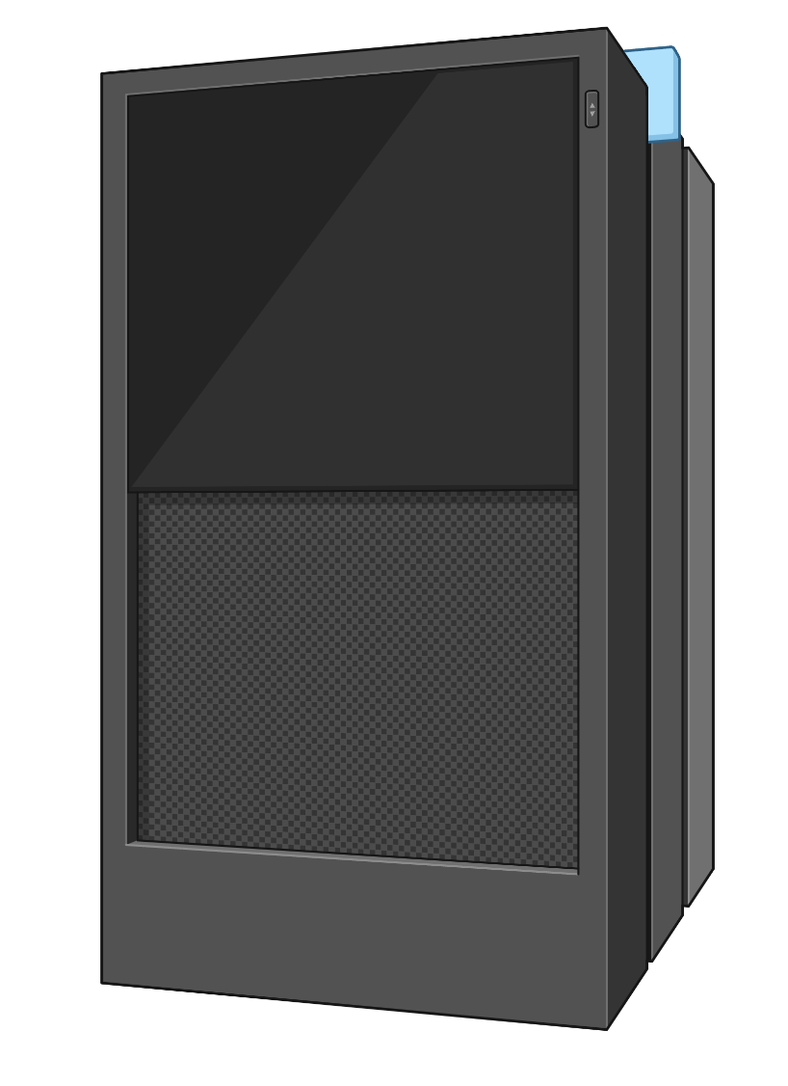
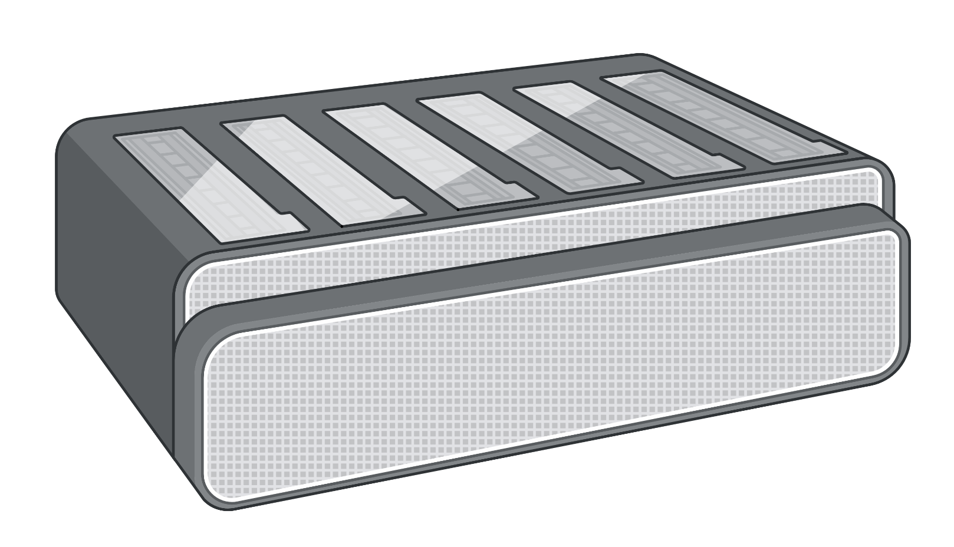
Hia5 enzyme methylates accessible adenines as the basis for fiber-seq
=Hia5
PacBio HiFi
Long-read sequencing
Oxford Nanopore
(Stergachis et al., Science 2020)

Slide 5
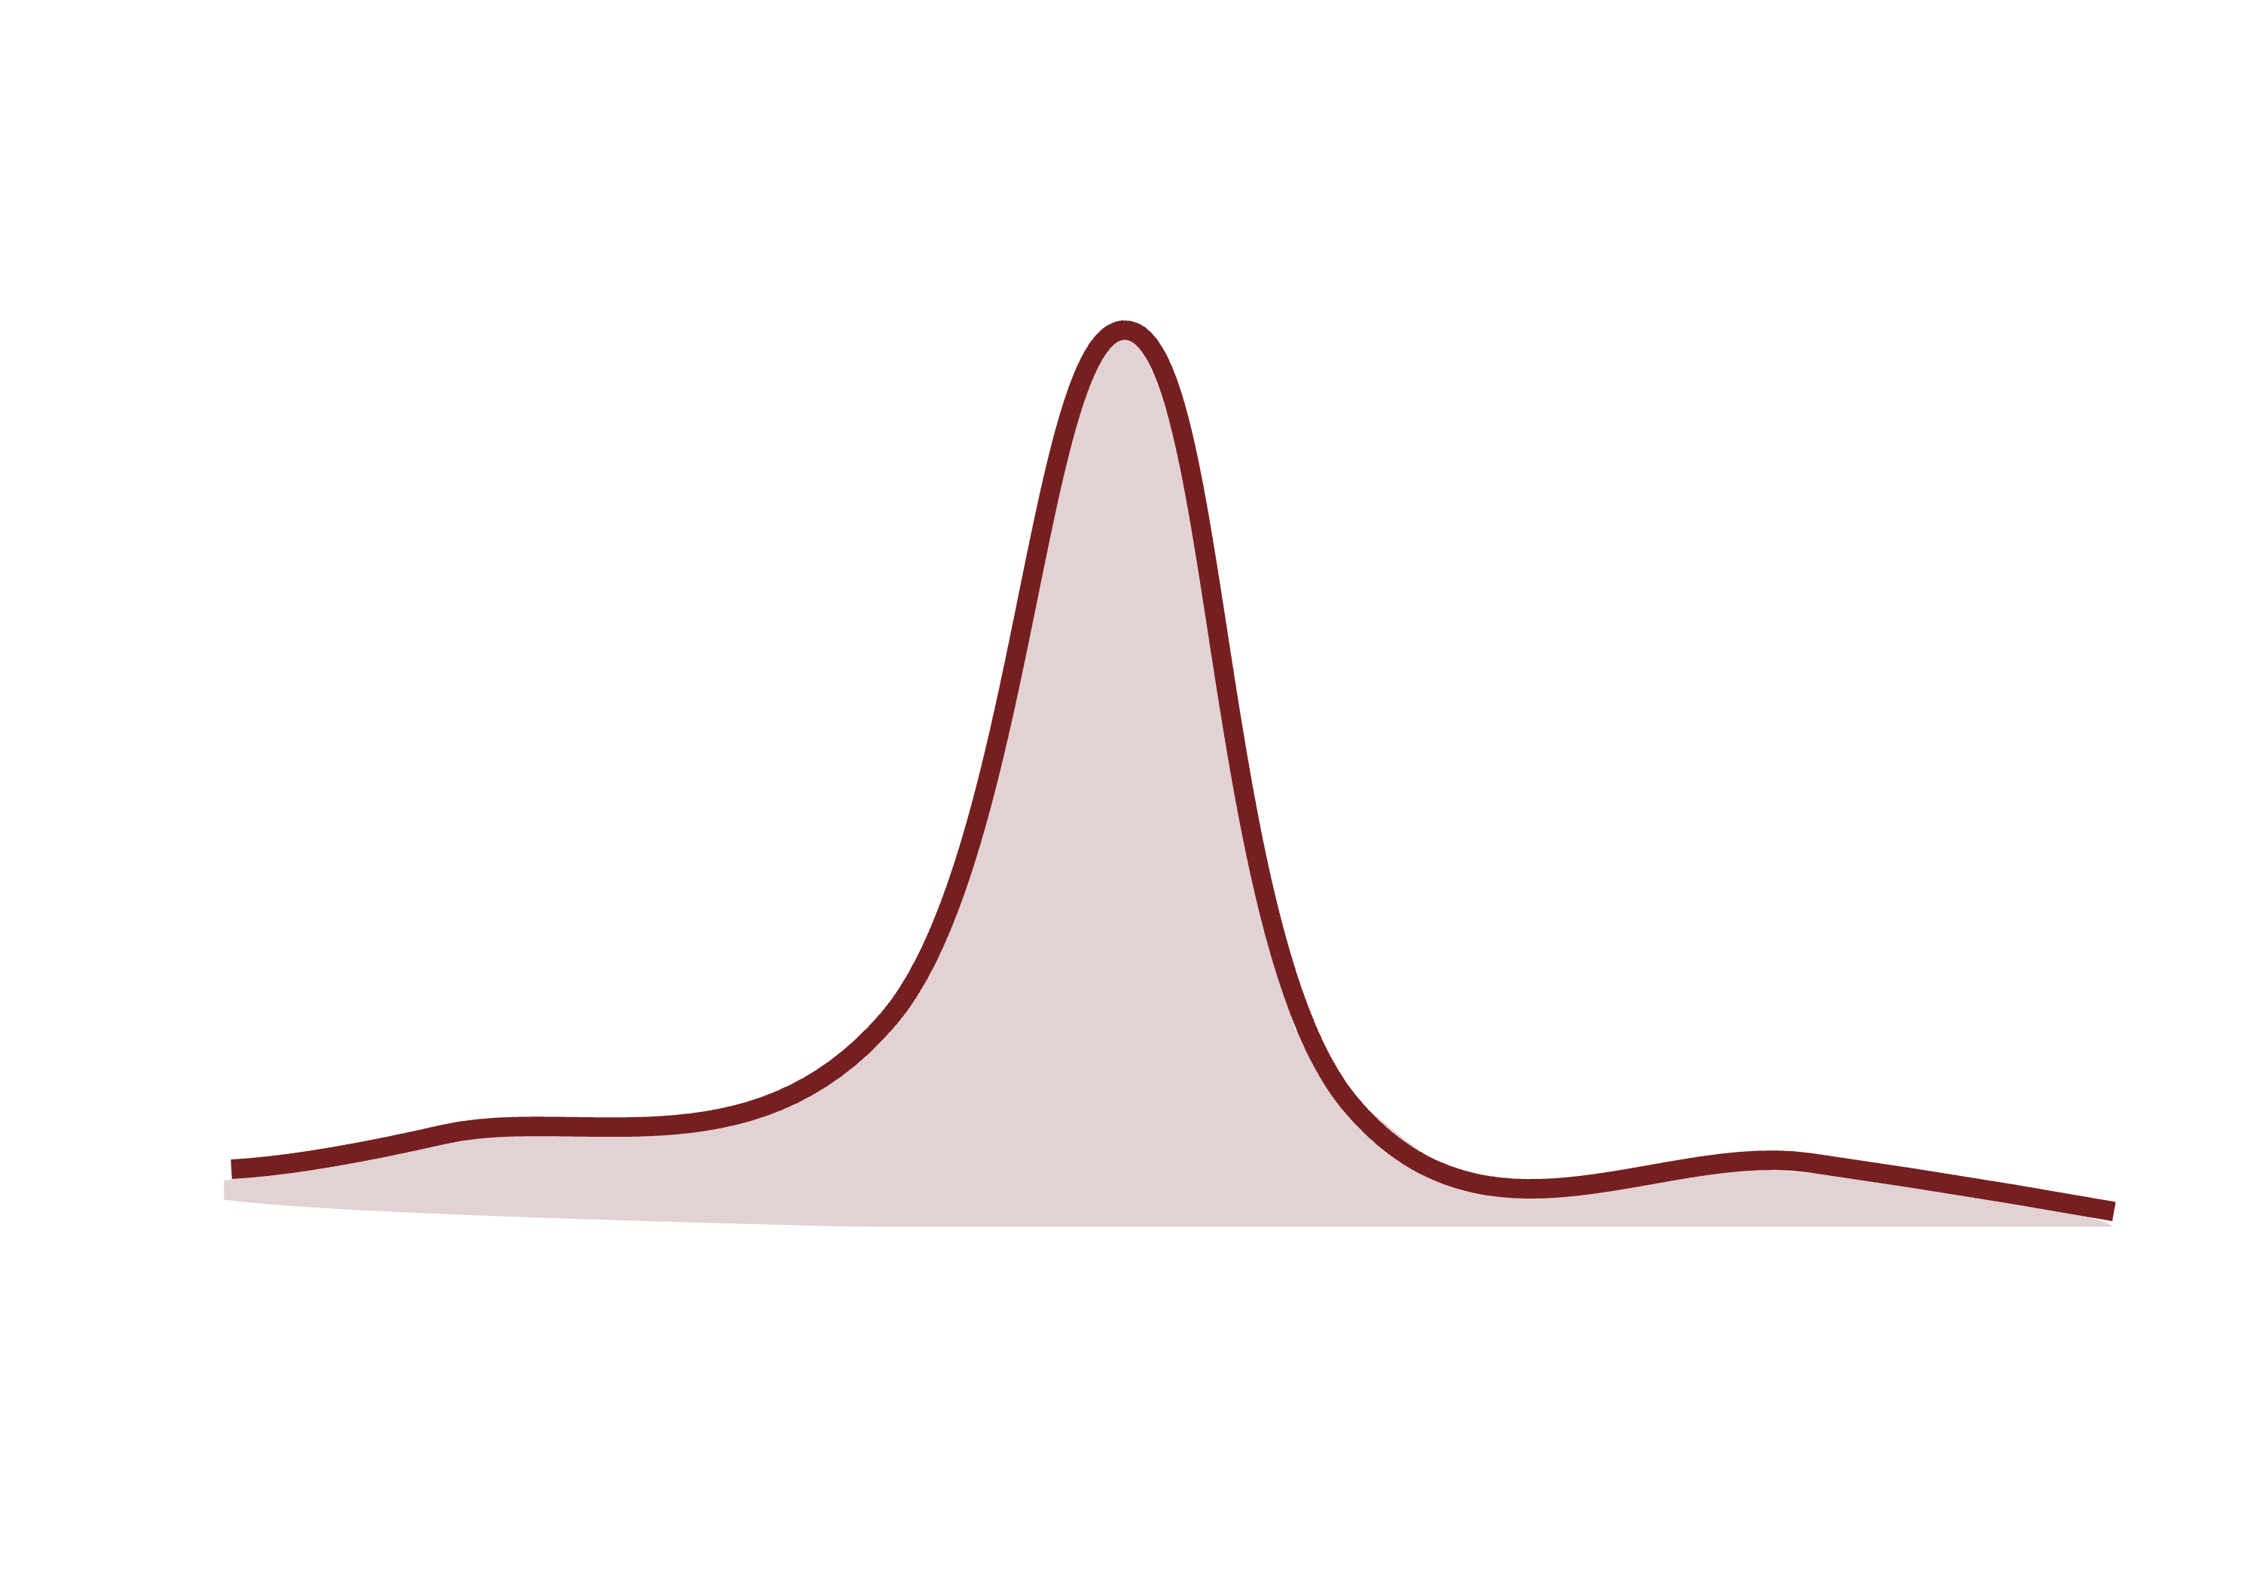
Long-read, single-molecule chromatin Fiber-sequencing can synchronously assess DNA sequence, structure, methylation, and chromatin architecture
TF = transcription factor

Slide 6
Fiber-seq: what’s new compared to next-generation sequencing-based functional genomic methods?
Why merge chromatin technology with long-read sequencing?
#1 Ability to look at single-molecule chromatin states.
#2 Ability to look at haplotype-selective chromatin.
#3 Inherently multi-omic (DNA sequence, 5mCpG, and chromatin on one assay).

Slide 7

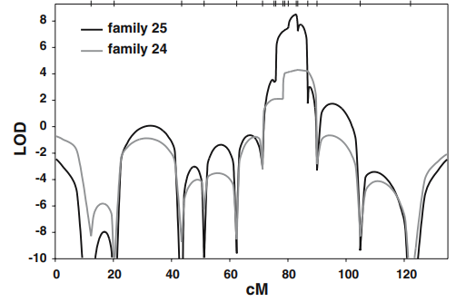
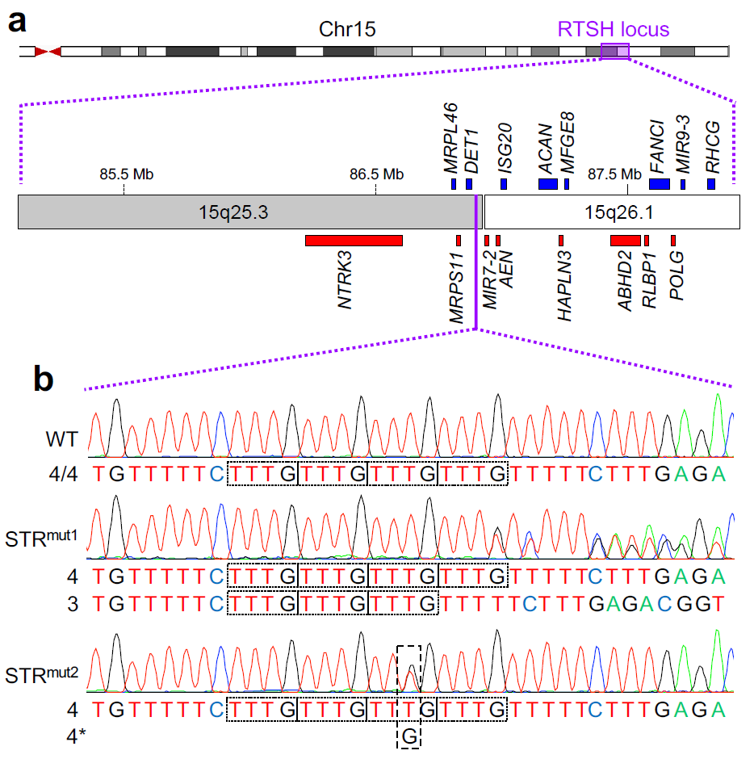
Resolving how non-coding variants cause Mendelian diseases
Nongoitrous Congenital Hypothyroidism (i.e., RTSH)
Elevated TSH levels but normal thyroid hormone levels (i.e., compensated hypothyroidism).
12% of cases have linkage to 15q25.3-q26.1 locus
Rare variant within a non-coding short tandem repeat (STR) segregating with RTSH in multiple families
STR
Healthy individuals:
hap1:
TGTTTTTCTTTGTTTGTTTGTTTGTTTTTCTTTGA
hap2:
TGTTTTTCTTTGTTTGTTTGTTTGTTTTTCTTTGA
Slide from Andrew Stergachis
hap1:
TGTTTTTCTTTGTTTGTTTGTTTGTTTTTCTTTGA
Individuals with RTSH:
Grasberger et al., Nature Genetics (2024)
hap2:
TGTTTTTCTTTGTTTGTTTGTTTTTCTTTGAGACG

Slide 8
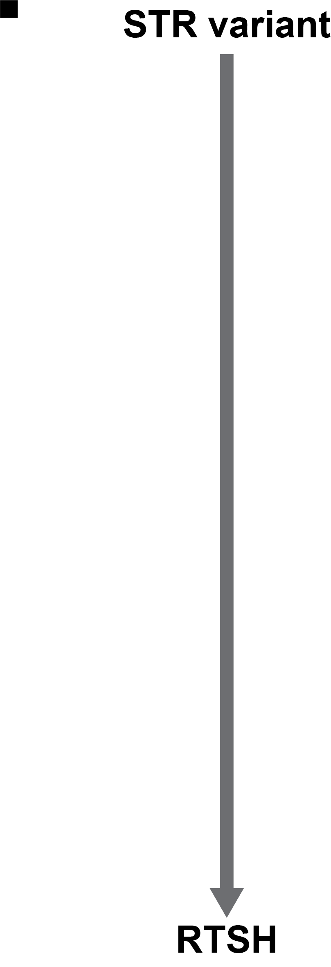
How does STR^{mut} cause RTSH?
What is the molecular basis of this genetic finding?
Slide from Andrew Stergachis
Grasberger et al., Nature Genetics (2024)

Slide 9
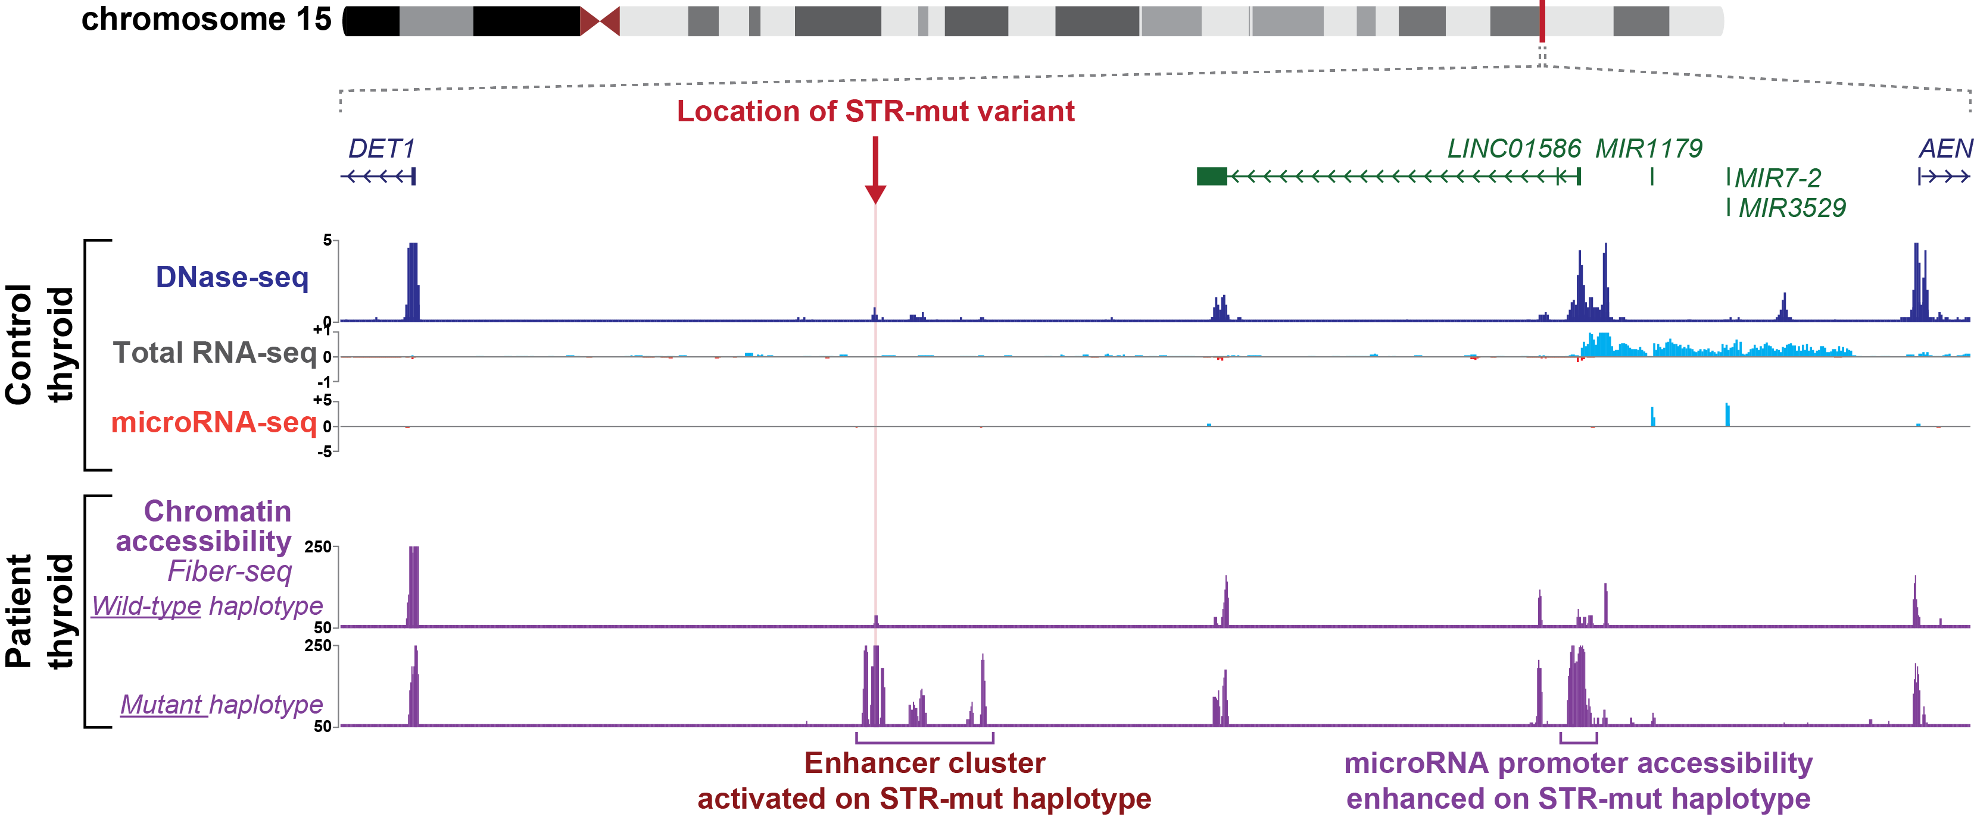
STR^{mut} overlaps a primate-specific Alu element
What is the chromatin profile at this site in thyroid tissue from individuals with RTSH?
Slide from Andrew Stergachis
Grasberger et al., Nature Genetics (2024)

Slide 10
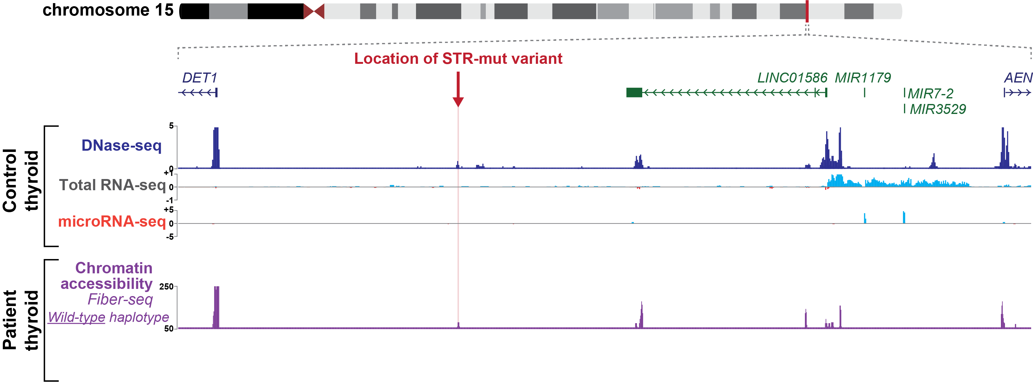
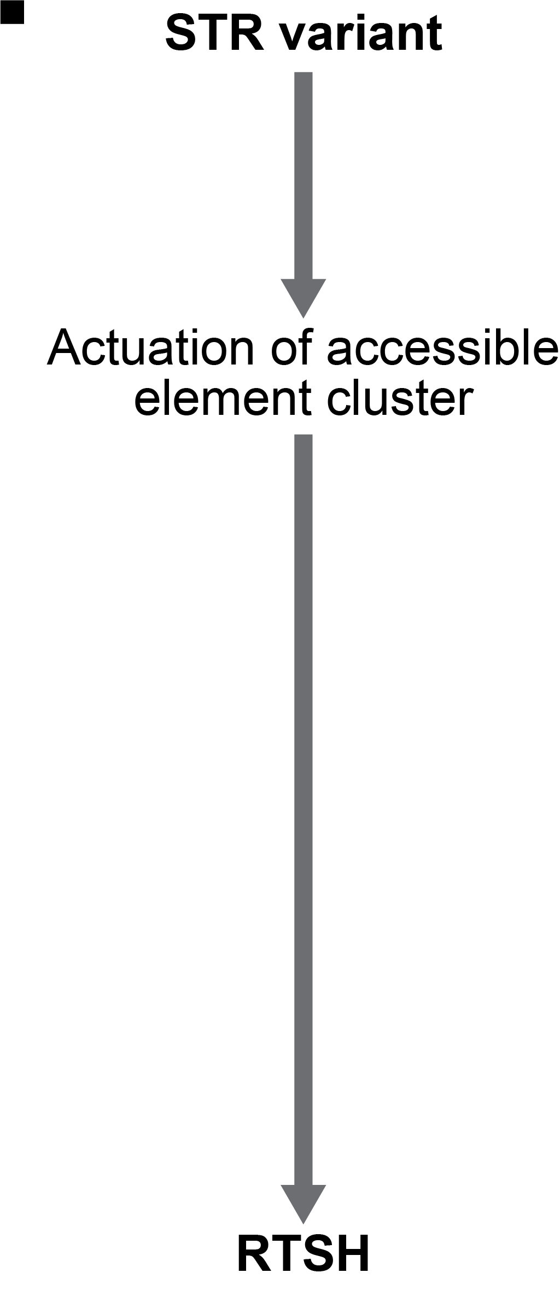
STR^{mut} haplotype creates a cluster of accessible chromatin elements
STR-mut haplotype creates an enhancer cluster
Slide from Andrew Stergachis
Grasberger et al., Nature Genetics (2024)

Slide 11
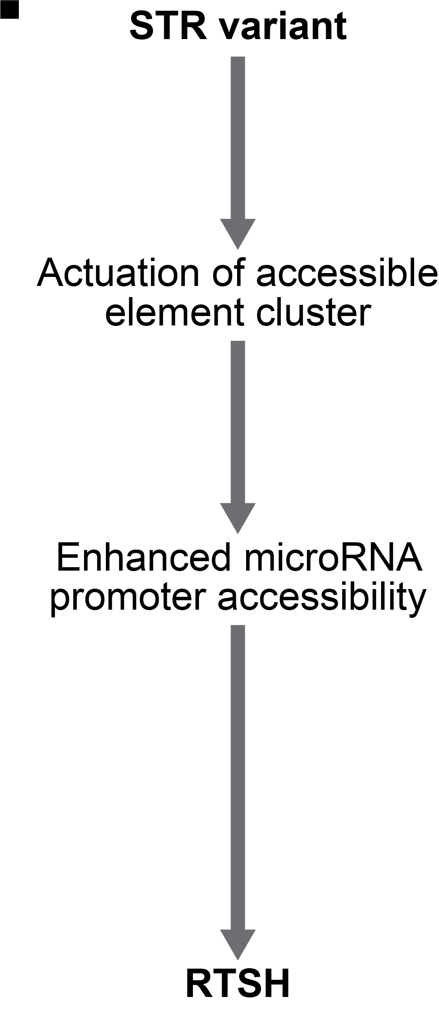
STR^{mut} haplotype enhances microRNA gene promoter accessibility
Haplotype
STR-mut haplotype creates an enhancer cluster
Zoom in close; crop; get rid of RNA-seq; could throw simplified footprint or mention
This cluster selectively enhances MIR7-2P promoter accessibility
Adapted from Andrew Stergachis
Grasberger et al., Nature Genetics (2024)

Slide 12
A guide to Fiber-seq definitions
Fiber (chromatin fiber) = sequencing read from chromatin treated with Hia5
Chromatin accessibility = open/accessible patch of DNA.
Nucleosome = histone octamer in which DNA is wound to form basis of chromatin. ~147bp stretch of inaccessibility on a fiber.
Methyltransferase-sensitive patch (MSP) = any accessible stretch on a fiber.
Linker regions = short accessible patches (MSPs) between nucleosomes.
FIRE = MSP corresponding to a Fiber-seq Inferred Regulatory Element.
Chromatin actuation = FIRE coverage / total coverage (% of fibers with accessibility).
Footprint = Short stretch of DNA protected from m6A modification (e.g. TF, Pol, nucleosome)
TF = transcription factor, Pol = polymerase

Slide 13
Compare and contrast: ATAC-seq vs. Fiber-seq
 | ATAC-seq | Fiber-seq
How accessible DNA is marked | Tn5 cuts and inserts adapters | Hia5 methylates A's (m6A); DNA stays intact
One read is… | A short fragment between two cuts | One chromatin fiber (~15-20Kb) with embedded CpG and chromatin signal throughout
Signal | Read counts: relative, population average | % of fibers with chromatin feature
Haplotypes | Only reads that cover a het SNP | Almost every read
Also on the read | — | 5mC/5hmC (cytidine methylation) on the same molecule

Slide 14
Compare and contrast: Chromatin workshop vs. Fiber-seq workshop
Stage | Chromatin workshop (ChIP-seq) | Fiber-seq
Feature calling | — (a read is just a fragment) | On each molecule: m6A used to derive chromatin features (nucleosomes, MSPs, FIREs, TF footprints)
Map | Chromap to BAM | pbmm2 to BAM, then phase reads (already done for tutorial)
Pile up / signal | bamCoverage to bigWig | % of fibers with a FIRE at each base
Peaks | MACS2 | FIRE peaks (FDR vs. shuffled FIREs, genome-wide)
Visualize | IGV, deepTools | IGV, UCSC hub (every fiber, FIREs + 5mC), FiberBrowser (footprints)
Manipulate / compare | bedtools intersect | fibertools (tags, pileup, haplotype tests) and FiberHMM (footprints)

Slide 15
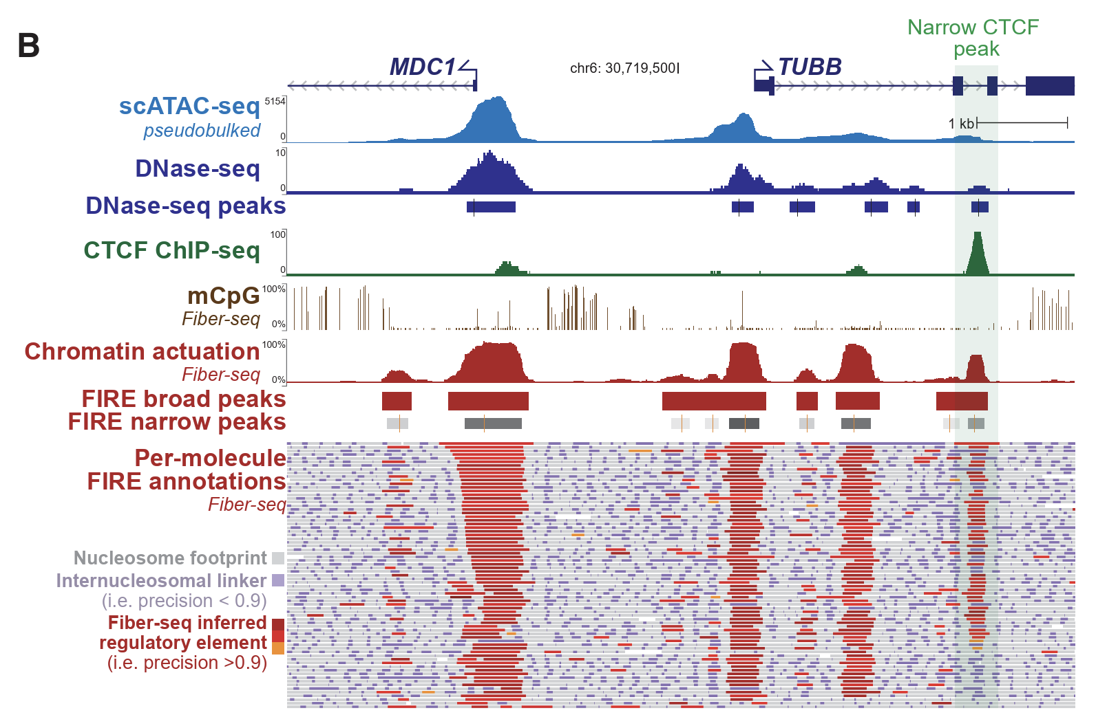
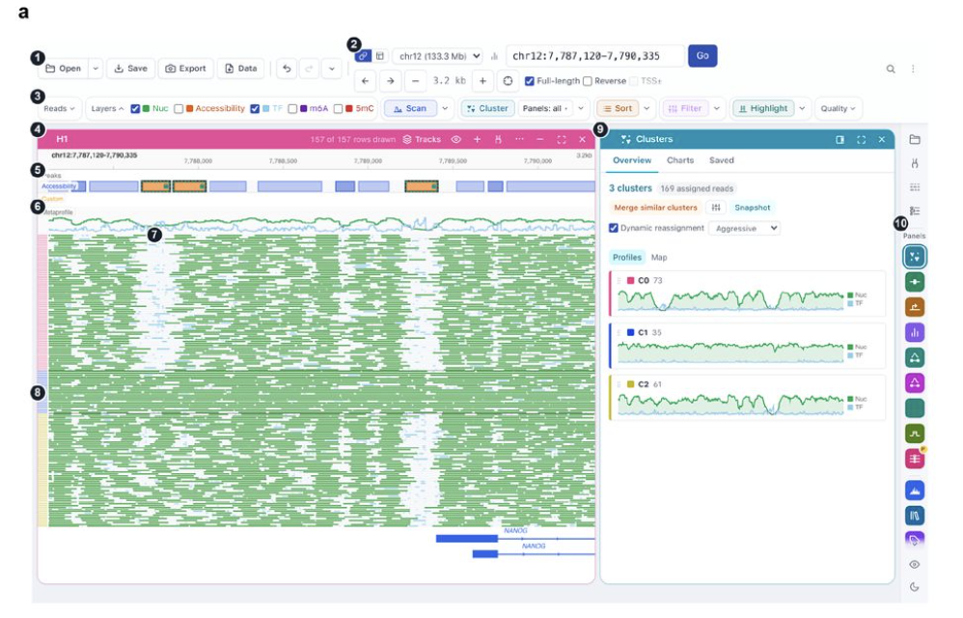
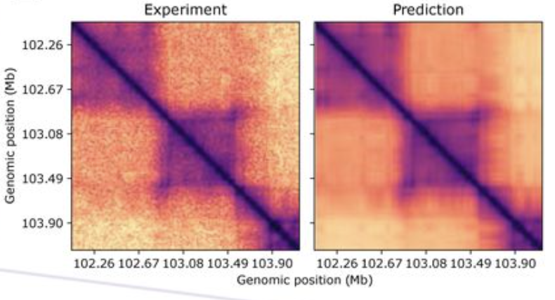
A quick guide to Fiber-seq tooling
fibertools: general processing toolkit for fiber-seq data.
fibertools-FIRE: call fiber-seq inferred regulatory elements.
FiberHMM: perform footprinting (TFs, CTCF, Pol II, etc.).
FiberFold: get 3D genome predictions from FIRE + 5mCpG + CTCF footprints.
(+)Fiberbrowser

Slide 16
Workshop (~45-50 minutes)

Slide 17
Fiber-seq Quality Control
GM12878 (pre-generated, open html): samples ~1.2 Gb sample of the data, not the whole genome.
Genomic coverage: at least 15X haploid coverage recommended for analyses (30X total coverage). For a 30X genome, would need approx. 90Gbp of data given 3B bases in the human genome.
  On average, should be >100Gb.
N50 length (bp): can be interpreted as essentially the average read length (although actual calculations are a little bit different).
  On average, should be >15Kb.
Methylation rate (m6A/AT): The rate of m6A methylation across the sample. Can vary between samples and cell/tissue types.
  On average, should be 2%-12% (FIRE accommodates this range).
Chromatin signal to noise (CSN) is calculated from the autocorrelation as a metric for how well the DNA chromatin was maintained during the fiber-seq reaction.
  On average, should be >25 (more binary, yes or no).
Absent nucleosome rate (MSP>400bp): Measure of disrupted chromatin prior to stenciling (i.e. apoptosis, autolysis etc.)
On average should be <2.5%
Untreated fiber rate (footprints >500bp): The percentage of reads with “larger than expected” inferred nucleosome lengths as a proxy for an unmethylated read.
  On average, should be <4%.

Slide 18

A guide to fiber-seq per-molecule feature annotation
Tag / part | Holds | Example (one GM12878 fiber, 35,208 bp) | Written by
MM / ML | Base modifications + probability (0–255): A+a / T-a = m6A, C+m = 5mC | MM:Z:C+m,19,67,…;A+a,40,10,3,…;T-a,32,0,4,… ML:B:C,78,56,236,… | PacBio instrument (SAM standard)
Ma:Z: length | Read length when the tag was written (a check) | Ma:Z:35208;… | ft
nuc. | Nucleosomes as start-length | ;nuc.:242-101,419-157,… | ft add-nucleosomes
msp. | MSPs (accessible patches) as start-length | ;msp.:111-131,343-76,… | ft add-nucleosomes
fire.Q | FIREs only (copies of MSPs); Q = one score each in Aq | ;fire.Q:5043-143 | ft fire
Aq:B:C | Scores in Ma order (0–255 ≈ precision × 255) | Aq:B:C,244 | ft fire
HP / PS | Haplotype (1 / 2) and phase block | HP:i:1 PS:i:1 | phasing

Slide 19
Two levels of feature identification for Fiber-seq
1. Per molecule
2. Per locus / element (pileup)
Nucleosomes, MSPs, FIREs and TF footprints on one read.
Stored as tags on the read in the BAM.
Many fibers stacked at one site.
% accessible, FIRE peaks.
Compare haplotypes at each peak.

Slide 20
2. Per locus / element (pileup)
% accessible = fibers with a FIRE ÷ all fibers covering the base
Peaks = local maxima of the FIRE pileup with FDR below 5% (default)
  FDR needs the whole genome, so in the tutorial we fetch our region from the genome-wide peak file.
Peak edges = median start / end of the FIREs underneath
Split by haplotype (H1 and H2 tracks)
fibers aligned to the reference
% accessible here = 4 / 6 (66% actuated)
FIRE outputs and peak calling: fiberseq.github.io/fire/outputs.html

Slide 21
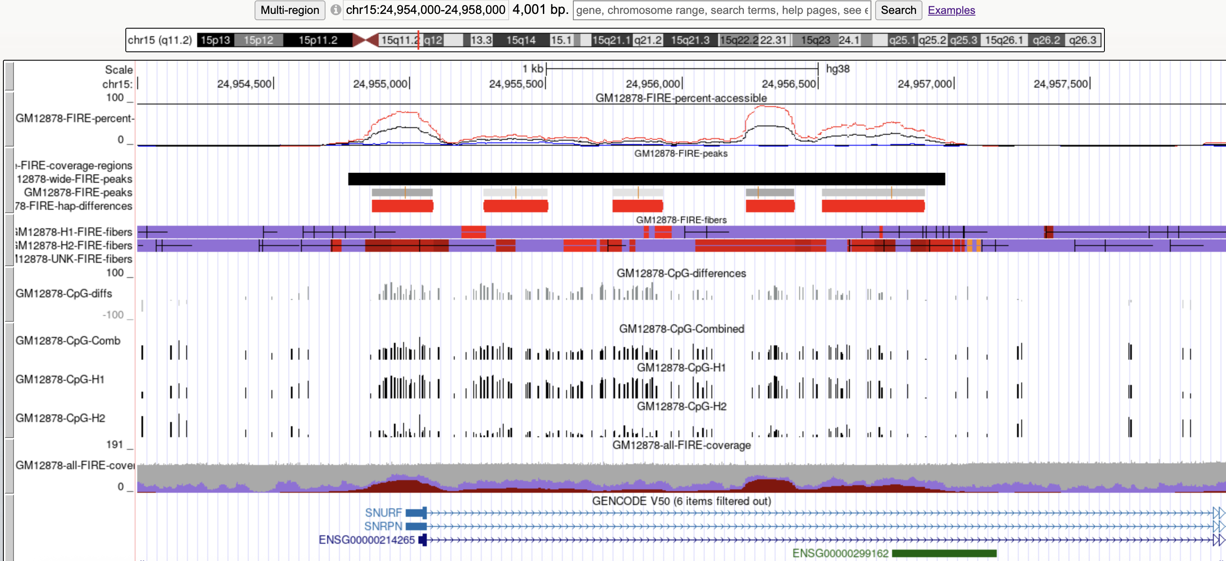
Visualization of Fiber-seq data with UCSC
Prebuilt UCSC TrackHub (to save us time, but you can make these for yourself)

Slide 22
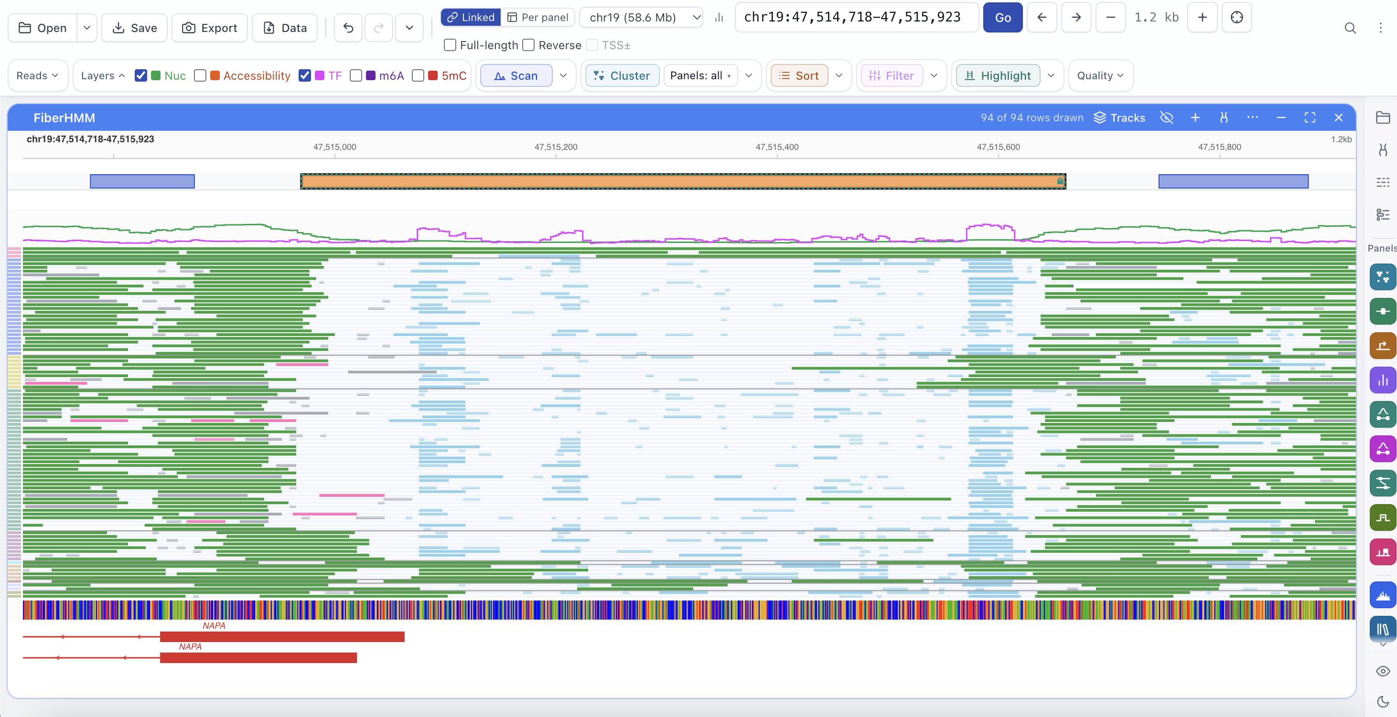
Visualization of footprint data with FiberBrowser
(Tullius et al., 2026 BioRxiv)

Slide 23
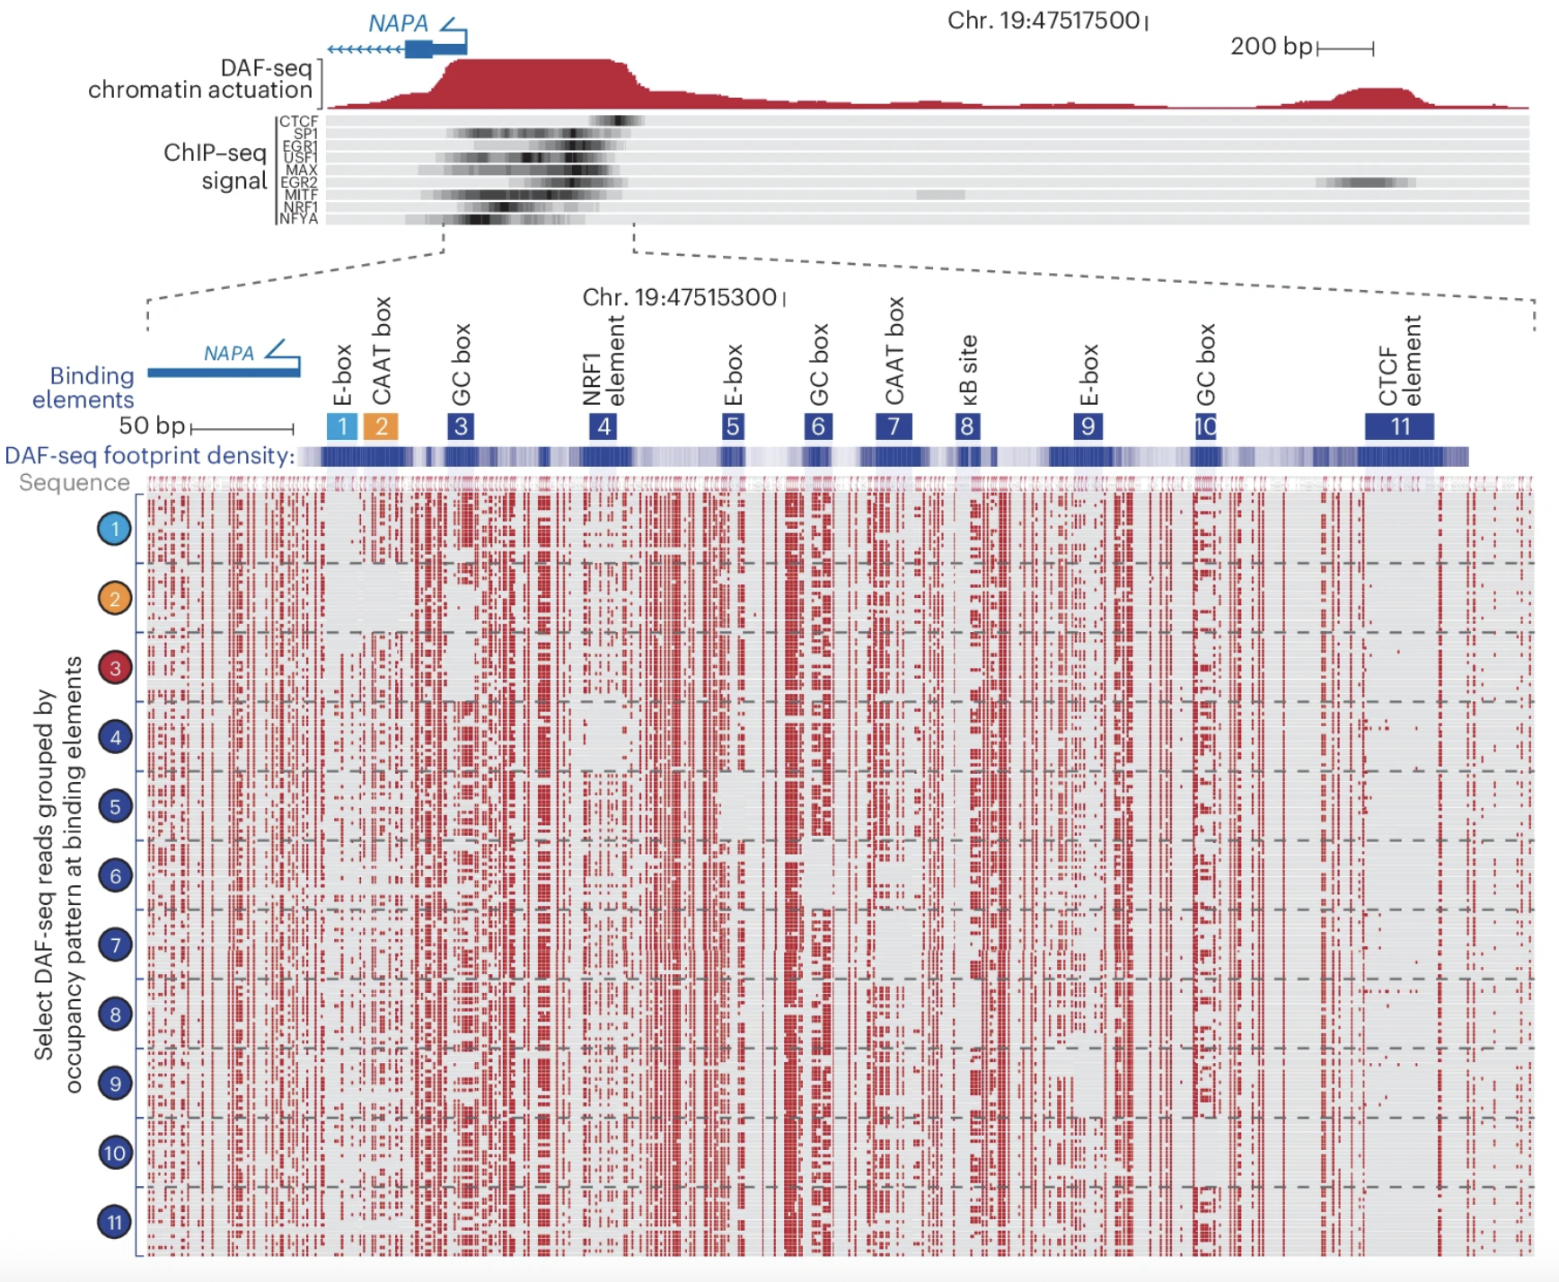
Distinct regulatory architecture at the NAPA promoter
DAF-seq
(Swanson et al., Nature Biotechnology 2026)

Slide 24
Final Notes and Tips
The order of steps in this workshop is different from what is typically done for a standard genome-wide run:
  We usually start with getting the derived chromatin features first before alignment and phasing to get a sense of quality control early on.
Run the fiber-seq qc pipeline on the raw data before going into alignment + phasing + fire to catch issues with data quality early on.
When analyzing fiber-seq data, always process with FIRE instead of analyzing straight off the raw m6A calls.
When comparing samples, don’t do peak overlaps; compare signal at a shared set of peaks (bonFIRE).
Don’t visualize raw m6A on IGV; use UCSC or Fiberbrowser (or MA tags in IGV).
Many thanks for helpful tips from Mitchell Vollger (developer of fibertools) and Tommy Tullius (developer of FiberHMM and FiberBrowser.
Notes:
m6A calling is happening directly on the instrument now
Ft run on unaligned to get qc sooner than later
Pbmm2 for alignment (standard hg38)
DeepVariant for small variant calling
Sniffles/Sawfish for structural variant calling
HiPhase for haplotype phasing
Broader fiber-seq toolkit (subsequent slide)

Slide 25
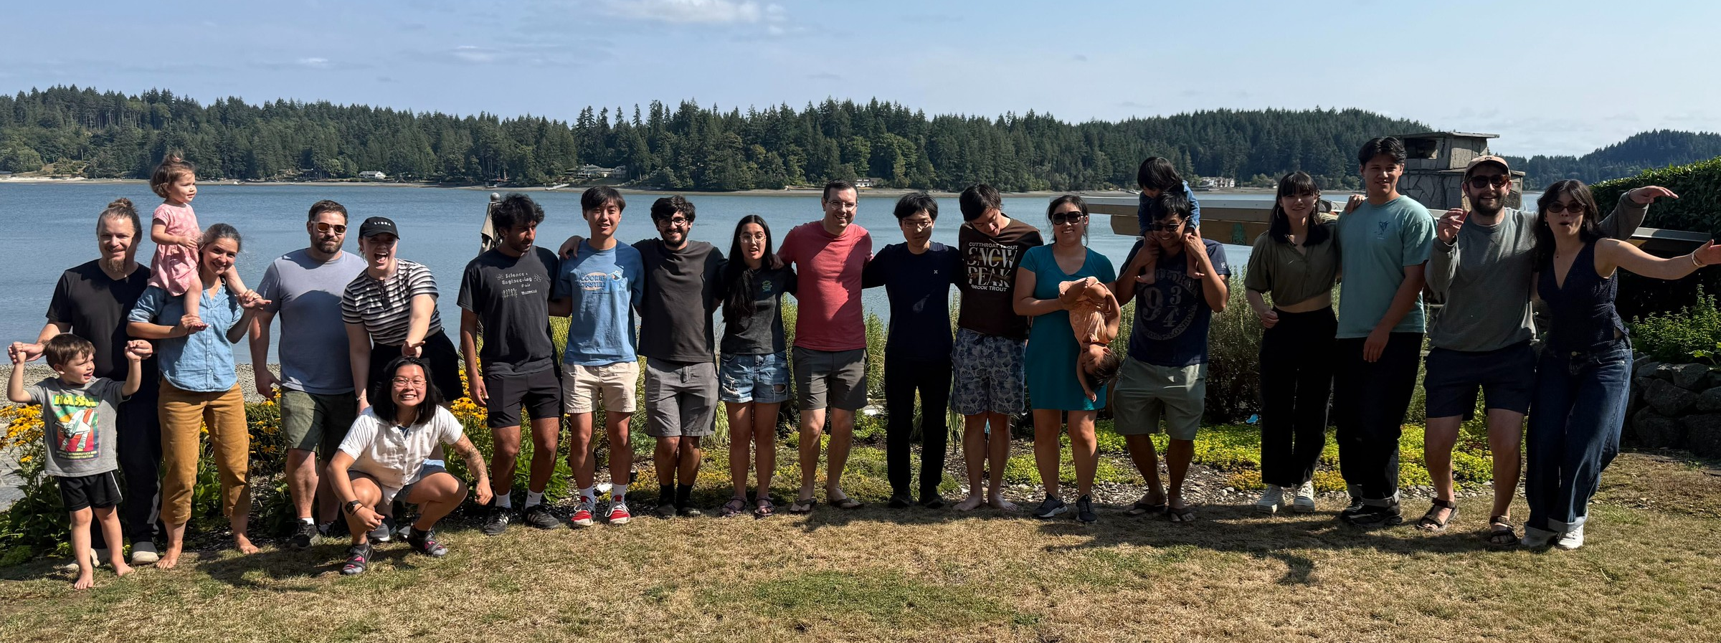

Acknowledgements
The Stergachis Laboratory (current)
Zachary Amador
David Baxter
Yong-Han Hank Cheng
Pankhuri Gupta
Michelle Johnson
Carissa A. Lee
Annelise Mah-Som
Ben Mallory
Anna Minkina
Devaraja Mudeppa
Shane Neph
Chris Oliveira
Min-Seon Park
Jane Ranchalis
Taylor Real
Adriana Sedeño Cortés
Min-Hwan Sohn
Andrew Stergachis*
Ben Stillman
Brandon Sun (alumni)
Elliott Swanson
And
Mitchell Vollger (previous postdoc, current faculty at Utah)
Fiber-seq resources:
fibertools documentation: https://github.com/fiberseq/fibertools-rs, https://fiberseq.github.io/index.html
fibertools-FIRE: https://github.com/fiberseq/FIRE
Fiber-seq qc: https://github.com/fiberseq/fiberseq-qc
Consensus fire pipeline: https://github.com/StergachisLab/fire_consensus_pipeline
bonFIRE: https://github.com/fiberseq/bonFIRE
FiberFold: https://github.com/altemoselab/fiberFold
FiberHMM: https://github.com/fiberseq/FiberHMM
FiberBrowser: https://github.com/fiberseq/FiberBrowser
Funding
NIH NHGRI K00 (K00HG014072)
Bonus technologies/tools from the lab:
Plasmid fiber-seq: https://github.com/StergachisLab/Plasmid-Fiber-seq
DAF-seq: https://github.com/StergachisLab/DAF-QC-SMK
IsoRanker: https://github.com/StergachisLab/IsoRanker

