Slide 1
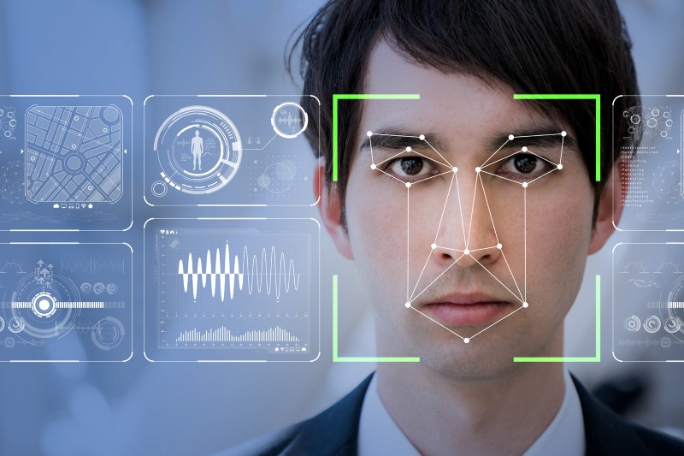
Facial recognition
Avoid a fight in venues with Nonlutte app

Slide 2

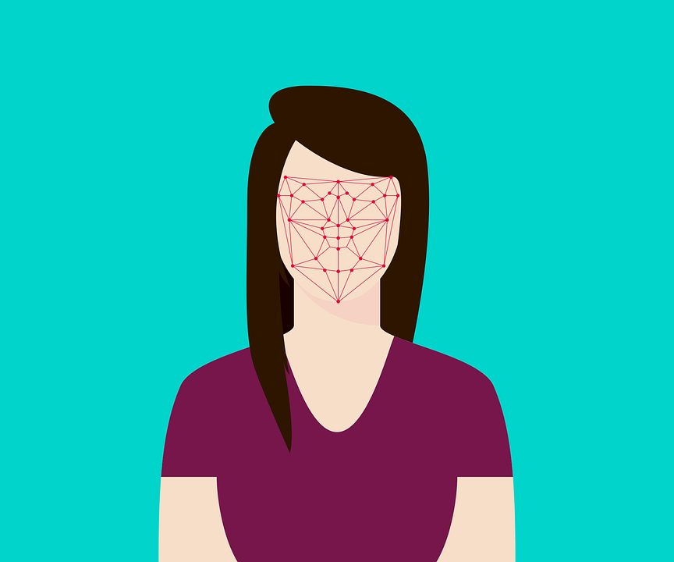
Easy to Implementation and accurateness much better
Emotion Detection APP
The emotions detected are anger, disgust, fear, happy, sad, surprised, and normal. These emotions are understood to be cross-culturally and universally communicated with particular facial expressions.

Slide 3
About the Project
Our model converts the video into vectors of video level feature extracts and to introduce knowledge transfer a largescale emotion-centric auxiliary image set is being used to classify the emotions.

Slide 4




Overview of the System
Key Benefit
Quick and easy. Check each person for less than 5 seconds
Accurate and objective. Different thresholds can be set for objective screening.
The Two main stages in the system are:
Feature extraction
Feature classification
The feature extraction stage involves pre-processing stages such as acquiring a sequence of images (15 frames/second) using a video camera and detecting the facial region of the image and standardizing the properties for lighting the image , this application BRIEF feature extraction is being used.
Friendly shielding. No contact and no interference.
Intelligent early warning. Real-time dynamic early warning function.

Slide 5
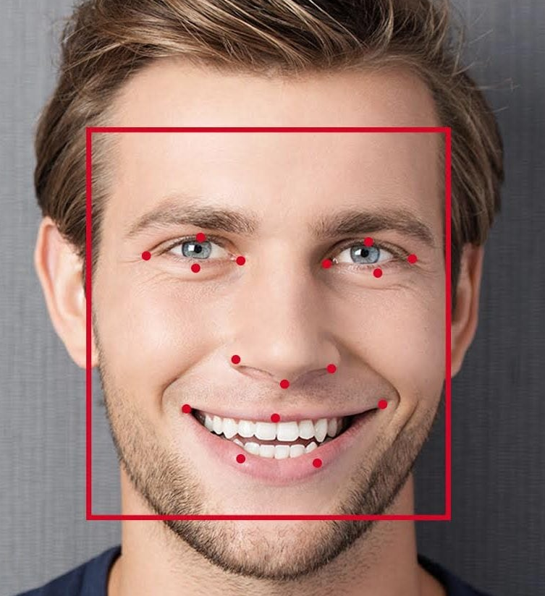
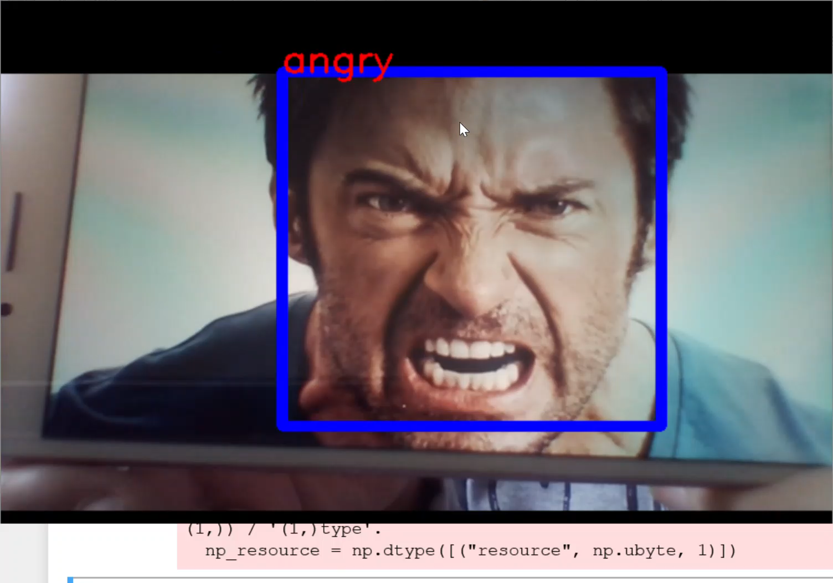
Real time solution
Besides, we can apply emotion analysis on a video streaming or web cam capturing. We try to act all emotion classes. As seen, this implementation runs very fast.

Slide 6
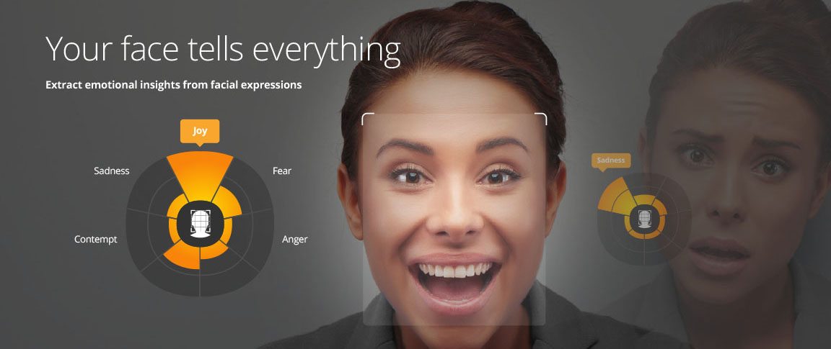
Thank you

