Slide 1
Three-Addressing code generation
Nicholas Marble, Chris Varga

Slide 2
Objective
Three-address code generation
Given a C parse tree.
Readable code

Slide 3
What it can do
Variables: Assignment/reusability
For Loops: Multilevel support
If statements: Many a kinds
Functions: No interconnections

Slide 4
What It can’t do
Scope: Everything is global
Arrays
Imported code
Type checking

Slide 5
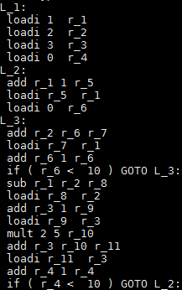
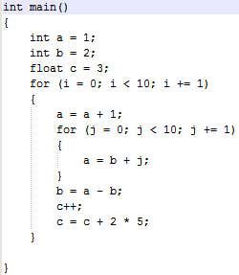
Multilevel Loops

Slide 6
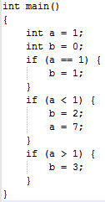
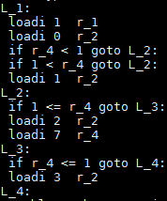
If statements

Slide 7
Issues
Unknown parser
Had to take time to learn how it worked
Order of work
To small of problems solved
Caused horrible looking code

Slide 8
Questions?

