Slide 1
AN EXPERIMENTAL APPLICATION OF UNSUPERVISED MODELING TO CHATBOTS
NICHOLAS MARBLE, CHRIS VARGA

Slide 2
OVERVIEW
Review of our Implementation Strategy
Adding New Evaluation Metrics
Pre-processing Tweets
Comparison to Other Chatbots

Slide 3
IMPLEMENTATION
Determine input subjects/ideas
Query for similar subjects/ideas
Model and rank all sentences
Reply with most similar tweet

Slide 4
CLUSTER TWEETS WITH LATENT SEMANTIC ANALYSIS (LSA)
Treat each tweet as a bag-of-words
Don’t care about order, only frequency
Create a term-document matrix
Identify tweet categories using SVD
Idea: create categories using similar concepts
Word | Sentences
 | S1 | S2 | S3 | S4 | S5
I | 1 |  |  | 1
Dog |  | 1 |  |  | 1
Cat | 1 | 1 |  |  | 1
Black |  |  |  | 1
Yellow | 1
Human |  | 1 |  |  | 1
Dolphin |  |  | 1
You |  |  | 1
Kanya |  |  |  | 1

Slide 5
LSA WITH TFIDF
Some words like “the” and “a” are very common
These common words skew the term-document matrix
Solution: assign greater weight to important words that are less frequent
Use TFIDF (term frequency inverse document frequency) to assign weights
Example: “The black cat was spying on the dog.”
“the” and “on” occur frequently in other text
“cat” and “dog” occur less frequently and therefore are more important

Slide 6



TFIDF FORMULAS
N = number of documents
D = set of all documents
t = term
= tf(t, d) i.e. how many times term t occurs in document d

Slide 7
RANKING THE BEST RESPONSE
Rank relevance of tweets to input in same category using cosine similarity
Take best matched
0 if not similar at all
Idea: the more similar the tweet, the better the response
If no tweets are similar, chatbot responds "I do not understand"
"I do not understand" counts as a non-response

Slide 8

COSINE SIMILARITY ON VECTORIZED TWEETS
Represent tweets as term frequency vectors
A = “hi there buddy” => [1 1 1 0]
B = “hi there dude” => [1 1 0 1]
C = “hi there buddy dude” (combined tweet vector)
cosine similarity =

Slide 9
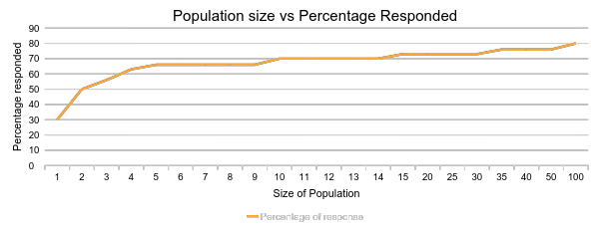
EXPERIMENTING WITH POPULATION SIZES
Observation: larger base “population” allows for larger range of responses

Slide 10
QUALITATIVE RESULTS
Had sample testers rate chatbot response as 'relevant' or 'not relevant'
Two different input sets: one more "formal," one more "slang"
"Slang" set had average of 16/30 relevant responses ~53%
"Formal" set had average of 14/30 relevant responses ~46%
Responses are 'relevant' to input but don’t always make sense

Slide 11
QUANTITATIVE RESULTS
Ask chatbot 30 questions from "slang" and "formal" input sets
Measure number of responses that are not "I do not understand"
"Slang" set had 86% response rate after pre-processing tweets
"Formal" set had 76% response rate after pre-processing tweets

Slide 12
PREPROCESSING TWEETS
Removed symbols such as @ and RT (retweet)
"Formal" set saw response rate go from ~80% to ~86% after preprocessing
We attribute this to higher degrees of similarity without extra symbols

Slide 13
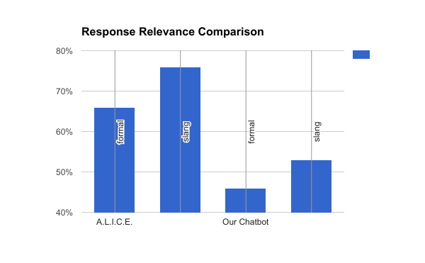
COMPARISON TO A.L.I.C.E. CHATBOT
A.L.I.C.E.
66% relevance in formal
76% relevance in slang
Our Chatbot
46% relevance in formal
53% relevance in slang
http://alice.pandorabots.com/

Slide 14
EXAMPLE RESPONSES FROM A.L.I.C.E.
Input:
“popcorn is a healthy snack”
Reponse:
“aren’t all healthy snack popcorn”

Slide 15
EXAMPLE RESPONSES FROM A.L.I.C.E.
Input:
“drinking water is important”
Reponse:
“And important is drinking water. “

Slide 16
EXAMPLE RESPONSES FROM OUR CHATBOT
Input:
“do you come to school by bus?”
Reponse:
“I’m tired of these crackheads on the bus.”

Slide 17
EXAMPLE RESPONSES FROM OUR CHATBOT
Input:
“All the best people are quirky… I bet I can outdo you though.”
Reponse:
“Remember when everyone was accused of being a communist back in the 50’s because the media? I bet those days were great let’s do that again.”

Slide 18
EXAMPLE RESPONSES FROM OUR CHATBOT
Input:
“drinking water is important”
Response:
“I’m done drinking until I lose 20 pounds.”

Slide 19
FUTURE WORK
Database improvement
Currently use a .csv file, prone to formatting errors etc…
Dedicated database would allow for indexing and easier data manipulation
Allows for changing subjects and adding ranking scores
Ranking system
Scores allow for picking tweets that are deemed “good”
Implement built in system to do this ranking

Slide 20
QUESTIONS

