Slide 1
9/16 Updates
Christopher Thai

Slide 2
Changes to the scraper
Used original VAST instead of VAST+
Search on protein sequences v/s biological units
Applied filters discussed last meeting
> 90% sequence identity
< 50% of aligned residues in query protein
Rate increased to 75% when searching for neighbors of neighbors
Low redundancy set
Subset filters not seen in VAST+
“representatives are chosen from each group where sequences show a BLAST p value of 10e-7 to each other” according to documentation
Much higher p-value than the medium and high redundancy set
Starting queries from MEROPS – Clan PA

Slide 3
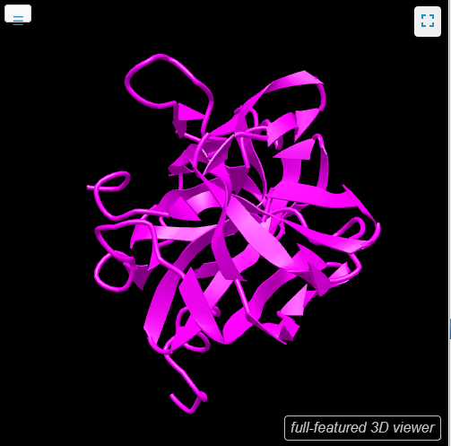
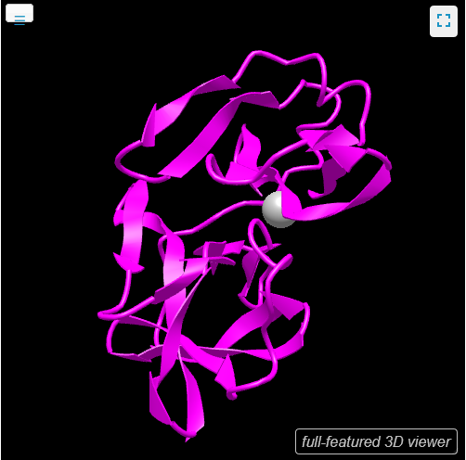
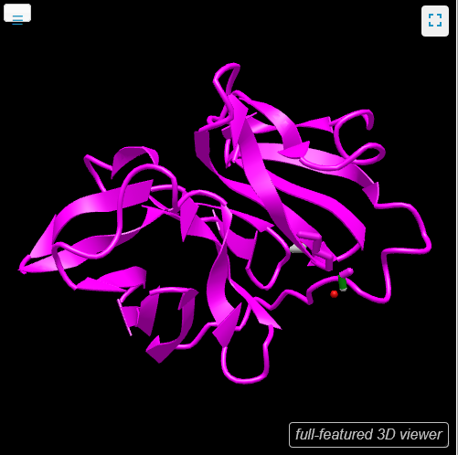
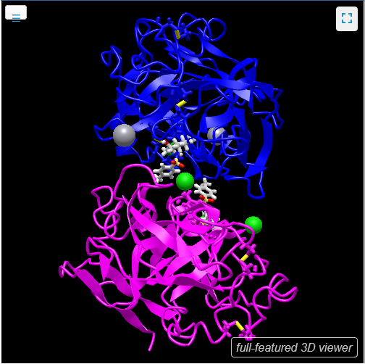
Example: 1L1N-A Poliovirus 3c Proteinase
1VCP-A
Semliki Forest Virus Capsid Protein (crystal Form I)
1WYK-A
SINDBIS VIRUS CAPSID PROTEIN
4NSY-B (in blue)
Wild-type lysobacter enzymogenes lysc endoproteinase covalently inhibited by TLCK

Slide 4
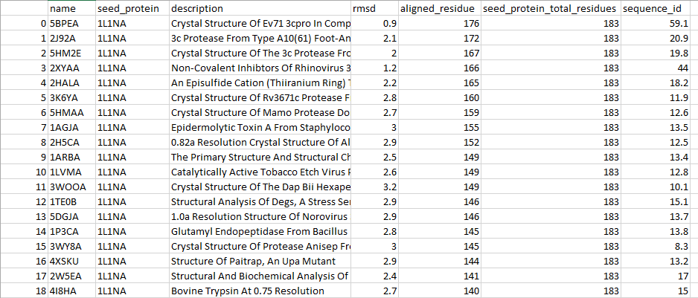
For 1L1N-A
63 neighbors and ‘neighbors-of-neighbors’ found
Due to changes to script, such as filtering

Slide 5
Next steps
Improve filtering of data
Start iterating over all of clan PA

