Slide 1
9/9 Updates
Christopher Thai

Slide 2
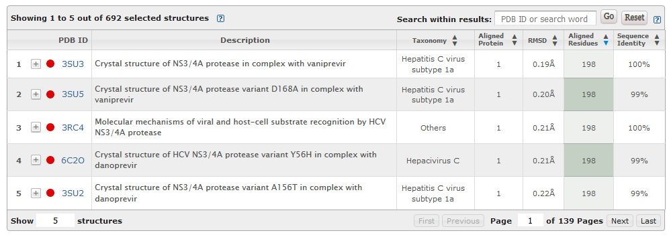
The Tech
Used a Python notebook
Libraries used:
Selenium (control a web browser instance with code)
Beautiful Soup (parses HTML text)
HTML code

Slide 3

Step 1: Use Selenium to extract total table length
Step 2: Input maximum row number to display all entries in table

Slide 4
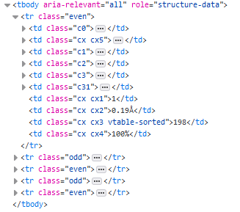
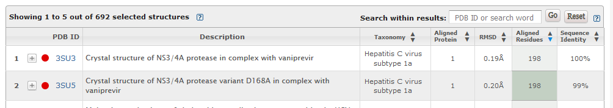
Every row maps to an ‘even’ or ‘odd’ class <tr> HTML element
Step 3: Iteratively parse through each ‘even’ and ‘odd’ element
Gather column data by parsing strings in each <td> class
Repeat search iteratively on all proteins seen through this process

Slide 5
Considerations
Script is very time consuming
Hours for just 1 pass through 3M5L related proteins
1 protein can have thousands of total matches
Unknown how long entire exhaustive search process may take
Questions:
How exactly do we plan to filter this data?
Should we filter this data during the scraping process?
Complete v/s partial matches?
Aligned proteins (same as above?)
Sequence identities?

