Slide 1
AKS – AAD for apps
a session into AKS pod identities

Slide 2
AKS - AAD
Cluster Identity: The identity used by the cloud provider running in various kubernetes components to perform operations against Azure, typically against Azure's resource group where the cluster lives. This identity is set during the cluster bring up process.
User Identity: What enables user/operator to authenticate against AAD using AAD before using kubectl commands.
Application Identities: Identities that are used by applications running on kubernetes to access any resources that uses AAD as identity provider. These resources can be ARM, Applications running on the same cluster, on azure, or anywhere else.

Slide 3
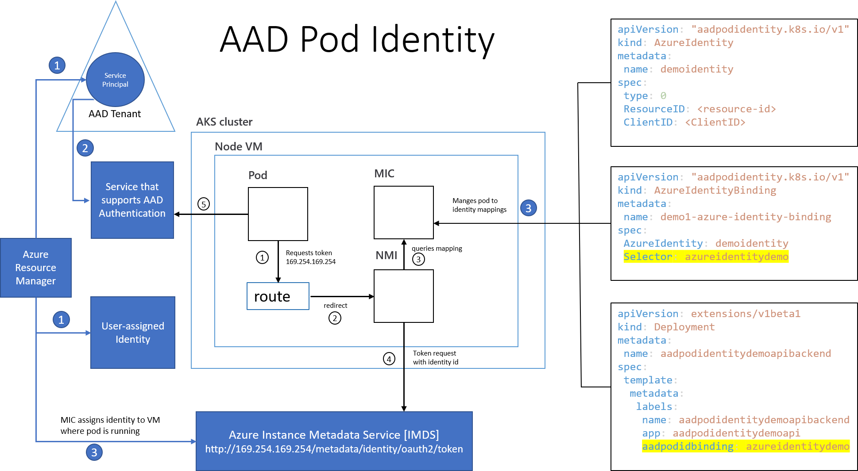

Slide 4
Code Example
from azure.keyvault.secrets import SecretClient
from azure.identity import ManagedIdentityCredential
credentials = ManagedIdentityCredential(
msi_res_id='/subscriptions/'+os.environ.get('SUBSCRIPTION')+'/resourceGroups/'+os.environ.get('RG')+'/providers/Microsoft.ManagedIdentity/userAssignedIdentities/'+os.environ.get('MSID')
)
secret_client = SecretClient(vault_url="https://"+os.environ.get('KEY_VAULT_NAME')+".vault.azure.net", credential=credentials2)
secret = secret_client.get_secret("demo-secret1")
print("SECRET IS: "+secret.value)

