Slide 1

Cubits
By Hocus Focus
Notes:
10 seconds

Slide 2
Introduction
Updates on progress of the idea, demonstration of product.
Key areas:
Problem overview
Background Research
Demonstration
Test protocol
Contents + Purpose
Notes:
10 seconds
...highlighting potential differences that may occur through exhibiting in an alternate context.

Slide 3
Problem Statement
At a development-focused workplace, task management software focuses primarily on assigning tasks, logging work, and monitoring progress.
What these products fail to address is persuasion to motivate employees to work together.
A lack of communication or collaboration is considered the source of workplace failures by 86% of executives and employees (Stein, 2012).
How can we use persuasive design to encourage employees to actively plan, collaborate and communicate their tasks?
Notes:
30 seconds
Clear definition of problem, demonstrating an understanding of
the underlying research questions being addressed
Clear description of project, situated in background research and studio context.

Slide 4
Objectives
Successful if users are…
...collaborating with each other in their tasks more (more assistance).
...communicating with each other on their tasks more.
...planning out the order of their tasks more.
And therefore, more productive at their work.
Notes:
20 seconds
Clear, well-articulated
and realistic objectives, with associated criteria for success identified.
Each success criteria has an associated (sensible) measure that it can be assessed against.
Success criteria are well-articulated and clearly mapped to project objectives and outcomes.
Appropriate metrics for measuring success against stated success criteria have been described.

Slide 5
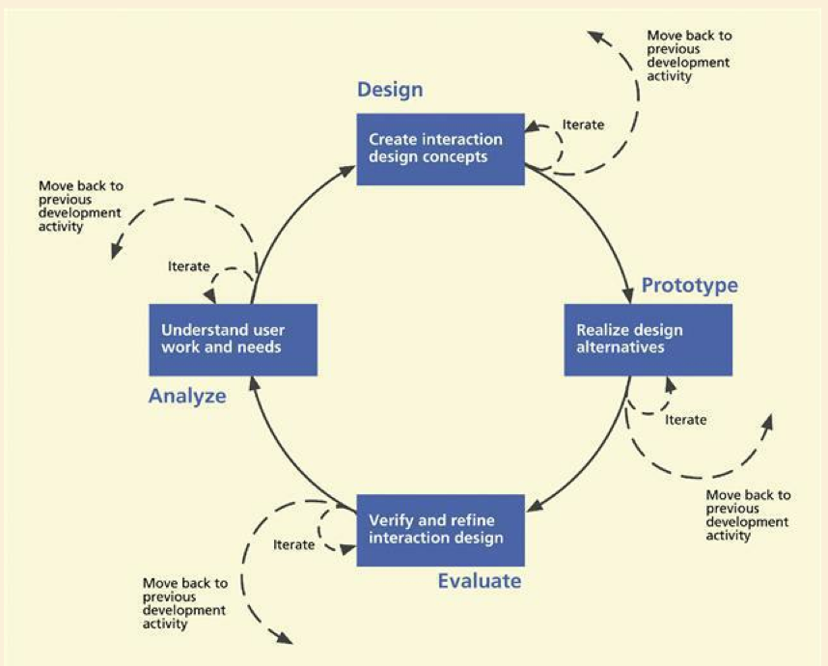
(Hartson, R., & Pyla, P, 2012)

Slide 6
Pre-research model
Notes:
40 seconds
Prototype/s demonstrates genuine effort to resolve key/central technical requirements for the project.

Slide 7
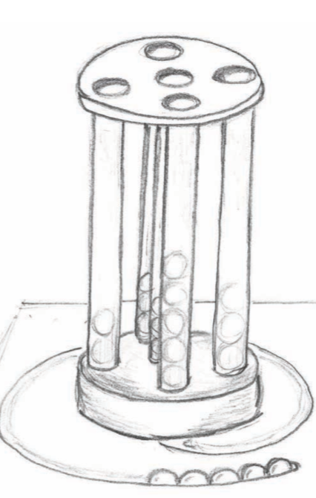
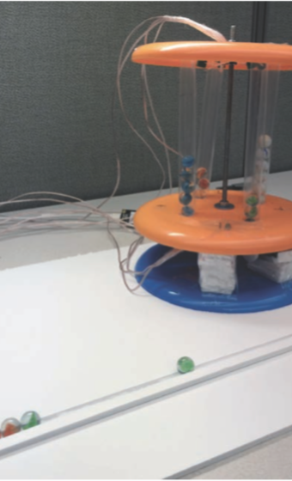
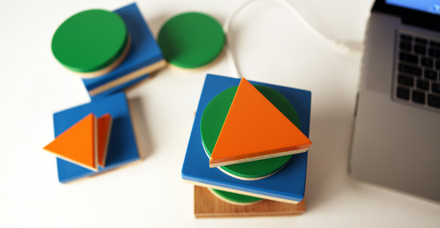

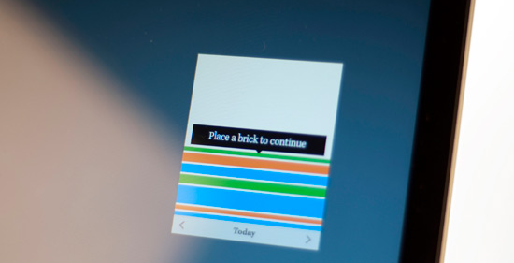
The Time Machine
Daily Stack
Curbing interruptions and distractions by physically abstracting blocks of time (Ahmed et al., 2014)
Stacked shapes as tasks. Communicates with computer to track time and progress (Archer, 2010).
Notes:
30 seconds
Sources are clearly used to support the presentation
Original and creative synthesis of materials. Element of delight in interaction or concept
Displays clear understanding of where proposed team and individual work fits into broader studio perspective

Slide 8
Ethnography
Ethnography was conducted at Redback Technologies, a company which has teams of software developers.
Findings:
Teams of 3-7, with a team leader for each.
Task allocation happens once a week, every Monday. Decided upon by the team and are loaded into task management software either as “features” or “bug fixes”.
Work is generally autonomous. Planning order of tasks happen independently.
Employees update their task status using a Kanban Board.
When there is a problem, team leaders get frequently called over to help out.
Tasks are sent back and forth from the developer to the tester to ensure quality.
Team leaders review every piece of code before it is declared ‘done’.
Observations have been accounted for in the research and development process.
Notes:
50 seconds
Presentation captures how the design for the project has progressed

Slide 9
Workplace Culture & Adopting Technologies
(Orlikowski, 1992)
The properties of organisations that influenced adoption:
Reward System
Adherence to Policies and Procedures
Firm Culture and Work Norms
Solution:
Make the reward clear.
Augment workflow. Do not replace.
Designing for individuals, but gently encouraging collaboration.
Notes:
40 seconds
Presentation captures how the design for the project has progressed

Slide 10
Research to Prototype Development
Independent workflow
Grudin’s Challenges for groupware: “Disparity of work and benefit” and “Disruption of Social Processes” (Grudin, 1994)
Originally, only the boss could assign tasks. Members can assign their own tasks now. Increased planning capabilities.
Emotional Design to promote play
Andre (1998) - “The Persona” - Our subjects rated learning tasks presented by the Persona as less difficult than presentations without a lifelike character.
Originally, Cubes were all the same. Now we have employed personification: names, faces, sounds for each cube.
Increases delight and playfulness - additional motivation to complete tasks
Uniquely identifies cubes - identification for planning
Open-ended interactions for social conventions
“While there are many formal processes in place for technical artifacts, managing social artifacts is only supported by informal processes” (Treude, 2009)
Originally, cubes are fixed. Now you can draw on the cubes. Open-ended interactions adapt to social norms.
Notes:
80 seconds
Presentation captures how the design for the project has progressed

Slide 11
Our Prototype
Purpose:
To resolve crafting requirements for building
To make sure all interactions are considered
Testing emotional design techniques
Prototype is transparent to demonstrate functionality.
Functional:
Placing Cubes in
Taking Cubes out
Simulated:
Software
Screens
Scanning
Alert cube
Doors
Notes:
30 seconds
Sources are clearly used to support the presentation
Original and creative synthesis of materials. Element of delight in interaction or concept
Displays clear understanding of where proposed team and individual work fits into broader studio perspective

Slide 12
Collaborative Environments
A virtual space for team members to share information to collaborate, and work effectively. (Heim, 2008)
Also known as groupware, Collaborative Working Environments (CWE), or Computer-Supported Cooperative Work (CSCW)
Our Interaction Paradigm
Notes:
20 seconds
Sources are clearly used to support the presentation
Original and creative synthesis of materials. Element of delight in interaction or concept
Displays clear understanding of where proposed team and individual work fits into broader studio perspective

Slide 13
Interaction Plan (Steps)
Input | Output | Purpose
Step 1 - Scan Cube (scan mode) | The scanner displays the task assigned to the cube. | Planning - To keep track of open tasks, and to find out who the cube is assigned to.
Step 2 - Submit inputs from the accompanying software | Loads the scanner with values to place into the next cube. Sets the scanner to “load” mode. | Planning - Help the user load their own custom tasks to each cube.
Step 3 - Scan Cube (load mode) | Loads the cube with the specified task. Sets the scanner back to “scan” mode. | Planning - Lets the user assign and create their own tasks.
Step 4 - Put cube into a pillar | Task is assigned to the pillar owner, and is added to the task queue. | Planning - Constructs the order in which the user will complete the tasks.
Step 5 - Take out the cube from the bottom | Finishes the task. Tasks move ahead in the queue. The next task in the queue begins. | Communication - Fully resolves the task.
Notes:
20 seconds
Interaction plan provides a clear description of the intended interactions for the project and situates these in the context of use.
Prototype/s is cleverly used to communicate intended interactions.

Slide 14
Interaction Plan (Miscellaneous)
Input | Output | Purpose
Take out a cube using the doors | Takes the task out of the queue. | Collaboration - Lets the user take out a cube from the queue to give to another person.
Shake alert cube | Send an alert to a specified pillar | Communication - Helps to call for assistance from either the boss from someone else specified.
Notes:
10 seconds
Interaction plan provides a clear description of the intended interactions for the project and situates these in the context of use.
Prototype/s is cleverly used to communicate intended interactions.

Slide 15
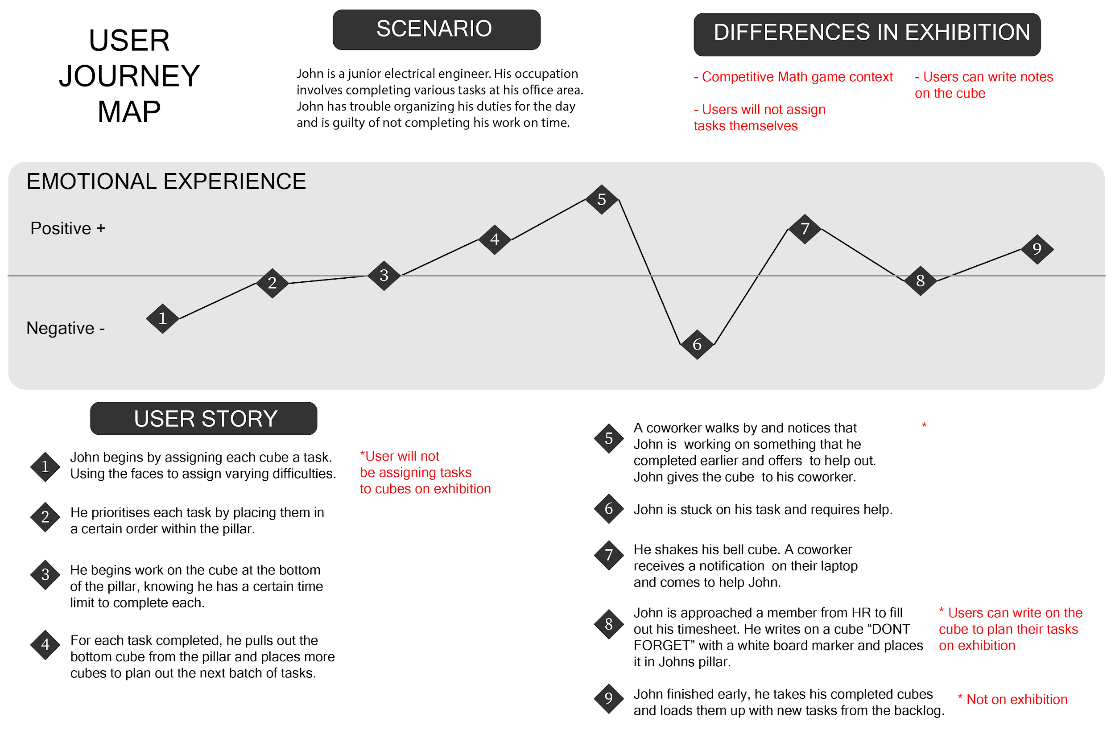
Notes:
80 seconds
...highlighting potential differences that may occur through exhibiting in an alternate context.

Slide 16
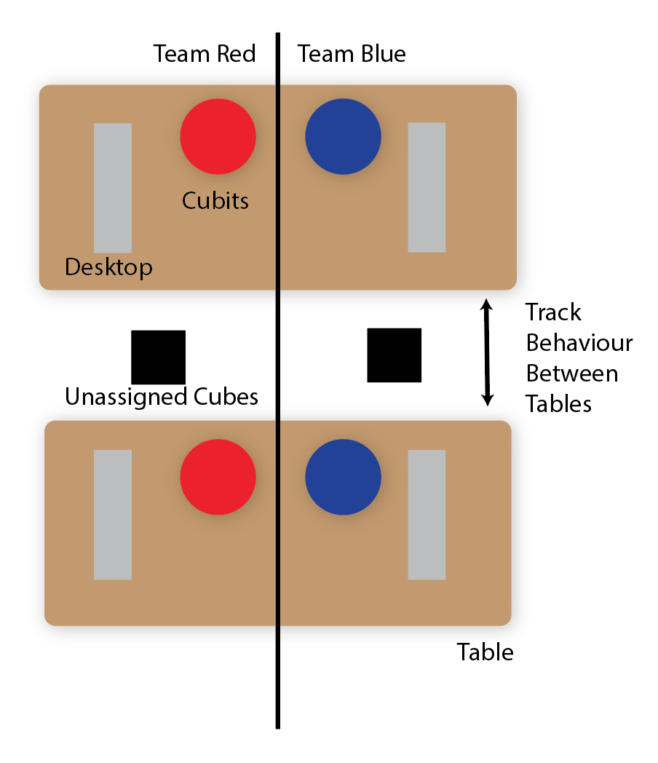
Game Design
An exhibit participant is not fit for the designed context.
Little relationship among strangers
No tasks to complete
No prolonged use
To address this, we created a competitive game with maths problems as tasks.
Quantifiable measurements will be taken. Improvements will be measured with and without cubits.
Other observations will be noted.
Notes:
30 seconds
...highlighting potential differences that may occur through exhibiting in an alternate context.

Slide 17
Success Criteria
Successful if groups that use Cubits are…
...collaborating with each other in their tasks more.
50% more instances of team assistance
...communicating with each other on their tasks more.
50% more team members crossing tables
...planning out the order of their tasks more.
50% longer time spent planning
...more productive at their work.
30% faster at completing the task
Notes:
30 seconds
Clear, well-articulated
and realistic objectives, with associated criteria for success identified.
Each success criteria has an associated (sensible) measure that it can be assessed against.
Success criteria are well-articulated and clearly mapped to project objectives and outcomes.
Appropriate metrics for measuring success against stated success criteria have been described.

Slide 18
Pin-up Materials Feedback
Poster & Brochure
Managers OR employees?
Managers AND employees?
Video Storyboard
Office, or Office + home?
Using it alone?
3D Model
Interactive vs looping?
Notes:
30 seconds
Clear, well-articulated
and realistic objectives, with associated criteria for success identified.
Each success criteria has an associated (sensible) measure that it can be assessed against.
Success criteria are well-articulated and clearly mapped to project objectives and outcomes.
Appropriate metrics for measuring success against stated success criteria have been described.

Slide 19
Conclusion
Further Development:
Implementing Hardware
Implementing Software for the Game
Usability testing
Final look and feel
Notes:
20 seconds
Clear, well-articulated
and realistic objectives, with associated criteria for success identified.
Each success criteria has an associated (sensible) measure that it can be assessed against.
Success criteria are well-articulated and clearly mapped to project objectives and outcomes.
Appropriate metrics for measuring success against stated success criteria have been described.

Slide 20
Bibliography
André, E., Rist, T., & Müller, J. (1998). Integrating Reactive and Scripted Behaviors in a Life-like Presentation Agent. In Proceedings of the Second International Conference on Autonomous Agents (pp. 261–268). New York, NY, USA: ACM. https://doi.org/10.1145/280765.280842
Archer, N. (2010). daily stack. Retrieved April 23, 2018, from https://www.designboom.com/technology/daily-stack/
C. Treude, & M. A. Storey. (2009). How tagging helps bridge the gap between social and technical aspects in software development. In 2009 IEEE 31st International Conference on Software Engineering (pp. 12–22). https://doi.org/10.1109/ICSE.2009.5070504
Grudin, J. (1994). Groupware and Social Dynamics: Eight Challenges for Developers. Commun. ACM, 37(1), 92–105. https://doi.org/10.1145/175222.175230
Notes:
...highlighting potential differences that may occur through exhibiting in an alternate context.

Slide 21
Bibliography
Hartson, R., & Pyla, P. (2012). The UX Book: Process and Guidelines for Ensuring a Quality User Experience. Morgan Kauffman.
Heim, S. (2008). The Resonant Interface HCI Foundations for Interaction Design First Edition. Pearson
Addison-Wesley. Retrieved from http://www.it.hiof.no/interaction-design/slides/chapter1.pdf
Orlikowski, W. J. (1992). Learning from Notes: Organizational Issues in Groupware Implementation. In Proceedings of the 1992 ACM Conference on Computer-supported Cooperative Work (pp. 362–369). New York, NY, USA: ACM. https://doi.org/10.1145/143457.143549
Stein, N. (2012). Is Poor Collaboration Killing Your Company? [Infographic]. Retrieved April 23, 2018, from https://www.salesforce.com/blog/2012/09/nick-stein-work-post-2.html
Notes:
...highlighting potential differences that may occur through exhibiting in an alternate context.

