Slide 1
Flying Drones with Gestures
How to fly drones directly using gestures filmed by a camera

Slide 2







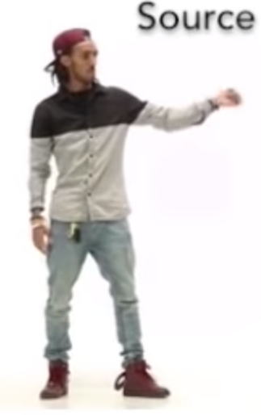

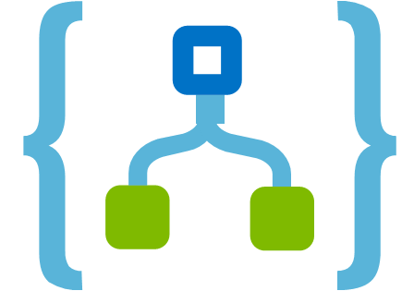





Pose Detection: How it Works
PoseNet
Gesture Detection
Steering Module
Video
Wireframe
Movements
Accounting
Accounting System
Azure SQL
Pricing Parameters
Reference Data
Contract Data
Payment
eBanking
Container Provider System
Insurer Contract Management System
Delivery of transport data:
Client
Start / end position
Temperature data
Storage of contract data for risk and capital management purposes
Storage of claims data for claims settlement
Transport Data
Contract Data
Document Storage
Legend:
Manual Interface
REST API
System
Database
Report
Component
Functionality
Flow
Logic Apps
Azure Functions

Slide 3

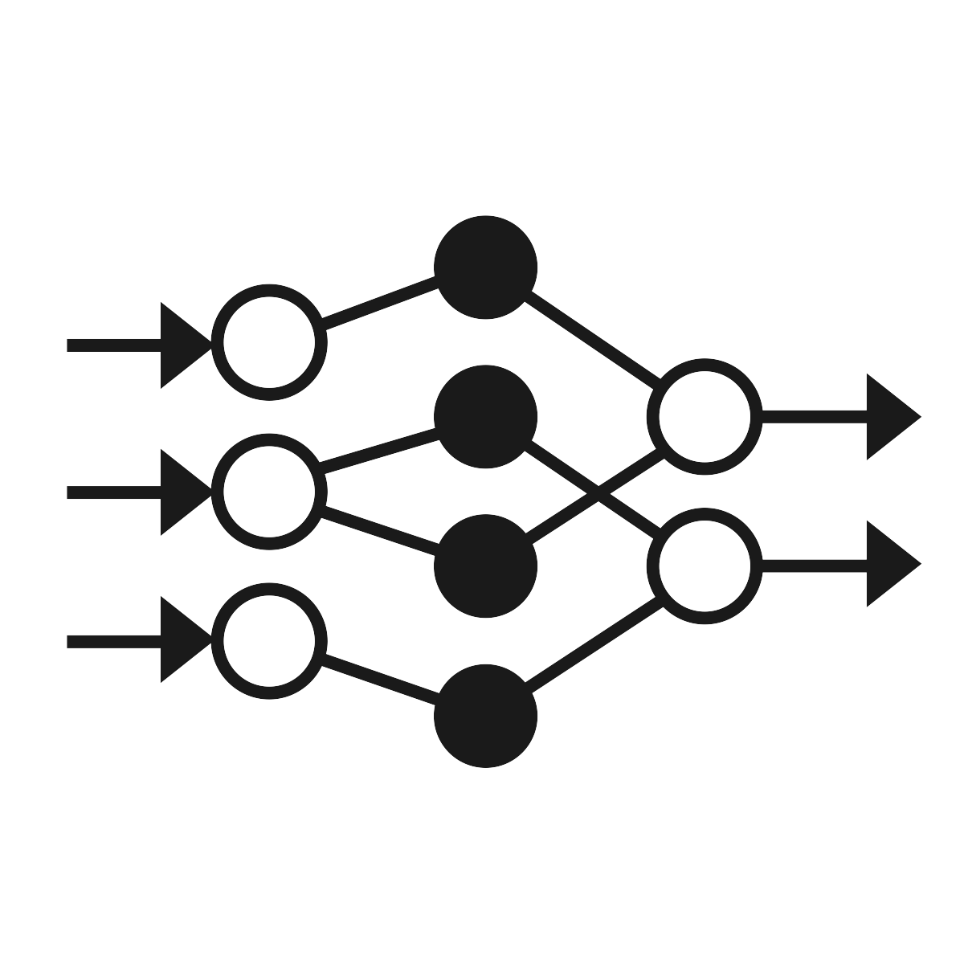

Pose Detection: How it Works
PoseNet
Gesture Detection
Steering Module
Client (Browser)
Video
Server
Server
Steering Module
Wireframe
Movements
Accounting
Accounting System
Azure SQL
Pricing Parameters
Reference Data
Contract Data
Payment
eBanking
Container Provider System
Insurer Contract Management System
Delivery of transport data:
Client
Start / end position
Temperature data
Storage of contract data for risk and capital management purposes
Storage of claims data for claims settlement
Transport Data
Contract Data
Document Storage
Legend:
Manual Interface
REST API
System
Database
Report
Component
Functionality
Flow
Logic Apps
Azure Functions

Slide 4

Project Planning
Stage 1
PoseNet
Posture Calculation with Deltas
Movement Display
Video
Wireframe
Movements
Stage 2
PoseNet
Posture Detection with Keras Model
Movement Display
Video
Wireframe
Movements
Stage 3
PoseNet
Gesture Detection with Keras Model
Steering Module
Video
Wireframe
Movements
Stage 4
PoseNet
Gesture Detection with Keras Model
Steering Module
Video
Wireframe
Movements
New functionality for a stage
Accounting
Accounting System
Azure SQL
Pricing Parameters
Reference Data
Contract Data
Payment
eBanking
Container Provider System
Insurer Contract Management System
Delivery of transport data:
Client
Start / end position
Temperature data
Storage of contract data for risk and capital management purposes
Storage of claims data for claims settlement
Transport Data
Contract Data
Document Storage
Legend:
Manual Interface
REST API
System
Database
Report
Component
Functionality
Flow
Logic Apps
Azure Functions

Slide 5
Postures
STOP
takeoff | 0
move forward | 1
flip | 2
left | 3
right | 4
land | 5

Slide 6
Gestures
take off
id=0
left
id=3
LAND
land
id=1
right
id=4
move
id=2
looping
id=5

Slide 7
Postures vs. Gestures
Posture
A posture is one single static position. It is thus possible to derive the movement from a single picture.
Modelling this is straight-forward. We train the model with single position data. Once trained, the model predicts a movement from a given position.
Move right
…turns into…
Model
Move right
Gesture
A gesture is a sequence of interconnected positions, e.g. a circle movement done with the hand. This allows for more complex movements.
…turns into…
Do 360° Spin
Compared to the posture model the gesture model now needs a group of positions including their sequence as input.
Model
Do 360° Spin
Gestures are also anchored in time. We assume a maximum duration of two seconds for a gesture. For each step of in time (0.05 sec) we thus send 40 positions covering the last two seconds.
40 positions = 2 sec
40 positions = 2 sec
40 positions = 2 sec
40 positions = 2 sec
t = 0.00 sec
t = 0.05 sec
t = 0.10 sec
t = 0.15 sec

Slide 8
Gestures Intricacies | Labelling Training Data
…
For our model one data point is a frame set ( ) of 20 consecutive frames which together make up a gesture. We show relevant frames (i.e. frames which are part of the gesture) as and non-relevant frames as . When we label a frame set as a gesture we show this with a in the sketches.
Our model should detect also frame sets containing only a fraction of relevant frames. We therefore also label incomplete frame sets. We assume a tolerance range of 5 frames before and after the last relevant frame of a gesture. Frame sets at the beginning or end of the tolerance range thus contain less relevant frames than frame sets in the middle of the range – see the first sketch below.
Standard case (20 frames)
set contains 15 relevant frames
set contains 18 relevant frames
set contains 20 relevant frames
set contains 17 relevant frames
…
…
…
…
…
…
…
…
…
…
…
…
…
…
…
…
…
…
…
…
…
…
…
…
…
…
…
t
-20
-15
-10
-5
-4
-3
-2
-1
0
+1
+2
+3
+4
+5
tolerance = -5 frames
tolerance = +5 frames
We humans are not perfect creatures and rarely manage to make gestures fitting exactly into 20 frames. Our model therefore also deals with longer and shorter gestures. We accept a deviation of up to +/-5 frames. This means gestures can be as short as 15 or as long as 25 frames (but the frame set is still limited to 20 frames). All frame sets within the interval of the last frame +/- the deviation thus contain the same number of relevant frames. This works for both longer and shorter gestures – see sketches below.
Gesture too short (17 frames)
set contains 15 relevant frames
set contains 17 relevant frames
set contains 14 relevant frames
…
…
…
…
…
…
…
…
…
…
…
…
…
…
…
…
…
…
…
…
…
…
…
…
…
…
…
t
-20
-15
-10
-5
-4
-3
-2
-1
0
+1
+2
+3
+4
+5
tolerance = -3.5 frames
deviation = +3 frames
tolerance = +3.5 frames
Gesture too long (22 frames)
set contains 17 relevant frames
set contains 20 relevant frames
set contains 18 relevant frames
…
…
…
…
…
…
…
…
…
…
…
…
…
…
…
…
…
…
…
…
…
…
…
…
…
…
…
t
-20
-15
-10
-5
-4
-3
-2
-1
0
+1
+2
+3
+4
+5
tolerance = -4 frames
deviation = -2 frames
tolerance = +4 frames

