Slide 1
Flying Drones with Gestures
How to fly drones directly using gestures filmed by a camera

Slide 2

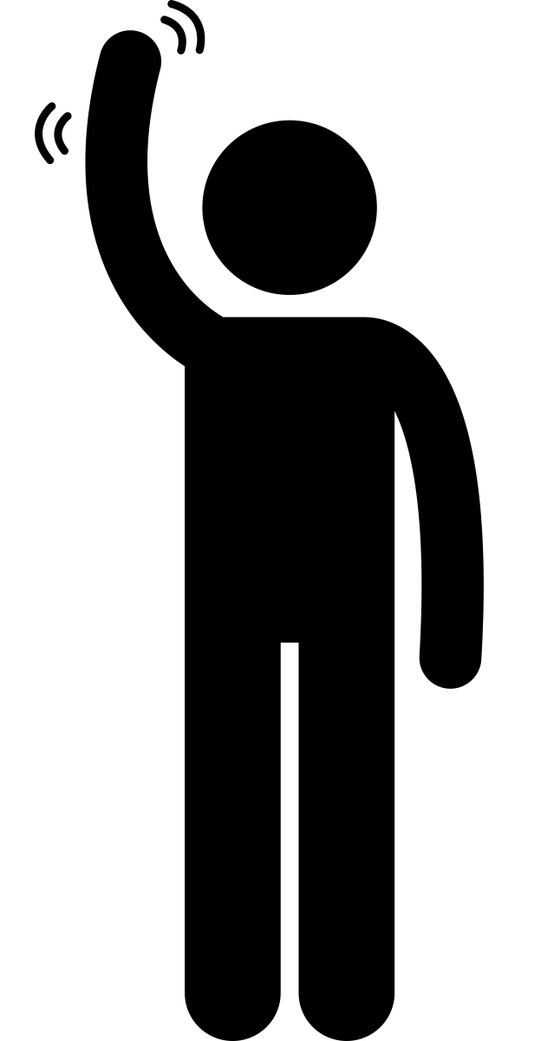

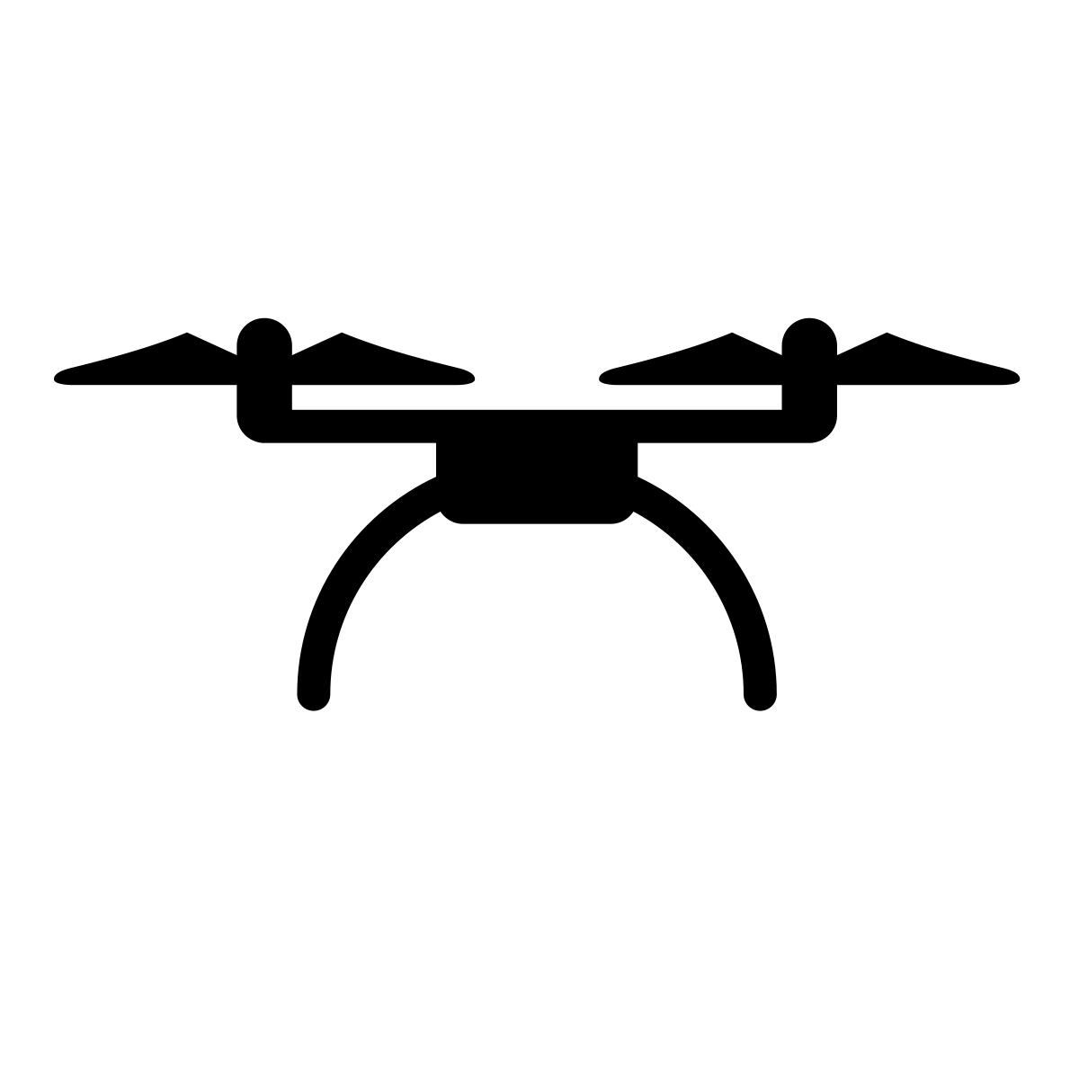



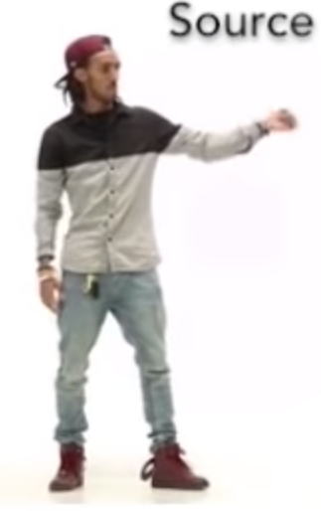

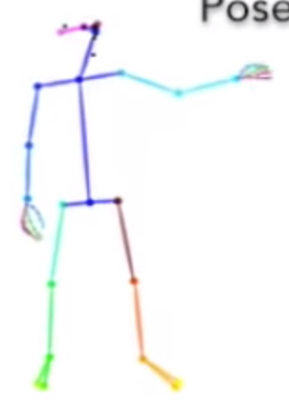

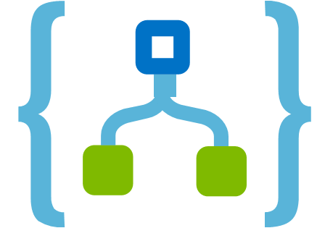




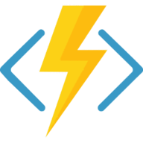
Pose Detection: How it Works
PoseNet
PoseDetection
Steering Module
Video
Wireframe
Movements
Accounting
Accounting System
Azure SQL
Pricing Parameters
Reference Data
Contract Data
Payment
eBanking
Container Provider System
Insurer Contract Management System
Delivery of transport data:
Client
Start / end position
Temperature data
Storage of contract data for risk and capital management purposes
Storage of claims data for claims settlement
Transport Data
Contract Data
Document Storage
Legend:
Manual Interface
REST API
System
Database
Report
Component
Functionality
Flow
Logic Apps
Azure Functions

Slide 3

Gestures
STOP
stop | 0
left | 1
right | 2
right | 3
down | 4
Images were snapshotted at 159%. Use support lines for snapshotting.

Slide 4
Gestures
STOP

Slide 5
Plan
Resolve open points:
Record a couple of test videos
Find a way how to get PoseNet working on Python with test videos
Transform PoseNet output into features / labels
Find a way how to steer the drone using Python
Find out how we can use live streams in a model
Plan:
Record videos to get train / test data
Generate features for PoseDetection model
Train PoseDetection model
Connect PoseNet, PoseDetection and steering module

