Slide 1
Flying Drones with Gestures
How to fly drones directly using gestures filmed by a camera

Slide 2







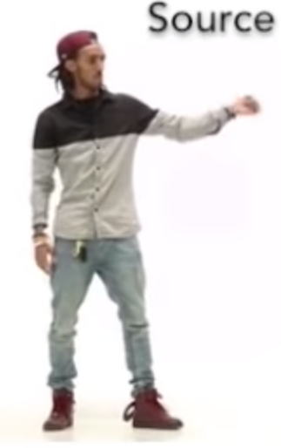

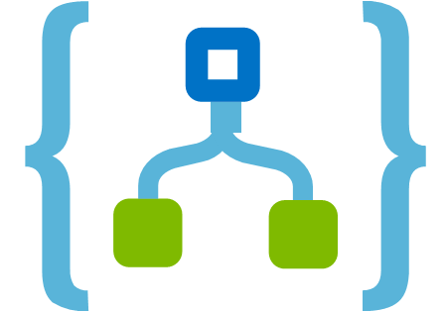





Pose Detection: How it Works
PoseNet
Gesture Detection
Steering Module
Video
Wireframe
Movements
Accounting
Accounting System
Azure SQL
Pricing Parameters
Reference Data
Contract Data
Payment
eBanking
Container Provider System
Insurer Contract Management System
Delivery of transport data:
Client
Start / end position
Temperature data
Storage of contract data for risk and capital management purposes
Storage of claims data for claims settlement
Transport Data
Contract Data
Document Storage
Legend:
Manual Interface
REST API
System
Database
Report
Component
Functionality
Flow
Logic Apps
Azure Functions

Slide 3

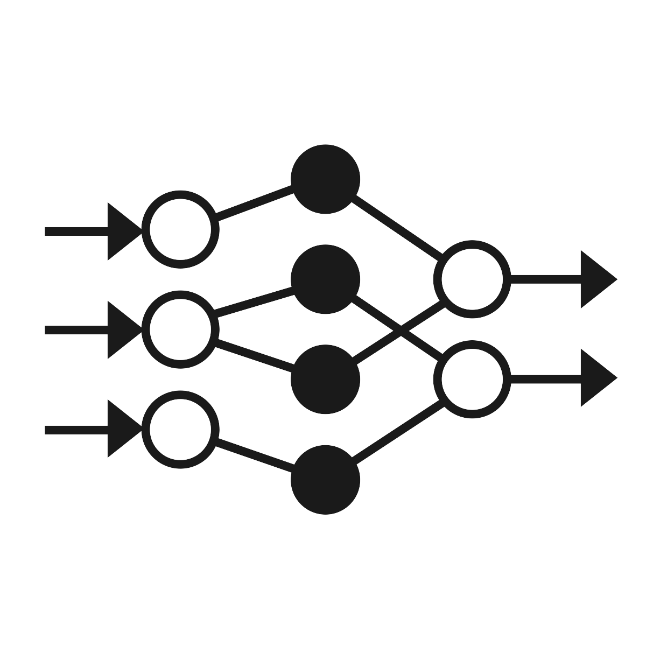

Pose Detection: How it Works
The PoseNet model runs on a local node.js server. The user records video using the browser which connects to the server. The server then broadcasts the wireframe via web socket.
The web socket server runs in Python and receives the broadcasted wireframe data. Upon receiving, the server feeds the wireframe into the model to predict the movements.
The Steering Module picks up the movements and translates them into the commands as required by the drone’s API.
PoseNet
Gesture Detection
Steering Module
Client (Browser)
Video
Server
Server
Steering Module
Wireframe
Movements
Accounting
Accounting System
Azure SQL
Pricing Parameters
Reference Data
Contract Data
Payment
eBanking
Container Provider System
Insurer Contract Management System
Delivery of transport data:
Client
Start / end position
Temperature data
Storage of contract data for risk and capital management purposes
Storage of claims data for claims settlement
Transport Data
Contract Data
Document Storage
Legend:
Manual Interface
REST API
System
Database
Report
Component
Functionality
Flow
Logic Apps
Azure Functions

Slide 4

Gestures
STOP
stop | 0
left | 1
right | 2
up | 3
down | 4
Images were snapshotted at 159%. Use support lines for snapshotting.

Slide 5
Gestures
STOP

Slide 6

Project Evolution
Stage 1
PoseNet
Posture Calculation with Deltas
Movement Display
Video
Wireframe
Movements
Stage 2
PoseNet
Posture Detection with Keras Model
Movement Display
Video
Wireframe
Movements
Stage 3
PoseNet
Gesture Detection with Keras Model
Steering Module
Video
Wireframe
Movements
Stage 4
PoseNet
Gesture Detection with Keras Model
Steering Module
Video
Wireframe
Movements
New functionality for a stage
Accounting
Accounting System
Azure SQL
Pricing Parameters
Reference Data
Contract Data
Payment
eBanking
Container Provider System
Insurer Contract Management System
Delivery of transport data:
Client
Start / end position
Temperature data
Storage of contract data for risk and capital management purposes
Storage of claims data for claims settlement
Transport Data
Contract Data
Document Storage
Legend:
Manual Interface
REST API
System
Database
Report
Component
Functionality
Flow
Logic Apps
Azure Functions

Slide 7
Postures vs. Gestures
Posture
A posture is one single static position. It is thus possible to derive the movement from a single picture.
Modelling this is straight-forward. We train the model with single position data. Once trained, the model predicts a movement from a given position.
Move right
…turns into…
Model
Move right
Gesture
A gesture is a sequence of interconnected positions, e.g. a circle movement done with the hand. This allows for more complex movements.
…turns into…
Do 360° Spin
Compared to the posture model the gesture model now needs a group of positions including their sequence as input.
Model
Do 360° Spin
Gestures are also anchored in time. We assume a maximum duration of two seconds for a gesture. For each step of in time (0.05 sec) we thus send 40 positions covering the last two seconds.
40 positions = 2 sec
40 positions = 2 sec
40 positions = 2 sec
40 positions = 2 sec
t = 0.00 sec
t = 0.05 sec
t = 0.10 sec
t = 0.15 sec

Slide 8
Plan
Resolve open points:
Record a couple of test videos
Find a way how to get PoseNet working on Python with test videos
Transform PoseNet output into features / labels
Find a way how to steer the drone using Python
Find out how we can use live streams in a model
Plan:
Record videos to get train / test data
Generate features for PoseDetection model
Train PoseDetection model
Connect PoseNet, PoseDetection and steering module

Slide 9
Project Evolution
Stage 1
PoseNet
Posture Calculation with Deltas
Movement Display
Video
Wireframe
Movements
Stage 2
PoseNet
Posture Detection with Keras Model
Movement Display
Video
Wireframe
Movements
Stage 3
PoseNet
Posture Detection with Keras Model
Steering Module
Video
Wireframe
Movements
Stage 4
PoseNet
Gesture Detection with Keras Model
Steering Module
Video
Wireframe
Movements
Stage 5
PoseNet
Gesture Detection with Keras Model
Steering Module
Video
Wireframe
Movements
Accounting
Accounting System
Azure SQL
Pricing Parameters
Reference Data
Contract Data
Payment
eBanking
Container Provider System
Insurer Contract Management System
Delivery of transport data:
Client
Start / end position
Temperature data
Storage of contract data for risk and capital management purposes
Storage of claims data for claims settlement
Transport Data
Contract Data
Document Storage
Legend:
Manual Interface
REST API
System
Database
Report
Component
Functionality
Flow
Logic Apps
Azure Functions

